Slide 1
Physics of Nuclear Medicine

Slide 2
Becquerel hypothesis
Becquerel investigated the hypothesis that sunlight would cause certain minerals to give off X–rays. He placed minerals on a light – tight envelope containing film and exposure them to sunlight. When he developed the film he found darkening due to X–rays. As part of his continuing studies, he accidentally did the experiment on a rainy day he left his minerals and film in a drawer and afterward decided to develop the film even though he assumed it would be black. He was surprised to find that X– rays came from the minerals without exposure to sunlight. After some confusion it become clear that he had discovered the natural radioactivity.

Slide 3
Natural radioactivity
Natural radioactivity was more amazing to physicists than X–rays since to produce X–rays it was necessary to put in electrical energy, while natural radioactivity provided a steady source of high – energy particles for an indefinite period of time with no input of energy. The story of natural radioactivity involved many more scientists such as Madame Curie who managed to separate from tons of uranium a very powerful radioactive element – radium. It was to play an important role in medicine in the treatment of cancer. Investigators of radioactivity discovered that certain natural elements, primarily the very heavy ones, have unstable nuclei that disintegrate to emit various rays – alpha (α), beta(β), and gamma(γ)rays.

Slide 4
Natural radioactivity played an important role in developing our understanding of the nucleus. The dramatic turning point in the use of radioactivity in medicine was the development of the nuclear reactor during world war in connection with the atomic bomb project. The nuclear reactor made possible the production of many artificial radionuclides in huge quantities.

Slide 5
Characteristics of alpha (α), beta(β), and gamma(γ)rays
The alpha, beta, and gamma rays were found to have quite different characteristics. Alpha and beta particles bend in opposite directions in magnetic and electric fields; alpha particles are positively charged and beta particles are negatively charged. Alpha particles, which stop in a few centimeter of air, are the nuclei of helium atoms. Beta particles are more penetrating but can be stopped in a few meters of air or a few millimeter of tissue – they are high speed electrons. Gamma rays are very penetrating and are physically identical to X – rays.

Slide 6
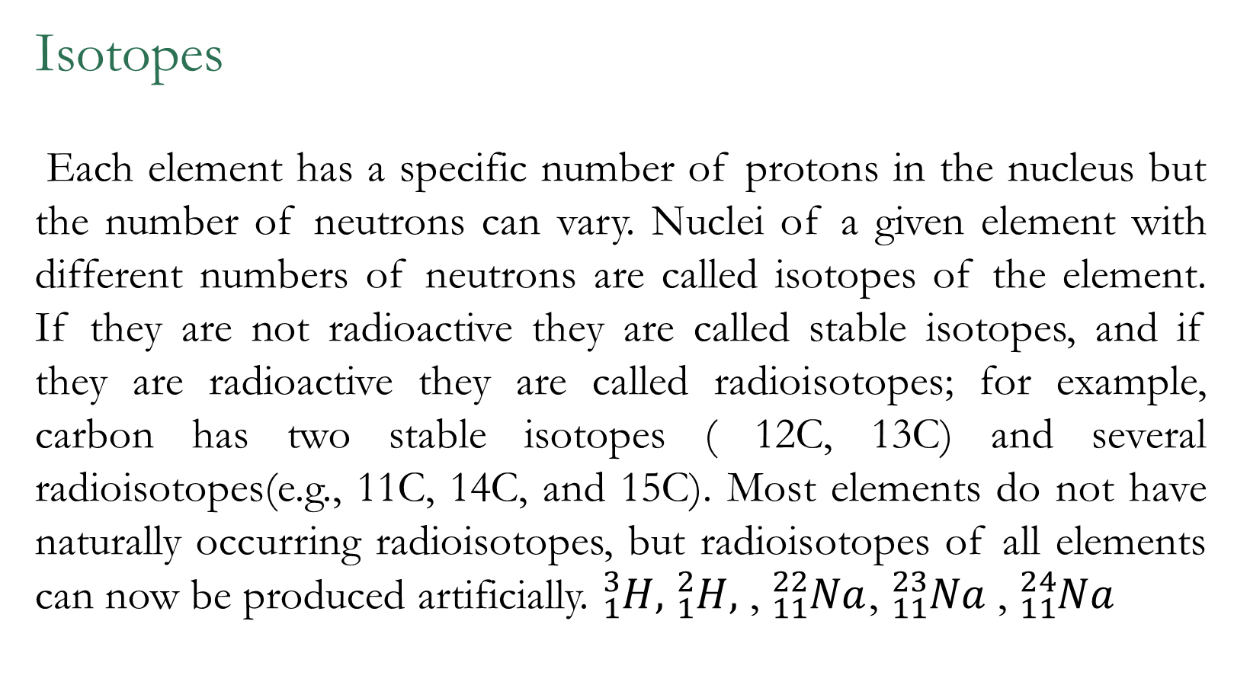
Isotopes
Each element has a specific number of protons in the nucleus but the number of neutrons can vary. Nuclei of a given element with different numbers of neutrons are called isotopes of the element. If they are not radioactive they are called stable isotopes, and if they are radioactive they are called radioisotopes; for example, carbon has two stable isotopes ( 12C, 13C) and several radioisotopes(e.g., 11C, 14C, and 15C). Most elements do not have naturally occurring radioisotopes, but radioisotopes of all elements can now be produced artificially. ${}_{1}^{3}{H,}$ ${}_{1}^{2}{H,}$ , ${}_{11}^{22}{Na}$, ${}_{11}^{23}{Na}$, ${}_{11}^{24}{Na}$

Slide 7
The purposes of radioactive elements in medicine
Radioactive elements have been used in medicine for research, diagnosis, and therapy. Radioactivity has been used to study the function of many organs and the chemical changes that take place within the body and we concerned on the clinical uses of radioactivity for the diagnosis of diseases – nuclear medicine. In a modern hospital about one – third of the patient have a nuclear medicine which are concerned with the detection of cancer and the other are used to detect problems of the heart, lungs, kidney, and joints. The most useful radionuclides are those that emit gamma rays. Extremely minute quantities of radioactive substances are used because these small quantities (typically less than 1µg) do affect the normal physiological functioning of the body.

Slide 8
Review of basic characteristics and units of radioactivity
When one element decays its daughter, which is also radioactive, is formed; each daughter decays until the final daughter. A particular radionuclide can be identified by its radioactivity alone just as humans can identified by their fingerprints. Characteristics that help identify the are the type and energy of its emitted particles or rays.
Beta particles are not very penetrating, they are easily absorbed in the body and little use for diagnosis, some radionuclide such as3 H and 14C play an important role in medical research. 32P is used for diagnosis of tumors in the eyes because they have enough energy to emerge from the eye.

Slide 9
Gamma rays with energies above 100 KeV can penetrate many centimeters of tissue. All of the gamma emitting radionuclides of the common organic elements – carbon, nitrogen, and oxygen – are short lived, which makes their use in the clinical medicine difficult without an accelerator. A few medical centers have installed cyclotrons for producing short – lived radionuclides.
Some man – made radionuclides emit types of radiation not emitted by natural radioactive substances. A metastable radionuclide decays by emitting gamma rays only, and the daughter nucleus differs from its parent only in having less energy. When metastable is used internally, the absence of beta rays greatly reduces the radiation dose to the patient like 99mTc.

Slide 10
Nuclear reactors produce radioactivity by adding neutrons to the stable nuclei; the resulting nuclei thus have too many neutrons and usually decay by emitting beta particles, which make the nuclei more positive. A type of disintegration is the emission of the beta rays or positron(β+ ) . A positron is physically identical to an electron except that it has a positive charge like 18F. Associated with positron emission is annihilation radiation. The energy equivalent of their masses(511 KeV each) is emitted as two 511 KeV photons which go in opposite directions.
A nucleus that is too positive can decay in another way. The nucleus can capture one of its own electrons ( usually a K electron), which then combines with a proton in the nucleus to form another and thus reduce the charge on the nucleus. Electron capture (ec) occurs in the decay of 125I . X – rays is always emitted after the ec as an electron falls into the open spot in the K shell.

Slide 11
Iodine 125 has swallowed one of its own electron to become 125Xe, the nucleus has 35 KeV of energy, which is sometimes emitted as 35KeV of gamma ray. When it is not, the nucleus transfers this energy directly to the remaining K electron, which then uses the energy to escape, leaving another vacancy in the K shell . This process is called internal conversion or isomeric transition (IT)and two gamma rays are emitted.

Slide 12
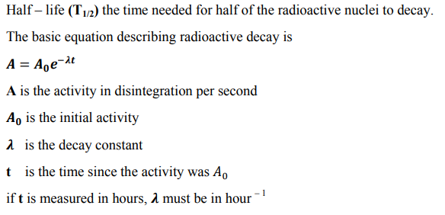

Slide 13
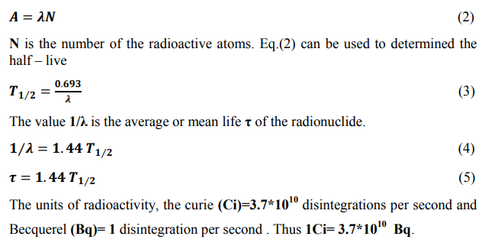
we can express this equation 1 as:

Slide 14
2. Sources of radioactivity for nuclear medicine
Radioactive drugs, or radiopharmaceuticals, must meet rigid standards of purity from both the drug aspect and the radioactivity aspect. One such drug is 131I its 8 – days half life permits delivery across the country, and weekly shipments are adequate for most medical facilities. However, it is no longer used extensively because its beta rays give a relatively large radiation dose to the patient.
One commonly used radionuclide is99m Tc, which has a 6 – hour half life. 99mTc is the daughter of 99Mo which has a 2.5 day half – life and by buying 3GBq ( 100mCi) of 99Mo it is possible to obtain useful amount of 99mTc. A system that produces a radionuclide in this way is called a generator.

Slide 15
123I which has a 13 hr. half – life and no beta emission, is suitable in for nuclear medicine studies, it can be easily produced in the cyclotron and other short – lived radionuclide such as 11C,13 N, 15O, 19O, 18F, 52Fe, 68Ga, and 81Rb. The same cyclotrons may be used to produce fast neutrons for the treatment of cancer. It might seen that 15O would be impractical because of its 2 – min half – life, but this is not the case.
This radioactive 6 gas can be rapidly purified and delivered to the patient, and since oxygen is such an active element, it is used by the body within seconds after it enters the lungs therefore it can be used as s diagnosis tool in nuclear medicine.

Slide 16
3. Basic instrumentation and its clinical applications:
Two quite different types of counting are done in nuclear medicine:
1. determining the amount of radioactivity in a given sample or volume.
2. determining the distribution of the radioactivity in the body, or imaging.
Film.
As previously mentioned, natural radioactivity was discovered through the use of film. In general, film is not very convenient for detecting radioactivity, although in autoradiography, a research area, it is placed in close contact with a radioactive specimen to obtain an image from the emitted beta ray

Slide 17
Scintillation screen such as zinc sulfide.
When an alpha particle strikes a crystal of zinc sulfide it gives off a weak flash of light, or a scintillation, and these researchers viewed and counted the flashes. Since this was a very tedious process, they welcomed more convenient techniques.
Geiger – Mueller counter(GM).
The (GM) does not distinguish between large and small amounts of ionization. It is now seldom used in research, but it is convenient for use in radiation protection. Since it is inefficient for detecting gamma rays, the most important rays in nuclear medicine, it is of little use in clinical nuclear medicine.

Slide 18
Photomultiplier tube(PMT).
It can both detect a weak flash of light and estimate the amount of light.
Scintillation crystal such as sodium iodine that would scintillate with good efficiency when a gamma ray is absorbed.
These crystals were attached directly to the PMT to detect the weak flashes of light. They were improved by the addition of thallium and are referred to as NaI(Ti). They are quite efficient for detecting gamma rays and come in a wide variety of sizes and shapes for special purposes, are the most widely used detectors in nuclear medicine. The intensity of the scintillation produced when a gamma ray deposits its energy in the crystal is proportional to the energy of the gamma ray.

Slide 19
Alternative detector.
One alternative detector that is widely used in nuclear physics research is the solid – state semiconductor detector. Its main advantage is that it has much better resolution than the Na(Ti) scintillation detector. Its main disadvantages are that it is not available in large sizes and that it is much more expensive than a scintillation detector of equivalent size. When a gamma ray is absorbed in the semiconductor it produces a large number of ion pairs, about one pair for each 3 eV of energy absorbed. When a 140 KeV gamma ray from 99mTc is absorbed it produces about 47000 ion pairs. Since only about 1000 electrons are produced from the photocathode of the scintillation detector and PMT system.
☒ The open or flat collimator is useful for detecting gamma rays from a relatively large volume such as the thyroid or kidney.
☒ The focused collimator is often used in nuclear medicine imaging since it permits the detector to efficiency detect gamma rays from a known small volume.

Slide 20
.✓ Thyroid function:
Evaluate the thyroid function by using a scintillation detector The thyroid uses iodine in the production of hormones that control the metabolic rate of the body. For the 24 hr uptake test, a small amount of 131I , about 300 KBq in a liquid or 8 capsule, is given by mouth, and 24 hr later the amount of 131I in the thyroid is counted for 1 min. The same original amount of 131I – the standard – is set aside at the beginning of the study, and 24 hr later it is placed in a neck phantom and also counted for 1 min. The ratio of the thyroid counts to the standard counts gives the percent 24 hr uptake.
(10 – 40)%→euthyroid
Above 40%→hyperthyroid
Less 10%→hypothyroid

Slide 21
✓ Kidney function
Kidney function is also often studied with scintillation detectors. About 7MBq of 131I labeled hippuric acid is injected into the bloodstream, and as it is removed from the blood by the kidneys the radioactivity of each kidney is monitored. The signals from each detector are fed to an electronic instrument called a rate meter to record the change in radioactivity with time. The rate meter averages the signals over a short period of time and indicates the count rate in counts per minute or counts per second(30) – min record of a typical normal kidney.

