Slide 1
Nuclear medicine imaging devices

Slide 2
Nuclear medicine therapy includes treatment with unsealed radioactive material in various forms, including free beta radiation emitting isotope, bound to antibody (radio immune therapy), imaging aspects to many of these therapeutic procedures can add to the evaluation of efficacy.
The most important aspect of nuclear medicine is imaging or producing pictures of the distribution of the radioactivity in a specific volume or organ. To produce nuclear medicine images use three devices:
1- Rectilinear scanner 2- Gamma camera 3- Positron camera

Slide 3
1- Rectilinear scanner:
Before the invention of the rectilinear scanner in 1950 by Benedict Cassen, nuclear medicine pioneers used to move their insensitive Geiger Counters over different parts of the body, which resulted in a fairly crude determination of the distribution of radioactivity.
The scanner consists of:
A scintillator which detects the γ radiation emitted by a radiopharmaceutical located in the organ. The detector consists of a NaI(Tl) crystal (12.7 cm in diameter, 5 cm thick) and a photomultiplier. It is mechanically connected to a light bulb.
An electronic circuit between detector and light bulb.
A film.

Slide 4
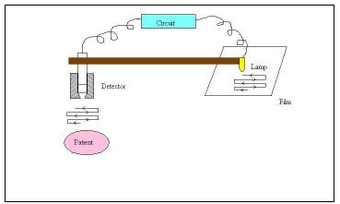

Slide 5
Mechanism
NaI (Tl) crystal of the detector moves in a pattern over studied area of the patient making a constant count rate or a map of the radiation distribution in the body. During most scans two images are made of the radiation distribution one image on a storage oscilloscope or consisting of marks tapped on paper, are usually visible during the scan. The density or sometimes the color of the marks indicates the intensity of the detected activity in the corresponding areas of the patient. The other image is made by moving a small light source over a photographic film. The intensity of the light increases with an increase in activity, producing dark areas on the film and can be modified electronically to enhance count rate differences in areas of medical interest. It is also possible to record the data taken during the scan on a magnetic tape or disc; these data can later analyzed by computer to provide a quantitative image. We use radionuclides of T_{1/2} > hour. Its gives static pictures. Dimensions of scan areas spacing of scan lines and rate of movement of scanning head is adjusted according to organ size and amount of radioactivity. Rectilinear scanner can scan the all body. It measures radiation distribution 7.5 - 12.5 cm from the end of the collimator. Thus, a scan from both sides of the patient is often necessary. A few scanners have two detectors facing each other so that they can simultaneously scan both sides of the patient.

Slide 6
Disadvantages
Time consuming: Scan lasts for over 30 min. Even by reducing time using 2 or more detectors, time is still very long.
Motion artifacts: The patient may remain motionless, but he can certainly not hold his breath for more than 60 s. Thus, scans of liver for instance include motion artifacts since liver moves up and down 2 cm during normal breathing.
Because of these defects, the invention of the gamma camera by Hal Angers in 1956 was indeed a breakthrough

Slide 7
Gamma cameras :
It is used in nuclear medicine to detect regions of biologic activity that may be associated with disease. Relatively short lived isotope, such as ¹²³I is administered to the patient. Isotopes arew often pre frenetically absorbed by biologically active tissue in the body, and can be used to identify tumors or fracture points in bone. Images are acquired after collimated photons are detected by a crystal that gives off a light signal, which is in turn amplified and converted into count data gamma camera, also called a scintillation camera or Anger camera, is a device used to image gamma radiation emitting radioisotopes, a technique known as scintigraphy. The applications of scintigraphy include early drug development and nuclear medical imaging to view and analyze images of the human body or the distribution of medically injected, inhaled, or ingested radionuclides emitting a gamma camera consists of one or more flat crystal planes (or detectors) optically coupled to an array of photomultiplier tubes.

Slide 8
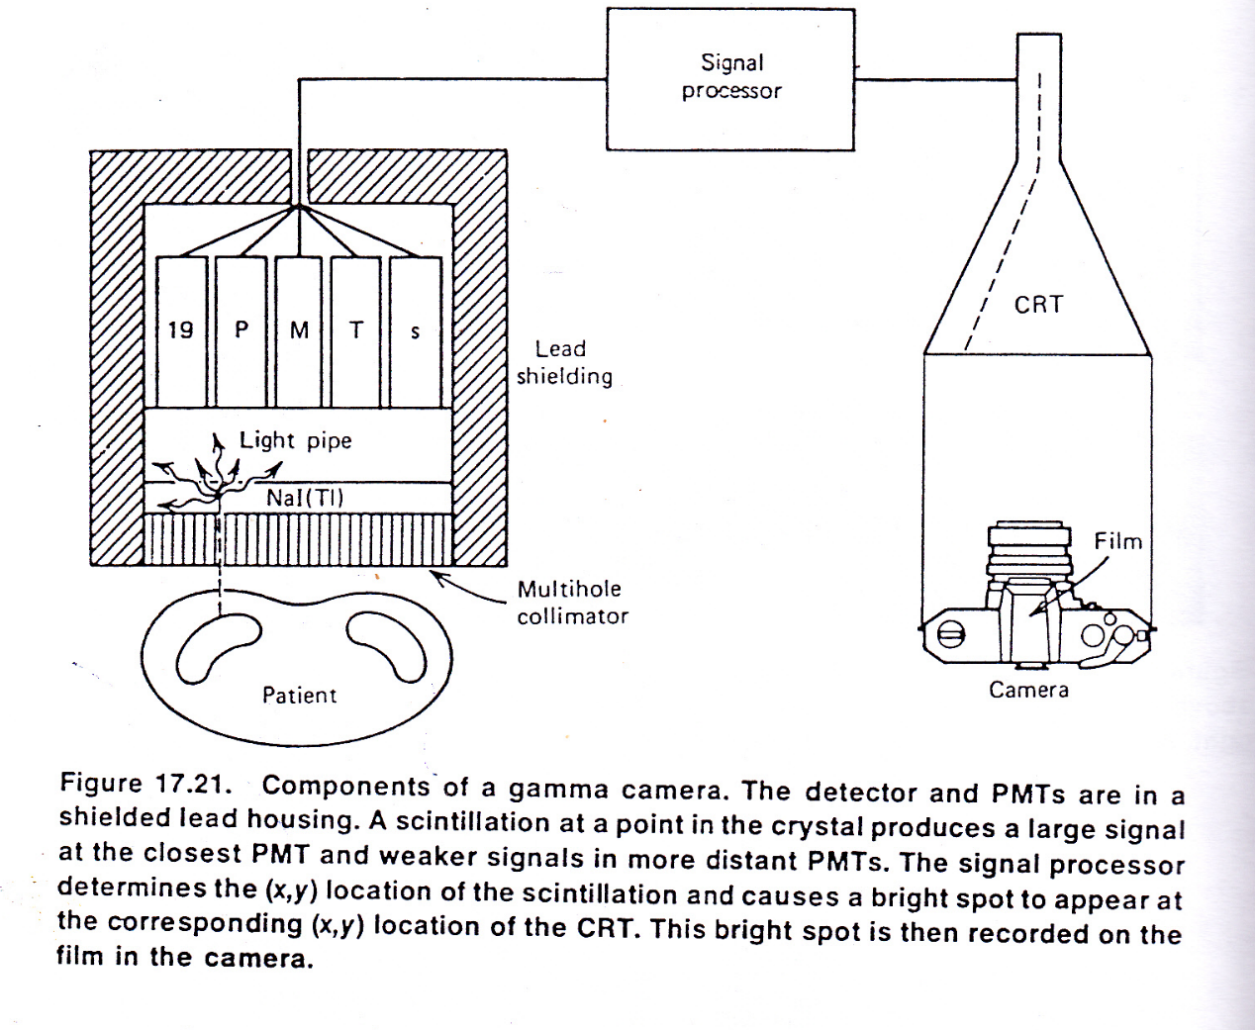

Slide 9
Mechanism
It has large crystal of NaI(TI) scintillation about 1 cm thick and 30 to 45 cm in diameter . The scintillations are viewed through a light pipe by an array of 19-37 PMTs. When a gamma ray interacts somewhere in the crystal the light from the scintillation produce a large signal in the closest PMT and weaker signal in PMTs further away. These signals are electronically processed to determine the (x,y) coordinates of the scintillation.
A parallel whole collimator is usually used with gamma camera. But occasionally a diverging whole collimator is used to view a large area such as lung. It covers the organ at the same time. The test time is about 1 to 2 min. it gives dynamic pictures. We can use very short half life radionuclide 2 min or more.

Slide 10
Positron emission tomography (PET) :
It is a nuclear medicine imaging technique which produces a three-dimensional image or picture of functional processes in the body. The system detects pairs of gamma rays emitted indirectly by a positron-emitting radionuclide (tracer), which is introduced into the body on biologically active molecular coincidence detection to image functional processes. Short-lived positron emitting isotope, the molecule most commonly used for this purpose is fluorodeoxyglucose (FDG), a sugar, for which the waiting period is typically an hour. During the scan a record of tissue concentration is made as the tracer decays, which can be used as a marker of metabolic utilization. Images of activity distribution throughout the body can show rapidly growing tissue, like tumor, metastasis, or infection. Positron emission tomography (PET) is a nuclear medicine imaging technique which produces a three-dimensional image or picture of functional processes in the body. PET is a valuable technique for some diseases and disorders, because it is possible to target the radio-chemicals used for particular bodily functions oncology; Neurology; pharmacology and others.

Slide 11
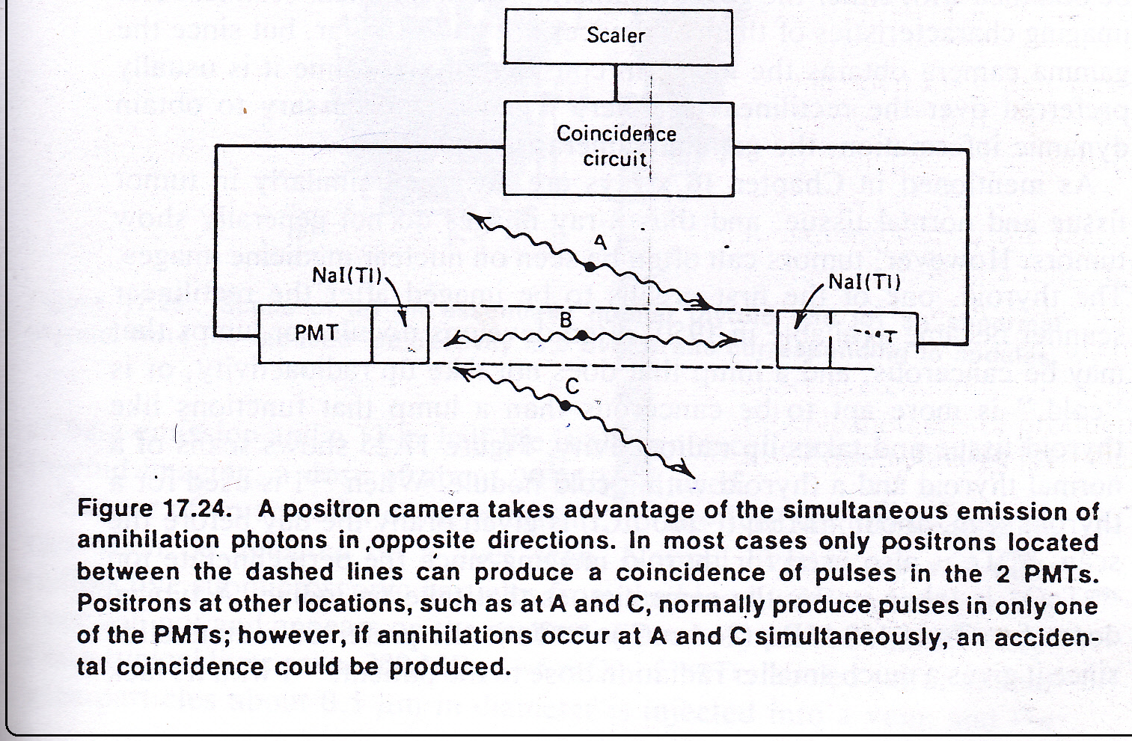

Slide 12
Physical principles of nuclear medicine imaging procedures:
X-rays are absorbed similarly in tumor tissue and normal tissue, and thus images do not generally show tumors. However, tumors can often be seen on nuclear medicine images.
Critical organ is the organ that receives largest radiation dose during procedure. Radiation dose in nuclear medicine is non-homogenous in the body. But it concentrates in certain organ these organs called critical organ.

Slide 13
Imaging procedure critical organ
brain scans intestine
Liver scans liver
Lung scan (study blood circulation) lungs
Bone scans bladder
Renogram bladder
Thyroid uptake (study amount ) thyroid
thyroid scan (study distribution) intestine

Slide 14
Radiation doses in nuclear medicine
The dose to particular organ of the body depends on the physical characteristics of the radionuclide- what particle it emits and their energies- and on the length of time the radionuclide is in the organ. Two factors determine the length of time the radionuclide is in the organ, or the effective half- life (T_{1/2 eff}) – the physical half- life (T_{1/2 phy}) and the biological half- life (T_{1/2 bio}). The biological half-life of an element is the time needed for one- half of the original atoms present in an organ to be removed from the organ, and it is independent of whether the element is radioactive. Most elements are excreted at an exponential rate. The effective half- life can be calculated as follows.
T_{1/2 bio} * T_{1/2 phy}
T _{1/2 eff} =
T_{1/2 bio} + T_{1/2 phy}
T _{1/2 ef}te that if the biological or physical half- life is much shorter than the other. The effective half- life is essentially equal to the shorter value.

