Slide 1
Cell biology Lab.3

Slide 2
The cell
The cell of the animal body show a wide variation form , coincident with their adaptation to perform a diversity of specific function . The tissue cells which have acquired affixed location in the body become polyhedral , columnar , flat(pavement), fusiform, or spindle shaped, and they may retain a-smooth contour or send out numerous processes . the nerve cell , with its processes sometimes several feet in length it perhaps the most aberrant type.

Slide 3
The laws which control or limit cell size a smalls body size are most well understood . some group of animal have larger cells then do others but it does not follow that small animal have small cells and large animals have large cells .the size of the individual is in general determined by the number of its cells , not by other size .

Slide 4
Anatomy of animal cells
1- Plasma membrane (cell membrane) :
Bilayer membrane is so thin that it can be visualized only under electron microscope. The plasma membrane is a selectively permeable membrane enclosing the cytoplasm of a cell. it surrounds a eukaryotic cell and serves as a barrier between the inner cell and its environment. The cytoplasmic membrane is composed of proteins and lipids. Carbohydrates are used to uniquely identify the cell to other cells. It regulates the flow of molecules (such as nutrients)into the cell and removes waste from the cell by opening and closing passages Called channels. selectively permeable because it permits the transport of some substances and inhibits the transport of other substances. Two types of transport mechanisms are used to move substances through the cytoplasmic membrane. These are passive transport and active transport.

Slide 5
Passive Transport
Passive transport moves substances into and out of the cell down a gradient. There are three types of passive transport. These are:
• Simple diffusion. Simple diffusion is the movement of substances from a
higher-concentration region to a lower-concentration region.
• Facilitated diffusion. is the movement of substances from a higher-concentration region to a lower-concentration region with the assistance of an integral protein across a selectively permeable membrane.
• Osmosis. Osmosis is the net movement (diffusion) of a solvent (water in living organisms) from a region of higher water concentration to a region of lower concentration.

Slide 6
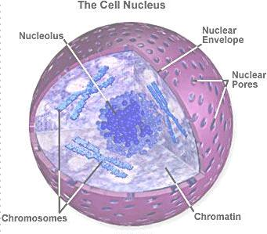
B. Active Transport
Active transport is the movement of a substance across the cytoplasmic membrane against the gradient by using energy provided by the cell.
2- Nucleus :-
Nucleus is bounded by a pair of membrane, the envelope not continuous but contains pores, these probably permit material to pass into & out of the nucleus. The nucleus of a eukarytoic cell contains DNA (hereditary information) and is contained within a nuclear envelope.

Slide 7
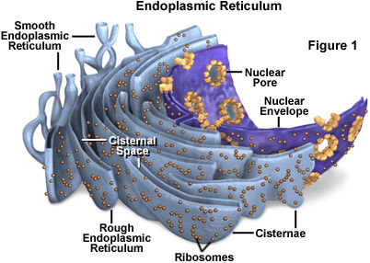
3- Endoplasmic reticulum (ER):-
A complicated system of membranous channels & vacuoles. The ER is the pathway for transporting lipids and proteins throughout the cell. it also provides the surface area for the chemical reaction that synthesizes lipids, it stores lipids and proteins until the cell needs them .This structure has two type(rough ER, which involved in protein synthesis , (smooth ER, involved in lipid synthesis , molecules that are produced or modified in the ER are eventually enclosed in vesicles that often transport them to the Golgi apparatus

Slide 8
4-Mitochondria (power houses of the cell) :
All eukaryotic cell contain mit. Mit. Are spherical or rod-shaped bodies, that range in size from 0.2 Mm to 5Mm in other words most mit. Are usually 0.5-1 Mm in diameter and 2-5Mm in length . the numbers in cell varies but in active cell (liver cells) may have over a thousand of them . Larger mitochondria can be seen under the light microscope, by E.M. can be seen their basic structure.
Composition :
1) It bounded by a double membrane , outer membrane is smooth , but inner membrane is repeatedly extended into fold , these project into interior space of mitochondria (cristae) .
(2) The membrane of mitochondria. Appear similar to cell membrane (phospholipid + proteins ).
(3) Matrix is the inner space of mitochondria. Filled by semi fluid medium that contains , DNA ,ribosome ,Enzymes . in which adenosine triphosphate (ATP) is produced. ATP is the energy molecule in the cell.

Slide 9
5-The Golgi apparatus (discovered camillogolgi 1898)
These structure is found in almost all animal and plant cells. It contains of a stack of flat . membrane bounded sacs .
Functions :-
(1) The protein synthesized by R.E.R. transfevered to Golgi apparatus ,here addition CHO may be added to them . these protein in vesicles may be migrate to the surface of the cell and discharge their contents to outside ,some protein sacs in apparatus retained within the cell as lysosomes .
(2) It is also the site where synthesis of Polysaccharides .
(3) The cellulose secreted by plant cells to form the cell wall is synthesized within the Golgi apparatus .

Slide 10
chloroplasts
The photosynthetic cells of algae and plants contain chloroplasts. are organelles that contain pigments of chlorophyll and carotenoids used for gathering light and enzymes necessary for photosynthesis. They are similar to mitochondria (function & structure) chloroplast use solar energy to synthesize carbohydrates and these CHO broken down in mit. To produce ATP molecules .-

Slide 11
Thank you

