Slide 1
Giardia lamblia

Slide 2
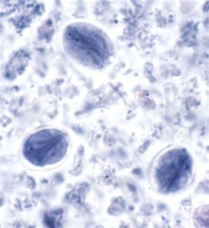
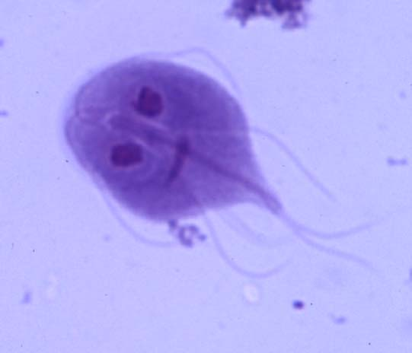
Cyste and trophozoite of G. lamblia

Slide 3
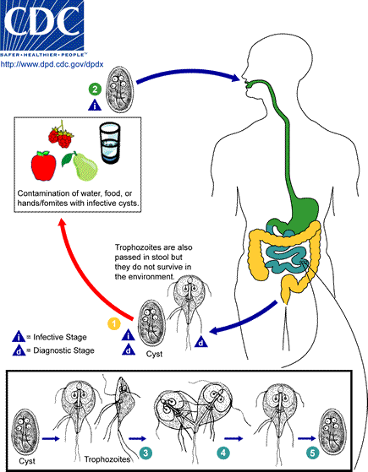
Life cycle of G. lamblia

Slide 4
Thank you

