Slide 1
Disorders of the adrenal glands

Slide 2
ADRENAL CORTICAL ADENOMA AND CARCINOMA Adrenal cortical adenomas and carcinomas may nonfunctioning or functioning The term functioning refers to metabolically active tumors that produce excessive amounts of adrenal cortical hormones. The most common clinical syndromes associated with a functioning adrenal cortical adenoma and functional carcinoma are primary hyperaldosteronism or Cushing's syndrome. however, many patients also have evidence of virilization or Feminization

Slide 3
Cushing's syndrome
Cushing's syndrome is caused by excessive adrenal secretion of corticosteroid with a resulting characteristic clinical presentation of truncal obesity, impotence or gynecomastia in the male, increased bruising and striae, hypertension, osteoporosis, peripheral extremity muscle wasting,
Cushing's syndrome may be due to:
a pituitary adenoma (Cushing's disease, 70%),
an ectopic ACTH-producing tumor 10%
a primary adrenal cortical tumor (20%).
Radiographic imaging tests
CT, MRI, or ultrasonography

Slide 4
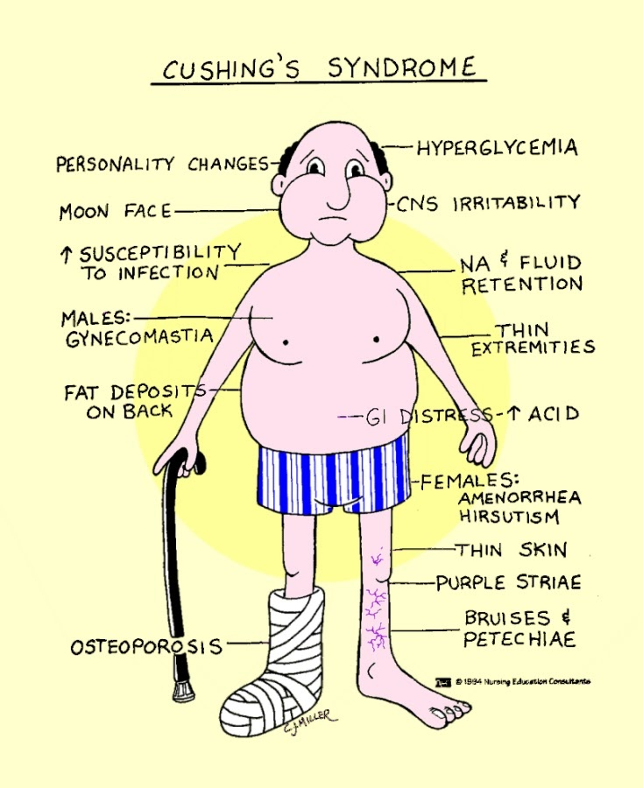

Slide 5
In patients with Cushing's syndrome due to a primary adrenal tumor, the underlying pathology may be a benign adenoma or an adrenal cortical carcinoma. An adrenal adenoma is more likely when the size of the lesion is < 6 cm and when pure Cushing's syndrome is present
treatment for Cushing's disease
Cushing's disease of pituitary origin treated by transsphenoidal hypophysectomy
IF treatment is ineffective then bilateral surgical adrenalectomy
Cushing's syndrome due to a primary adrenal tumor treated by Surgical adrenalectomy

Slide 6
Clinical presentation of adrenal cortical carcinoma : 50% functioning with symptoms related to excessive adrenal cortical steroid production. 50% are nonfunctioning tumors and these patients present with nonspecific symptoms such as abdominal pain, mass, fatigue, and weight loss. Treatment : Complete surgical excision

Slide 7
PRIMARY ALDOSTERONISM It is a secondary cause of hypertension characterized by excessive and unregulated secretion of aldosterone.
Etiology
An adrenal cortical adenoma
bilateral adrenal hyperplasia
This distinction is important because adenomas respond to surgery, whereas hyperplasia is treated medically.

Slide 8
Clinical features Hypertension is a central feature of the disease. Other symptoms are nonspecific and may include polyuria, nocturia, proximal muscle weakness, and headaches
The biochemical features of primary aldosteronism.
1. Hypokalemia
2. High plasma aldosterone
3. Low plasma renin activity
4. Metabolic alkalosis

Slide 9
Screened for the disease A Hypertensive patients with: • Spontaneous hypokalemia • Moderately severe hypokalemia after conventional diuretic therapy • Refractory hypertension
How is the diagnosis confirmed?
The best way to confirm the diagnosis of primary aldosteronism is to demonstrate nonsuppressible aldosterone secretion during prolonged salt repletion.

Slide 10
The localization procedures Computed tomographic (CT) scan of the adrenals, Bilaterally enlarged adrenals suggest hyperplasia Scintigraphy Adrenal vein sampling for aldosterone
Indications for surgery
primary aldosteronism
unilateral adenoma.
Spironolactone is used to treat primary aldosteronism medically

Slide 11
PHEOCHROMOCYTOMA Pheochromocytoma is a tumor derived from chromaffin cells that is associated with pathologic secretion of catecholamines (norepinephrine and epinephrine).
Location
About 90% are located in the adrenal gland;
10% may be extra-adrenal.
Most extra-adrenal pheochromocytomas are associated with sympathetic ganglia in the retroperitoneum

Slide 12
Rule of 10% 10% of tumors are: Extra-adrenal Malignant Associated with MEN syndromes Bilateral Pediatric
Symptoms:
The symptoms are those of excessive catecholamine secretion and include the classic triad of headaches, sweating, and palpitations. Pheochromocytoma, however, can present with var-
ious nonspecific symptoms, including tremors, nausea, dyspnea, fatigue, dizziness, and chest or abdominal pain.

Slide 13
Physical findings Hypertension most common which may be sustained or paroxysmal. . signs of catecholamine excess include tachycardia, tremor, , and Raynaud's phenomenon.
Who should be evaluated?
Priority for evaluation should be given to patients with:
• Headaches, sweating, and palpitations
• Incidental adrenal mass
• Hypertensive crisis with surgery, anesthesia, or parturition
• Family history of pheochromocytoma

Slide 14
Localization of pheochromocytomas 1. CT scan of the abdomen or pelvis 2. Magnetic resonance imaging (MRI) 3. Metalodobenzylguanidine (MIBG)
Preoperative regimen:
The goal of preoperative management to prevent cardiovascular morbidity due to severe hypertension. The standard medical preparation has been to treat patients with the nonslictive a-adrenergic blocker, phenoxybenzamine, for 4 weeks before surgery.
beta-blocking drugs are used to control cardiac arrhythmias. In these cases, a-blockade should be in place first to avoid a paradoxical hypertensive crisis.

Slide 15
In addition to medications, many of these patients are volume depleted and require vigorous intravenous hydration the day before surgery.
NEUROBLASTOMA
the most common extracranial solid tumor of childhood,
80% of children are diagnosed at < 4 years of age.
These tumors are of neural crest cell origin and can occur anywhere in the neuroectodermal chain.
Approximately 50% arise in the adrenal medulla, and most of the others occur along the sympathetic chain

Slide 16
Presention: Non specific :like fever, abdominal pain, abdominal mass, weight loss, anemia, bone pain, and/or proptosis and perior- bital ecchymoses. Neuroblastomas may also present on prenatal Ultrasonography.

Slide 17
Staging System for Neuroblastoma
Stage 1 Tumor confined to organ of origin with grossly complete excision
Stage 2A Unilateral tumor with gross residual after resection
Stage 2B Unilateral tumor with positive ipsilateral lymph nodes
Stage 3 Tumor crossing the midline or positive contralateral lymph nodes
Stage 4 Metastatic disease beyond regional lymph nodes
Stage 4S Unilateral tumor with or without positive ipsilateral lymph nodes with metastatic disease limited to the liver, skin, and/or bone marrow

Slide 18
Stage 4S reflects a unique expression of metastatic neuroblastoma. Patients are generally < 1 year of age and have localized primary tumors, as well as metastases limited to the liver, skin, and bone marrow. These tumors have a tendency to resolve with little or no treatment.
urinary catecholamine metabolites measured
In addition to radiographic evaluation, all patients undergo a 24-hour urine collection for measurement of catecholamine metabolites. Urinary homovanillic acid (HMA) and/or vanillyl- mandelic acid (VMA) levels are elevated in more than 90% of patients with neuroblastoma

Slide 19
MIBG scan (MIBG) is an amine precursor that is concentrated in neuroblas- tomas and other neuroendocrine tumors. MIBG scans are very sensitive for detecting neuroblastomas.
Treatment :
Patients with low-stage favorable tumors may be treated with surgical excision alone.
Patients with higher risk tumors require adjuvant multiagent chemotherapy and sometimes radiotherapy as well.

