Slide 1
Parotid glands
Size is the largest salivary gland , mainly serous secretion
Site and extension;
It locate below the auricle it occupy the space between the ramous of mandible and stern mastoid muscle. It extend ;
Up word ; to the root of zygomatic arch
Down word to the angle of mandible
Anterioly; to cover part of master m.

Slide 2
Post; to overlap the sternomastoid m
Medialy to the pharyngeal wall
It consist of many parts
1-Superfacial part which is the main part and large part.
2-Deep part small part

Slide 3
3- post glenoid part lie in contact with ext. audatory meatus behind the temporo -mandibular joint
4- accessory part small part lie between parotid duct and zygomatic arch.
Parotid duct;( stenens duct) 5 cm long arise from ant. Part.

Slide 4
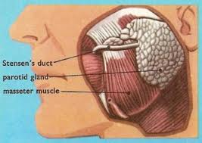

Slide 5
Stracture inside of parotid gland
1- facial nerve the most superfacial structure and it divided to 5 terminal br.
2-retromandibular vein; (intermediat position) it forms inside the gland by union of ? M.V+ S.T.V
3-external carotid artery the deepest structure
4-Auroculotemporal nerve; impeded in the upper part of the gland
5-deep parotid l.n

Slide 6
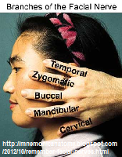

Slide 7
The parotid duct
5 cm long it begin at ant. Border of the gland \it end by open in vestibule of the mouth at opposed to upper 2nd molar tooth. It has as oblique course in side the buccinators m.
Providing a valvulur mechanism
Blood supply; small br. From ext. carotid art
Venous drainage in to retrombandibular vein
L.n to deep and superfacial parotid l.n
Nerve supply; sensory –greterauricular nerve,capsule and C.T
auricular temporal nerve supply the parenchyma
Sympathetic– from sympathetic plexus around E.C.A. and middle meningel art.

Slide 8
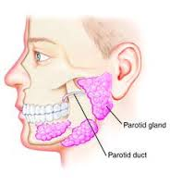

Slide 9
Capsule of parotid gland
The gland has no true fibrous capsule .
The gland acquire facial capsule from investing deep fascia of the neck which split to 2 layer at the lower border of the gland
1- superfacial layer which enclose the superfacial part and the masster m. and its attach above to the zygomatic arch.
2- deep layer which cover the inner surface of the gland , it produce the stylomandibular ligament which separate the lower border of gland from the submandibular salivary gland.

Slide 10
Cranial cavity
Inside the cranial cavity the brain which envelope by meanings ( dura matter, arichenoid matter, and pai matter) from out side to inside
Dura matter; its formed of strong white fibrous tissue, its consist of 2 layers, outer and inner layer. the outer layer separate from inner layer to form the dural venous sinus

Slide 11
Dural folds
They are membrane fold inside the cranial cavity produced by in word reduplication of inner layer of dural matter between the different parts of the brain
Functions;
1-they partially subdivided the cranial cavity into compartments so this decrease the effects of shocks on the brain
2- they support the upper part of the brain thus protecting its lower part from being pressed on

Slide 12
Types of dural folds
1- vertical folds which include;
A- falx cerebri
B- falx cereballi
2- horesental folds; which include
A- tentorium cerebelli
B-diaphragma sellae
C-cavum trigiminale

Slide 13
Falx cerebri
Its sickle shaped fold of dura.
Site; it descend from the dura of the vault of skull to occupy the median longitudinal fissure between the 2 cerebral hemispheres and above the corpous collosm.
Parts and attachments;
Apex; its tapering its ant end, its attached to the crista galli and frontal crest.

Slide 14
Base. The post broad end its continuous with the upper border of tentorium cereballi.
Upper convex; ( attach border) attach to the lip of sup. Sagittal sulcus.
Lower concave; (free border) lie above the corpous collosum in the bottom of median longitudinal fissure of the brain.
Venous sinuses related to the falx cerebri;
1- sup.sagittal sinus 2-inf. Sagittal sinus 3- straight sinus

Slide 15
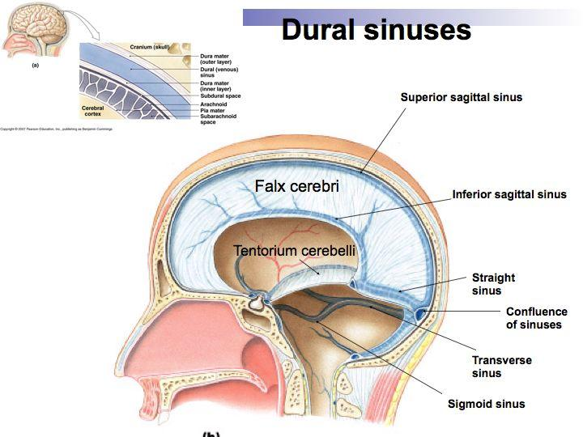

Slide 16
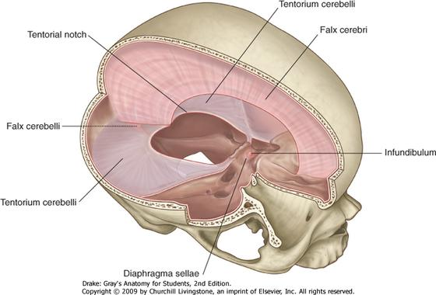

Slide 17
Falx cereballi
It’s a dural folds lying between rt and lf cereballar hemispheres.
Its triangular in shape.
Parts and attachments;
Base; above and its continuous with lower layer of tentorium cereballi.
Apex . Below and reach to the post. Border of foramen magnum.
Ant. Border project upward between the 2 cereballar hemispheres.
Post border attach to the internal occipital crest.

Slide 18
Tentorium cereballi
Site; it’s a dural fold which roof the post cranial fossa separating the cerebrum above from cerebellum below.
Shape ; tent shape having a peak above.
Surface;
Upper surface ; give attachment to the falx cerebri.
Lower surface give attachment to the base of falx cereballi.

Slide 19
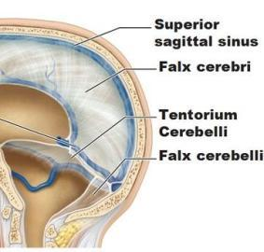

Slide 20
Dural venous sinus related to the tentorium.
1- the rt and lf sup. Petrosal sinuses
2-rt and lf transverse sinuses.
3- the straight sinus.
Cavum trigiminale.
It’s a sacculated fold of the inner layer of the dura mater in the middle cranial fossa near to the apex of the petrous temporal bone , its cover the trigeminal ganglion.

Slide 21
Diaphragma sellAe
It’s a circular fold in the inner layer of dura mater that roof the sella turcica above the pituitary gland. it has a central hole of the infindibulium.

Slide 22
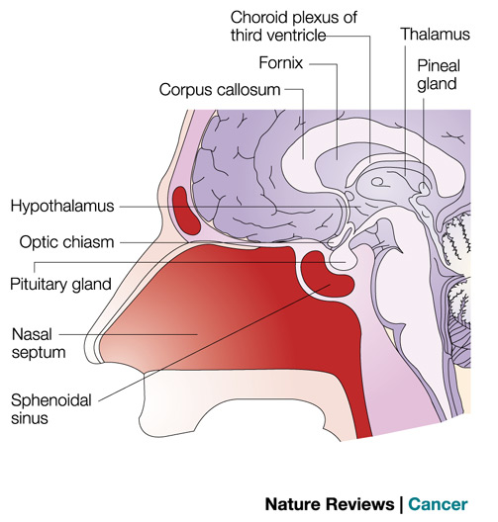

Slide 23
Dural venous sinuses
They are venous channel inside the cranial cavity between inner and outer layer of dural matter.
Character;
1- they are may single ,pair.
2- they are devoid of valve
3- they are lined by endothelium
4-many of them groove the bone on which they lie.

Slide 24
Classification
Single sinuses; sup. Sagital sinus , inf. Sagital sinus, straight sinus , occipital sinus ,basilar sinus
Pair sinuses; spheno pariatal sinus, cavernous sinus, sup. Petrosal sinus, inf.petrosal sinus, transverse sinus , sigmoid sinus, inter cavernous sinuses

Slide 25
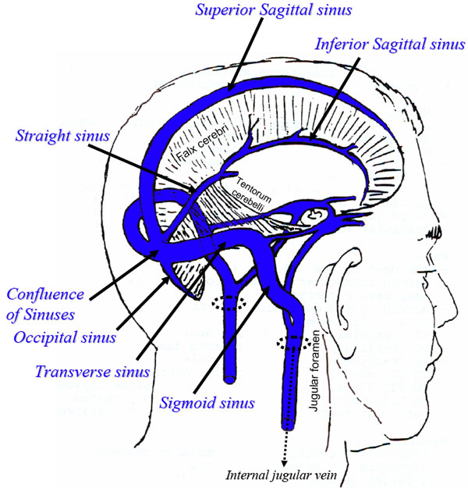

Slide 26
Sup. Sagittal sinus
It begin at the apex of falx cerebri above the crista galli and terminate by becoming rt transverse sinuse
It’s a largest venous sinus its size increase as it pass back word.
Course ; its pass backward at the upper convex border of falx cerebri, grooving the inner aspect of skull cap, forming the sup. Sagittal sulcus.

Slide 27
Inf. Sagittal sinus
It lie in the inf. Border of post. 2/3 of falx cerebri.
It end by free margin of tentorium by uniting with grear cerebral vein to form the straight sinus.

Slide 28
Straight sinus
Its formed by union of great cerebral vein with inf. sagittal sinus.
It terminate at the int. occipital protuberance it usually tent to the lf forming lf transverse sinus.
An apithelio ?sinosidal body; lying on the anterior part of the sinus controls the flow of venous flow from the great cerebral vein thus regulate the formation of C.S.F.

Slide 29
Cavernous sinus
Its one of the most important dural sinus.
Its name come from that its cavity contains network of interlacing trabiculi ( cavernous) giving it spongy appearance.
Its lie on the side of the body of sphenoid in middle cranial fossa.
It extend from sup. Orbital fissure anteriorly to the apex of petrous temporal bone posterior.
It about 2 cm long and 1 cm width.

Slide 30
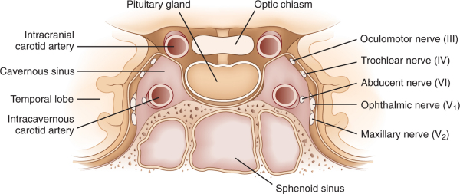

Slide 31
Relation
Anterior; sup orbital fissure
Posterior; apex of petrous temporal bone and trigiminal ganglion
Medialy ; pituitary gland , body of sphenoid& sphenoidal air sinus
Lat. Uncus of temporal bone of the brain
Sup. I.C.A
INF. Body of sphenoid and sphenoidal air sinus.

Slide 32
Structure inside the sinus
1- I.C.A. its pulsation help the drainage of sinus.
2- Abduscent nerve

Slide 33
Structure imbedded in the lat. Wall of the sinus
3rd cranial n
4th cranial n.
Ophthalmic and maxillary nerve ( 5th )

Slide 34
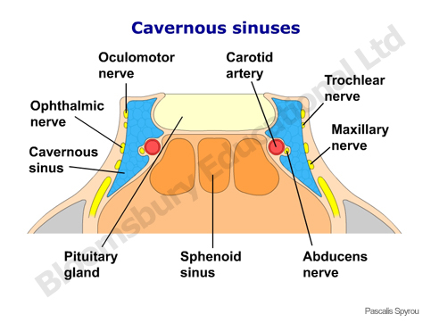

Slide 35
Tribuataries and commincation of the sinus
Ophthalmic v, sphenopariatal sinus,cetral vein of retina
Meddle cerebral v. , inf. Cerebral v
Emissary v. from pterigoid plexus
Intercavernous sinuses and veins from pituitary gland.
It drain to sup and inf . Petrossal sinus by 2 veins.

Slide 36
Clinical importance of sinus ; is any infection of danger area ( ?) cause thrombosis of the sinus. which its very danger condition

Slide 37
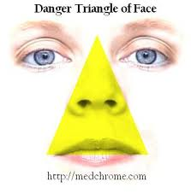

Slide 38
Sup. Petrosal sinus
Its begin from post end of cavernous sinus.
It end by joining the lateral end of transverse sinus
Inf. Petrosal sinus;
It begin from post .end of cavernous sinus
It end by opening into sup. Bulb of I.J.V

Slide 40
Transverse sinus
Its begin at the int. occipital protuberance as a follow;
The RT sinus is usually continuation of sup. Sagittal sinus.
The lf sinus usually continuation of straight sinus.
It end opposet the mastoid temporal bone by becoming sigmoid sinus.

Slide 41
Sigmoid sinus
It begin as continuation of transverse sinus
Run in the sigmoid sulcus
End by passing through post compartment of jugular foramen to become the IJV

Slide 42
Pituitary gland
It lie in hypophyseal fossa below the diaphragma sella.
Shape ; an ovoid body transverse diameter is 12 mm and ant.post. Diameter is 8 mm.
Relations;
Above; diaphragma sellae which separate the gland from optic chiasma
Below ; body of sphenoid and sphenoidal air sinus separating the gland from nasopharanx.

Slide 44
Ant. Trapiculium sellae and sphenoidal air sinus
Post. Dorsum sellae separating the gland from
pons and basilar artery.
On each side ; cavernous sinus and its contents
Blood supply ; inf & sup hypophyseal arteries branches from I.C.A
VENOUS DRAINGE; to the surrounding dural sinuses ,cavernous and inter cavernous .

Slide 45
Orbital cavity
Bony orbit; its pyramidal shaped spaces in the norma frontalis having base apex and 4 wall.
Base; in the orbital opening
Apex lie in optic canal
Walls ; medial ,lateral ,roof and floor.

Slide 46
Foramina and fissures in the orbit
Structres passing through it | Foramen
Optic nerve surrounding by its meanings Ophthalmic art. | Optic foramen
3rd, 4th, 6th, cran. N and ophthalmic nerve and vein | Sup. Orbital fissur
Infraorbital n. infraorbital a. zygomatic n Emissary vein between inf. Orbital vein and pterigoid plexuses | Inf. Orbital fissure
Ant. Ethemoidal n & vessels | Ant. Ethemoidal f.
Post . Ethemoidal n & vessels | Post , ethemoidal f.
Infra orbital n and vessels | Infra orbital groove or canal

Slide 47
Contents of the orbit
1- the eyeball
2- 7 extra ocular m.
3- nerves of the orbits; motor (3rd, 4th, 6th cr. N) and sensory neves.
4- vessels ( ophthalmic art. & sup and inf ophalmic vein)
5- orbital ligaments ,fascia and nerves

Slide 48
Lachrimal apparatus
Consist of ; lachrimal gland and its duct
Congunctival sac
Lacrimal sac and naso lacrimal duct.
Lacrimal gland; consist of 2 parts
Main part; lies on lacrimal fossa in the roof of orbit .
palbepral part; imbedded in the lateral part of the upper eye lid .

Slide 49
The lacrimal glands give about 12 ducts open in to sup. Fornex of conjunctiva.
Blood supply; lacrimal br. Of ophtha. Artery
Nerve supply ; lacrimal bra. Of ophthalmic nerve.

Slide 50
Extra ocular muscles
Levetor palpebrae superioris; origin from post part of roof of the orbit just infront of optic f.
Insertion; it divide to 3 slips inserted to ;
1- the skin of the upper eyelid
2-the tarsus of the upper eyelid
3- the upper fornix of conjunctiva.
N. suuply ; the sup. Division of 3rd cr. N.
Sympathetic fiber supply the deep part of the M. which is involuntary M. called mullers m.
Actions; elevate upper eyelid and upper fornix of conjunctiva

Slide 51
The 4 recti muscles ; sup. ,inf, medial and lateral; nerve supply by 3rd cr. N except SUP. OBLIQUE SO4 AND LAT RECTUS LR6
Functions; lat recus abduct the eye
Med. Rectus adducts the eye
Sup rectus ; elevate and adduct the eye
Inf. Rectus ; depress and adduct the eye

Slide 52
The oblique muscles
Sup oblique; function depress and abduct and rotate the eye laterally.(lock to your shoulder)
Nerve supply 4TH CR. NERVE. ( SO4)
Inf. Oblique ;
N supply by inf. Division of occulomotor nerve
Action; elevate , abducts and rotate the eye laterally.

Slide 53
Optic nerve
Its sensory nerve carrying visual impulses
Its fiber are the axons of the ganglion cells of the retina
Its end in the cranial cavity by joining the optic chiasma.
The optic nerve considered as a tract of the brain because;
1-it has no neurilemmal sheath so its fiber of in cabaple to regenerate
2- its surround by meningese
Optic nerve is pierce by central artery of retina ( br. Of ophthal art.)

Slide 54
Thank you
DR. ALAA JAMEL

