Slide 1
Cranial Ner ves
By
Dr. Firas Abdullah Noori

Slide 2
Learning outcomes
At the end of the lecture, students should be able to:
11.1 Enumerate the cranial nerves.
11.2 Describe the origin, course & distribution
of cranial nerves.
11.3 Describe the structure innervated by cranial
nerves.
11.4 Correlate the structure innervated with the
clinical conditions of cranial nerve palsies.

Slide 3
Nervous System

Slide 4
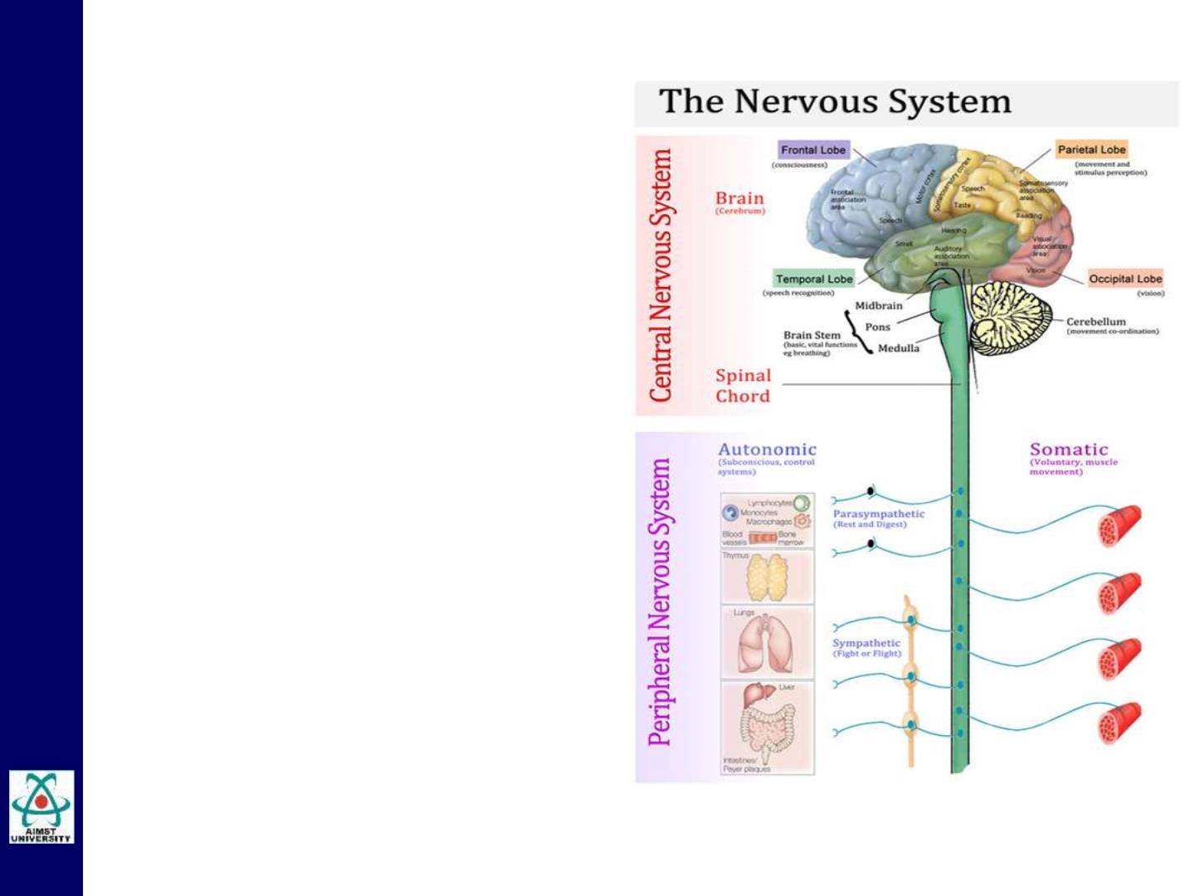
Nervous System
Nervous system has 2
components:
1.Central nervous system:
- Brain and spinal cord.
2.Peripheral nervous system:
- Nerves and ganglia
- Cranial nerves.
- Spinal nerves.

Slide 5
Peripheral Nervous System
Nerves
• Nerves are bundles of either long dendrites and
or long axons.
• There are no cell bodies in nerves.
Ganglia
• Cell bodies of a nerve (PNS) or nuclei (in gray
matter of the CNS).

Slide 6
The Cranial Nerves

Slide 7
Cranial Nerves
Features
1. Cranial nerves are part of the PNS.
2. They are attached to the part of the CNS called the
brain stem (midbrain, pons and medulla).
3. Exceptions are CN I and CN II which connect directly
to higher levels of the brain.
4. Innervate:
• Skeletal muscles
• Sensory structures
• Smooth muscles, cardiac muscles and
secretory glands (ANS)

Slide 8
Cranial Nerves
The Sensory information from the head and neck is
received and the motor information is sent out via the 12
pairs of cranial nerves.
Each cranial nerve are ..
• Referred to by a name or number !! ..
• It has at least a motor, sensory or parasympathetic
component.
• Some of them have more than one component.
• Most of the nuclei are situated in the brainstem.
All the nerves are distributed in the head and neck, except
cranial nerve X, which also supplies structures in the
thorax and abdomen.

Slide 9
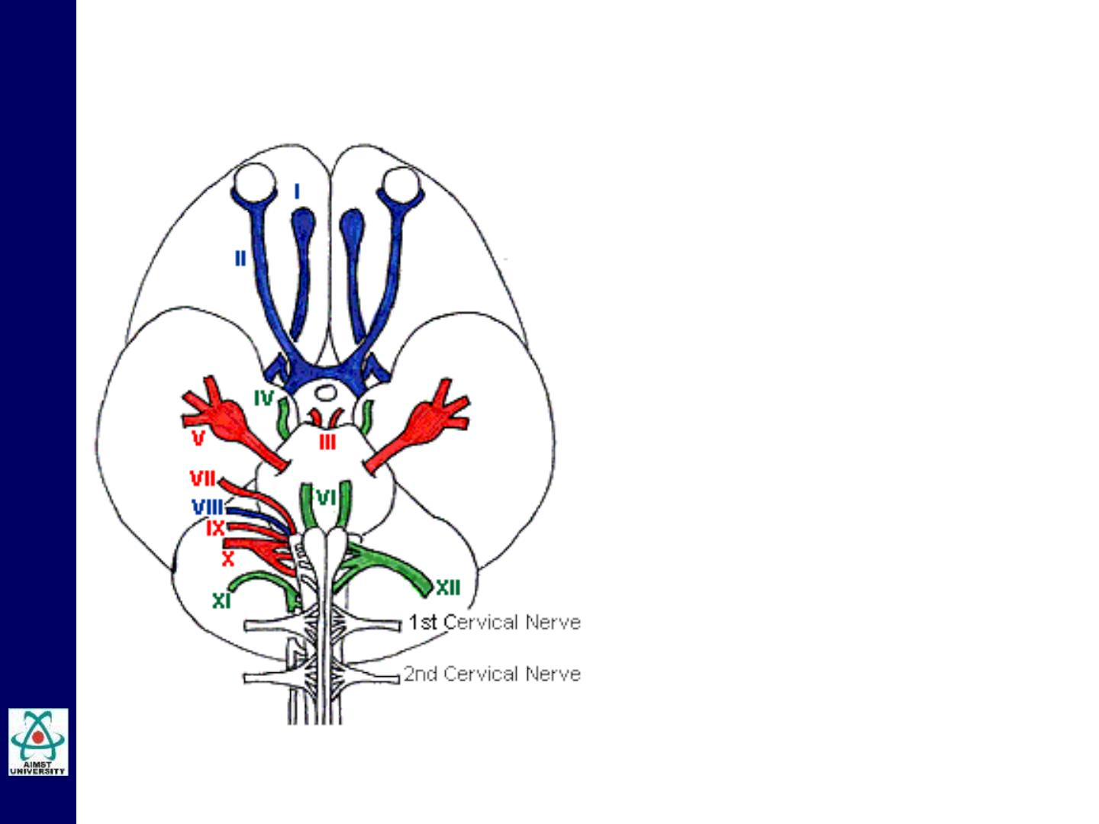
Cranial Nerves
1. Olfactory Nerve
2. Optic Nerve
3. Oculomotor Nerve
4. Trochlear Nerve
5. Trigeminal Nerve
6. Abducent Nerve
7. Facial Nerve
8. Vestibulo Cochlear
Nerve
9. Glossopharyngeal Nerve
10. Vagus Nerve
11. Accessory Nerve
12. Hypoglossal Nerve

Slide 10
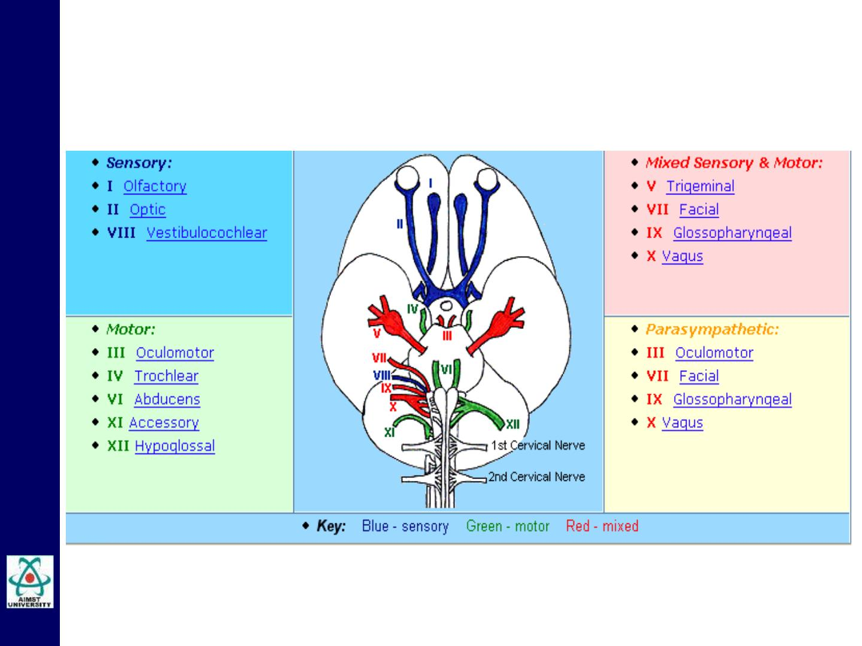
Cranial Nerves
Components

Slide 11
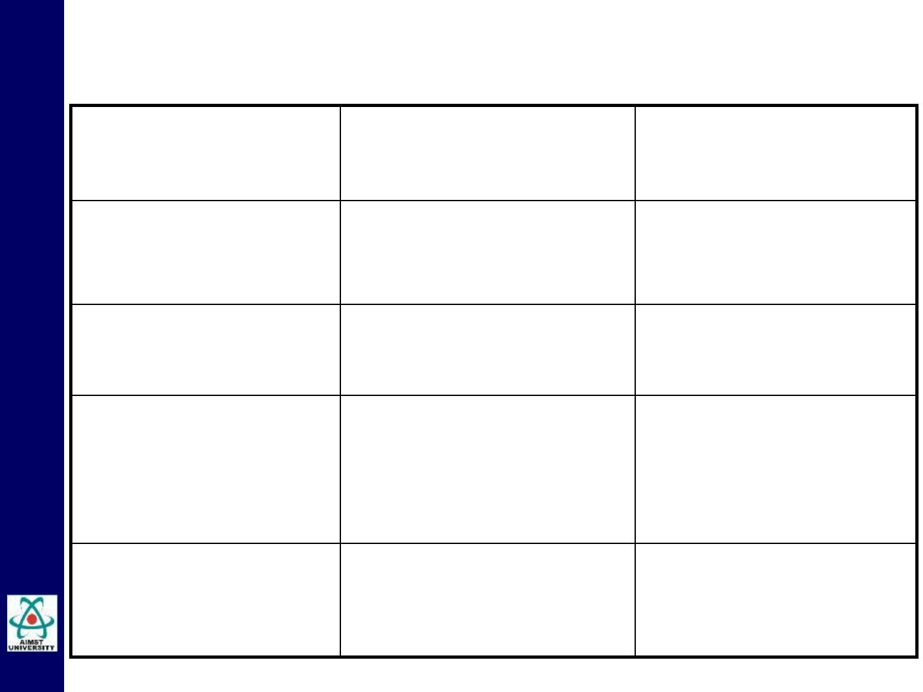
Cranial Nerves
Nerve
Function
Exit from cranial
cavity
(Component)
I. Olfactory
(Sensory)
Smell
Cribriform plate of
ethmoid
II. Optic
Vision
Optic canal
(Sensory)
III. Oculomotor
(Motor)
Raises upper eyelid,
turns eyeball upward,
downward, and medially;
constricts pupil;
Superior orbital
fissure
accommodates eye
IV. Trochlear
(Motor)
Assists in turning
eyeball downward
and laterally
Superior orbital
fissure

Slide 12
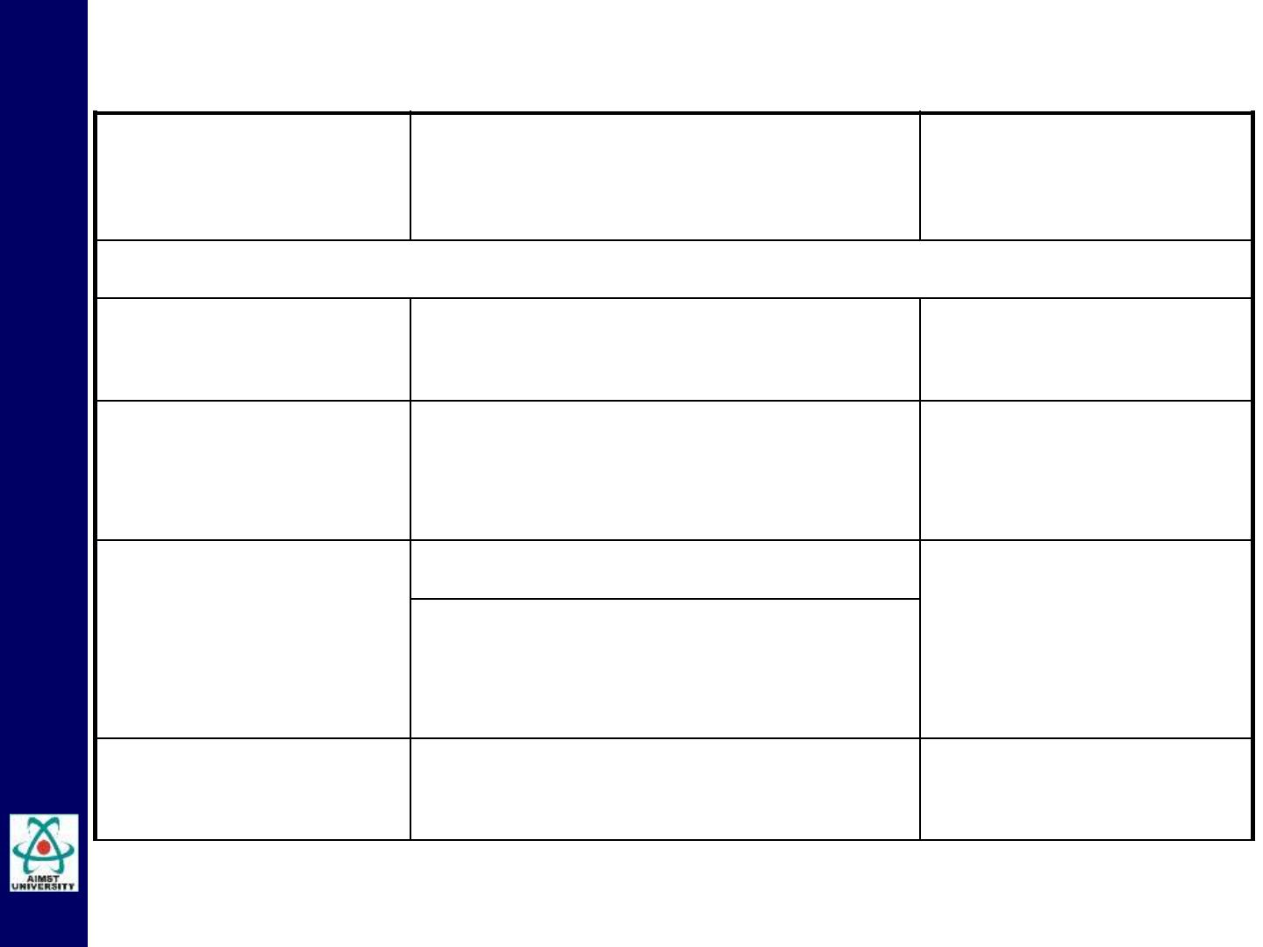
Cranial Nerves
Nerve
(Component)
Function
Exit from cranial
cavity
V. Trigeminal (Mixed)
V 1. Opthalmic
(Sensory)
Cornea, skin of forehead, scalp, Superior Orbital
eyelids, and nose
fissure
V 2. Maxillary
(Sensory)
Skin of face over
maxilla; teeth of
upper jaw
Foramen Rotundum
V 1. Mandibular
(Mixed)
Motor: Muscles of mastication
Foramen Ovale
Sensory: Skin of cheek, skin over
mandible and side of head, teeth
of lower jaw
VI. Abducent
(Motor)
Lateral rectus muscle turns
eyeball laterally
Superior orbital
fissure

Slide 13
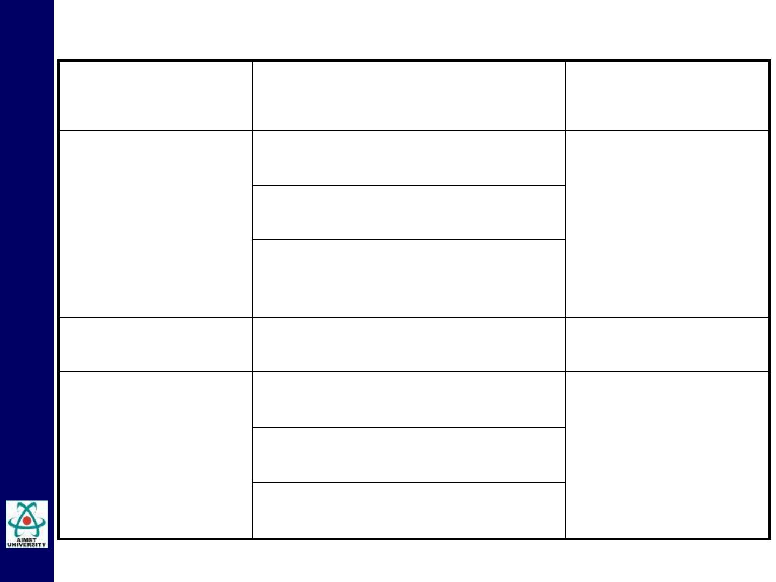
Cranial Nerves
Nerve
(Component)
Function
Exit from cranial
cavity
VII. Facial
(Mixed)
Motor: Muscles of facial
expression
Internal auditory
meatus, facial canal
& stylo- mastoid
foramen
Sensory: Taste from anterior
two-thirds of tongue
Parasympathetic:
Submandibular and sublingual
salivary glands
VIII. Vestibulo-
cochlear (Sensory)
Hearing; Inner ear
Internal auditory
meatus
IX.
Motor: Stylopharyngeus muscle
Jugular foramen
Glossopharyngeal assists swallowing
(Mixed)
Sensory: General sense & taste
from posterior one-third of tongue
Parasympathetic: Parotid
salivary gland

Slide 14
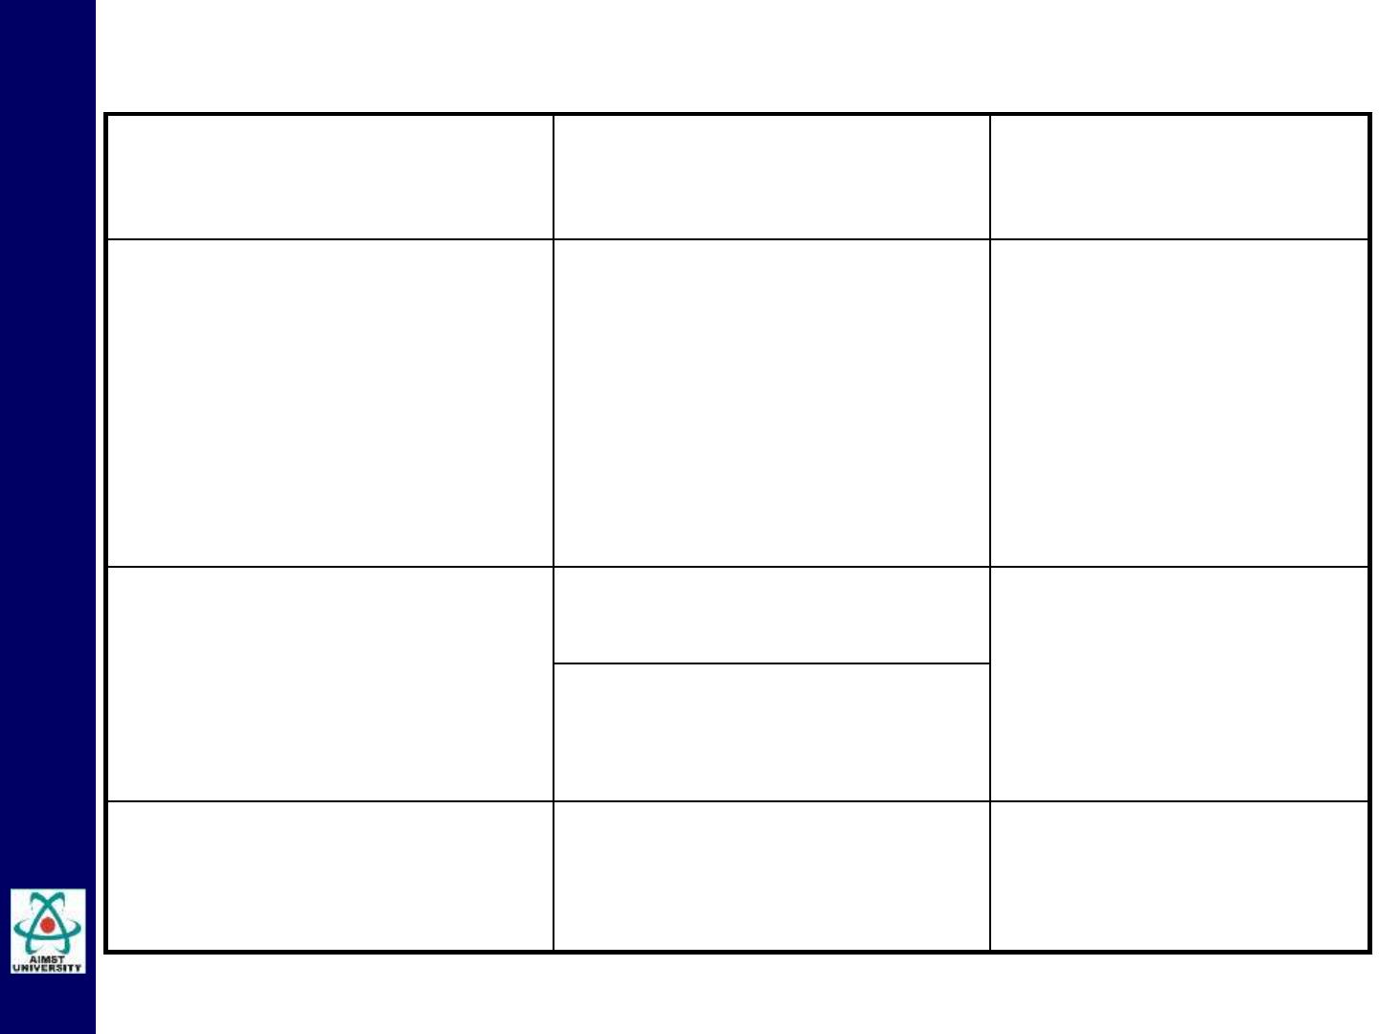
Cranial Nerves
Nerve
Function
Exit from cranial
cavity
(Component)
X. Vagus (Mixed)
Heart and great thoracic Jugular foramen
blood vessels; larynx,
trachea, bronchi, and
lungs; alimentary tract
from pharynx to splenic
flexure of colon; liver,
kidneys, and pancreas
XI. Accessory
(Motor)
Cranial root: Muscles of Jugular foramen
the soft palate
Spinal root:
Sternocleidomastoid &
Trapezius muscle
XII. Hypoglossal
(Motor)
Intrinsic & Extrinsic Hypoglossal
Muscles of Tongue. canal

Slide 15
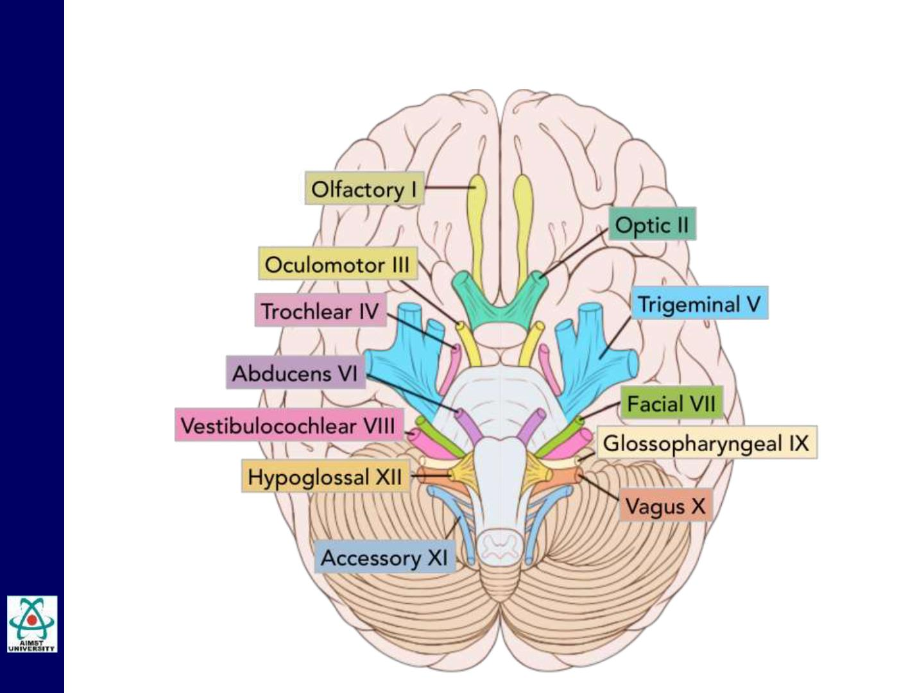
Cranial Nerves
Attachment

Slide 16
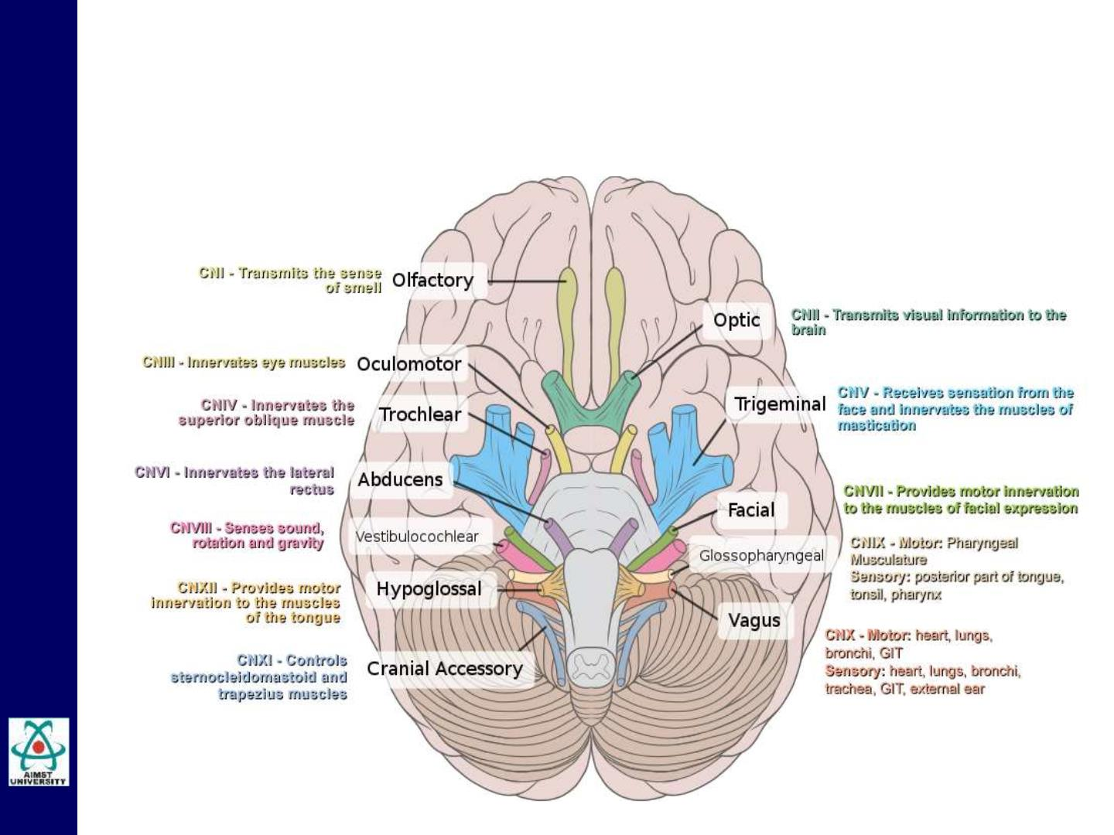
Cranial Nerves
Functions

Slide 17
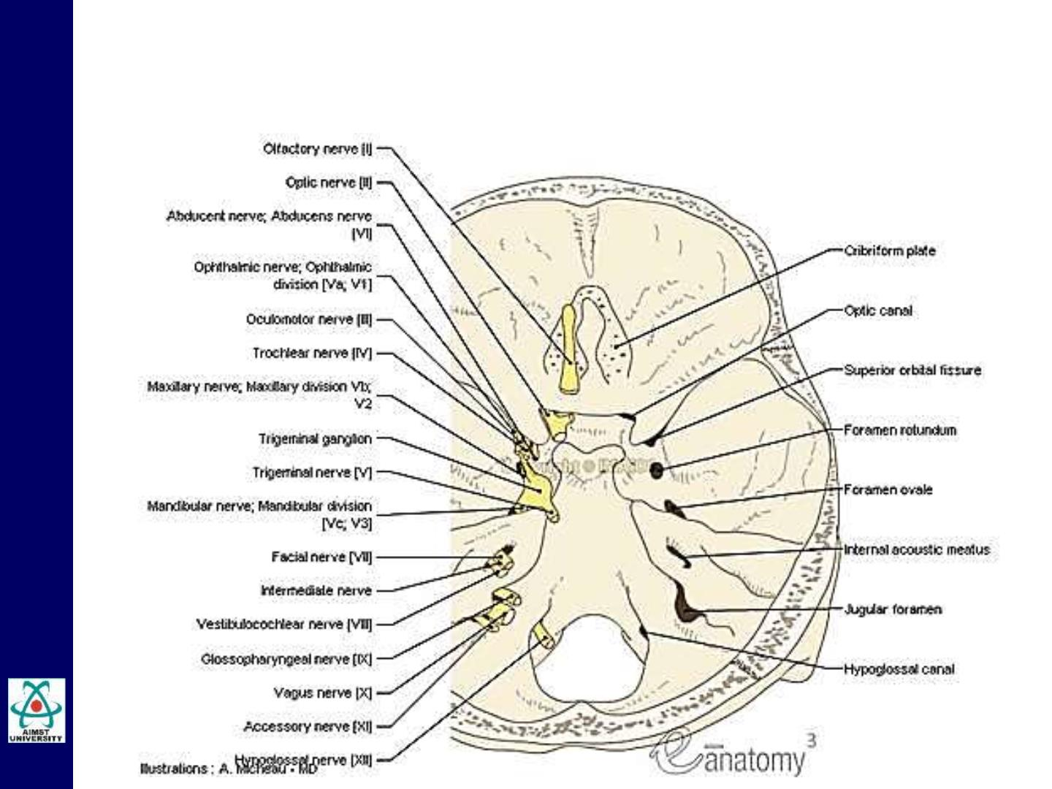
Cranial Nerves
Exits

Slide 18
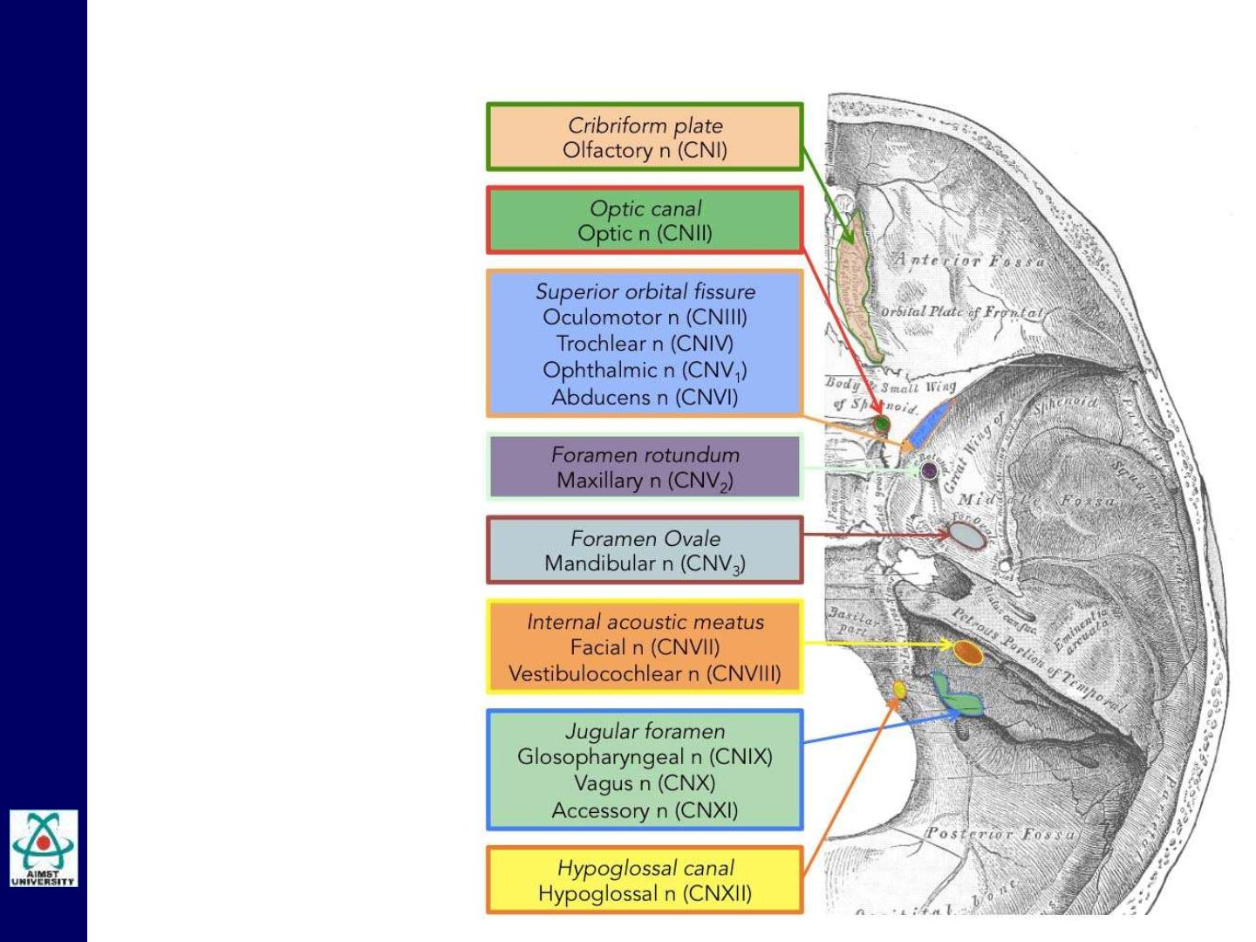
Cranial Nerves
Exits

Slide 19
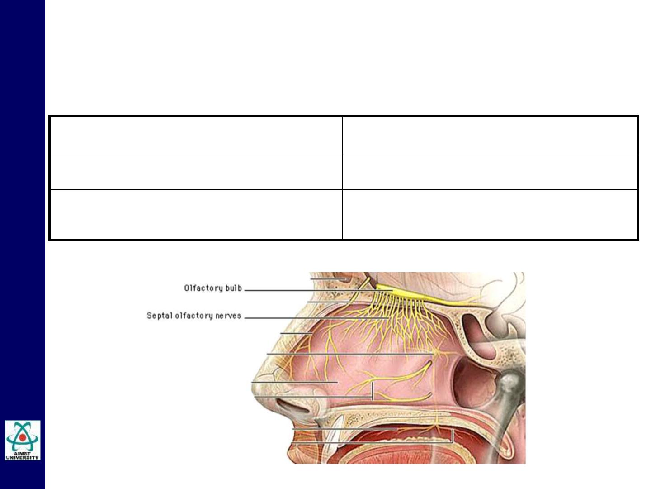
Cranial Nerve I: Olfactory
Component:
Function:
Sensory
Smell
Tract:
Olfactory cells of Nasal Mucosa →
Olfactory Bulbs → Pyriform Cortex

Slide 20
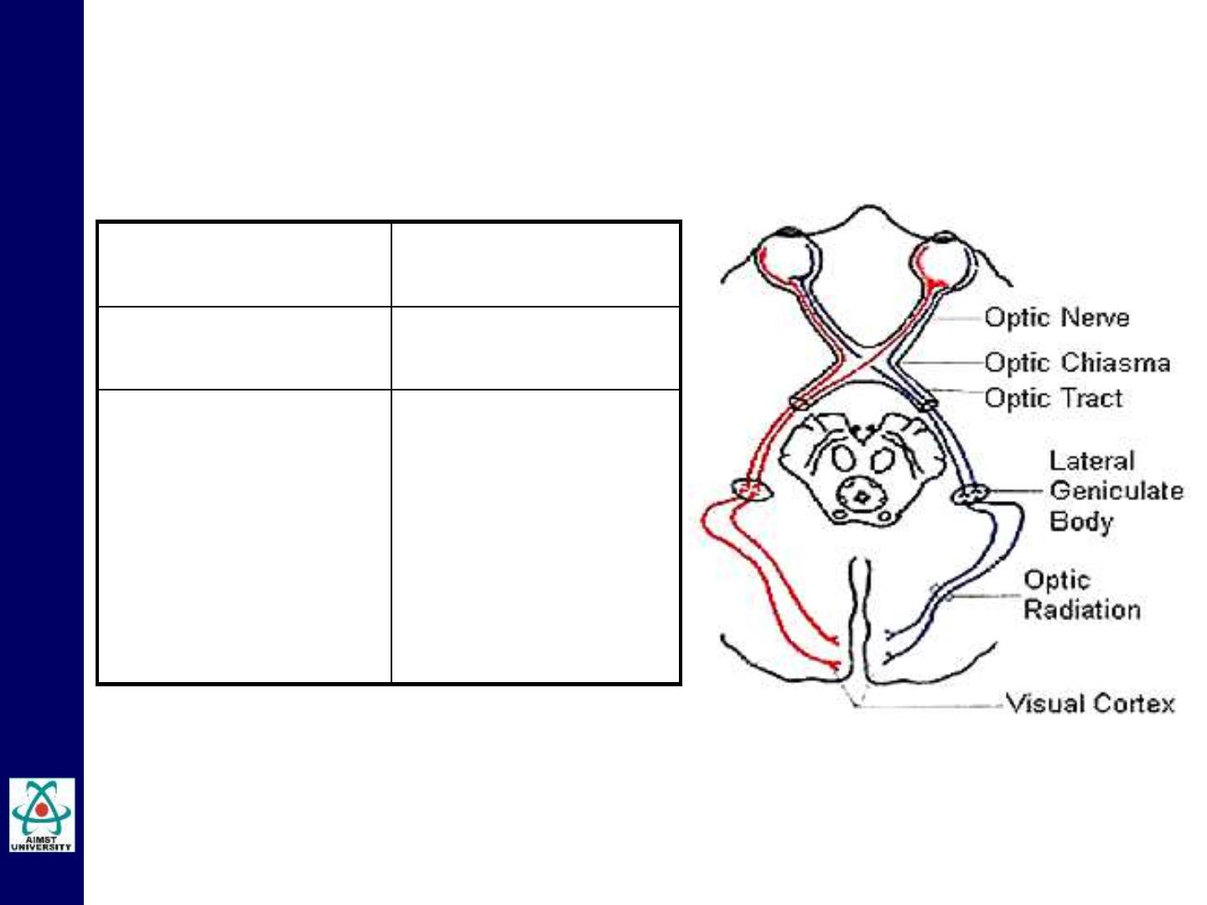
Cranial Nerve II: Optic
Component(s): Sensory
Function:
Tract:
Vision
Retinal Ganglion
cells → Optic
Chiasma →
Thalamus →
Primary Visual
Cortex in
Occipital lobe

Slide 21
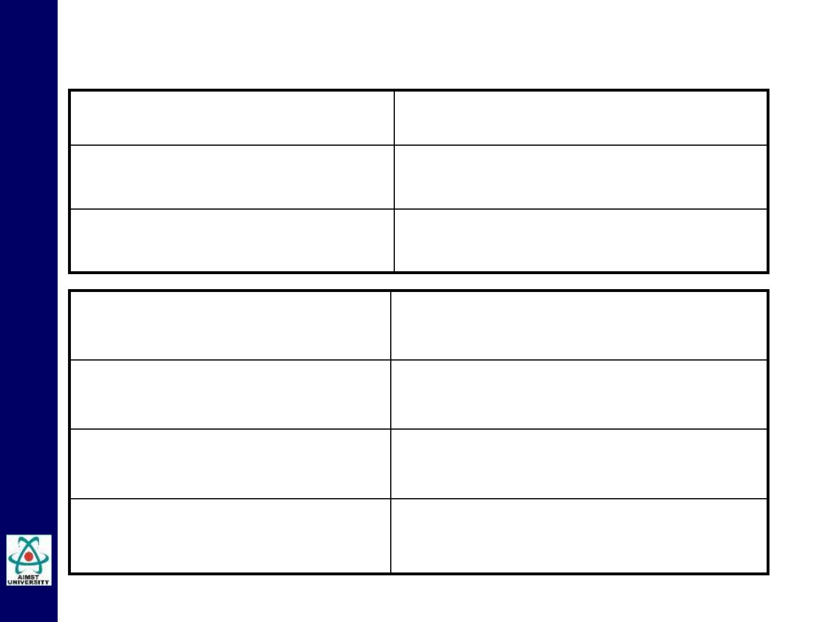
Cranial Nerve III: Oculomotor
Component #1:
Function(s):
Motor
Movement of eyeball & lens
accomodation
Structure(s) Innervated:
4 eyeball muscles & 1 eyelid
muscle
Component #2:
Nucleus location:
Function:
Parasympathetic
midbrain
pupil constriction
Structure(s) Innervated:
ciliary muscle and pupillary
constrictor muscles

Slide 22
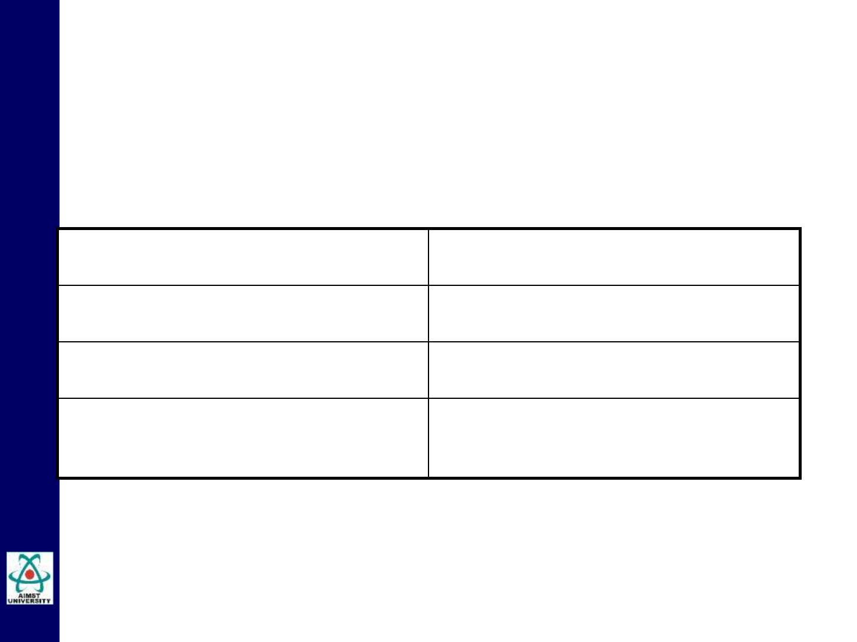
Cranial Nerve IV: Trochlear
Component:
Motor
Function:
Moves Eyeball
Midbrain
Nucleus location:
Structure(s) Innervated:
Superior Oblique Muscles

Slide 23
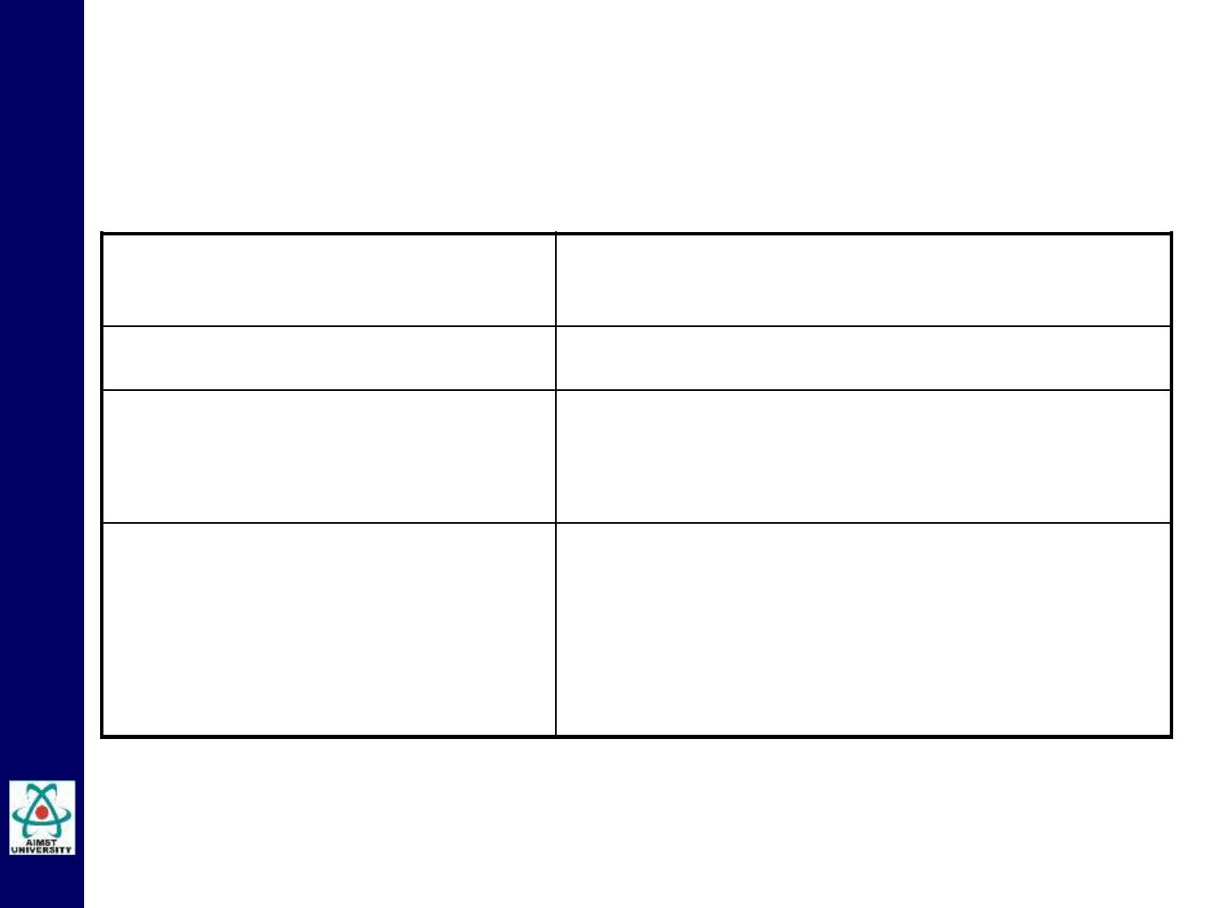
Cranial Nerve V: Trigeminal
Component #1:
Sensory (Impulses of Touch, Pain, Heat
and Cold)
Locations of nuclei:
Function:
Pons and Medulla
(1) Sensations; (2) General Sensory
from Tongue; (3) Proprioception
Structure(s) Innervated:
(1) Face, Scalp, Teeth, Lips, Eyeballs,
Nose & Throat lining; (2) Anterior 2/3 of
Tongue; (3) Muscles of Mastication

Slide 24
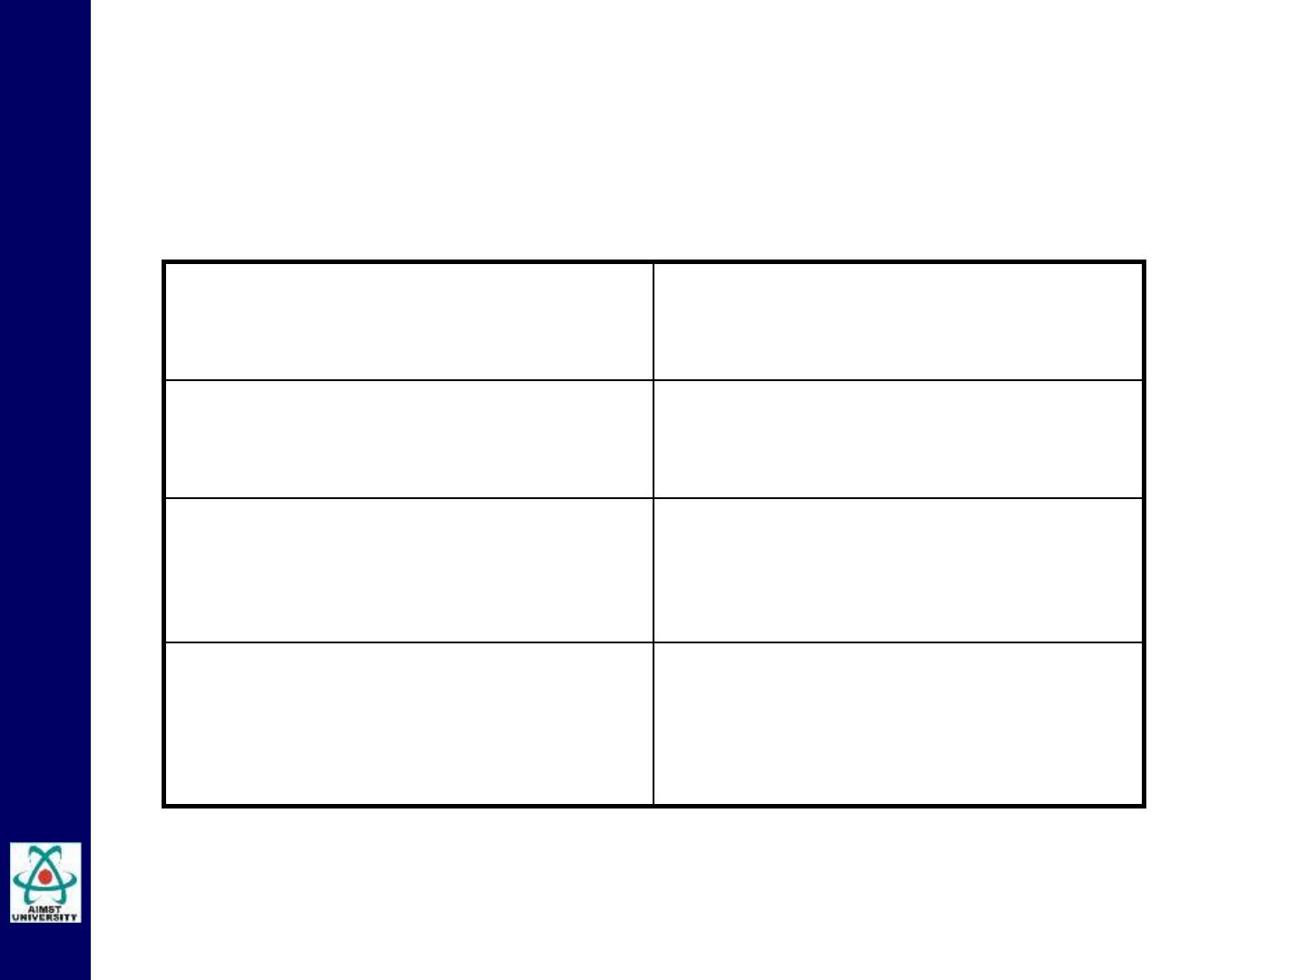
Cranial Nerve V: Trigeminal
Component #2:
Function:
Motor
Chewing
Nucleus location:
Trigeminal motor Nucleus in
Pons
Structure(s) Innervated:
Muscles of Mastication

Slide 25

Cranial Nerve V: Trigeminal
• V1. Ophthalmic
• Exits superior orbital fissure,
• Sensory to forehead, nasal cavity.
• V2. Maxillary
• Exits foramen rotundum through wall of maxillary sinus to
inferior orbital foramina)
• Sensory to cheek, upper lip, teeth, nasal cavity.
• V3. Mandibular
• Exits foramen ovale to mandibular foramen to mental
foramen
• Motor to jaw muscles--Masseter, temporalis, pterygoids&
digastric
• Sensory to chin & tongue.

Slide 26
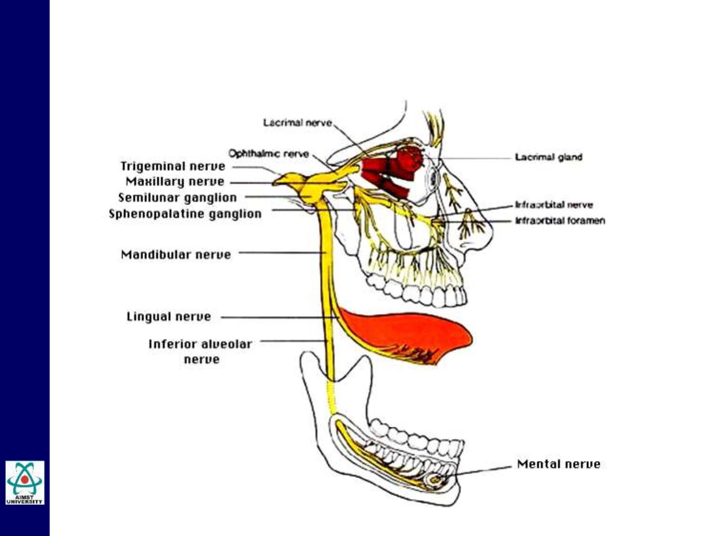
Cranial Nerve V: Trigeminal

Slide 27
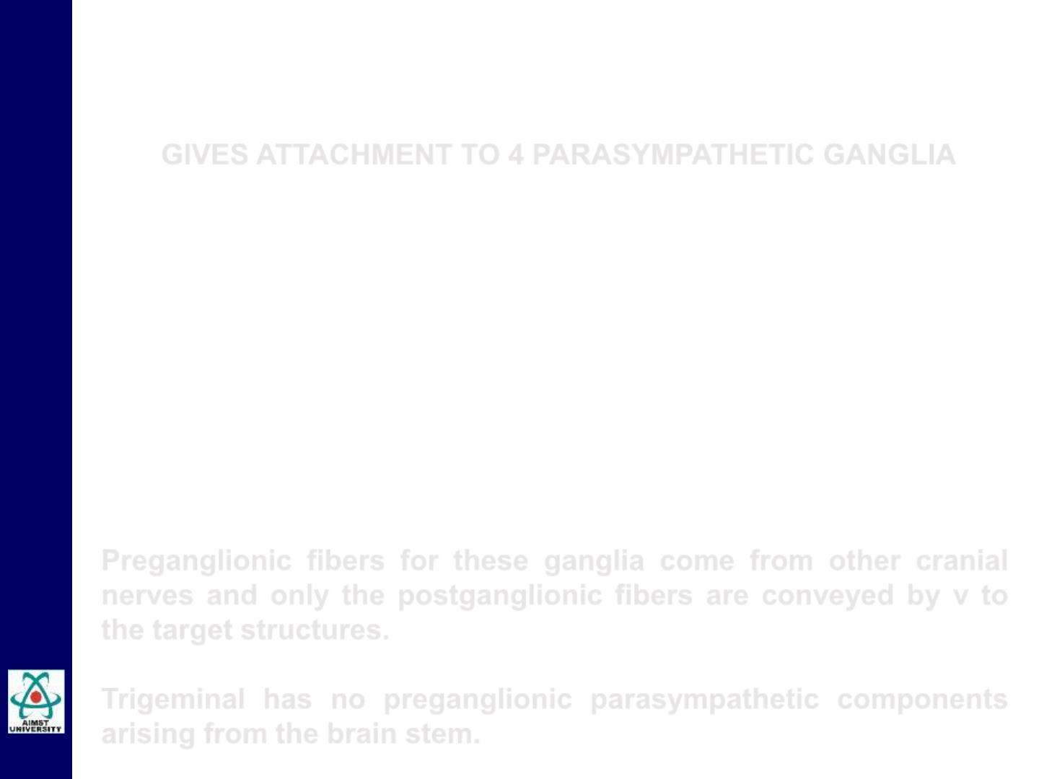
Cranial Nerve V: Trigeminal
GIVES ATTACHMENT TO 4 PARASYMPATHETIC GANGLIA
• CILIARY GANGLION, ATTACHED TO V₁
• PTERYGOPALATINE GANGLION, ATTACHED TO V₂
• SUBMANDIBULAR GANGLION, ATTACHED TO V₃
• OTIC GANGLION ATTACHED TO V₃
Preganglionic fibers for these ganglia come from other cranial
nerves and only the postganglionic fibers are conveyed by v to
the target structures.
Trigeminal has no preganglionic parasympathetic components
arising from the brain stem.

Slide 28
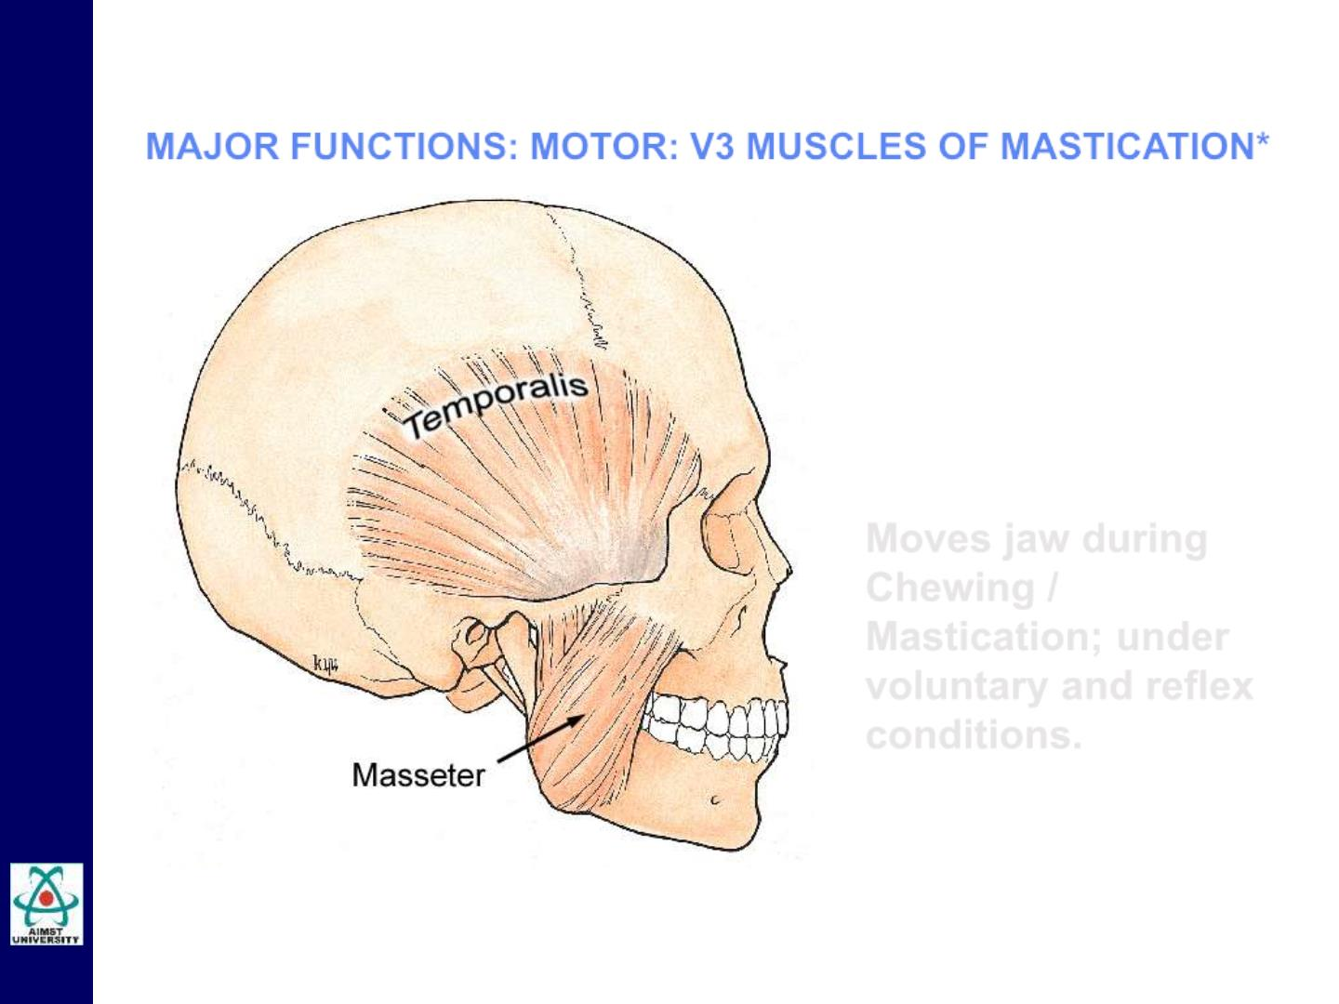
Cranial Nerve V: Trigeminal
MAJOR FUNCTIONS: MOTOR: V3 MUSCLES OF MASTICATION*
Not shown is ..
Pterygoid Muscles
Moves jaw during
Chewing /
Mastication; under
voluntary and reflex
conditions.

Slide 29
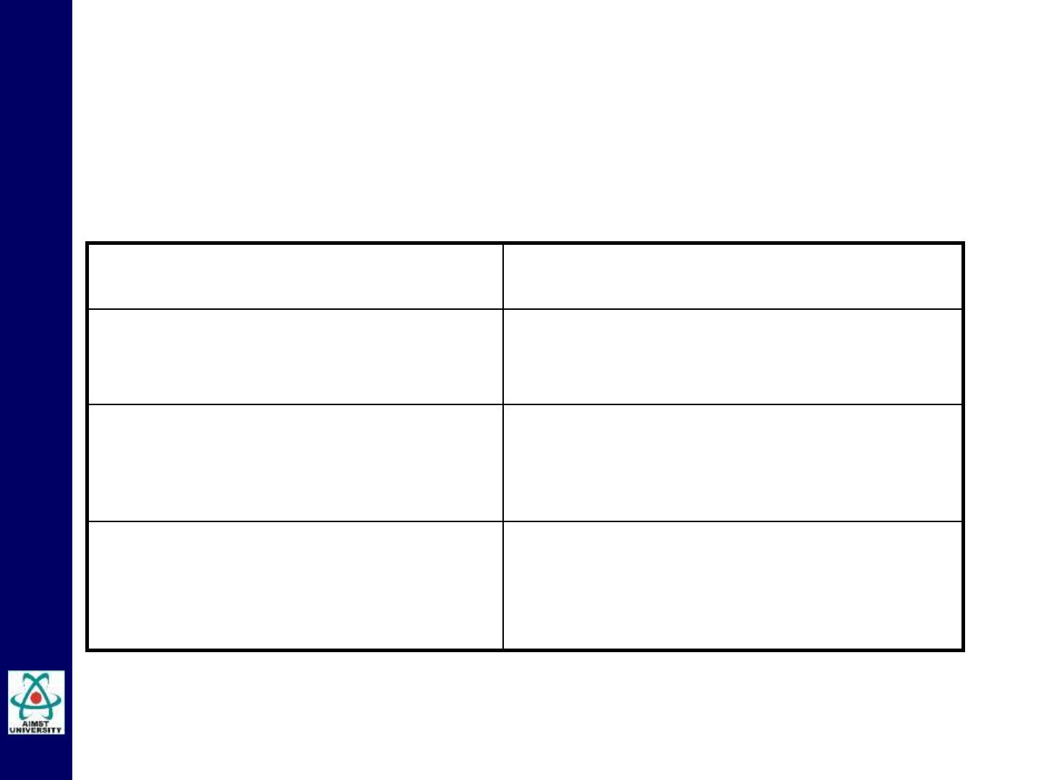
Cranial Nerve VI: Abducent
Component:
Function:
Motor
Eyeball movement
Nucleus:
Abducent nucleus in pons
Structure(s) Innervated:
Lateral Rectus Muscle of Eye

Slide 30
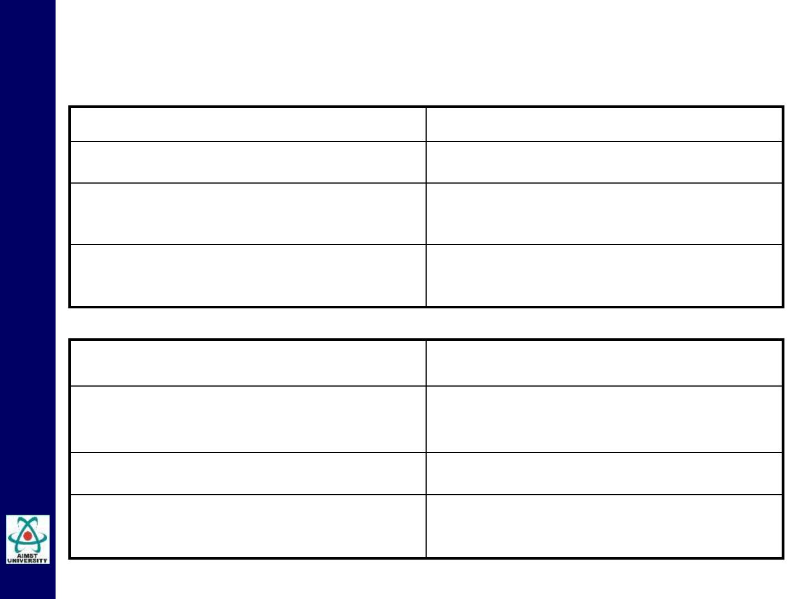
Cranial Nerve VII: Facial
Component #1:
Sensory
Medulla
Nucleus location:
Function:
(1) Taste & (2) Proprioception
Structure(s) Innervated:
(1) Anterior 2/3 of Tongue & (2)
Face and Scalp
Component #2:
Motor
Nucleus location:
Facial motor Nucleus in Pons
Function:
Facial Expressions
Muscles of the Face
Structure(s) Innervated:

Slide 31

Cranial Nerve VII: Facial
Component #3:
Parasympathetic
Nucleus location:
Superior salivatory nucleus in
medulla
Function:
Salivation and Lacrimation
(drooling and tears)
Structure(s) Innervated:
Salivary and Lacrimal Glands via
Submandibular and
Pterygopalatine Ganglia

Slide 32
Cranial Nerve VII: Facial
• Exit through the Internal acoustic meatus & stylomastoid
foramen.
• Facial muscles (five branches fan out over face from
stylomastoid foramen)
• Temporal
• Zygomatic
• Buccal
• Mandibular
• Cervical
• “chorda tympani” ( join V )
3
• Taste to anterior 2/3 of tongue
• Submandibular, sublingual salivary glands
• Lacrimal glands.

Slide 33
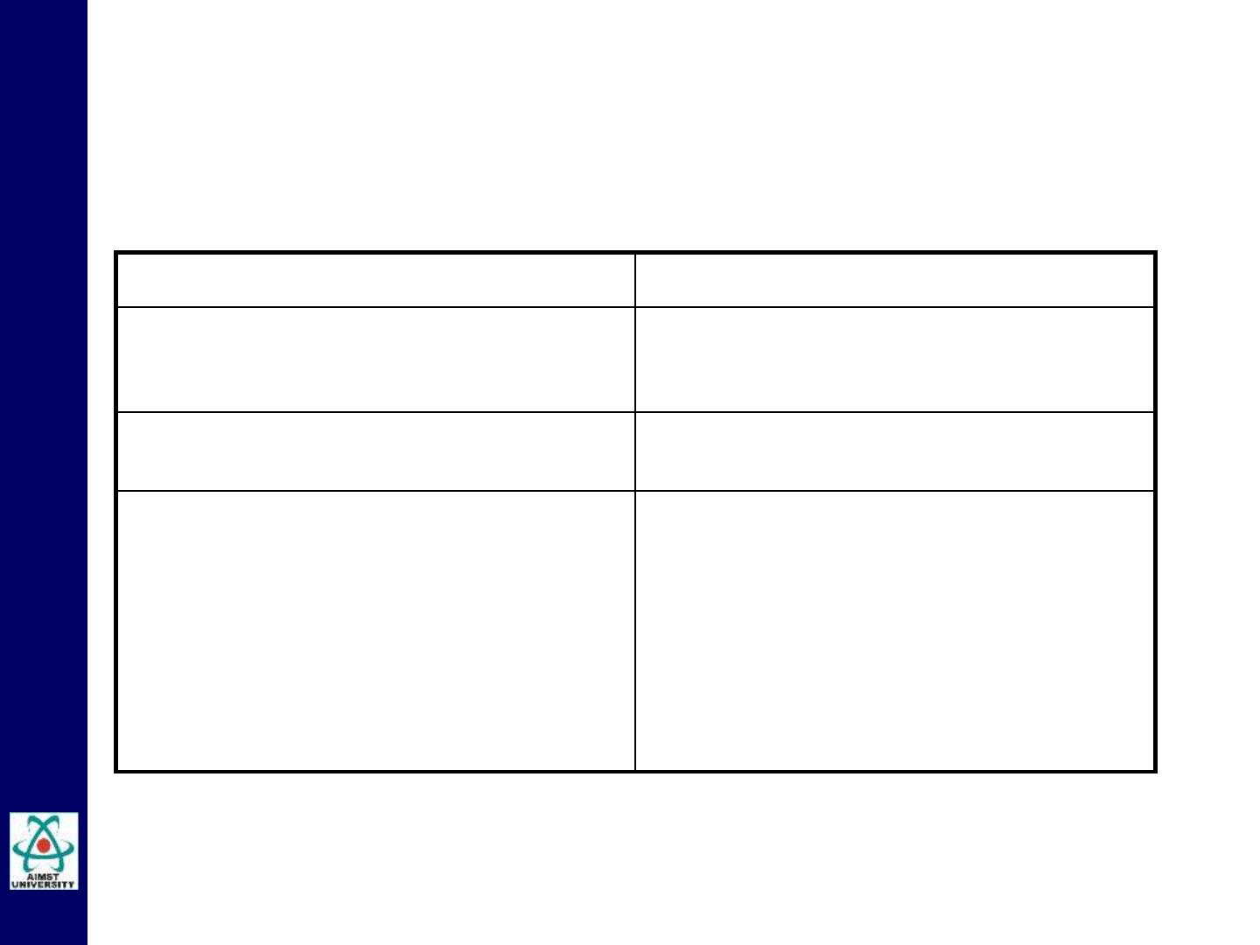
Cranial Nerve VIII: Vestibulo-Choclear
Component:
Functions:
Sensory
(1) Balance
(2) Hearing
In Pons and Medulla
Nucleus:
Structure(s) Innervated:
• Vestibular Apparatus of
internal ear
• Cochlea of internal ear →
auditory cortex in the temporal
lobes

Slide 34
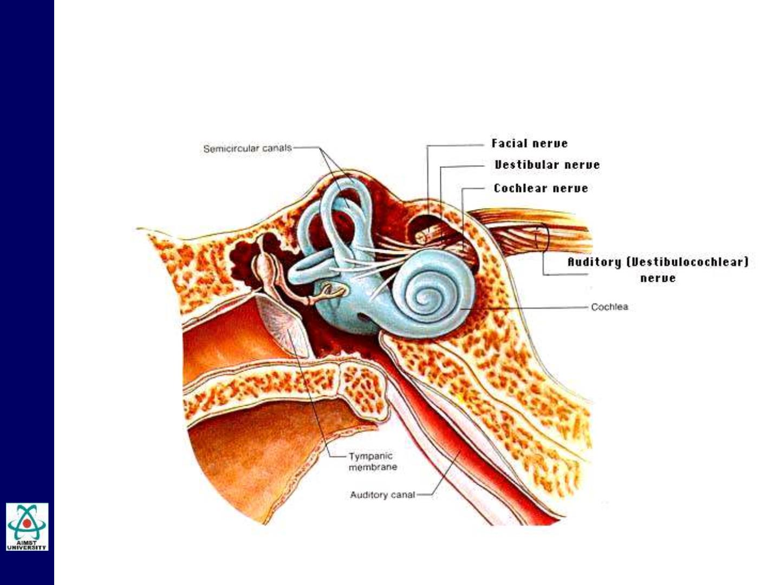
Cranial Nerve VIII: Vestibulo-Choclear

Slide 35

Cranial Nerve IX: Glossopharyngeal
Component #1:
Sensory
medulla
Nucleus location:
Function:
(1) taste; (2) proprioception for
swallowing & (3) blood pressure
receptors
Structure(s) Innervated:
(1) posterior two thirds of tongue;
(2) throat muscles & (3) carotid
sinuses

Slide 36
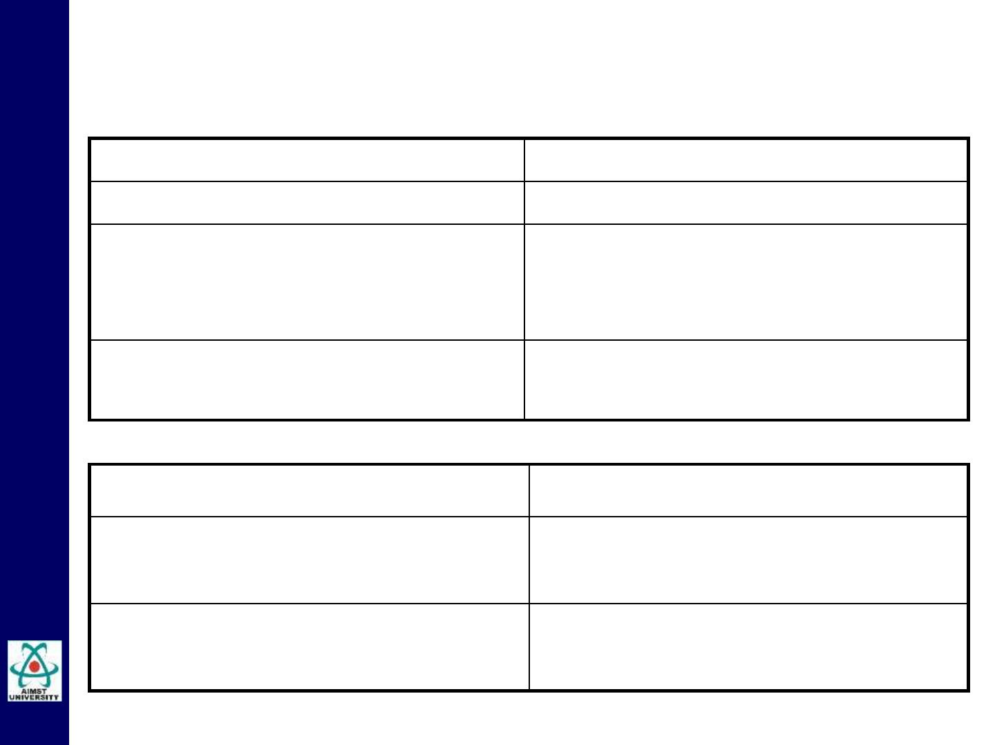
Cranial Nerve IX: Glossopharyngeal
Component #2:
Nucleus location:
Function:
Motor
medulla
(1) swallowing and gag reflexes &
(2) tear production
Structure(s) Innervated:
(1) throat muscles and (2) lacrimal
glands
Component #3:
Function:
Parasympathetic
saliva production
Structure(s) Innervated:
parotid glands

Slide 37
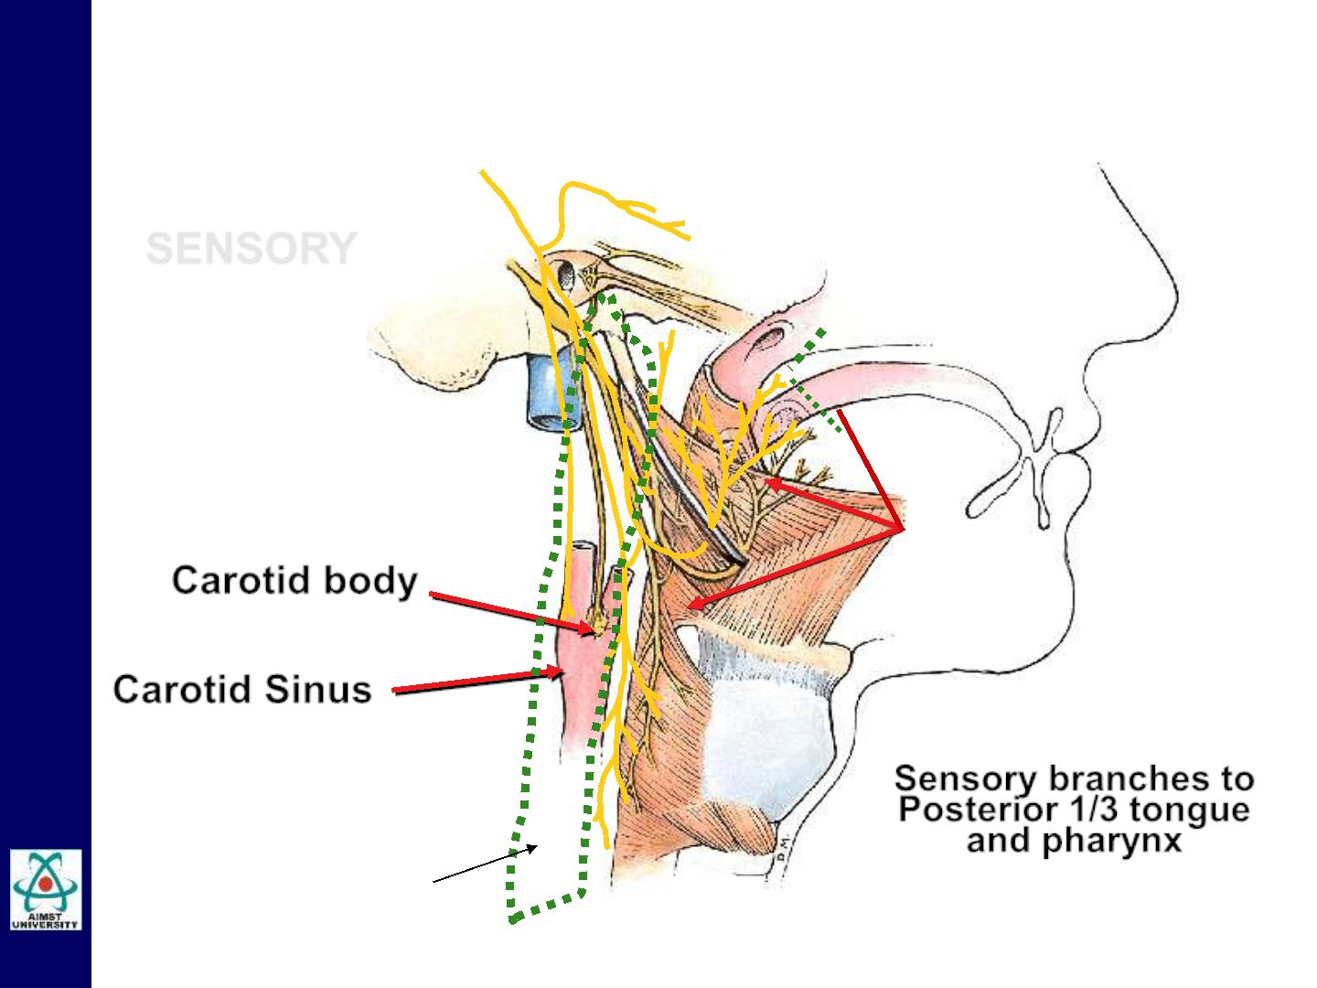
Cranial Nerve IX: Glossopharyngeal
MAJOR FUNCTIONS
SENSORY
Carotid body
Carotid Sinus
Sensory branches to
Posterior 1/3 tongue
and pharynx
Pharynx

Slide 38
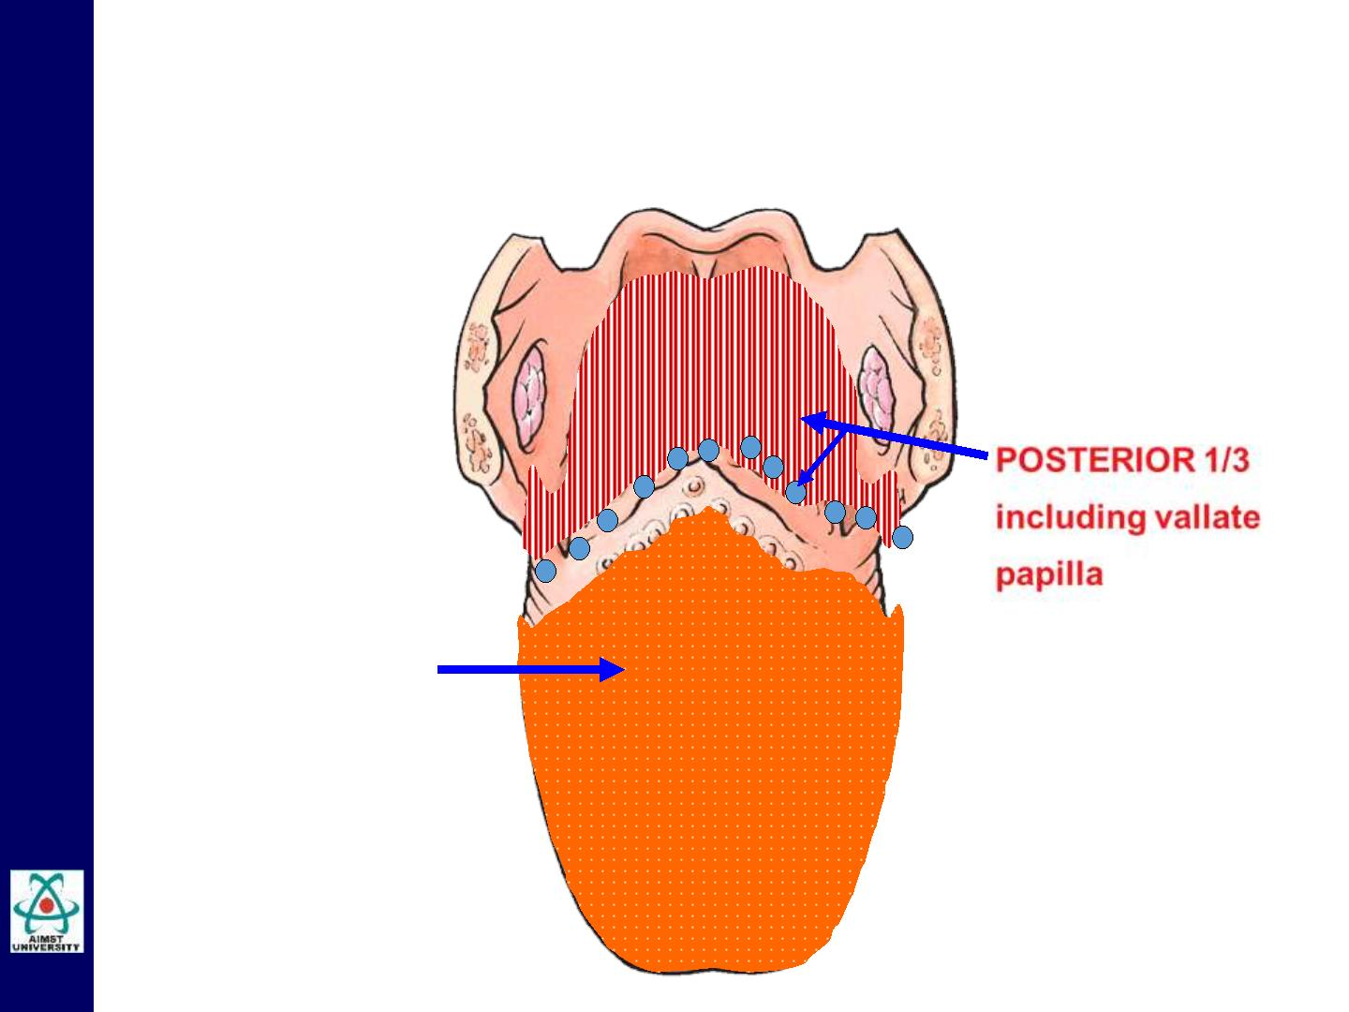
Cranial Nerve IX: Glossopharyngeal
MAJOR FUNCTIONS
Remember the
supply of the
anterior two-
thirds???
General
sensations
and taste-IX
General
sensations-V₃
Taste-VII

Slide 39
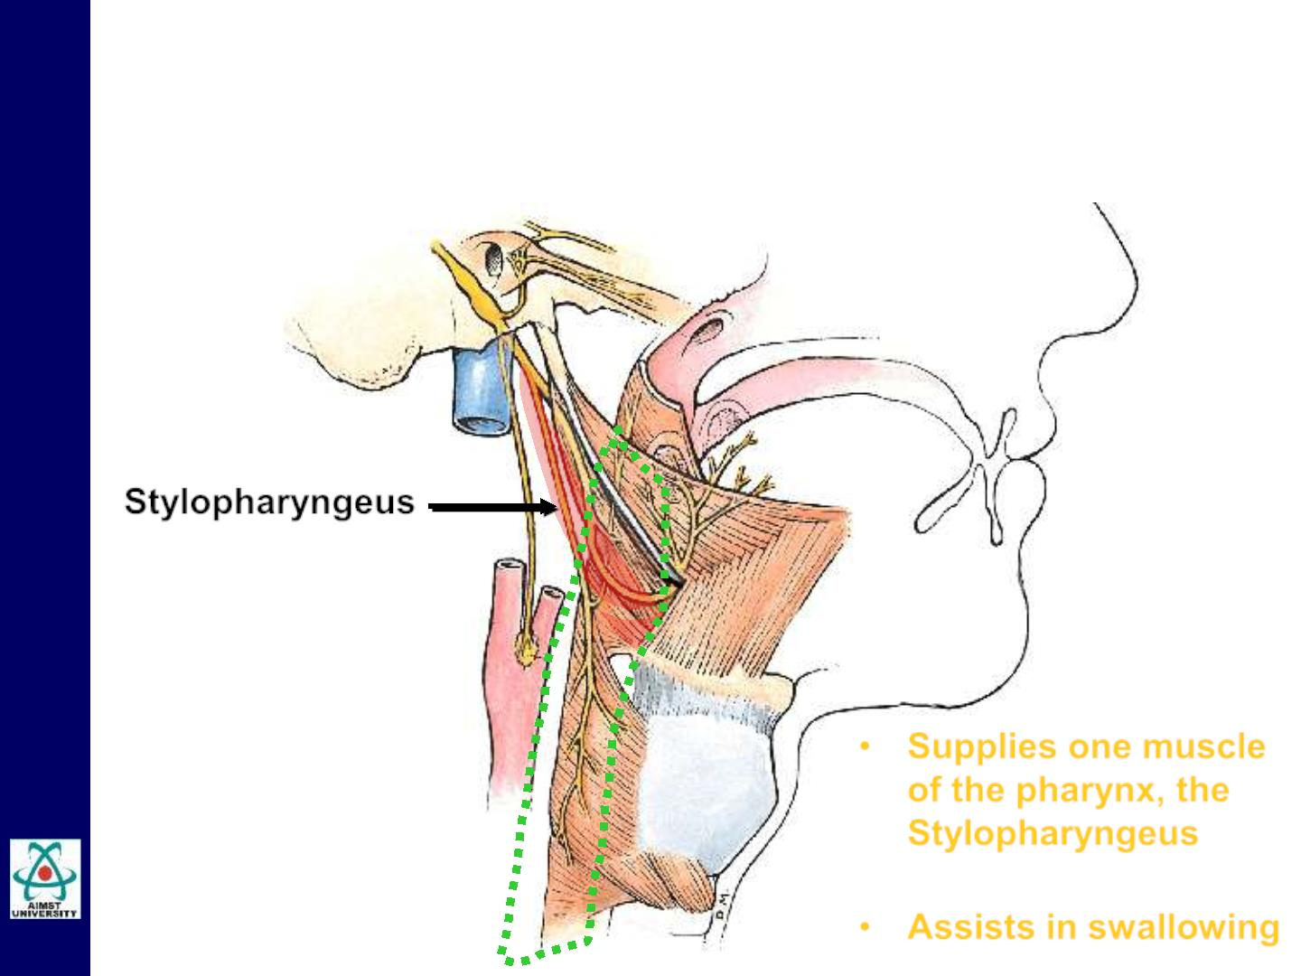
Cranial Nerve IX: Glossopharyngeal
MAJOR FUNCTIONS
Stylopharyngeus
• Supplies one muscle
of the pharynx, the
Stylopharyngeus
• Assists in swallowing

Slide 40

Cranial Nerve X: Vagus
Component #1:
Nucleus location:
Function:
Sensory
medulla
(1) chemoreceptors; (2) pain
receptors; (3) sensations; (4)
taste
Structure(s) Innervated:
(1) blood oxygen concentration,
carotid bodies; (2) respiratory &
digestive tracts; (3) external ear,
larynx & pharynx (4) tongue.

Slide 41
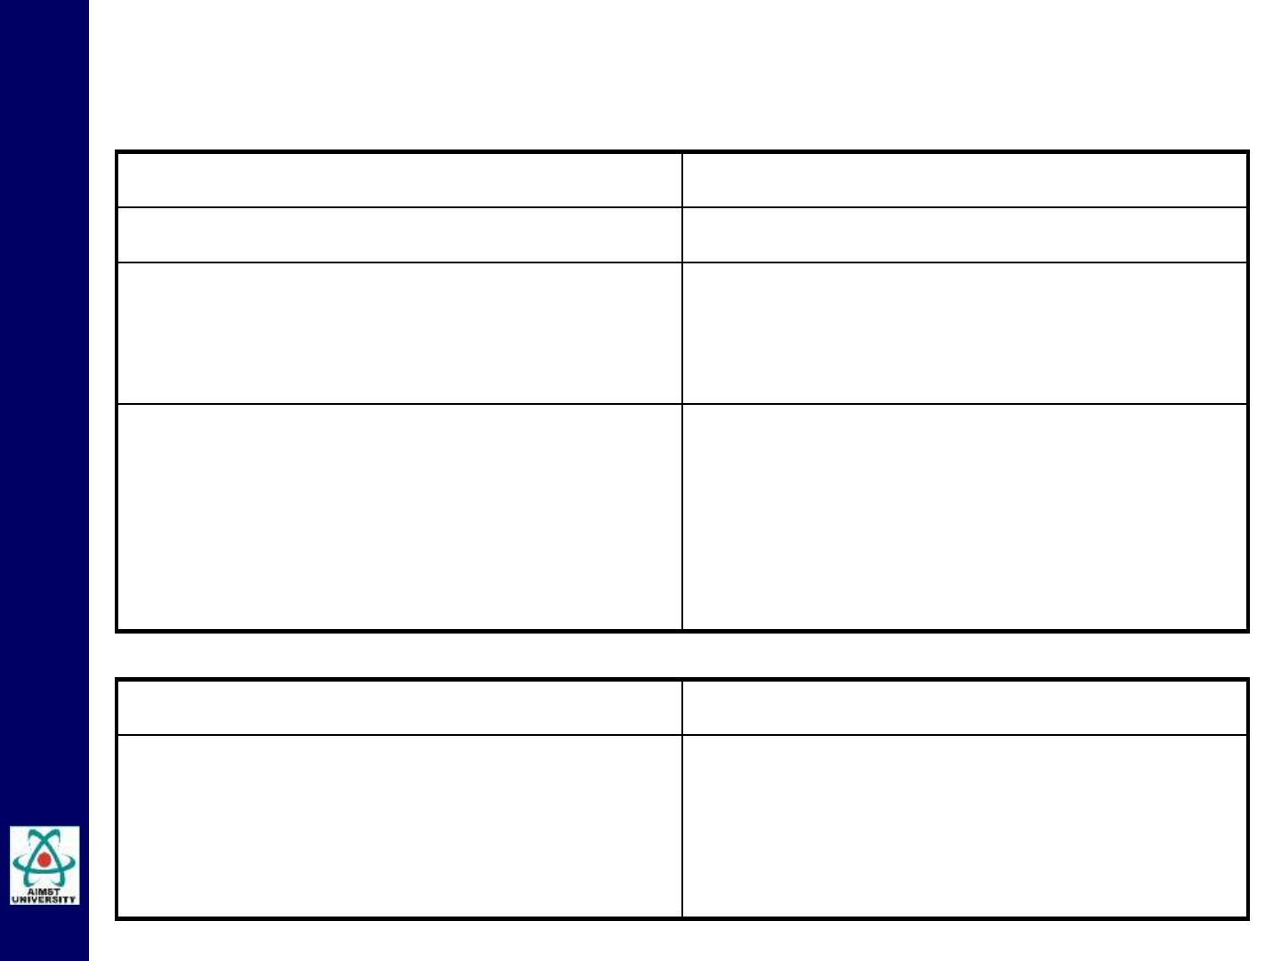
Cranial Nerve X: Vagus
Component #2:
Nucleus location:
Function(s):
Motor
medulla
(1) heart rate & stroke volume; (2)
peristalsis; (3) air flow; (4) speech
& swallowing
Structure(s) Innervated:
(1) pacemaker & ventricular
muscles; (2) smooth muscles of
the digestive tract (3) smooth
muscles in bronchial tubes (4)
muscles of larynx a & pharynx
Component #3:
Parasympathetic
Structure(s) Innervated:
smooth muscles and glands of the
same areas innervated by motor
component, as well as thoracic
and abdominal areas

Slide 42
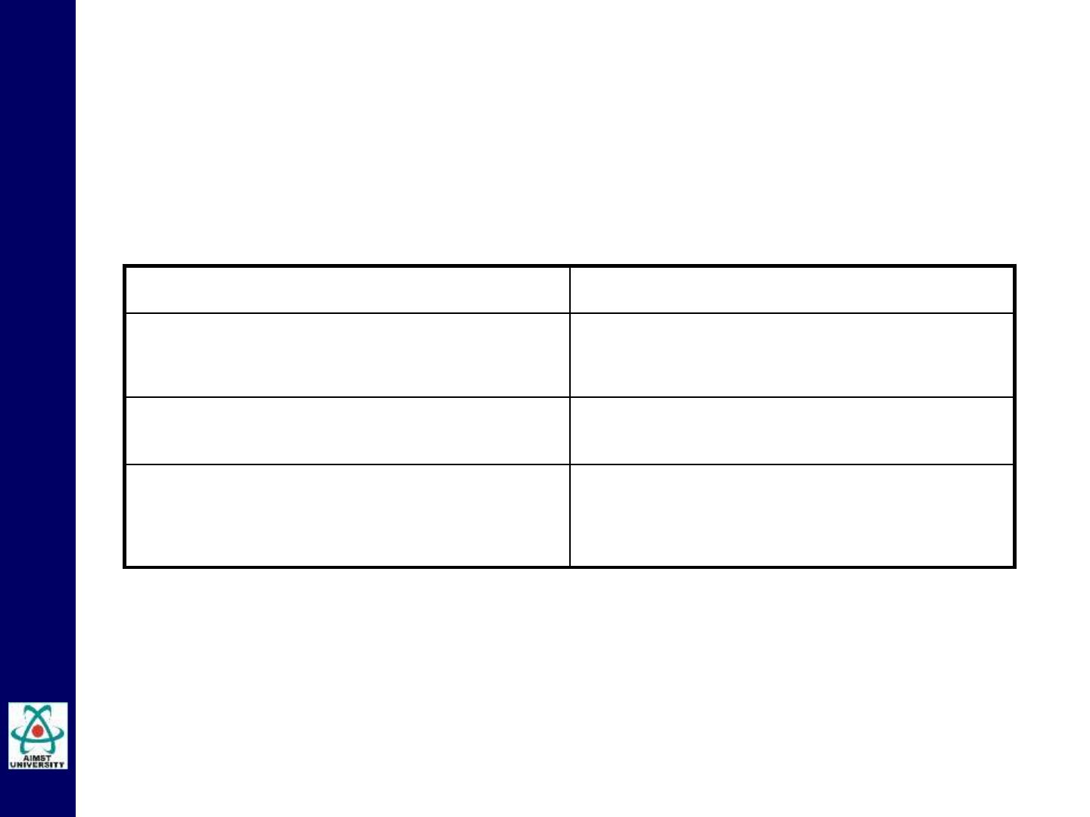
Cranial Nerve XI: Accesory
Component:
Function:
Motor
head rotation (& shoulder
shrugging!)
Nucleus location:
accessory nucleus in medulla
Structure(s) Innervated:
trapezius &
sternocleidomastoid muscles

Slide 43
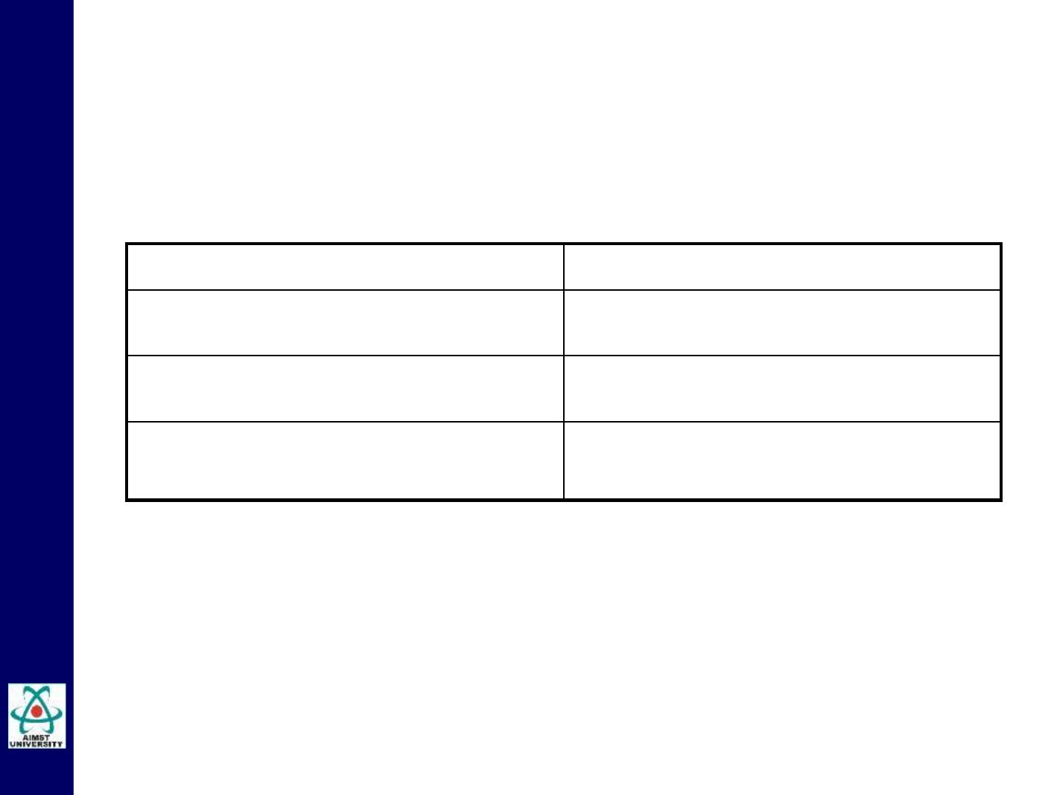
Cranial Nerve XII: Hypoglossal
Component:
Function:
Motor
Speech and swallowing
Nucleus location:
In medulla
Structure(s) Innervated:
Throat and tongue muscles

Slide 44
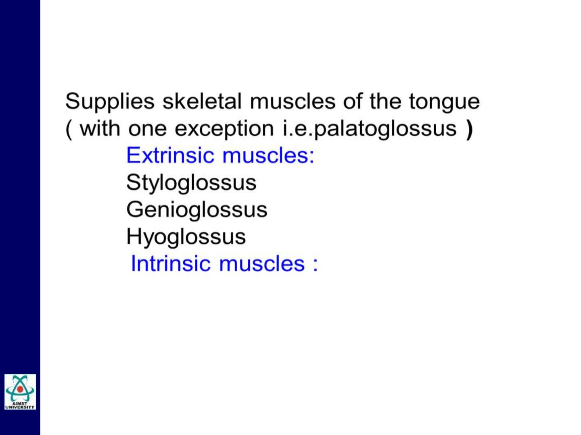
Cranial Nerve XII: Hypoglossal
MAJOR FUNCTIONS
Controls shape and movements of the tongue and
helps in mastication, speech and swallowing

Slide 45
The Cranial Nerves
Clinical Considerations

Slide 46
Cranial Nerve I: Olfactory- Clinical Considerations
• Bilateral anosmia can be caused by disease of the
olfactory mucous membrane, such as the common
cold or allergic rhinitis.
• Unilateral anosmia can result from disease affecting
the olfactory nerves, bulb, or tract.
• A lesion of the olfactory cortex on one side is unlikely
to produce complete anosmia, because fibers from
each olfactory tract travel to both cerebral
hemispheres.

Slide 47
Cranial Nerve V: Trigeminal- Clinical Considerations
• Trigeminal Neuralgia
In trigenimal neuralgia, the severe, stabbing pain over
the face is of unknown cause and involves the pain fibers
of the trigeminal nerve.
Pain is felt most commonly over the skin areas
innervated by the mandibular and maxillary divisions of
the trigeminal nerve; only rarely is pain felt in the area
supplied by the ophthalmic division.
Condition typically affect in older population.
Antiepileptic medications are the most effective agents.

Slide 48
Cranial Nerve VII: Facial- Clinical Considerations
• Bell’s Palsy
Bell palsy is a dysfunction of the facial nerve, as it lies within
the facial canal.
It is usually unilateral. The site of the dysfunction will
determine the aspects of facial nerve function that do not work.
The swelling of the nerve within the bony canal causes
pressure on the nerve fibers; this results in a temporary loss
of function of the nerve, producing a lower motor neuron type
of facial paralysis.
The affected side becomes flat and expressionless.
The cause of Bell palsy is not known; it sometimes follows
exposure of the face to a cold draft.

Slide 49
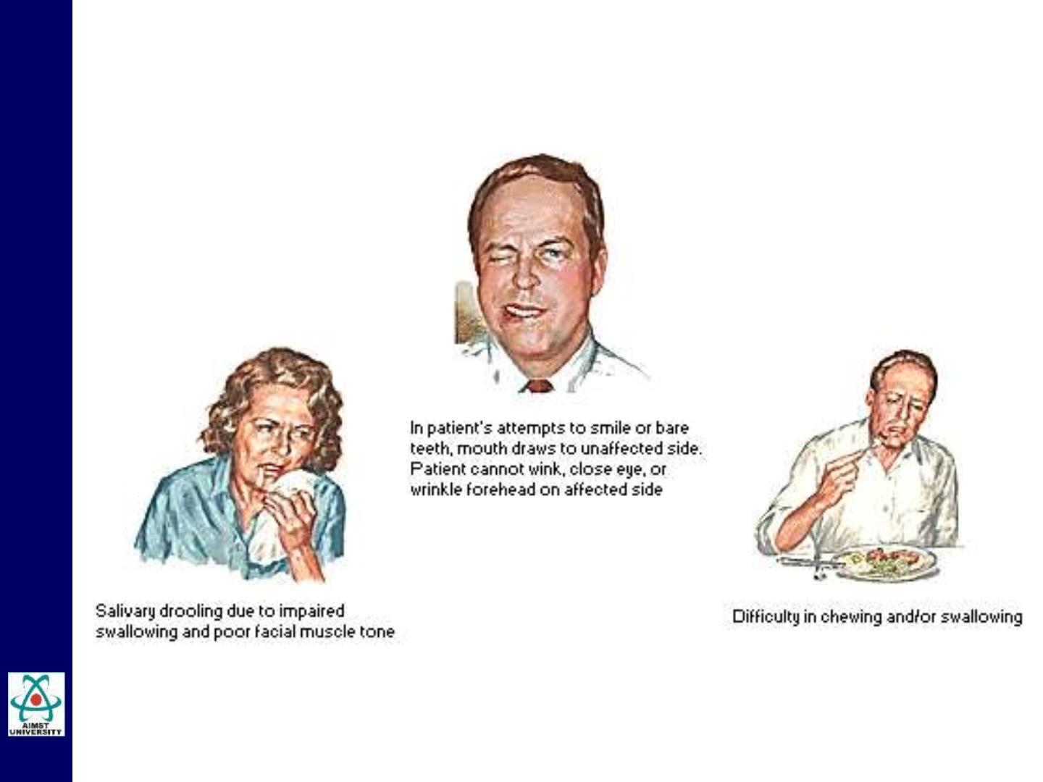
Cranial Nerve VII: Facial- Clinical Considerations
Bell’s Palsy

Slide 50
Cranial Nerve VIII: Auditory- Clinical Considerations
• Disturbance of Vestibular functions
Disturbances of vestibular nerve function include giddiness
(vertigo) and nystagmus.
Vestibular nystagmus is an uncontrollable rhythmic
oscillation of the eyes, and the fast phase is away from the
side of the lesion.
The causes of vertigo include diseases of the labyrinth, such
as Meniere's disease.
• Disturbance of Choclear functions
Disturbances of cochlear function are manifested as deafness
and tinnitus.

Slide 51
