Slide 1
ThiQar college of Medicine Family & Community medicine dept.
Family Medicine Lecture 13 post graduate-FAMCO prepared by: Dr. Muslim N. Saeed Tuesday ,January 20th,2015

Slide 2
Clinical Problem Solving
Taking care of patients requires clinical decision-making skills.
• Most physicians rely on “mindlines” formed by previous knowledge and experience.
• A lag exists between the publication of new evidence and its incorporation into clinical practice.
• Clinicians should use evidence-based medicine techniques to update their mindlines.
The foundation of these mindlines is the tacit knowledge physicians acquire during their early training.

Slide 3
For example, for a child with fever and tonsillar exudates, one physician’s mindline may be to treat with penicillin,
and another physician’s mindline may be to obtain a culture and treat if the results are positive for Streptococcus.

Slide 4
To make sound clinical decisions, the clinician must first check his or her mindline. If there are knowledge gaps in
the mindline, it can be updated by asking a focused clinical question.

Slide 5
Focusing the Question
• Identify the existence of a knowledge gap.
• Determine the information source most likely to answer the type of question.
• Develop a focused question consisting of four parts: patient’s problem, intervention, comparison intervention, and outcome of
interest.

Slide 6
Patient-oriented outcomes are always better than disease-oriented outcomes because they are direct measures rather than secondary markers.
For example, a study documenting that a new drug reduces total cholesterol by 20% (secondary marker) is important, but not as persuasive as a study documenting a decrease in cardiovascular death (direct measure).

Slide 7
Finding the Evidence
• Usefulness = (Relevance × Validity)/Work
• Conflicting evidence is often the result of “medical chatter.”
• POEMs and guidelines require the least amount of work to find relevant and valid results.

Slide 8
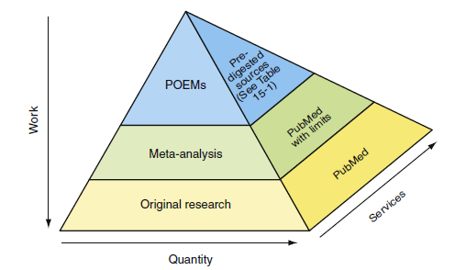

Slide 9
the work required to find useful medical information is inversely proportional to its quantity.
At the bottom of the pyramid is original research. Although plentiful, much of it represents “medical chatter” among
researchers.

Slide 10
Checking the relevance and validity of such studies requires knowledge
of statistical methods and study design. It is too time consuming to be useful for answering clinical questions that
arise during a patient visit.

Slide 11
At the next level of the pyramid are systematic reviews and meta-analyses.
Often, these types of reviews focus on disease-oriented outcomes rather than patient-oriented outcomes, potentially making them less relevant.
such as an increase in bone mineral density, may be a secondary marker for fracture risk

Slide 12
At the peak of the pyramid are patient-oriented evidence that matters (POEM) reviews.
POEMs offer the most useful type of information for answering clinical questions that arise during patient visits.
Unfortunately, a POEM does not exist for every clinical question. In these cases the
clinician must step down the pyramid until relevant information
is found.

Slide 13
Often, minimal or no reliable medical evidence is available to answer a clinical question. In these cases, practicing
clinicians must rely on their clinical experience and background medical knowledge—their mindlines.

Slide 14
Incorporating Patient Preferences
-Until the 1980s, medical decision making was physician driven.
• There has been a cultural shift from paternalistic to shared decision making.
• The degree of shared decision making depends on risk, benefit, and a patient’s preferences.
• Decision aids can help patients understand complex probabilities.

Slide 15
Increased patient participation in medical decision making is associated with increased trust, higher patient satisfaction,
and greater compliance with treatment, particularly lifestyle changes.

Slide 16
Free EBM web resources :
http://www.medicine.ox.ac.uk/bandolier/index.html
http://www.cochrane.org/
http://www.guideline.gov/

