Slide 1
ThiQar college of Medicine Family & Community medicine dept.
Foundation Lecture 8 prepared by: Dr. Muslim N. Saeed March 4th,2019

Slide 2
Complementary and Alternative Medicine

Slide 3
Definition
Complementary and alternative medicine is a group of medical practices, and products that are not considered part of conventional medicine.
There is no alternative to the proper conventional medical practice.
However, it can complement conventional medicine through relieving pain, alleviating mood, improving the quality of life .That is why the term "complementary medicine" is preferred.

Slide 4
Complementary and alternative medicine is based on multiple healing traditions practiced long before conventional medicine.
In the developed world, in contrast to developing and poor countries, many CAM practices (e.g. acupuncture, chiropractic, homeopathy…) are in the hands of physicians or authorized healthcare professionals. In the United States, half of the alternative practitioners are physicians.
Acupuncture has been practiced by an anesthetist to treat pain and primitively by old ladies for local treatment of arthritis.

Slide 5
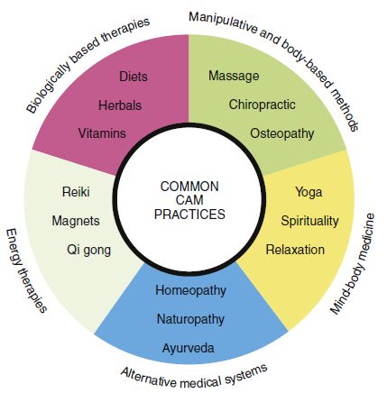

Slide 6
Acupuncture
Acupuncture is to treat patients by insertion of needles at particular points in the body (joined together as meridians).
These needles are stimulated either through manual manipulation or through passing a weak electrical current.

Slide 7
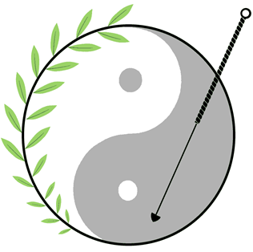

Slide 8
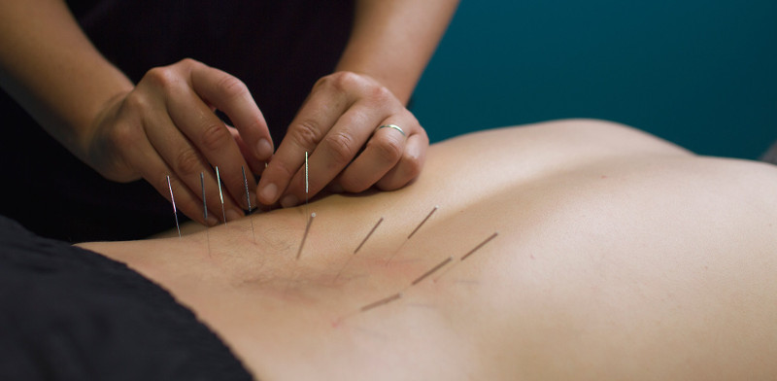

Slide 9
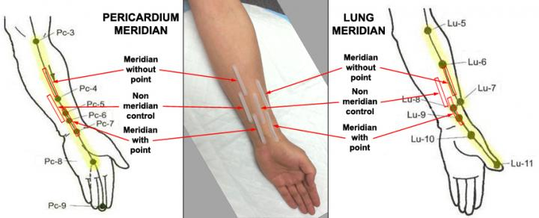
Meridians

Slide 10
Acupuncture is now practiced in different countries around the world to relieve some types of pain e.g. neck pain and also to treat postoperative nausea and vomiting, While in China, it is used to treat pain as well as different types of diseases.

Slide 11
Acupressure is applying pressure to acupuncture points e.g. through non-penetrating needles.

Slide 12
Homeopathy
Homeopathy is using highly diluted preparations of substances that can be derived from animal, plant, mineral and synthetic substances e.g. arsenic oxide, sodium chloride, venom of snake, opium and thyroid hormones.

Slide 13
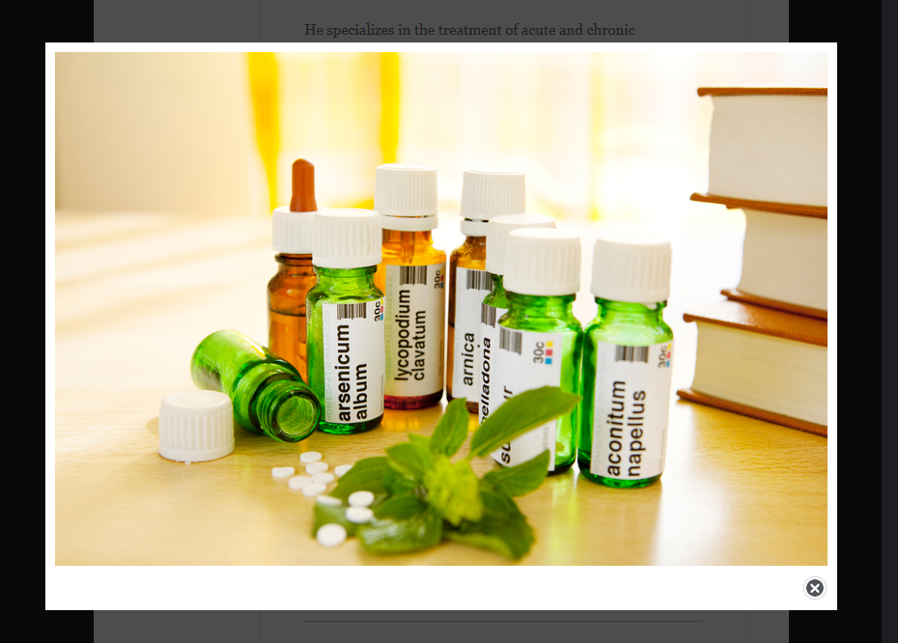
Homepathy

Slide 14
Chiropractic
Chiropractic aims to treat and prevent mechanical disorders of the musculoskeletal system especially the spine.
Spinal manipulation (spinal adjustment) is the most common treatment used in chiropractic care.

Slide 15
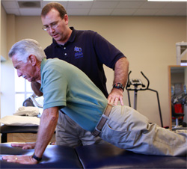

Slide 16
Many procedures are used by chiropractors for treatment of the spine, other joints. These procedures include:
1-physical fitness promotion
2-postural advice
3-relaxation
4-stress reduction

Slide 17
Chiropractic is considered the largest alternative profession behind medicine and dentistry in the U.S. A
Chiropractic found effective in treatment of low back pain, neck pain, some kinds of headaches.

Slide 18
Osteopath (Osteopathic Medicine)
There are many treatment techniques, both active and passive .
Examples of osteopathic techniques include
articulatory technique
balanced ligament tension
Many osteopaths also manage organic conditions such as asthma, menstrual pain, and pulmonary infections.

Slide 19
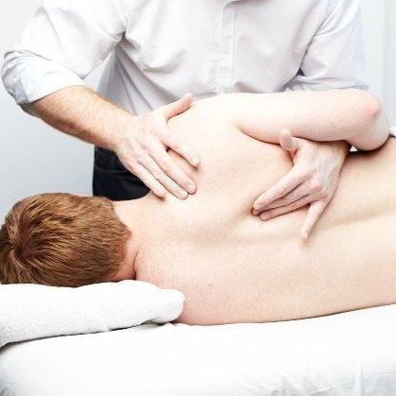

Slide 20
Holistic medicine
“Holistic medicine is the art and science of healing that addresses care of the whole person—body, mind, and spirit. The practice of holistic medicine integrates conventional and complementary therapies to promote optimal health and to prevent and treat disease by addressing contributing factors”.

Slide 21
Mind-Body Medicine
Mind-body medicine approaches may
enhance healing and optimize health. They may be recommended to most patients for health maintenance and disease management and could easily be incorporated through group visits or health coaches.

Slide 22
Spirituality
Spirituality is the feelings, thoughts, experiences, and behaviors that arise from a search for that which is generally considered sacred or holy.
Religion is the codified and ritualized beliefs and behaviors of those involved in spirituality.

Slide 23
RISKS ASSOCIATED WITH THE USE OF CAM
1- Delay in reaching a correct diagnosis. This particularly important in serious diseases such as cancer.
2- Alternative therapies are directly related to a number of adverse effects and toxicities.
3- Most of the alternative therapies are not evaluated scientifically to assess their safety.
4- Forms of alternative remedies can be a source of unwanted interactions with drugs, radiotherapy or during surgery.
5- Because there are no clear guidelines for practicing these therapies particularly in developing countries; this makes it easy for those who are unqualified to practice these alternative methods with serious consequences on the health of patients, in addition to a great financial burden on individuals as well as on the economy of the country.

Slide 24
REASONS FOR POPULARITY OF CAM DESPITE ADVANCES IN CONVENTIONAL MEDICINE
1- There are a number of diseases that are chronic in nature and so far conventional medicine fails to find a sustainable cure for them or for their complications such as certain types of arthritis, cardiovascular diseases, diabetes, cancers, allergies.
2- Critics said that modern medicine concentrates on the disease more than the patient as a whole; bodily, psychologically and socially. They claim that doctors partially trained to deal with the psychology of the patient, and are not trained to deal with the social aspects of patients.

Slide 25
3- People may feel frightened by modern medicine with its surgical operations, invasive diagnostic procedures and treatment with drugs particularly injections with all their painful, unpleasant and sometimes dangerous adverse effects.
4- The cost of some conventional diagnostic techniques, drugs and surgical interventions could be very high. These expensive diagnostic and treatment methods may force some patients to seek cheaper alternative therapies.

Slide 26
5- Alternative therapies become an industry with vigorous marketing, as a profitable trade.
6- Low level of scientific understanding among the public may have contributed to the widespread use of alternative therapies. This, in addition to the psychological effects of these therapies (placebo effect).

Slide 27
End

