Slide 1
L 2 Second lecture
د. خالد

Slide 2
Major differences between male and female
1-male is generaly thinner than female because of accumulation of fat in the subcut.tissue of the female body.
2-The boney landmarks of the ……
3-The shoulder region of the male is wider……….

Slide 3
Histologically the human body is consist of 4 basic tissue :
* Epithelial tissue
*Connective tissue C.T.
*Muscle
*Nerve

Slide 4
Anatomicaly the basic structure of the human body
1-Fascia
2-Ligament
3-Tendon
4-Cartilage
5-Bone
6-Vessel
7-Muscle
8-Nerve

Slide 5
Only 4 of these will be taken at this lecture
Fascia
Ligament
Tendon
cartilage

Slide 6
Fascia
It is a continous layer of fibrous connective tissue that arranged in sheets.
Two types of fascia
*superficial (subcut.t.) it connect……….
*deep
-femoral sheath
-retinacula

Slide 7
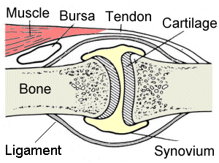

Slide 8
Ligament
Usually connect something to something else
Mostly connect bone to bone
It is a dense C.T.thicker than the fascia & devided into two types:

Slide 9
1-Thin:examples
*mesentaries
*coronary ligament of the liver
2-Thick:examples
*pattelar ligament
*ligamentum flavum

Slide 10
Tendon
It is part of muscle and always connect muscles to other structures
We have two types of tendons

Slide 11
Thick: located at the end of muscles near the insertion region e.g.calcaneus tendon and biceps tendon
Thin: (apponeurosis)

Slide 12
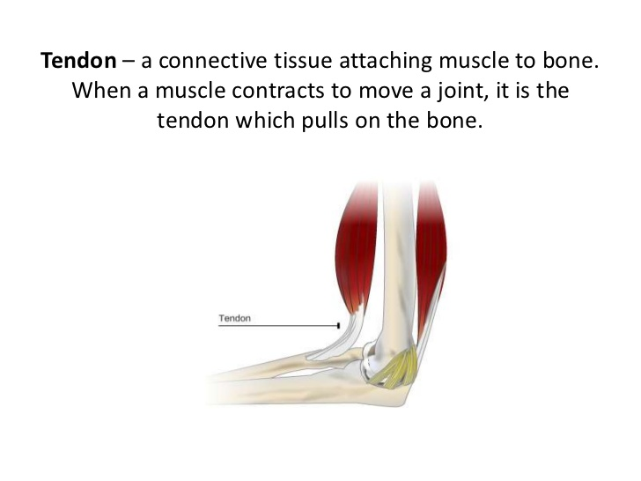

Slide 13
Cartilage
Three types
1-hyaline cartilage: found at the rings of trachea and ribs
2-fibrous cartilage: IVD,shoulder,hip and knee
3-ellastic: ENT

Slide 14
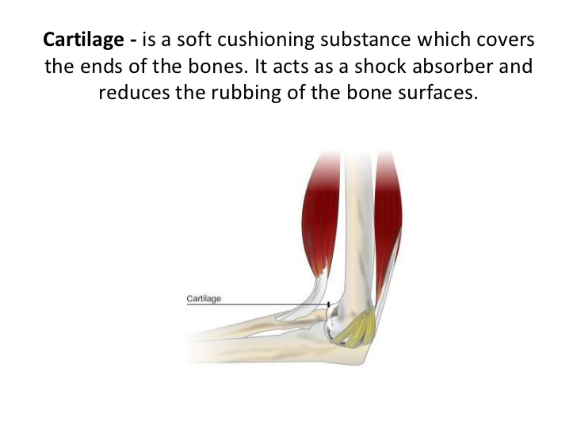
Cartilage

Slide 15
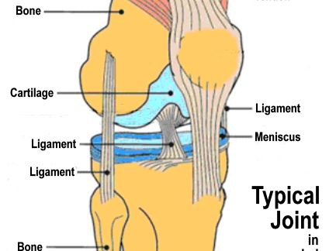

Slide 16
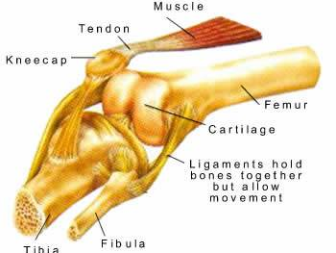

Slide 17
