Slide 1
ThiQar college of Medicine Family & Community medicine dept. Foundation Lecture 10
prepared by: Dr. Muslim N. Saeed March 18th, 2019

Slide 2
objectives
1. Identify and describe the major structures
and functions of the respiratory system.
2. Recognize, define, spell, and pronounce
terms related to the pathology and the
diagnostic and treatment procedures of
the respiratory system.

Slide 3
The respiratory system
The respiratory system brings oxygen into the body cells, and removes carbon dioxide.
Consist of :
1-The upper respiratory tract ; the nose,
mouth, pharynx, epiglottis, larynx, and trachea.
2-The lower respiratory tract; the bronchial
tree and lungs. These structures are protected by, the thoracic cavity which is also known as the rib cage.

Slide 4
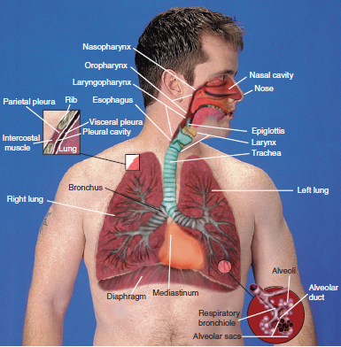

Slide 5
The Nose
Air enters the body through the nose and passes through the nasal cavity, which is the interior portion of the nose.
The Tonsils
The tonsils form a protective circle of lymphatic tissue around the entrance to the respiratory system

Slide 6
The Paranasal Sinuses
Cavities filled with air, lined with mucous membrane, are located in the bones of the skull.
The Pharynx
(FAR-inks),the throat, receives the air after it passes through the nose.

Slide 7
The Larynx
(LAR-inks), also known as the voice box, is a
triangular chamber located between the pharynx and the trachea.
The larynx is protected by a cartilages. The thyroid cartilage is the largest, it is commonly known as Adam’s apple.
-The larynx contains the vocal cords . During speech, they close together, and sound is produced, causing the cords to vibrate
against each other.

Slide 8
The epiglottis (ep-ih-GLOT-is), which is a lid-like structure located at the base of the tongue, swings and closes off so that food does not enter the trachea and the lungs.
The Trachea
(TRAY-kee-ah), commonly known as the
windpipe, is the tube located in front of the esophagus that extends from the neck to the chest.

Slide 9
The Bronchi
(BRONG-kye) are formed where the trachea
divides into two branches known as the primary bronchi
(singular, bronchus). Like an inverted tree, this is referred to
as the bronchial tree with one branch going into each lung.
-Within the lung, each primary bronchus divides and
subdivides into smaller bronchioles (BRONG-kee-ohlz), which are the smallest branches of the bronchi.
The Alveoli
(al-VEE-oh-lye), also known as air sacs, are the
very small grape-like clusters found at the end of each
bronchiole (singular, alveolus). Each lung contains
millions of alveoli that are filled with air from the
bronchioles .

Slide 10
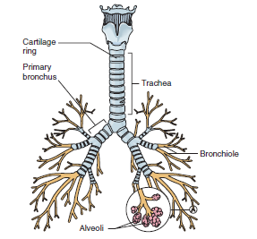
bronchial tree

Slide 11
The Lungs
are the organs of respiration, are divided into lobes. A lobe is a subdivision or part of an organ.
-The right lung has three lobes: the superior, middle, and inferior.
-The left lung has only two lobes: the superior and inferior. It is slightly smaller than the right lung because of the space taken up by the heart.

Slide 12
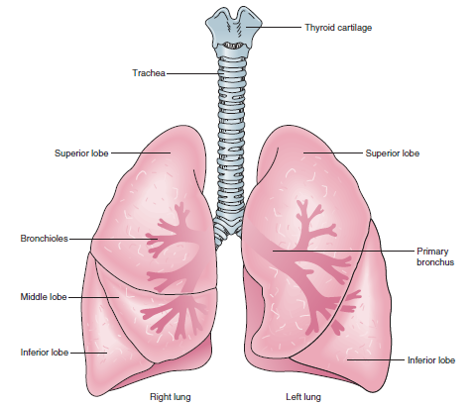

Slide 13
The Mediastinum
(mee-dee-as-TYE-num) is the cavity located between the lungs.
The Pleura
(PLOOR-ah) is a thin, moist membrane that covers the outer surface of the lungs and lines the inner surface of the rib cage.
I-The parietal pleura (pah-RYE-eh-tal) is the outer layer of the pleura that lines the walls of the thoracic cavity, Parietal means relating to the walls of a cavity.
II-The visceral pleura (VIS-er-al) is the inner layer of
pleura that surrounds each lung. Visceral means
relating to the internal organs.

Slide 14
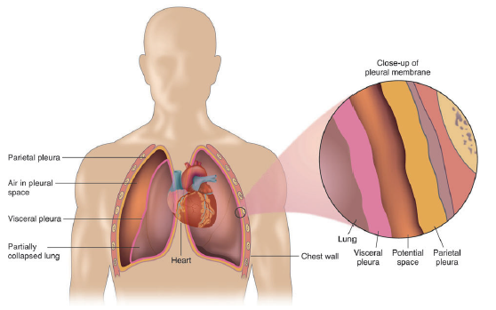

Slide 15
The Diaphragm
(DYE-ah-fram) is the muscle that separates the thoracic cavity from the abdomen . the contraction and relaxation of this muscle that makes breathing possible.

Slide 16
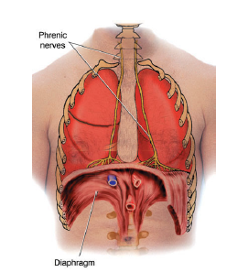
The Diaphragm

Slide 17
MEDICAL SPECIALTIES RELATED TO THE RESPIRATORY SYSTEM
Otolaryngologist:(oh-toh-lar-in-GOL-oh-jist), also known as an ENT, is a physician specialized in the diagnosis and treatment of diseases of the ears, nose, throat, (ot/o means ear, laryng/o means larynx, and -ologist means specialist).
-A pulmonologist (pull-mah-NOL-oh-jist) is a physician who specializes in diagnosing and treating diseases of the lungs (pulmon
means lung, and -ologist means specialist).

Slide 18
Diseases of respiratory system
Chronic obstructive pulmonary disease, also known as COPD, is a lung disease in which it is hard to breathe.
Most people with COPD, who are usually smokers or former smokers.
Chronic Bronchitis
(brong-KYE-tis), the airways have become inflamed and thickened,(bronch means bronchus, and -itis means inflammation). This results in excessive mucus production, which causes coughing and difficulty getting air in and out of the lungs.
Emphysema
(em-fih-SEE-mah) is the progressive loss of lung function

Slide 19
Asthma (AZ-mah) is a chronic allergic disorder with episodes of severe breathing difficulty, coughing, and wheezing.
Wheezing is a breathing sound caused by a partially obstructed airway.
A bronchospasm (brong-koh-spazm) is a contraction of the smooth muscle in the walls of the bronchi and bronchioles(bronch/o means bronchi, and -spasm means involuntary
contraction).

Slide 20
common cold is an upper respiratory infection can be caused by different viruses.
Allergic rhinitis (rye-NIGH-tis),is an allergic reaction to airborne allergens (rhin means nose, and -itis means inflammation).

Slide 21
Epistaxis (ep-ih-STACK-sis), is bleeding from the nose.
-Influenza (in-flew-EN-zah), also known as the flu, is an acute, highly contagious viral respiratory infection.
Rhinorrhea (rye-noh-REE-ah), also known as a runny nose, is the watery flow of mucus from the nose (rhin/o means nose, and -rrhea means abnormal discharge).
Sinusitis (sigh-nuh-SIGH-tis) is an inflammation of the sinuses.

Slide 22
Pharynx and Larynx
Pharyngitis (fah-rin-JIGH-tis), also known as a sore throat, is an inflammation of the pharynx (pharyng means pharynx, and -itis means inflammation).
Laryngitis (lar-in-JIGH-tis) is an inflammation of the larynx (laryng means larynx, and -itis means inflammation

Slide 23
Voice Disorders
Aphonia (ah-FOH-nee-ah) is the loss of the ability of normal speech sounds (a- means without, phon means voice or sound, and -ia means abnormal condition).
Dysphonia (dis-FOH-nee-ah) is any change in voice quality,(dys- means bad, phon means voice or sound, and -ia means abnormal condition).

Slide 24
Pleural Cavity
Pleurisy (PLOOR-ih-see), also known as pleuritis, is an inflammation of the pleura (pleur means pleura, and -isy is a noun ending).
Pneumothorax (new-moh-THOR-racks) is the accumulation of air in the pleural space (pneum/o means lung or air, and -thorax means chest).
Hemothorax ….. ?

Slide 25
Pleural effusion (eh-FEW-zhun) is accumulation of fluid in the pleural space.
Hemoptysis (hee-MOP-tih-sis) is coughing up of blood or bloodstained sputum(hem/o means blood, and -ptysis means spitting).
Pyothorax (pye-oh-THOH-racks) is the presence of pus in the pleural cavity(py/o means pus, and -thorax means
chest). This condition is also known as empyema(em-pye-EE-mah).

Slide 26
Atelectasis (at-ee-LEK-tah-sis) is the collapse of part or all of a lung (atel means incomplete, and –ectasis means enlargement).
Pulmonary edema (eh-DEE-mah) is an accumulation of fluid in lung tissues. Edema means swelling.

Slide 27
Tuberculosis (too-ber-kew-LOH-sis) (TB), which is an infectious disease caused by Bacteria, it can also affect other parts of the body.
Pneumonia (new-MOH-nee-ah) is an infection or inflammation of the lungs in which the smallest bronchioles
and alveoli fill with pus and other liquid (pneumon means lung, and -ia means abnormal condition).

Slide 28
Pneumoconiosis (new-moh-koh-nee-OH-sis) is fibrosis of the lung tissues caused by dust in the lungs, (pneum/o means lung, coni means dust, and -osis means abnormal condition or disease).
Apnea (AP-nee-ah) is the absence of spontaneous respiration (a- means without and -pnea means
breathing).
Tachypnea (tack-ihp-NEE-ah) is rapid rate of respiration usually more than 20 breaths per minute (tachy-means rapid, and –pnea means breathing).
Tachypnea is the opposite of bradypnea(less than 10 breaths per minute).

Slide 29
Dyspnea (DISP-nee-ah), also known as shortness of breath (SOB), is difficult breathing (dys means difficult, and -pnea means breathing).
Cyanosis (sigh-ah-NOH-sis) is a bluish discoloration of the skin caused by a lack of oxygen (cyan means blue, and -osis means abnormal condition).
Hypoxia (high-POCK-see-ah) is below-normal oxygen levels in the body tissues and cells, (hyp- means deficient, ox means oxygen, and -ia means abnormal
condition).

Slide 30
End

