Slide 1
ThiQar college of Medicine Family & Community medicine dept.
Foundation lecture 11 prepared by: Dr. Muslim N. Saeed April 1st ,2019

Slide 2
INFORMATION AND COMMUNICATION TECHNOLOGY IN MEDICINE

Slide 3
Information and Informatics
Information Technology is the use of hardware, software, services, to manage information.
Informatics is the scientific field that deals with biomedical information, data and knowledge for optimal use for problem-solving and decision-making.

Slide 4
Innovative Use of Learning Technologies:
An Information Technology-enabled educational environment.
1.Easy technology support.
2.Investment in simulation technologies.
3.Continuous evaluation and improvement.
4.Training educators to use IT successfully
5.Life-long learning and knowledge access skills.

Slide 5
ICT changing the future of Health
The key developments in health care in last 25 years are the inclusion of information and communications technologies.
ICT have changed the ways in which medicine is practiced and taught.

Slide 6
Internet changing the future:
What is the Internet?
-The largest network of networks in the world.
-Uses TCP/IP protocols and packet switching.
-Runs on any communications substrate.

Slide 7
Power of Internet
-A network of networks, joining many government, university and private computers together and providing an infrastructure for the use of E-mail, bulletin boards, file archives , text, documents, databases and other resources.

Slide 8
Internet and Digital divide
• The digital divide is the gap between people with effective access to digital and information technology, and those with very limited or no access at all.

Slide 9
Information and Communication Technology rapidly changing the world
• Information and Communication Technology or ICTs [allow users to participate in a rapidly changing world.

Slide 10
The importance of information literacy
Information literacy is defined as knowledge and mastery of technical tools that facilitate access to information (websites, databases, etc.) to find solutions to problems.

Slide 11
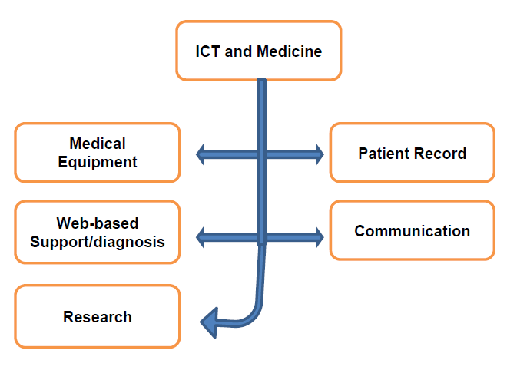

Slide 12
1.Web-based support/diagnosis
• On the internet you can find variety of medical information, including:
-Symptom diagnosis, for people who wish to identify their problem without consulting a Doctor.
-Information about available treatments/alternative therapies.
-Support groups for people suffering from particular conditions
-Access to medical research/journals Information about side effects.

Slide 13
2.Helps the Medical Professionals and Patients
-As medical professionals become more specialized, diagnosis and treatment occur in cooperation between different physicians.
-They also be able to communicate about their patients, to talk freely about medical data and refer to that data during their discussion.

Slide 14
3.Helps the Physicians to cope up with knowledge explosion
• The medical knowledge increases at an amazing pace. Physicians are required to keep up with new knowledge for their whole life. To ensure the quality of diagnosis and treatment, special emphasis on continuous education is needed.

Slide 15
Telemedicine:
• The development of mobile communications, teleconferencing.
• Internet has been of benefit in healthcare delivery. By this revolution, differences between medical specialists, medical Centers and patients have been eliminated. ICTs permit valuable Professional expertise to be made available to remote areas.

Slide 16
Continuing Medical Education supported by E-learning
-One of the key challenges facing medical faculties is to introduce e-learning into initial and continuous training programs.
-Users of e-learning can proceed at their own pace, in the way that best suits them.

Slide 17
E-medicine
• Medical equipment is becoming increasingly more sophisticated as a result of advances in ICTs.
However, they require certain economies of scale for their effective usage.
Tele- radiology offers an effective means for achieving this by giving wider access to diagnostic equipment.

Slide 18
E-learning is Multidimensional
• E-learning adds many dimensions to the educational process to enhance both the students and instructors educational experience.

Slide 19
Challenges to Medical Professionals
Patients, are increasingly using the Internet, and sometimes appear to know more about their diseases than their physicians.

Slide 20
Medical Professionals to be well communicated
• Which is closely linked to raise awareness among physicians in training of the benefits of using ICT to improve the quality of interventions and health care delivery.

Slide 21
The Third challenge
• To motivate medical students and practitioners to use ICT to find information, learn and develop.
It is proposed that information literacy should be a mandatory skill for all medical students.

Slide 22
3D animations helps faster learning
• Although underemployed in most medical faculties, it represents the future of initial and continuous medical training. Virtual resources and communities, simulations and 3D animations.

Slide 23
E-learning to Medical Professionals
• Information literacy should be considered as a mandatory skill in the training of all physicians.
• E-learning, represents the future of initial and continuous medical training.

Slide 24
institutes and colleges should be equipped with:
• Tools such as virtual simulators, 3D animations, that will have a growing impact on medical education and practice.

Slide 25
On line learning in Medical Education
• The use of online learning provides solutions that can overcome some problems with traditional education, especially in the area of medicine.

Slide 26
New technologies helps in
• To optimize Patient care.
• To establish a true longitudinal Patient record.
• To maximize the amount of medical data.

Slide 27
Helps in early decision making
• To develop a Point of Care handheld device and support architecture to improve military health care by improving medical decision making and reducing errors beginning at the first responder level.

Slide 28
Information technology limits the Patient – Doctor Relationship:
• The traditional and humanistic concept of doctor-patient relationship is also under threat as IT is used to bypass the need for personal consultations.

Slide 29
Harms of Information technology in Medicine
• One of the potential harms caused by indiscriminate use of IT is information overload and, misinformation. Both can paralyse and impair the patients' decision-making capacity. The flood of accessible but unverified information on the world-wide-web is a cause for concern.

Slide 30
End

