Slide 1
ThiQar college of Medicine Family & Community medicine dept.
Foundation lecture 13 prepared by: Dr. Muslim N. Saeed April 15th ,2019

Slide 2
objectives
On completion of this lecture, you should be able to:
1. Name and describe the structures of the
urinary system.
2. Recognize, define, spell, and pronounce
terms related to the pathology and the diagnostic and treatment procedures of the urinary system.
3. spell, and pronounce terms related to the pathology and the diagnostic and treatment procedures of the urinary system.

Slide 3
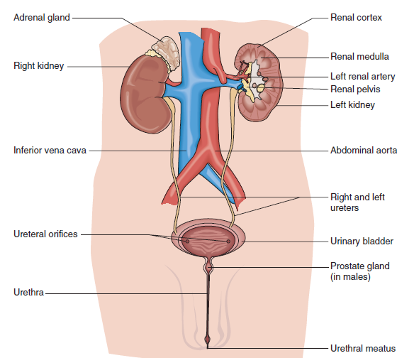
STRUCTURES OF THE URINARY SYSTEM
The urinary system, also referred to as the urinary tract, consists of two kidneys, two ureters, one bladder, and a urethra
The adrenal glands, which are part of the endocrine system, are located on the top of the kidneys.

Slide 4
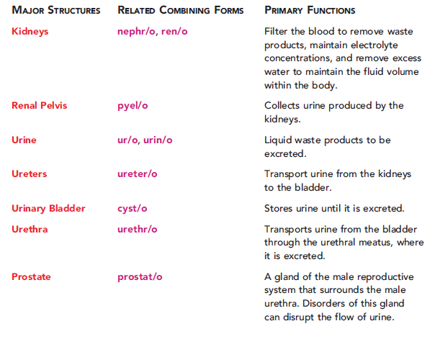

Slide 5
The Kidneys
-The term renal (REE-nal) means pertaining to the kidneys (ren means kidney or kidneys, and -al means pertaining to).
-The renal cortex (REE-nal KOR-tecks) is the outer region of the kidney. It contains over one million microscopic units called nephrons.
-The cortex is the outer portion of an organ.
-The medulla (meh-DULL-ah) is the inner region of the
kidney; it contains most of the urine-collecting tubules.
-A tubule is a small tube.
-A nephron (NEF-ron) is a functional unit of the kidney.

Slide 6
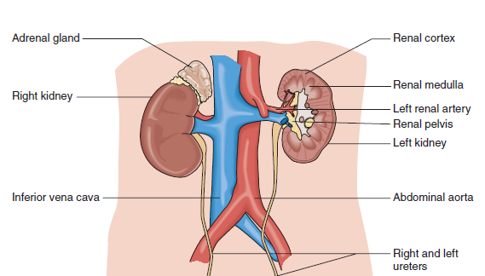
The Kidneys

Slide 7
-Each nephron contains a glomerulus (gloh-MER-youlus), which is a cluster of capillaries
-The renal pelvis is the funnel-shaped area within each kidney that is surrounded by renal cortex and medulla.
-This is where the newly formed urine collects before it flows into the ureters.

Slide 8
-The ureters (you-REE-ters) are two narrow tubes, each about 10–12 inches long, which transport urine from the kidney to the bladder.
-The urinary bladder is a hollow muscular organ that is a reservoir for urine before it is excreted from the body
-The urethra (you-REE-thrah) is the tube extending from the bladder to the outside of the body.
Caution: The spellings of ureter and urethra are very similar!

Slide 9
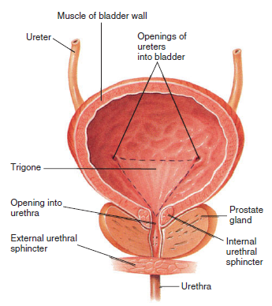

Slide 10
A nephrologist (neh-FROL-oh-jist) is a physician who specializes in diagnosing and treating diseases and disorders of the kidneys (nephr means kidney, and -ologist means specialist).
-A urologist (you-ROL-oh-jist) is a physician who
specializes in diagnosing and treating diseases and
disorders of the urinary system of females and the
genitourinary system of males (ur means urine, and
-ologist means specialist).
-The term genitourinary refers to both the genital and urinary organs.

Slide 11
Renal failure, also known as kidney failure, is the
inability of one or both of the kidneys to perform their functions.
Uremia (you-REE-mee-ah), also known as uremic
poisoning, is a toxic condition resulting from renal failure (ur means urine, and -emia means blood condition).

Slide 12
Nephrotic syndrome (neh-FROT-ick) is a condition in which protein are lost in the urine (nephr/o means kidney, and -tic means pertaining to).
Nephrosis (neh-FROH-sis) is degenerative kidney
disease (nephr means kidney, and -osis means abnormal condition or disease).

Slide 13
-Anuria (ah-NEW-ree-ah) is the absence of urine formation by the kidneys (an- means without, and -uria means urine).
-Edema (eh-DEE-mah) is excessive fluid in the body tissues.
-Hyperproteinuria (high-per-proh-tee-in-YOU-ree-ah) is the presence of high concentrations of
protein in the urine (hyper- means excessive, protein means protein, and -uria means urine).

Slide 14
The term nephropathy (neh-FROP-ah-thee) means any disease of the kidney (nephr means kidney, and –pathy means disease).
Hydronephrosis (high-droh-neh-FROH-sis) is the dilation of one or both kidneys (hydr/o means
water, nephr means kidney, and -osis means abnormal condition or disease).

Slide 15
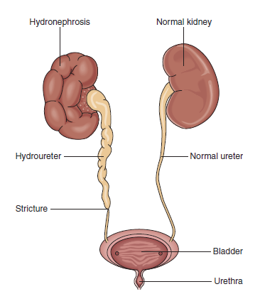
Hydronephrosis

Slide 16
Glomerulonephritis (gloh-mer-you-loh-neh-FRY-tis):
is a type of kidney disease caused by inflammation of the glomeruli (glomerul/o means glomeruli, nephr means
kidney, and -itis means inflammation).
Polycystic kidney disease (pol-ee-SIS-tick) is a genetic
disorder characterized by the growth of numerous
fluid-filled cysts in the kidneys (poly- means many, cyst
means cyst, and -ic means pertaining to).
Renal colic (REE-nal KOLL-ick) is an acute pain in the
kidney area.
Colic means spasmodic pains in the abdomen.

Slide 17
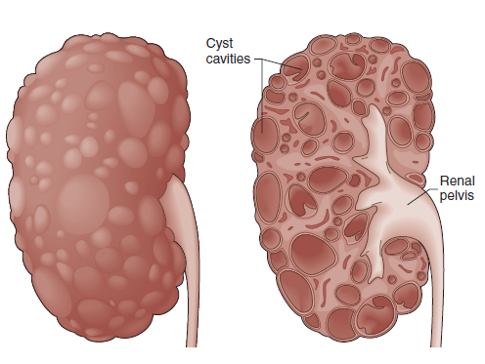
Polycystic kidney disease

Slide 18
-nephrolith (NEF-roh-lith), also known as renal
calculus or a kidney stone, is found in the kidney. (nephr/o means kidney, and -lith means stone).
-ureterolith (you-REE-ter-oh-lith) is a stone located
along the ureter (ureter/o means ureter, and
-lith means stone).
-cystolith (SIS-toh-lith) is a stone located within the urinary bladder (cyst/o means bladder, and –lith means stone).

Slide 19
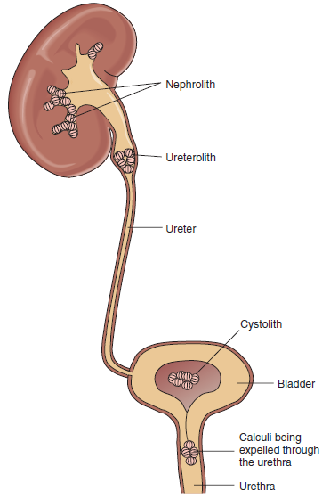

Slide 20
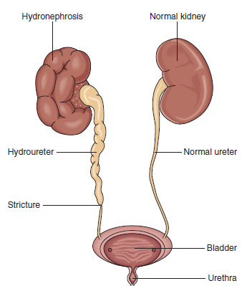
Hydroureter (high-droh-you-REE-ter) is the distention of the ureter with urine that cannot flow because the ureter is blocked (hydr/o means water, and –ureter means ureter)

Slide 21
Urinary Tract Infections
-A urinary tract infection (UTI) infections can affect all, or parts, of the urinary system
-Urethritis (you-reh-THRIGH-tis) is an inflammation of the urethra (urethr means urethra, and -itis means inflammation).
-Cystitis (sis-TYE-tis) is an inflammation of the bladder (cyst mean bladder, and -itis means inflammation).

Slide 22
Urinary Tract Infections
-Pyelitis (pye-eh-LYE-tis) is an inflammation of the
renal pelvis (pyel means renal pelvis, and -itis means inflammation).
-Pyelonephritis (pye-eh-loh-neh-FRY-tis) is an inflammation of both the renal pelvis and of the kidney (pyel/o means renal pelvis, nephr means kidney, and –itis means inflammation).

Slide 23
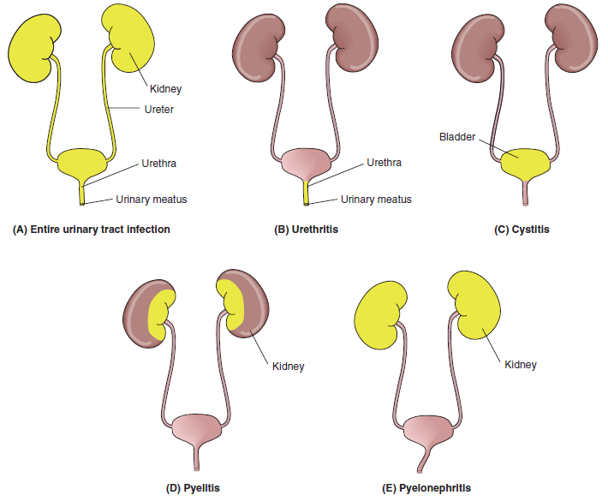

Slide 24
-Benign prostatic hypertrophy (pros-TAT-ick high-
PER-troh-fee), also known as an benign prostatic
hyperplasia, enlarged prostate, is an abnormal enlargement of the prostate gland.
-Prostate cancer is one of the most common cancers among men.
-Prostatitis (pros-tah-TYE-tis) is an inflammation of the prostate gland (prostat means prostate gland, and –itis means inflammation).

Slide 25
-Dysuria (dis-YOU-ree-ah) is difficult or painful urination (dys- means painful, and -uria means urination).
-Enuresis (en-you-REE-sis) is the involuntary discharge of urine (en- means into, and -uresis means urination).
-Nocturnal enuresis (nock-TER-nal en-you-REE-sis) is urinary incontinence during sleep. It is also known as bed-wetting.
-Nocturnal means pertaining to night.

Slide 26
-Nocturia (nock-TOO-ree-ah) is excessive urination during the night (noct means night, and -uria means urination).
-Oliguria (ol-ih-GOO-ree-ah) means scanty urination (olig means scanty, and -uria means urination).
-Polyuria (pol-ee-YOU-ree-ah) means excessive urination (poly- means many, and -uria means urination).
-Polyuria is the opposite of oliguria

Slide 27
Urinary retention is the inability to empty the bladder.
This condition is also more common in men, and is associated with an enlarged prostate gland.
-Incontinence (in-KON-tih-nents) means the inability to control the excretion of urine and feces.
-Urinary incontinence is the inability to control the voiding of urine.

Slide 28
-Urinalysis (you-rih-NAL-ih-sis) is the examination of urine to determine the presence of abnormal elements (urin means urine, and -analysis means a study of the parts).
-A KUB (Kidneys, Ureters, Bladder) is a radiographic study of these structures.
-Catheterization (kath-eh-ter-eye-ZAY-shun) is the insertion of a tube into the bladder to remove urine when the patient is unable to urinate.

Slide 29
-Cystography (sis-TOG-rah-fee) is a radiographic examination of the bladder after instillation of a contrast(cyst/o means bladder, and -graphy means the process of creating a picture or record).
The resulting film is a cystogram.
-Cystoscopy (sis-TOS-koh-pee) is the visual examination of the urinary bladder using a cystoscope (cyst/o means bladder, and -scopy means visual examination).
-An intravenous pyelogram (in-trah-VEE-nus PYE-ehloh- gram), is a radiographic study of the kidneys and ureters (pyel/o means renal pelvis, and -gram means a picture or record).
A contrast medium is administered intravenously to clearly define these structures in the resulting image.

Slide 30
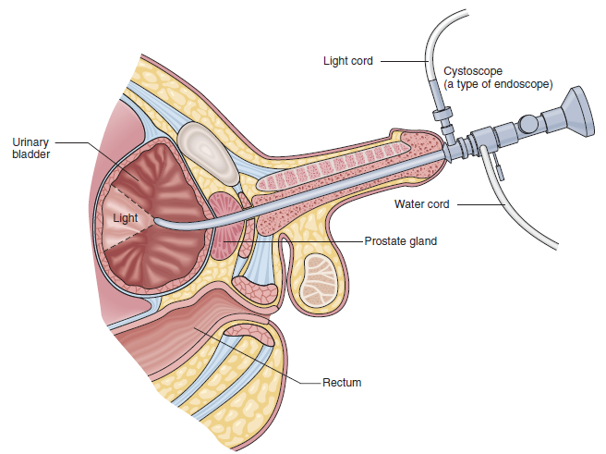
Cystoscopy

Slide 31
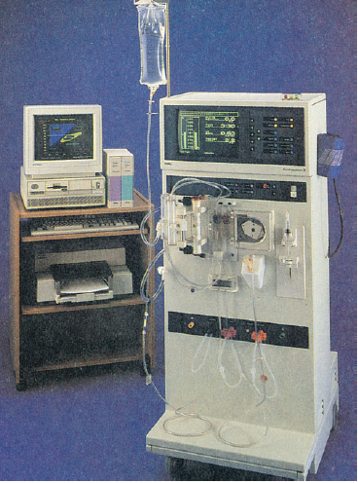
Dialysis
Dialysis (dye-AL-ih-sis) is a procedure to remove waste products from the blood of a patient whose kidneys no
longer function (dia- means complete , and -lysis means separation).

Slide 32
A nephrolithotomy (nef-roh-lih-THOT-oh-mee) is the surgical removal of a nephrolith (kidney stone) through an incision in the kidney (nephr/o means kidney, lith means stone, and -otomy means surgical incision).
-A percutaneous nephrolithotomy (per-kyou-TAY-nee-us nef-roh-lih-THOT-oh-mee) is performed by making a small incision in the back to crush and remove a kidney stone.
Percutaneous means performed through the skin.

Slide 33
-A ureterectomy (you-ree-ter-ECK-toh-mee) is
the surgical removal of a ureter (ureter means ureter, and -ectomy means surgical removal).
-Ureteroplasty (you-REE-ter-oh-plas-tee) is the surgical repair of a ureter (ureter/o means ureter, and –plasty means surgical repair).
-Ureterorrhaphy (you-ree-ter-OR-ah-fee) is the surgical suturing of a ureter (ureter/o means ureter, and -rrhaphy means surgical suturing).

Slide 34
-A cystectomy (sis-TECK-toh-mee) is the surgical removal of the urinary bladder (cyst means bladder, and -ectomy means surgical removal).
-A lithotomy (lih-THOT-oh-mee) is a surgical
incision for the removal of a stone from the
bladder (lith means stone, and -otomy means surgical incision).
-This term (lithotomy)also is used to describe a physical examination position.

Slide 35
-Catheterization is performed to withdraw urine from the bladder.
A prostatectomy (pros-tah-TECK-toh-mee) is the
surgical removal of the prostate gland.
(prostat means prostate, and -ectomy means surgical removal).

Slide 36
End

