Slide 1
ThiQar college of Medicine
Family & Community medicine dept.
Foundation lecture 14
prepared by: Dr. Muslim N. Saeed
May 6th ,2019

Slide 2
Objectives
1. Describe the functions and structures of the nervous system.
2. Identify the major divisions of the nervous system and describe the structures by location and function.
3. Identify the medical specialists who treat disorders of the nervous system.
4. Recognize, define, spell, and pronounce terms related to the pathology and the diagnostic and treatment procedures of the nervous system.
5. Recognize, define, spell, and pronounce terms related to the pathology and the diagnostic and treatment procedures of mental health disorders.

Slide 3
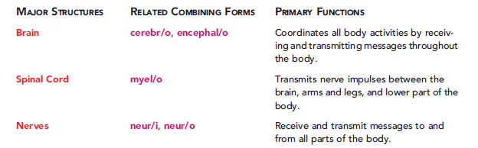

Slide 4
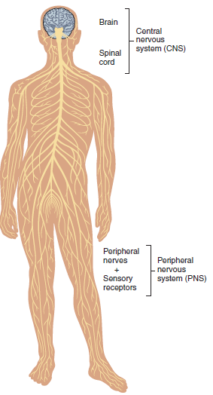
Structure of nervous system

Slide 5
A nerve is one or more bundles of neurons that connect the brain and the spinal cord with other parts of the body.
Neurons (NEW-ronz) are the basic cells of the nervous system that allow different parts of the body to communicate with each other.
A myelin sheath (MY-eh-lin) is the protective covering of most peripheral nerves

Slide 6
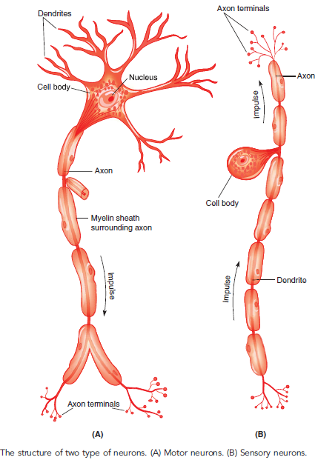

Slide 7
THE CENTRAL NERVOUS SYSTEM
The meninges (meh-NIN-jeez) are the system of membranes that cover the brain and spinal cord.
Cerebrospinal fluid (ser-eh-broh-SPY-nal), also known as spinal fluid or is a clear, colorless, and watery fluid that flows throughout the brain and around the spinal cord.

Slide 8
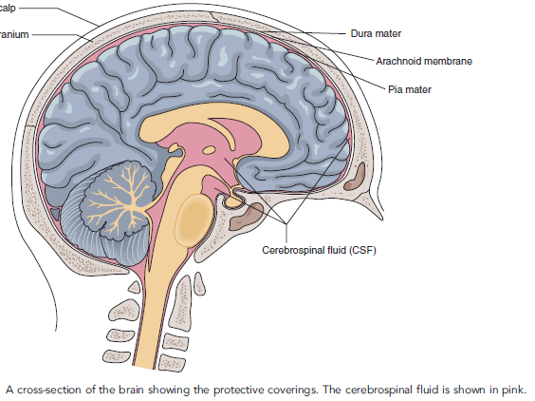

Slide 9
The Parts of the Brain
The cerebrum(seh-REE-brum), which is the largest and uppermost part of the brain, consists of four lobes.
The thalamus(THAL-ah-mus) is located below the cerebrum.
The hypothalamus(high-poh-THAL-ah-mus) is located below the thalamus.
The cerebellum(ser-eh-BELL-um) is located in the lower back of the cranium below the cerebrum.
The brainstem is located in the base of the brain
and forms the connection between the brain and
spinal cord.

Slide 10
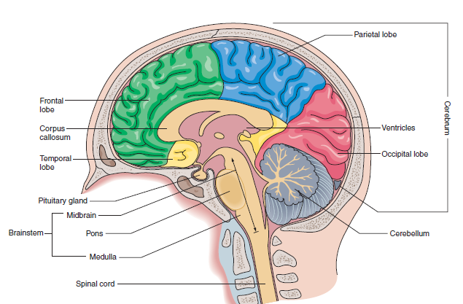

Slide 11
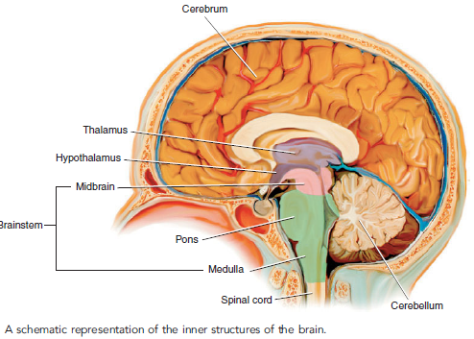

Slide 12
The term cerebral (SER-eh-bral) means pertaining to the cerebrum or to the brain (cerebr means brain, and -al means pertaining to).
The cerebrum is divided to create two cerebral hemispheres.
1-The left cerebral hemisphere controls the majority of functions on the right side of the body. .
2-The right cerebral hemisphere controls most of
functions on the left side of the body.

Slide 13
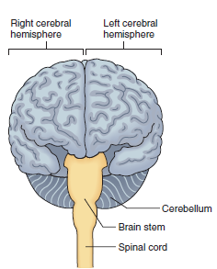

Slide 14
The Cerebral Lobes
Each cerebral hemisphere is subdivided to create pairs of
cerebral lobes. Each lobe is named for the bone of the
cranium that covers it.
1.The frontal lobe controls skilled motor functions,
memory, and behavior.
2.The parietal lobe receives and interprets nerve
impulses from sensory receptors in the tongue, skin,
and muscles.
3.The occipital lobe controls eyesight.
4.The temporal lobe controls the senses of hearing and
smell, and the ability to create, store, and access new
information.

Slide 15
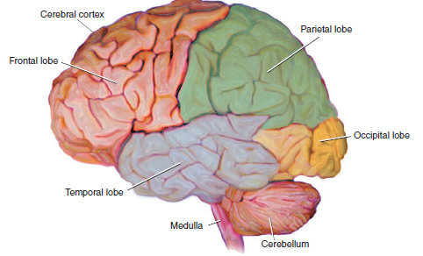

Slide 16
The spinal cord is a long, fragile tube-like structure that begins at the end of the brain stem and continues down almost to the bottom of the spinal column.

Slide 17
The peripheral nervous system
The peripheral nervous system consists of the 12 pairs of cranial nerves that extend from the brain, plus 31 pairs of spinal nerves that extending from the spinal cord.
Peripheral means pertaining to body parts that are away from the center of the body.

Slide 18
The 12 pairs of cranial nerves originate from the undersurface of the brain.
The two nerves of a pair are identical in function and structure, and each nerve of a pair serves half of the body.
These cranial nerves are identified by Roman numerals and are named for the area or function they serve

Slide 19
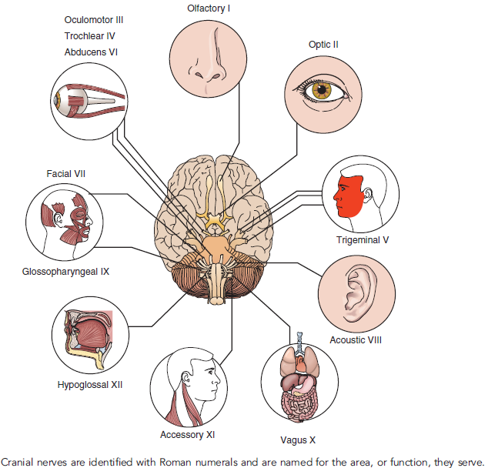

Slide 20
The 31 pairs of peripheral spinal nerves are grouped together, and named, based on the region of the body they innervate.

Slide 21
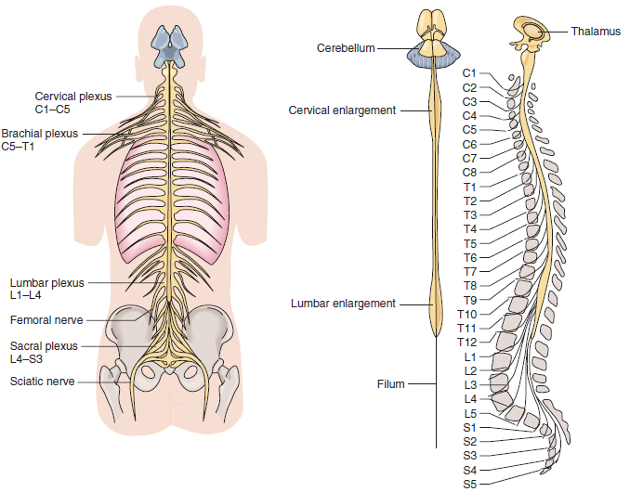

Slide 22
-An anesthesiologist (an-es-thee-zee-OL-oh-jist) is a physician who specializes in administering anesthetic agents before and during surgery (an- means without, esthesi means feeling, and -ologist means specialist).
-An anesthetist (ah-NES-theh-tist) is amedical professional
who specializes in administering anesthesia, but is not a
physician, for example, a nurse anesthetist (an- means
without, esthet means feeling, and -ist means specialist).
-A neurologist (new-ROL-oh-jist) is a physician who
specializes in diagnosing and treating diseases and
disorders of the nervous system (neur means nerve,
and -ologist means specialist).

Slide 23
-A neurosurgeon is a physician who specializes in
surgery of the nervous system.
-A psychiatrist (sigh-KYE-ah-trist) is a physician who
specializes in diagnosing and treating chemical dependencies, emotional problems, and mental illness (psych means mind, and -iatrist means specialist).
-A psychologist (sigh-KOL-oh-jist) holds an advanced
degree, but is not a medical doctor (MD). This specialist
evaluates and treats emotional problems and mental
illness (psych means mind, and -ologist means
specialist).

Slide 24
Cephalalgia (sef-ah-LAL-jee-ah), also known as a headache, is pain in the head (cephal means head, and -algia means pain).
-A migraine headache (MY-grayn),is characterized by throbbing pain on one side of the head.
-An encephalocele (en-SEF-ah-loh-seel), also known as a craniocele, is a congenital herniation of brain tissue through a gap in the skull (encephal/o means brain, and -cele means hernia).
-Herniation means protrusion of a structure from its normal position.
-A meningocele (meh-NING-goh-seel) is the congenital
herniation of the meninges through a defect in the skull or
spinal column (mening/o means meninges, and -cele means hernia). Compare this with an encephalocele.

Slide 25
Hydrocephalus (high-droh-SEF-ah-lus) is a condition in which excess cerebrospinal fluid accumulates in the ventricles of the brain (hydr/o means water, cephal means head, and -us is a singular noun ending).
-Meningitis (men-in-JIGH-tis) is an inflammation of the meninges of the brain and spinal cord (mening means meninges, and -itis means inflammation).
Compare with encephalitis.

Slide 26
Dementia (dee-MEN-shee-ah) is a slowly progressive
decline in mental abilities, including memory, thinking,
and judgment, that is often accompanied by personality
changes.
-Encephalitis (en-sef-ah-LYE-tis), which is an inflammation
of the brain,(encelphal means brain, and -itis means
inflammation).
-Parkinson’s disease (PD) is a chronic, degenerative
central nervous disorder characterized by a slow gait.
Gait describes the manner of walking.

Slide 27
Amnesia (am-NEE-zee-ah) is a memory disturbance characterized by a total or partial inability to recall past experiences.
-A concussion (kon-KUSH-un) is a violent shaking up or jarring of the brain (concuss means shaken together, and -ion means condition or state of).
-A cerebral contusion (SER-eh-bral kon-TOO-zhun) is
the bruising of brain tissue as the result of a head injury (contus means bruise, and -ion means condition). Compare with concussion.
-A cranial hematoma (hee-mah-TOH-mah) is a collection of blood trapped in the tissues of the brain (hemat means blood, and -oma means tumor).
Named for their location, the types of cranial hematomas include an epidural hematoma located above the dura mater or a subdural hematoma,
which is located below the dura mater

Slide 28
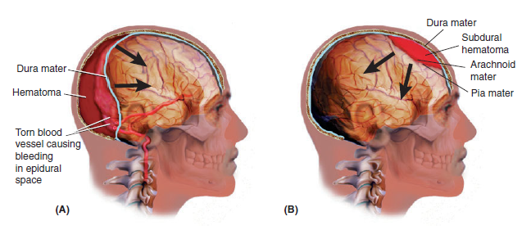

Slide 29
Levels of consciousness (LOC) are terms used to describe alterations of consciousness caused by injury, disease, or substances such as medication, drugs, or alcohol.
Lethargy (LETH-ar-jee) is a lowered level of consciousness marked by listlessness, drowsiness, and apathy. As used here, apathy means indifference and a reduced level of activity.
-A stupor (STOO-per) is an unresponsive state from which a person can be aroused only briefly and with vigorous, repeated attempts.
-Syncope (SIN-koh-pee), also known as fainting, is the brief loss of consciousness caused by the decreased flow of blood to the brain.
-A coma (KOH-mah) is a profound (deep) state of
unconsciousness. The term comatose refers to a
person who is in a coma.

Slide 30
A brain tumor is an abnormal growth located inside the skull
Intracranial pressure is the amount of pressure inside
the skull (intra- means within, crani means cranium,
and -al means pertaining to).
A stroke, or CVA, is properly known as a cerebrovascular
accident (ser-eh-broh-VAS-kyou-lar). This condition is
damage to the brain that occurs when the blood flow to
the brain is disrupted because a blood vessel is either
blocked or has ruptured.

Slide 31
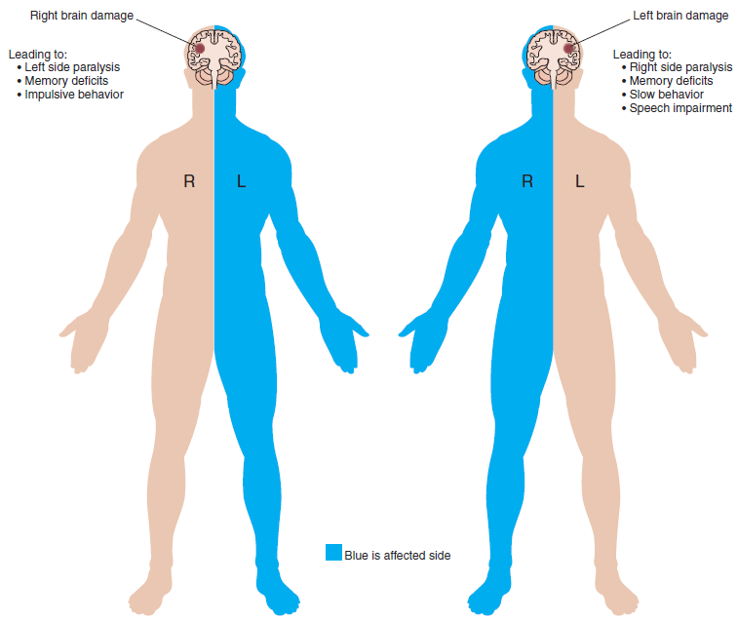

Slide 32
End

