Slide 1
Foundation of Medicine L5 medical terminology
By Dr. Muslim N.Saeed
Dept of Family & Community medicine
Monday, December 3rd ,2018

Slide 2
MAJOR BODY SYSTEMS
Major Functions | Major Structures | Body System
-Supports and shapes the body. -Protects the internal organs. -Forms some blood cells . -stores minerals. | bones, joints, and cartilage | Skeletal System
Holds the body erect. Makes movement possible. Moves body fluids and generates body heat. | muscles, fascia, and tendons | Muscular System
Blood circulates throughout the body to transport oxygen and nutrients to cells, and to carry waste products to the kidneys where waste is removed by filtration. | heart, arteries, veins, capillaries, and blood | Cardiovascular System
Removes and transports waste products from the fluid between the cells. Destroys harmful substances such as pathogens and cancer cells in the lymph nodes. Returns the filtered lymph to the bloodstream where it becomes plasma again. | lymph, lymphatic vessels, and lymph nodes | Lymphatic System
Defends the body against invading pathogens and allergens. | tonsils, spleen, thymus, skin, and specialized blood cells | Immune System

Slide 3
MAJOR BODY SYSTEMS
Major Functions | Major Structures | Body System
Brings oxygen into the body for transportation to the cells. Removes carbon dioxide and some water waste from the body.. | nose, pharynx, trachea, larynx, and lungs | Respiratory System
Digests ingested food so it can be absorbed into the bloodstream. Eliminates solid waste. | mouth, esophagus, stomach, small intestines, large intestines, liver, and pancreas | Digestive System
Filters blood to remove waste. Maintains the electrolyte and fluid balance within the body. | kidneys, ureters, urinary bladder, and urethra | Urinary System
Coordinates the reception of stimuli. Transmits messages throughout the body. | nerves, brain, and spinal cord | Nervous System
Integrates all body functions. | adrenal glands, gonads, pancreas, parathyroids, pineal, pituitary, thymus, and thyroid | Endocrine System

Slide 4
MAJOR BODY SYSTEMS
Major Functions | Major Structures | Body System
Produces new life. | Male: penis and testicles Female: ovaries, uterus, and vagina | Reproductive Systems
Protects the body against invasion by bacteria. Aids in regulating the body temperature and water content. | skin, sebaceous glands, and sweat glands | Integumentary System
Receive visual and auditory information and transmit it to the brain. | eyes and ears | Special Senses

Slide 5
Major Body Cavities
1- The Dorsal Cavity
The dorsal cavity, which is located along the back of the
body and head. Divided into:
A-The cranial cavity, which is located within the skull,
surrounds and protects the brain. Cranial means
pertaining to the skull.
B-The spinal cavity, which is located within the spinal
column, surrounds and protects the spinal cord.

Slide 6
2-The Ventral Cavity
The ventral cavity , which is located along the front of the body , contains the body organs that maintain homeostasis.
A-The thoracic cavity (thoh-RAS-ick), also known as the
chest cavity or thorax, surrounds and protects the
heart and the lungs.
*The diaphragm is a muscle that separates the thoracic and abdominal cavities.

Slide 7
B-The abdominal cavity (ab-DOM-ih-nal) contains primarily the major organs of digestion.
*This cavity is frequently referred to simply as the abdomen (AB-doh-men).
C-The pelvic cavity (PEL-vick) contains primarily the organs of the reproductive and excretory systems.

Slide 8
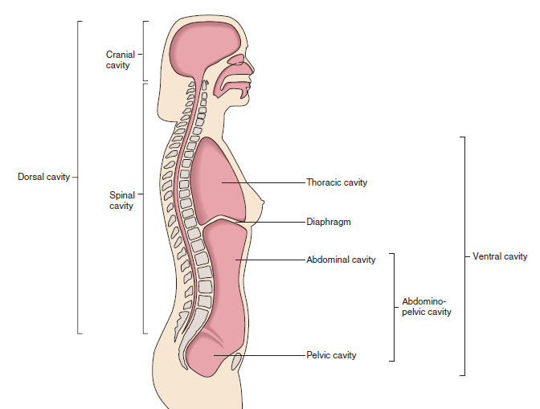

Slide 9
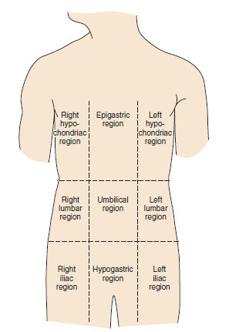
Regions of the Thorax and Abdomen
1.The hypochondriac regions (high-poh-KON-dree-ack): means below the ribs. (hypo- means below, chondr/i means cartilage, and -ac means pertaining to). Right and Left Hypochondriac regions.
2. The epigastric region (ep-ih-GAS-trick) is located above the stomach (epi- means above, gastr means
stomach, and -ic means pertaining to).
3.The lumbar regions (LUM-bar):
(lumb means lower back, and -ar means pertaining to). Right and Left Lumbar regions.

Slide 10
Regions of the Thorax and Abdomen
4. The umbilical region (um-BILL-ih-kal) surrounds the umbilicus (um-BILL-ih-kus).
5.The iliac regions (ILL-ee-ack)(ili means hip bone, and -ac mean pertaining to). Right and Left Iliac.
6. The hypogastric region (high-poh-GAS-trick) is located below the stomach (hypo- means below, gastr means stomach, and -ic means pertaining to).

Slide 11
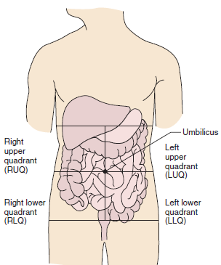
Quadrants of the Abdomen The term quadrant means divided into four
1.Right upper quadrant (RUQ)
2.Left upper quadrant (LUQ)
3.Right lower quadrant (RLQ)
4.Left lower quadrant (LLQ)

Slide 12
The Peritoneum
-The peritoneum (pehr-ih-toh-NEE-um) is a membrane that protects and holds the organs in place within the abdominal cavity.
-Peritonitis (pehr-ih-toh-NIGH-tis) is inflammation of
the peritoneum (periton means peritoneum, and -itis
means inflammation).

Slide 13
Genetic Disorders” hereditary disorder” and congenital disorder
Genetic disorder :
-Down syndrome (DS) is a genetic variation that is associated with characteristic facial appearance, learning disabilities, and physical abnormalities such as heart valve disease.
-Hemophilia (hee-moh-FILL-ee-ah) is a group of hereditary bleeding disorders.
Congenital disorder:
-A congenital disorder (kon-JEN-ih-tahl) is an abnormal
condition that exists at the time of birth. Congenital
means existing at birth.

Slide 14
TISSUES
-A tissue is a group or layer of specialized cells that join together to perform certain specific functions.
The four main types of tissue are epithelial, connective, muscle,
and nerve.
-Adipose tissue, also known as fat, provides protective padding, insulation, and support (adip means fat, and -ose means pertaining to)
-Histology (hiss-TOL-oh-jee) is the study of the structure,
composition, and function of tissues (hist means tissue, and
-ology means a study of).
-A histologist (hiss-TOL-oh-jist) is a specialist in the study of the organization of tissues at all levels (hist means tissue, and
-ologist means specialist).

Slide 15
Incomplete Tissue Formation
-Aplasia (ah-PLAY-zee-ah) is the defective development , or the congenital absence, of an organ or tissue (a- means without, and -plasia means formation).
*Compare aplasia with hypoplasia.
-Hypoplasia (high-poh-PLAY-zee-ah) is the incomplete
development of an organ or tissue (hypo- means
deficient, and -plasia means formation).

Slide 16
Abnormal Tissue Formation
-Anaplasia (an-ah-PLAY-zee-ah) is a change in the structure of cells (ana- means excessive, and -plasia means formation).
This abnormal cell development is characteristic of tumor formation in cancers.
-Dysplasia (dis-PLAY-see-ah) is abnormal development or growth of cells, tissues, or organs (dys- means bad, and -plasia means formation).
-Hyperplasia (high-per-PLAY-zee-ah) is the enlargement of an organ or tissue(hyper means excessive, and -plasia means formation).
*Contrast hyperplasia with hypertrophy.
-Hypertrophy (high-PER-troh-fee) is a general increase in the size, but not in the number, of cells in the tissues (hyper- means excessive, and –trophy means development). This enlargement is not due to tumor formation. Contrast hypertrophy with anaplasia and hyperplasia.

Slide 17
GLANDS
-A gland is a group of specialized epithelial cells that are capable of producing secretions.
-Adenitis (ad-eh-NIGH-tis) is the inflammation of a gland (aden means gland, and -itis means inflammation).
-Adenocarcinoma (ad-eh-noh-kar-sih-NOH-mah) is a malignant tumor that originates in glandular tissue (aden/o means gland, carcin means cancerous, and -oma means tumor).
*Malignant means harmful, capable of spreading, and potentially life threatening.
-Adenoma (ad-eh-NOH-mah) is a benign tumor that arises in glandular tissue (aden means gland, and –oma means tumor).
*Benign means not life threatening.

Slide 18
Pathology
Pathology (pah-THOL-oh-jee) is the study of the nature and cause of disease that involves changes in structure and function. The word root (combining form) path/o and the suffix -pathy mean disease.
A pathologist (pah-THOL-oh-jist) specializes in the laboratory analysis of tissue samples to confirm or establish a diagnosis (path means disease, and –ologist means specialist).
Postmortem means after death and a postmortem examination is also known as an autopsy (AW-top-see).

Slide 19
Premature birth : which is a birth that occurs earlier
than 37 weeks of development, can cause serious health problems.
The study of the medical problem and care of the aged
is known as Geriatrics (jer-ee-AT-ricks).or as Gerontology (gerontologist).
Both of these terms have the same meaning; however, geriatrics is the preferred term.

Slide 20
End

