Slide 1
Foundation of Medicine
L6 medical terminology
By Dr. Muslim N.Saeed
Dept of Family & Community medicine
Monday, Jan 7th ,2019

Slide 2
Overview
PRIMARY FUNCTIONS | RELATED COMBINING FORMS | MAJOR STRUCTURE
Pumps blood into the arteries. | cardi/o | Heart
Transport blood to and from all areas of the body. | angi/o, vas/o | Blood Vessels
Transport blood away from the heart to all parts of the body. | arteri/o | Arteries
Permit the exchange of nutrients and waste products between the blood and the cells. | capill/o | Capillaries
Return blood from all body parts to the heart. | phleb/o, ven/o | Veins
Brings oxygen and nutrients to the cells and carries away waste. | hem/o, hemat/o | Blood

Slide 3
The term cardiovascular means pertaining to the heart and blood vessels (cardi/o means heart, vascul means blood vessels, and -ar means pertaining to).

Slide 4
The Walls of the Heart
The epicardium (ep-ih-KAR-dee-um) is the external layer of the heart(epi- means upon, cardi means heart, and -um is a singular noun ending).
The myocardium (my-oh-KAR-dee-um), is the middle and thickest three layer of the heart (my/o means muscle, cardi means heart, and -um is a singular noun ending).
The endocardium (en-doh-KAR-dee-um),is the inner lining of the heart (endo- means within, cardi means heart, and -um is a singular noun ending).

Slide 5
The heart is divided into left and right sides.
The atria (AY-tree-ah) are the two upper chambers of the heart. (singular, atrium).
The ventricles (VEN-trih-kuhls) are the two lower
chambers of the heart. (singular, ventricle).
The atria are separated by the interatrial septum.
A septum is a wall that separates two chambers.
The ventricles of the heart, which are separated by the interventricular septum

Slide 6
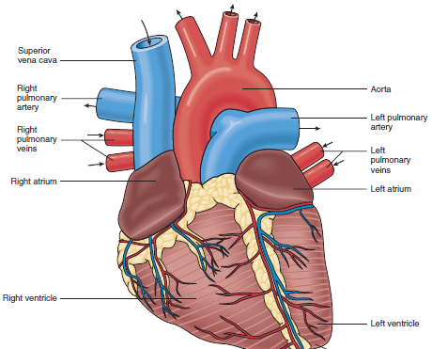
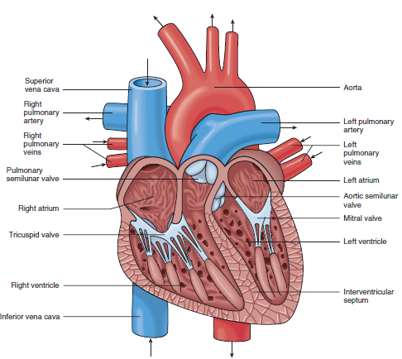

Slide 7
The Valves of the Heart
The tricuspid valve (try-KUS-pid) between the right atrium and the right ventricle.
Tricuspid means having three cusps (points).
The pulmonary semilunar valve (sem-ee-LOO-nar) is located between the right ventricle and the pulmonary artery, semi-lunar means half-moon.

Slide 8
The mitral valve (MY-tral), also known as the bicuspid valve, is located between the left atrium and left ventricle. Mitral means shaped like a bishop’s miter (hat). Bicuspid means having two cusps (points).
The aortic semilunar valve (ay-OR-tick sem-ee-LOOnar) is located between the left ventricle and the aorta.
Aortic means pertaining to the aorta, and semilunar means half-moon.

Slide 9
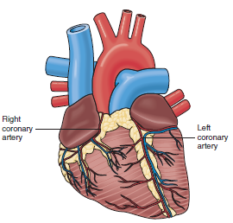
The coronary arteries (KOR-uh-nerr-ee), which supply oxygen-rich blood to the myocardium,

Slide 10
BLOOD
Plasma (PLAZ-mah) is a straw-colored fluid that contains nutrients, hormones, and waste products.
Erythrocytes (eh-RITH-roh-sights), also known as red blood cells (RBC), (erythr/o means red, and –cytes means cells).
Leukocytes (LOO-koh-sites), also known as white blood cells (WBC), are the blood cells involved in defending the body,
(leuk/o means white, and -cytes means cells).

Slide 11
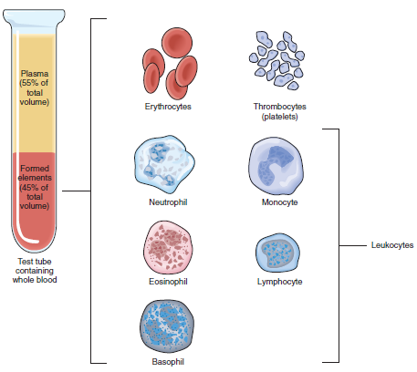

Slide 12
A cardiologist (kar-dee-OL-oh-jist) is a physician who specializes in diagnosing and treating diseases of the heart . (cardi means heart, and -ologist means specialist).
-A hematologist (hee-mah-TOL-oh-jist) is a physician who specializes in diagnosing and treating diseases of blood(hemat means blood, and –ologist means specialist).
-A vascular surgeon is a physician who specializes in
the diagnosis, medical management, and surgical
treatment of disorders of the blood vessels.

Slide 13
Coronary Artery Disease
Coronary artery disease is atherosclerosis of the coronary
arteries that reduces the blood supply to the heart muscle.
Atherosclerosis (ath-er-oh-skleh-ROH-sis) is hardening
and narrowing of the arteries caused by a buildup of
cholesterol plaque on the interior walls of the arteries
(ather/o means plaque or fatty substance, and -sclerosis
means abnormal hardening)
This type of plaque (PLACK), which is found within
the lumen of an artery, is a fatty deposit that is similar to
the buildup of rust inside a pipe.

Slide 14
Ischemic heart disease (iss-KEE-mick) is a group of
cardiac diseases resulting from an insufficient supply of oxygenated blood to the heart.
Ischemic means pertaining to the disruption of the blood supply.
Ischemia (iss-KEE-mee-ah) is a condition in which
there is an insufficient oxygen supply due to a restricted blood flow by to a part of the body (isch- means to hold back, and -emia means blood). For example, cardiac ischemia is the lack of blood flow and oxygen to the heart muscle.

Slide 15
Angina (an-JIH-nuh), also known as angina pectoris, is a severe chest pain due to inadequate blood flow to the myocardium.
A myocardial infarction (my-oh-KAR-dee-al in-FARKshun), is the occlusion of one or more coronary arteries caused by plaque buildup.
As used here, occlusion means total blockage.
An infarct is a localized area of dead tissue caused by a lack of blood.

Slide 16
Cardiomegaly (kar-dee-oh-MEG-ah-lee) is the abnormal enlargement of heart(cardi/o means heart, and megaly means abnormal enlargement).
Carditis (kar-DYE-tis) is an inflammation of the heart
(card means heart, and -itis means inflammation).
Endocarditis (en-doh-kar-DYE-tis) is an inflammation
of the inner lining of the heart (endo- means within,
card means heart, and -itis means inflammation).
Cardiomyopathy (kar-dee-oh-my-OP-pah-thee) is the
term used to describe all diseases of the heart muscle
(cardi/o means heart, my/o means muscle, and -pathy
means disease).

Slide 17
-Endocarditis is an inflammation of the lining of the heart.
-Myocarditis (my-oh-kar-DYE-tis) is an inflammation of myocardium(my/omeans muscle, card means heart, and -itis means inflammation).
-Pericarditis (pehr-ih-kar-DYE-tis) is an inflammation of the pericardium (peri- means surrounding, card means heart, and -itis means inflammation).

Slide 18
-Cardiac arrest is an event in which the heart abruptly
stops pumping blood. Sudden cardiac death results if treatment is not provided within a few minutes.
Arrhythmia (ah-RITH-mee-ah) :the loss of the normal rhythm, of the heartbeat.
-Bradycardia (brad-ee-KAR-dee-ah) is an abnormally
slow resting heart rate(rates less than 60 beats per minute) (brady- means slow, card means heart, and -ia means abnormal condition).
-Tachycardia (tack-ee-KAR-dee-ah) is an abnormally
rapid resting heart rate(rate more than 100) (tachy- means rapid, card means heart, and -ia means abnormal condition).
-Palpitation (pal-pih-TAY-shun) is a racing heart(feeling heart beats).

Slide 19
Arteriosclerosis (ar-tee-ree-oh-skleh-ROH-sis),is thickening and the loss of elasticity of arterial walls (arteri/o means artery, and -sclerosis mean abnormal hardening).
Phlebitis (fleh-BYE-tis) is the inflammation of a vein (phleb means vein, and -itis mean inflammation).
-Varicose veins (VAR-ih-kohs VAYNS) are abnormally swollen veins.

Slide 20
Polycythemia (pol-ee-sy-THEE-mee-ah) is an abnormal increase in the number of red cells in the blood due to excess production by the bone marrow.
-Septicemia (sep-tih-SEE-mee-ah), is a spread of microorganisms and their toxins via the circulating blood.
A hemorrhage (HEM-or-idj) is the loss of a large amount of blood in a short time.

Slide 21
Leukemia (loo-KEE-mee-ah) is a type of cancer characterized by increase in the number of
abnormal leukocytes (white blood cells)
(leuk means white, and -emia means blood condition).
Anemia (ah-NEE-mee-ah) is a lower than normal number of erythrocytes (red blood cells) in the blood (an- means without or less than, and -emia means blood).

Slide 22
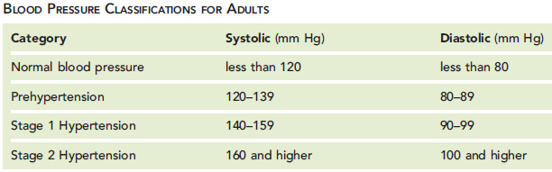
Hypertension, commonly known as high blood pressure, is the elevation of arterial blood pressure.
Hypotension (high-poh-TEN-shun) is lower than normal arterial blood pressure.

Slide 23
Electrocardiography (ee-leck-troh-kar-dee-OG-rah-fee) is recording the electrical activity of the heart (electr/o means electric, cardi/o means heart, and graphy means the process of recording a picture or record).
An electrocardiogram (ee-leck-troh-KAR-dee-ohgram) is a record of the electrical activity of the heart. (electr/o means electric, cardi/o means heart, and -gram means picture or record).

Slide 24
Percutaneous transluminal coronary angioplasty (PTCA), is also known as a balloon angioplasty.
Coronary artery bypass graft (CABG) is also known as bypass surgery. In this surgery, which requires opening the chest, a piece of vein from the leg or chest is implanted on the heart.

Slide 25
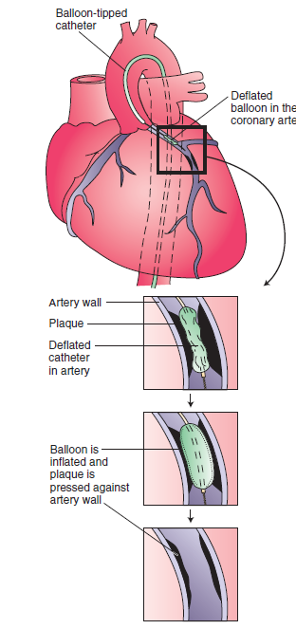
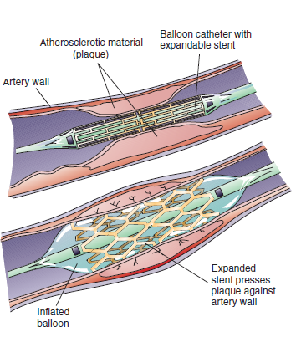

Slide 26
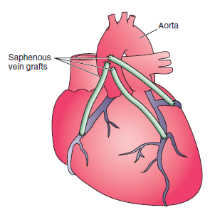
Coronary artery bypass graft (CABG)

Slide 27
Cardiopulmonary resuscitation , commonly known as CPR, is an emergency procedure for life support consisting of artificial respiration and manual external cardiac compression. Cardiopulmonary means pertaining to the heart and lungs.
Hemostasis (hee-moh-STAY-sis) means to stop or control bleeding (hem/o means blood, and –stasis means stopping or controlling).

Slide 28

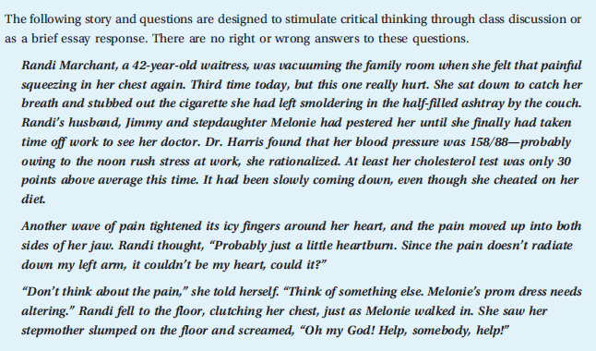

Slide 29
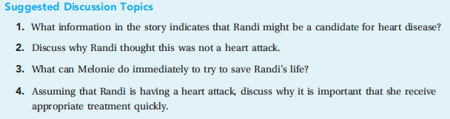

Slide 30
End

