Slide 1
Pancreas
assist .prof.
Dr. Alaa Jamel
Cabs, mrcsi, mbchb

Slide 2
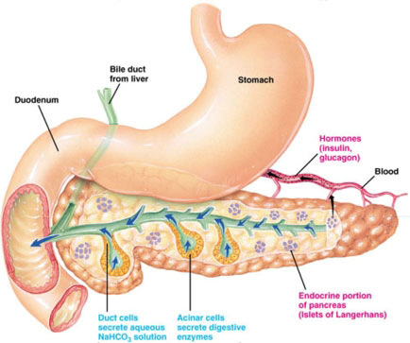

Slide 3
Pancreas
Types of gland ; mixed why?
Site and shape;its elongated retropertoneal organ extending from the cap of dud. To the hilum of spleen
Parts; head ,neck, body and tail of pancrease
Relations
The head; it accuping the concavity of the duod.

Slide 4
Uncinate process its a hook like projection arise from the lower lf part of the head. its lies behind
Sup. mesentric vessele.
Ant. Relation of the head of pancreas.; T.C.S.
*trans. colon
*coil of jej.
*Sup mesentric art.
Sup,lat,& inf relation
Dud cap

Slide 5
Post. Relation
CBD
IFC and termination of RT and lf portal vein
.Aorta behind the uncinate process

Slide 6
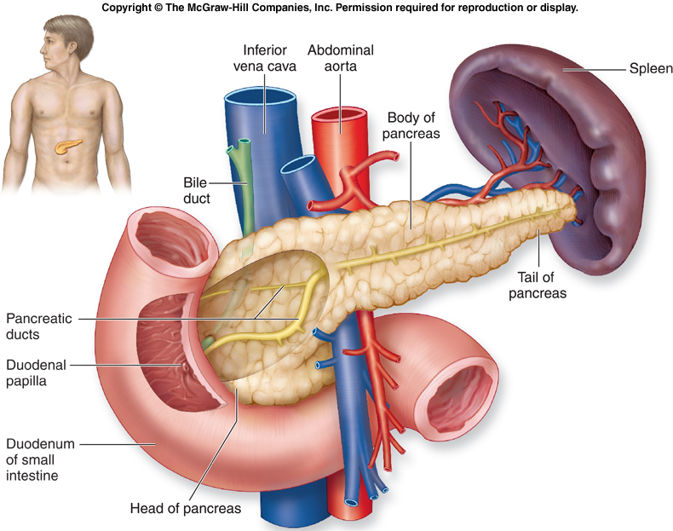

Slide 7
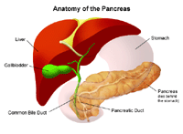

Slide 8
THE NECK
Its constricted part at the junction between the head and body
ant.relation – pyloro dud.junction
Post relation—junction between splenic and sup .mesentric veins to form the portal vein.

Slide 9
Applied anatomy ;
CA. head of pancreas will affect structure related to head and neck of pancreas lead to
A- widening of duod. Concavity
B- compression of C.B.D-- obst.jnudice
Compression on pylorodud.junction --- pyloric obst.
Compression onIVC– edema of lower limb
Compression on portal vein – ascites (fluid in peritoneal cavity)

Slide 11
BODY OF PANCREAS;
Extend to the lf slightly upward crossing the median plane opposite L1.
Post surface relations;
Its applied to the post abdominal wall. its not cover by peritoneum,
Its related to ;

Slide 12
2 arteries ; abdominal aorta & origin of sup.mes.art
2 veins ; splenic vein and lf renal vein
2 muscles ;lf psoas major & lf crus of diaphragm
2 glands ; lf kidney & lf suprarenal gland

Slide 13
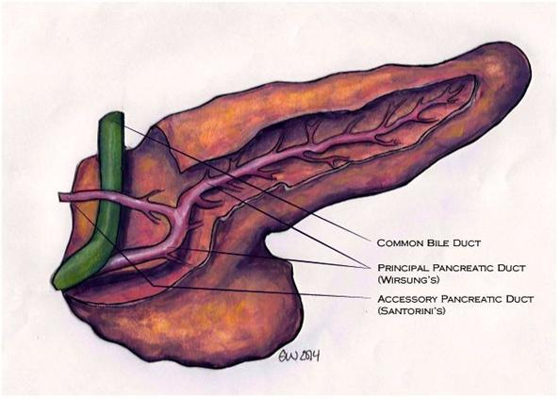

Slide 14
Tail of pancreas
It’s the narrow left end of the gland which lie in the linorenal lig. together with splenic vessels
Its related to the visceral surface of the spleen

Slide 15
Ducts of pancreas;
2 ducts
1- main pancreatic duct (wirsung duct)
Start from the tail and passes to the right towords the head passing along the whole
length of the gland.
Emerge from the head and unite with C.B.D to open in ampulla of vator which open in 2nd part of dud.in summit of the major dud.papilla.

Slide 17
Accessory pancreatic duct;(duct of santorini)
Small duct drain uncinate process and the lower part of the head .
It run up word in front of the main pancreatic duct to open separately in to the 2nd part of dud. At a minor dud.papilli 1 inch above the major dud.papilli
Some time the main and accessory duct communicate in the head of pancreas

Slide 18
Arterial supply of pancreas;
1- pancreatic branches from splenic art. supply the body
2- sup.pancreatico dud. artery ---gastrodud.artery supply the upper part of the head
3- inf. Pancreatico dud.art.---sup. mesenteric art. supply the lower part of the head.

Slide 19
Venous drainage ;
Body drain to the splenic vein
Head drain to the portal vein directly
Lymphatic drainage
It fallow the arteries and drained into
1- pancreatrico splenic L.N. around spl. art
2-caeliac L.N around caeliac trunk
3- sup mesentric L.N (along sup .mesentric art,)

Slide 20
Thank you

