Slide 1
Pons & medulla oblongata
By
Dr. Amjed Hassan

Slide 2
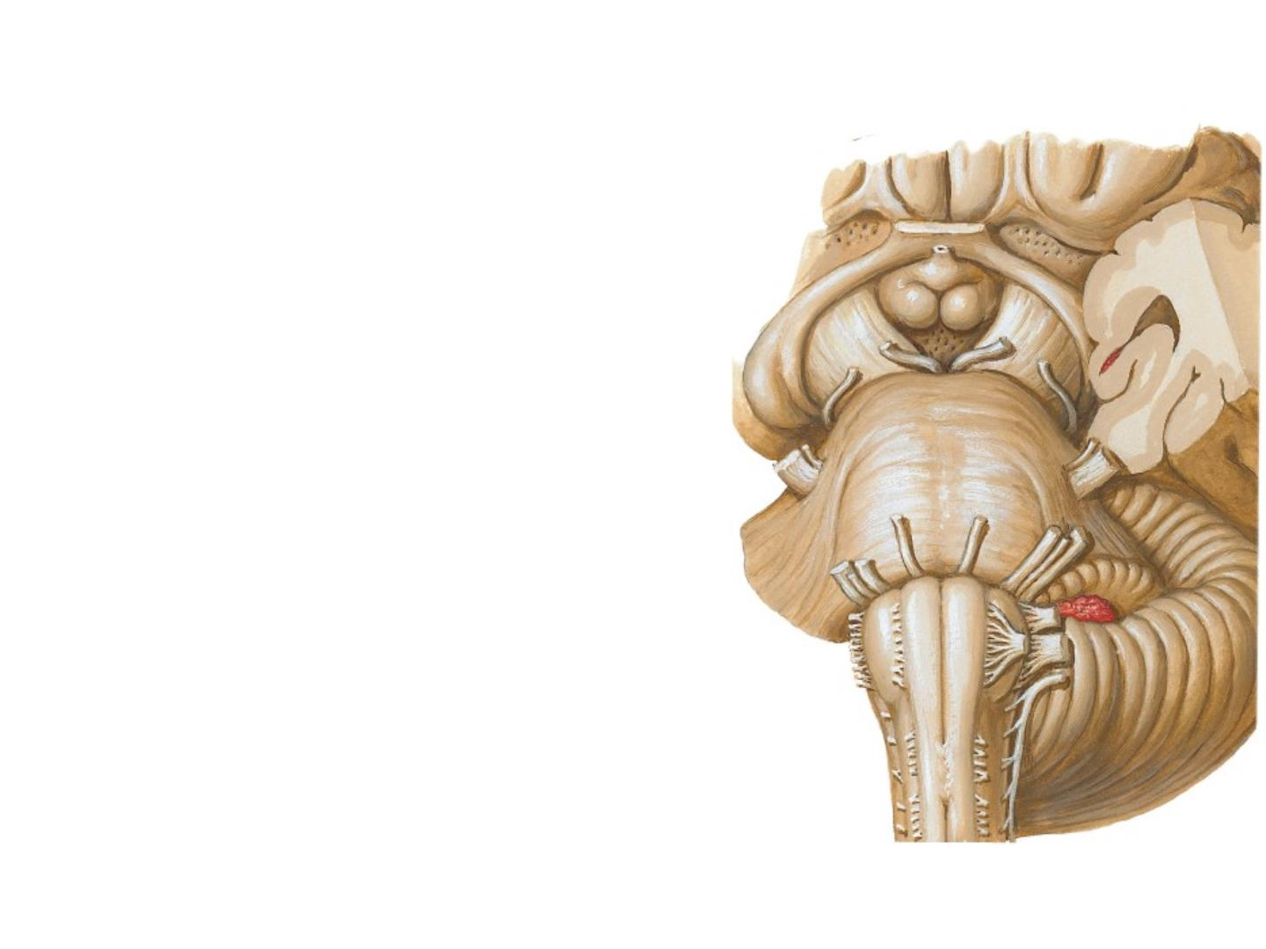
Brai nstem
A stal kl i ke shaped structure
occupi es the posteri or crani al
fossa of the skull and connect s
the narrow spi nal cor d wi th the
ex panded f orebrai n.
It consists of:
1. M edul l a obl ongata,
2. Pon s,
3. Mi dbrai n

Slide 3

Functi ons of Brai nstem:
(1) A codui t for asce nding tracts and
de sce nding tracts connecti ng the spinal cor d
to the different parts of the higher centers in
the f orebrai n;
(2) it contai ns i mportant ref l ex centers associ ated
wi th thecontrol of respirationand the
cardiovascular systemand wi th the control
of consciousne ss;
(3) it contains theimporta nt nucleiof crani al
nerves III t hr ough XII.

Slide 4
Medulla Oblangata

Slide 5
Gr oss
A ppearance :
•
•
Connects the pons
superi orl y wi th the
spi nal cor d inf eriorly.
Its conical in shape
i nferi orl y, & is broad
superi orl y.

Slide 6

• The junction of medul la
and spi nal cor d is at :
1. corresponds approxi matel y
to the level of :
For amen M agnum
2. the origin of the anteri or
and posteri or roots of the
1st cervi cal spi nal ner v e.

Slide 7
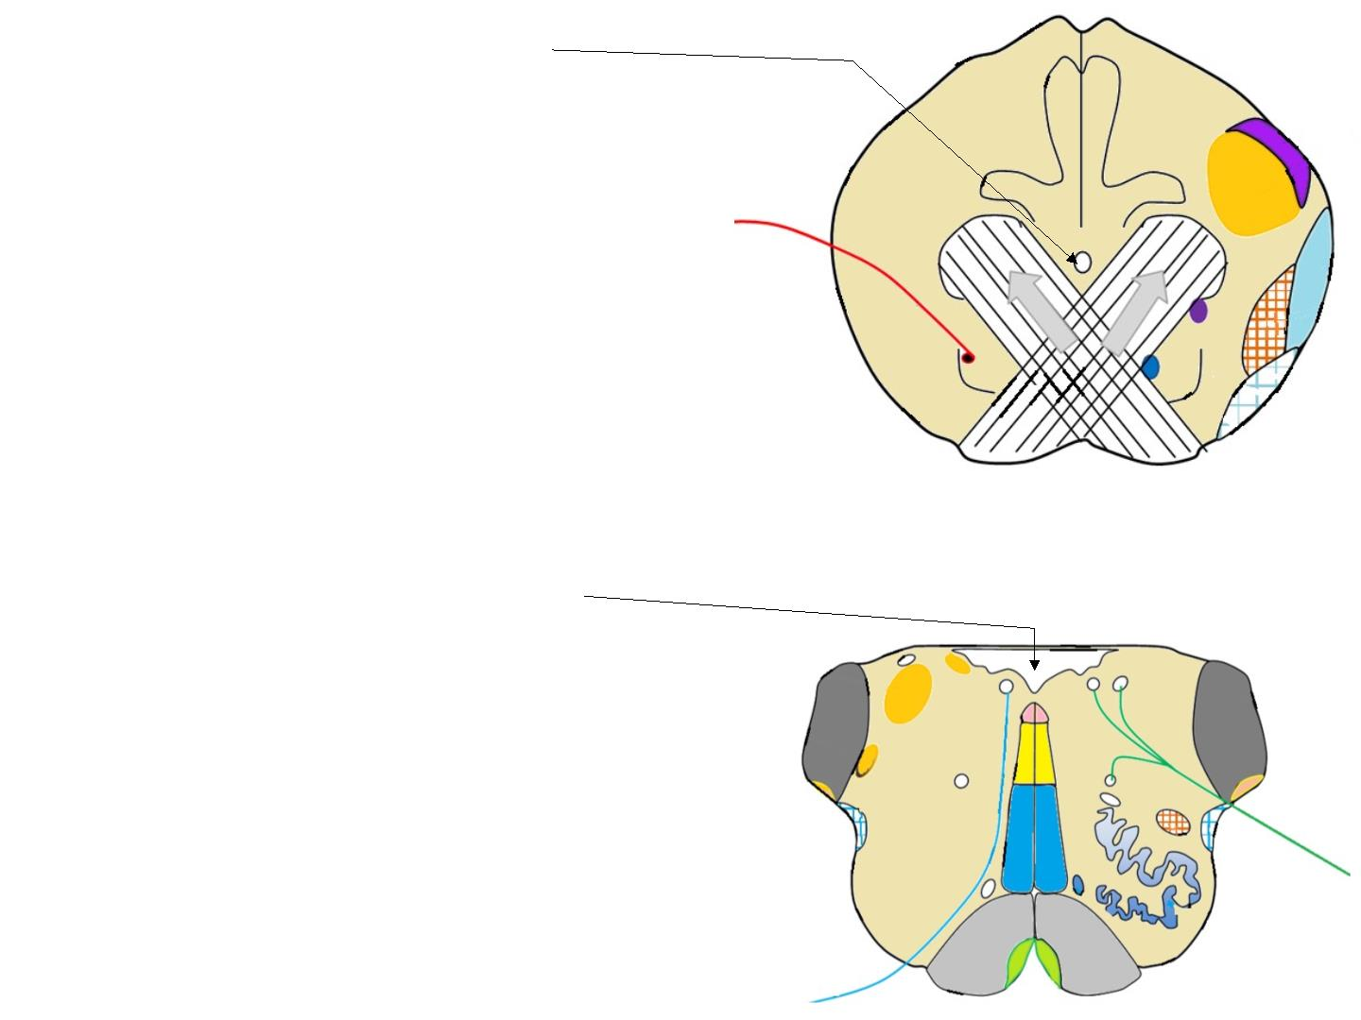
• The central c anal
of the spinal cor d conti n-
ues upward i nto the lower
hal f of the medulla;
• in the upper hal f of the
medul l a, it expands as
the cavity of the 4th
ventri cl e

Slide 8
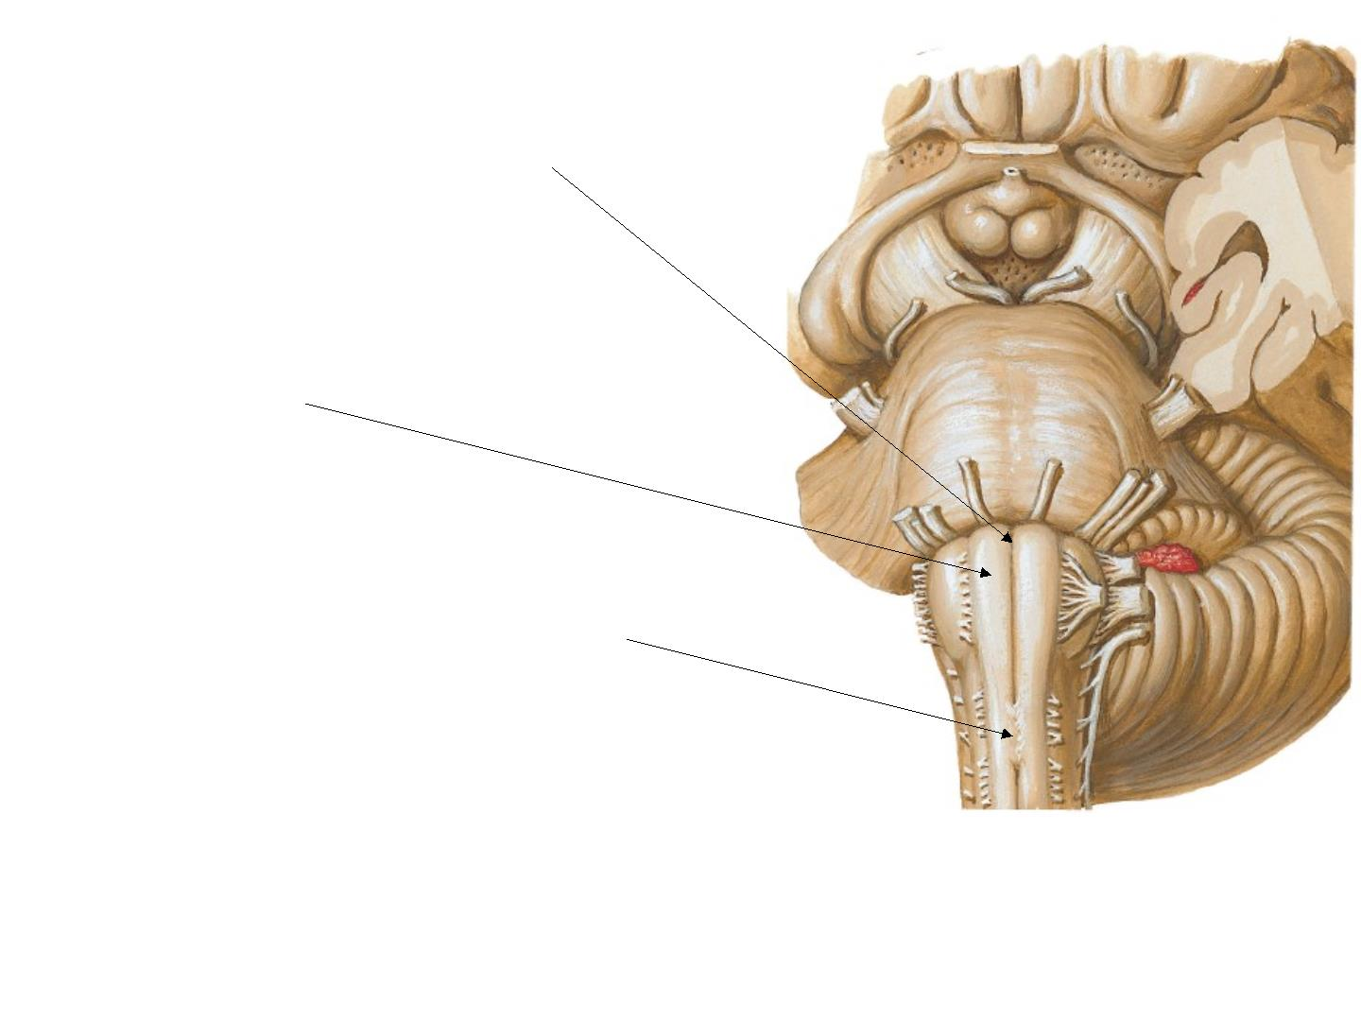
Ante rior surface of
me dulla
1. A nteri or medi an fissure:
conti nues wi th t hat
of spi nal cor d.
2. Pyrami d :
Contai ns
corti cospi nal f i bers
3. Decussat i on of pyrami ds:
site of cr oss- ov er of corti co-
spi nal fibers to the opposi te
si de.

Slide 9
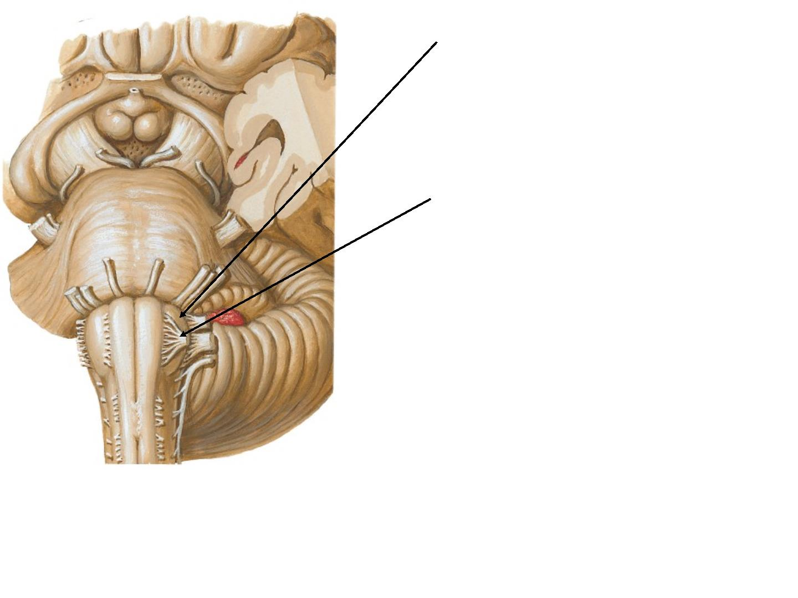
4. Olive:
underlies Inferior
ol i vary nucl ei .
• rootlets of the
hy pogl ossal nerve
emerges f rom gr oov e
bet w een pyrami d &
ol ive.
5. Inf erior cerebel l ar
peduncle:
whi ch connect the
medulla to the
cerebel l um

Slide 10
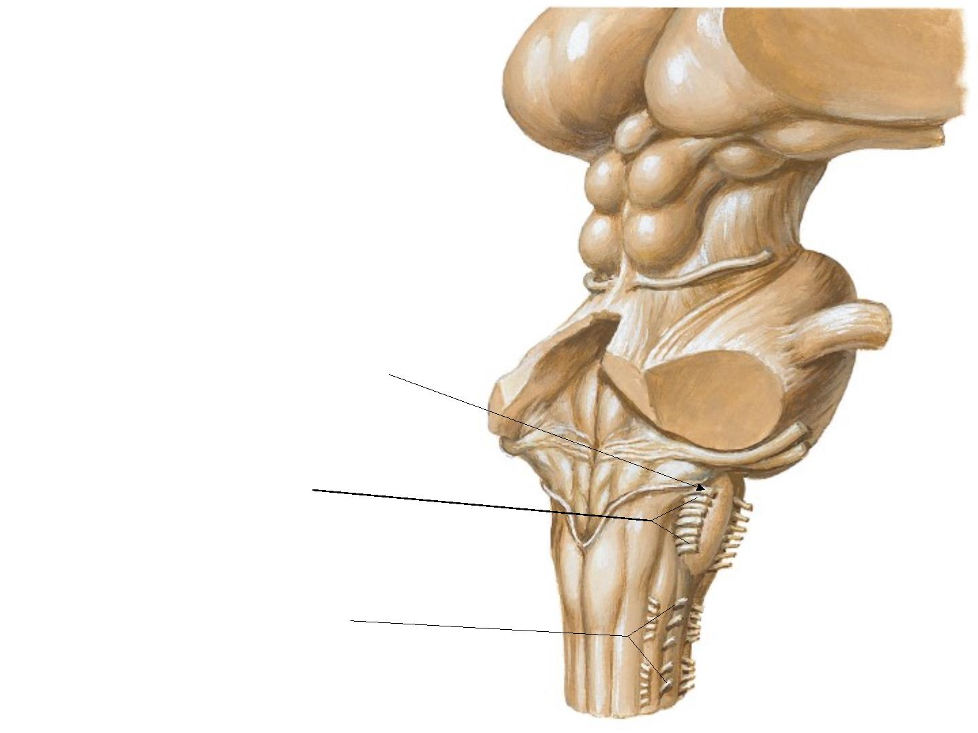
• In the groove between
the olive and the
i nferi or cerebel l ar
peduncl e emerge the
roots of :
1. Gl ossophar y ngeal
2. V agus nerves
3. Crani al roots of
A ccessory nerve

Slide 11
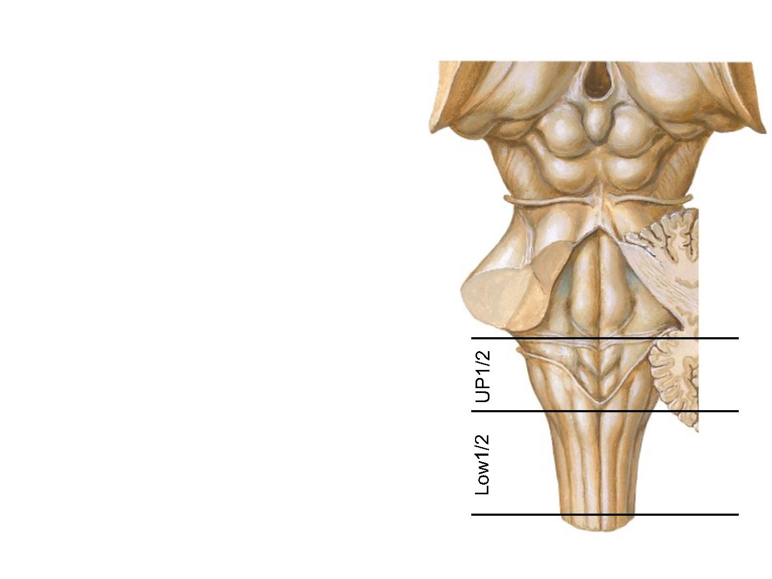
Poste rior surface of
Me dulla
• the superi or hal f of the medul l a
obl ongata f orms the lower
par t of the floor of the 4th
ventricle .
• The posteri or surface of the
i nferi or hal f of the medulla is
conti nuous wi th posteri or asp ect
of the spi nal cor d.

Slide 12
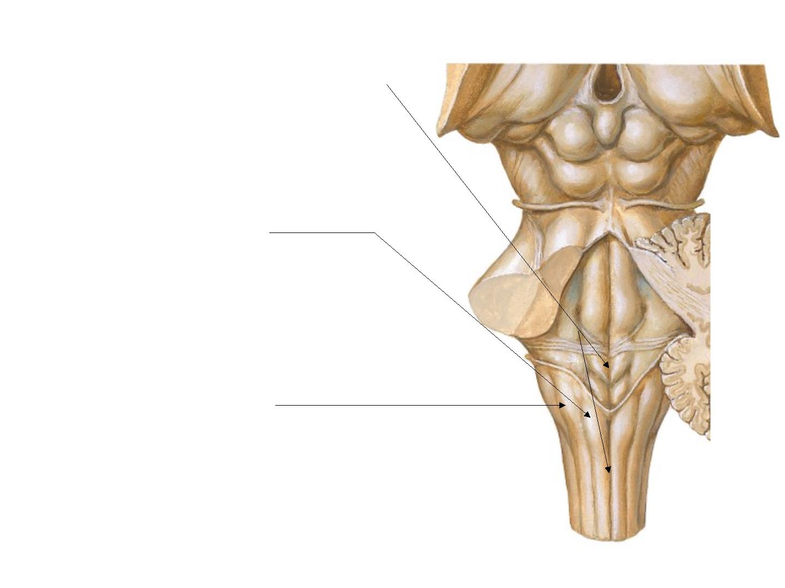
Features posteri orl y ar e:
•
Posteri or medi an sul cus.
on eac h side of the medi an
sul cus, there is an, the
•
Graci l e tubercl e,
el ongated swel l i ng pr oduced
by the underlyi ng graci l e
nucl eus.
•
Cuneate tubercl e,
l ateral to the gracile tubercle
is a similar swel l i ng,
pr oduced by the underl ying
cuneate nucl eus.

Slide 13
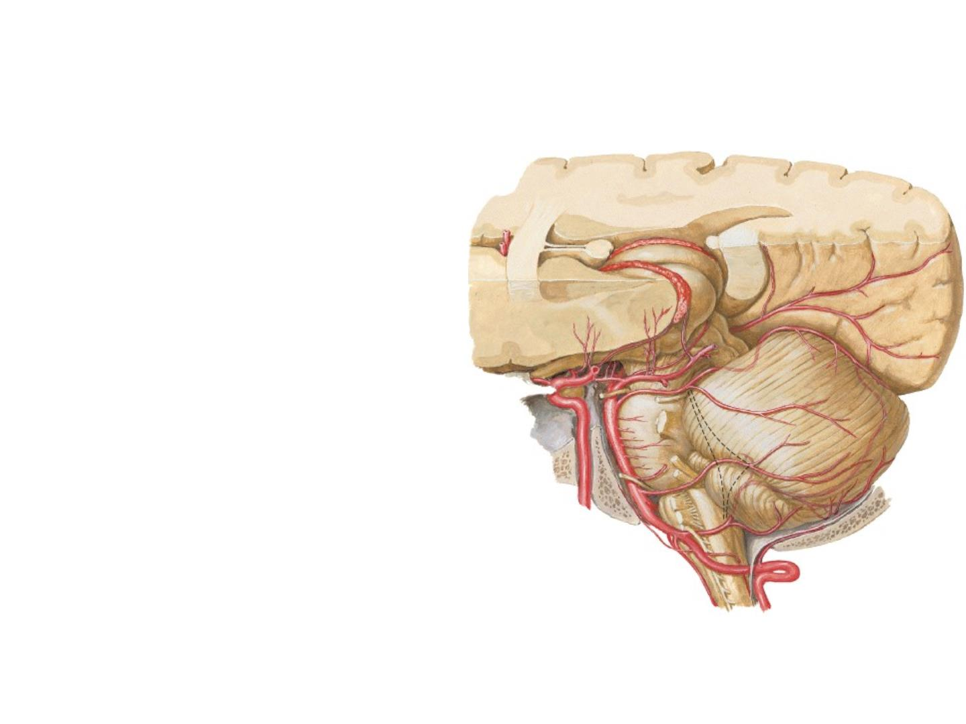
Bl ood Suppl y of M edulla
is supplied by the :
1. V ertebral artery,
2. A nteri or spi nal artery
3. Posteri or spi nal artery
4. Posteri or i nferi or
cerebel l ar artery,
5. Basi l ar arteri es.

Slide 14
I nternal f eatures of
M edul l a Obl angata

Slide 15

A
Level D ecussati on of Pyrami ds
Cav ity
Cent r al can al
Nucleus gracilis & Nucl eus cuneatus,
Spi nal nucl eus of crani al nerve V,
A ccessory nucl eus
Nucle i
D ecussati on of Corti cospi nal tracts,
Pyrami ds
Motor Tracts
Spi nal tract of crani al nerve V,
Posteri or spi nocerebel l ar tract,
L ateral spi nothal ami c tract,
A nteri or spi nocerebel l ar tract
Se nsory Tra cts

Slide 16
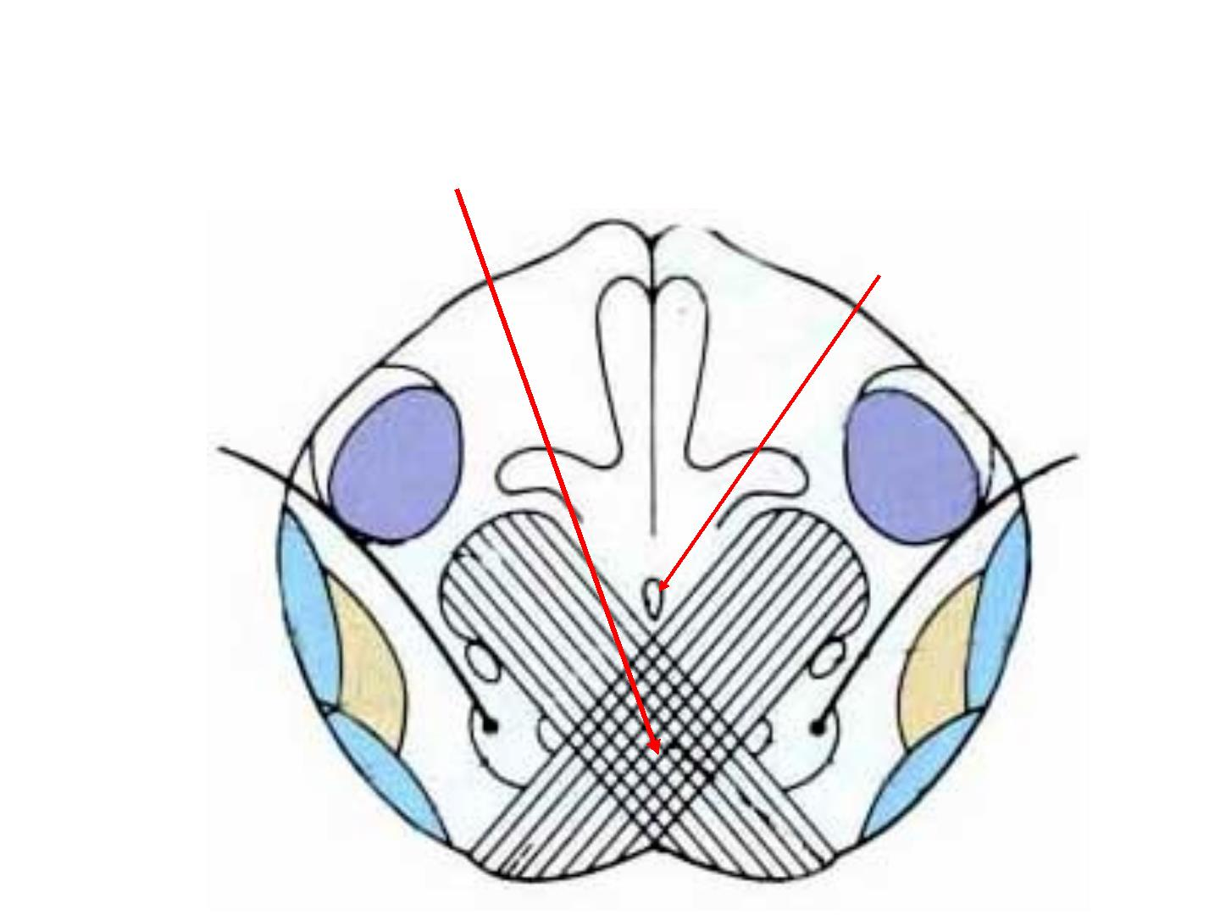
A .Transverse secti ons of the medul l a oblongata:
L evel of decussat i on of the pyrami ds
Cent r al can al

Slide 17
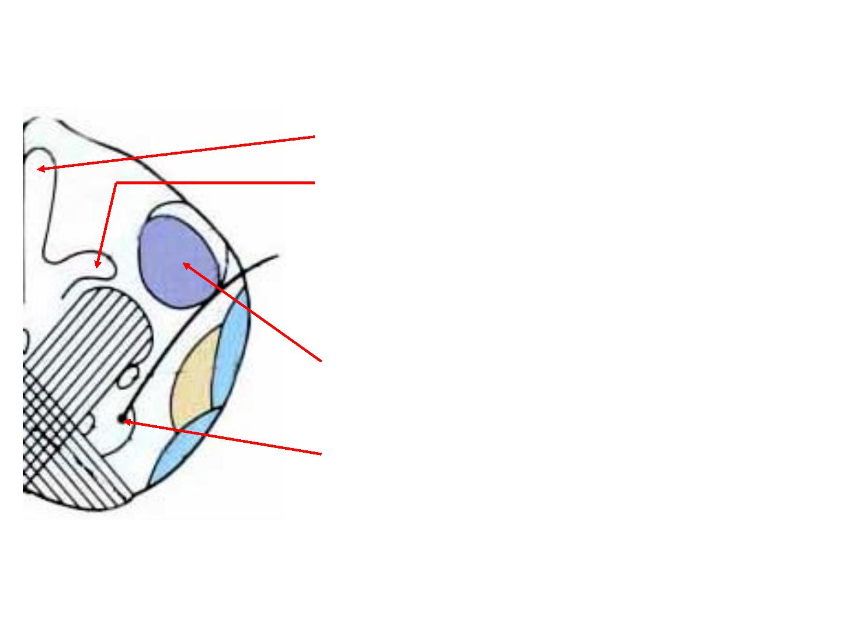
Nucl ei :
1. N. Graci l i s
2. N. Cunat us
3. Spi nal N. of tri gemi nal nerve
4. A ccessory N.

Slide 18
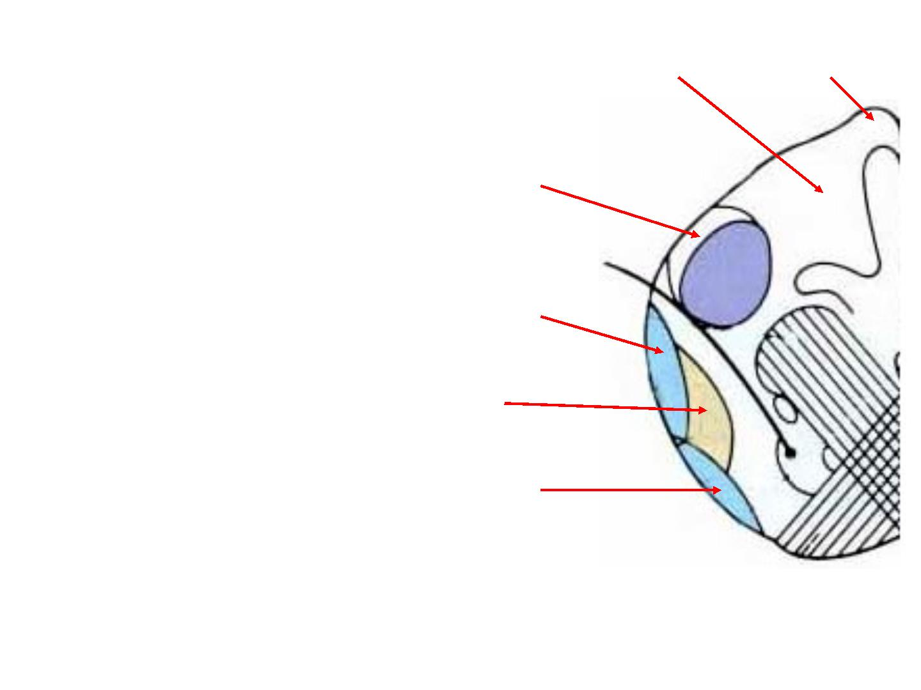
Fasci cul i Cunatus & graci l is
Tracts :
1. Spi nal tract of crani al nerve V,
2. Posteri or spi nocerebel l ar tract,
3. L ateral spi nothal ami c tract,
4. A nteri or spi nocerebel l ar tract

Slide 19

B
Level Decussat i on of medi al l emni sci
Cav ity
Cent r al can al
Nucleus graci lis, Nucl eus cuneatus,
Spi nal nucl eus of crani al nerve V,
Nucle i
A ccessor y nucl eus, Hy pogl ossal nucl eus
Motor Tracts
Pyrami ds
Decussat i on of medi al l emni sci ,
Posteri or spi nocerebel l ar tract,
L ateral spi nothal ami c tract,
Se nsory Tra cts
A nteri or spi nocerebel l ar tract,
Spi nal tract of crani al nerve V,

Slide 20
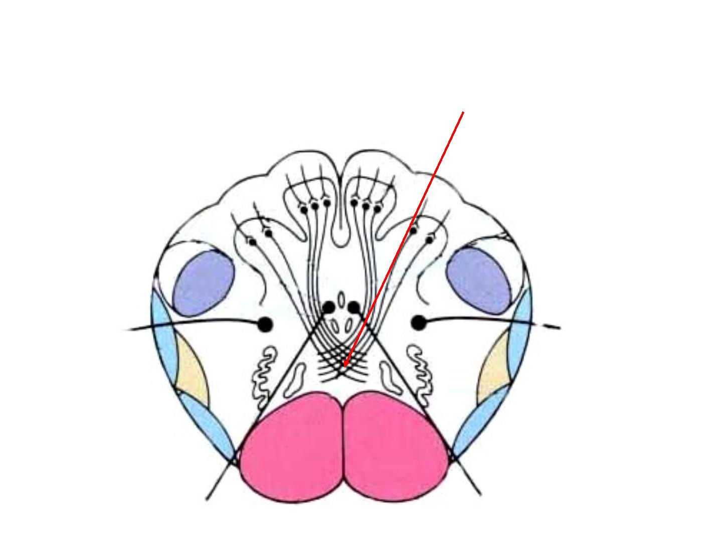
B. Transverse secti ons of the medul l a oblongata:
L evel of decussat i on of medi al l emnesci
Pyrami ds

Slide 21
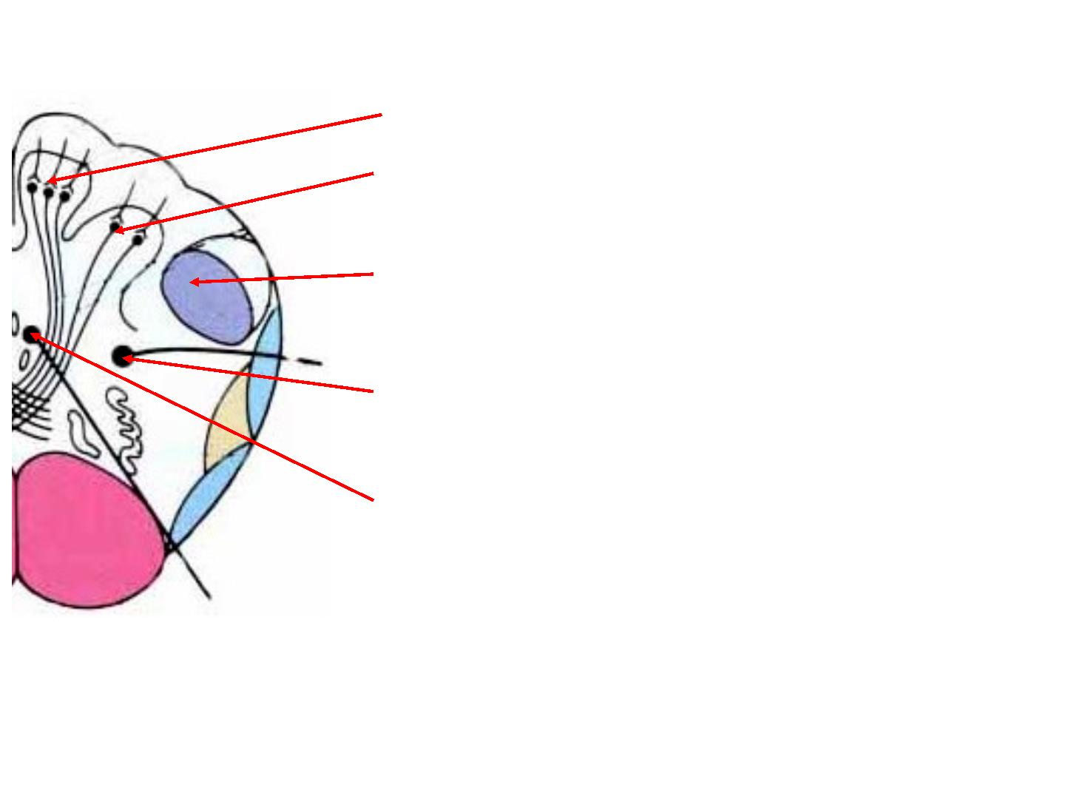
Nucl ei :
1. N. Gracil i s
2. N. Cunat us
3. Spi nal N. of tri gemi nal nerve
4. A ccessory N.
5. Hypogl osal N

Slide 22
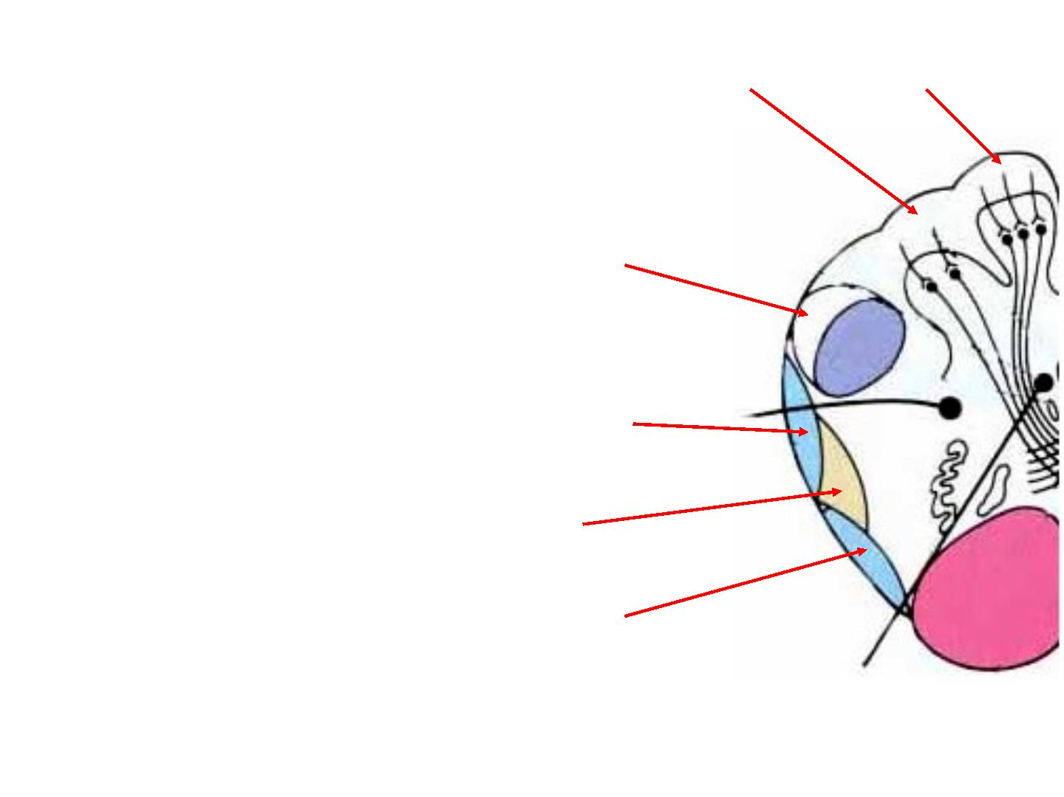
Fasci cul i Cunatus & graci l is
Tracts :
1. Spi nal tract of crani al nerve V,
2. Posteri or spi nocerebel l ar tract,
3. L ateral spi nothal ami c tract,
4. A nteri or spi nocerebel l ar tract

Slide 23

C
Level
Ol i ves, I nf eri or cerebel l ar peduncl e
Cav ity
Four t h ventri cl e
I nf eri or ol i vary nucl eus,
Spi nal nucl eus of crani al nerve V,
V esti bul ar nucl eus,
Nucle i
Gl ossophar y ngeal nucl eus, V agal nucl eus,
Hy pogl ossal nucl eus, nucl eus
ambi guus,
nucl eus of tractus
sol i tari us
Pyrami ds, M edi al l ongi tudi nal f asci cul us,
Tectospi nal tract,
Motor Tracts
M edi al l emni scus,
L ateral spi nothal ami c tract,
A nteri or spi nocerebel l ar tract,
Spi nal tract of crani al nerve V
Se nsory Tra cts

Slide 24
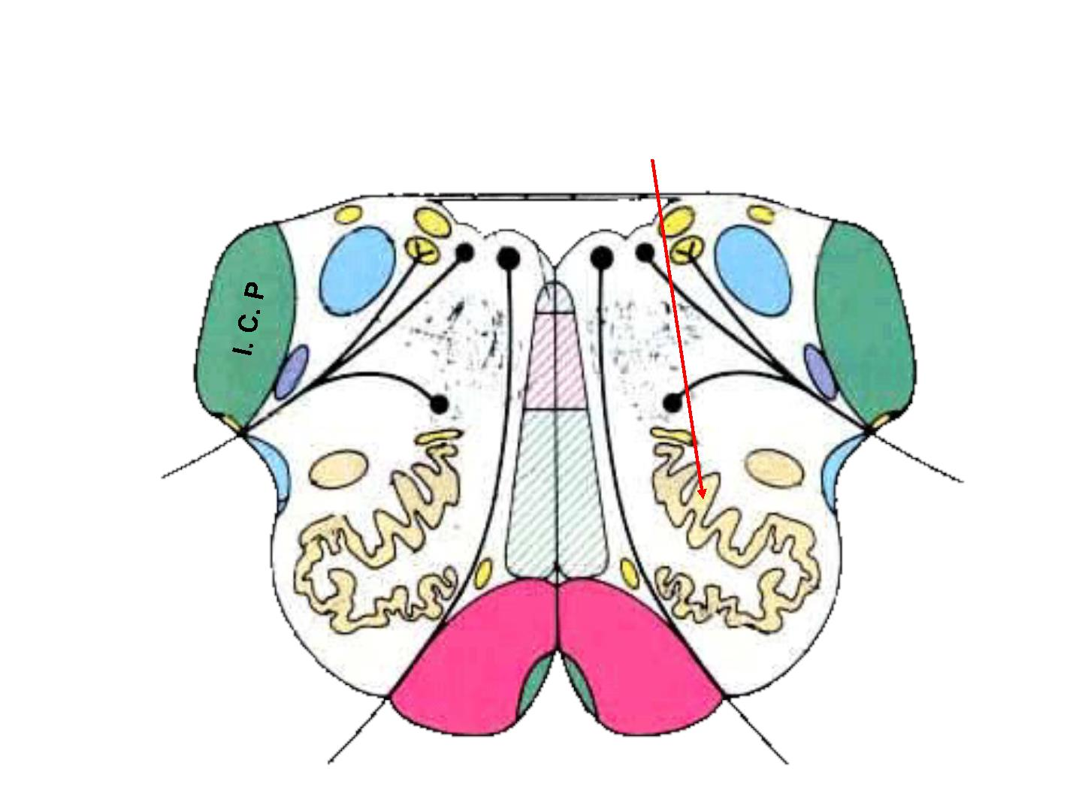
C. Transverse secti ons of the medul l a oblongata:
L evel of decussat i on of Ol i vary nucl ie
I.C.P : Inferior cerebellar peduncle

Slide 25
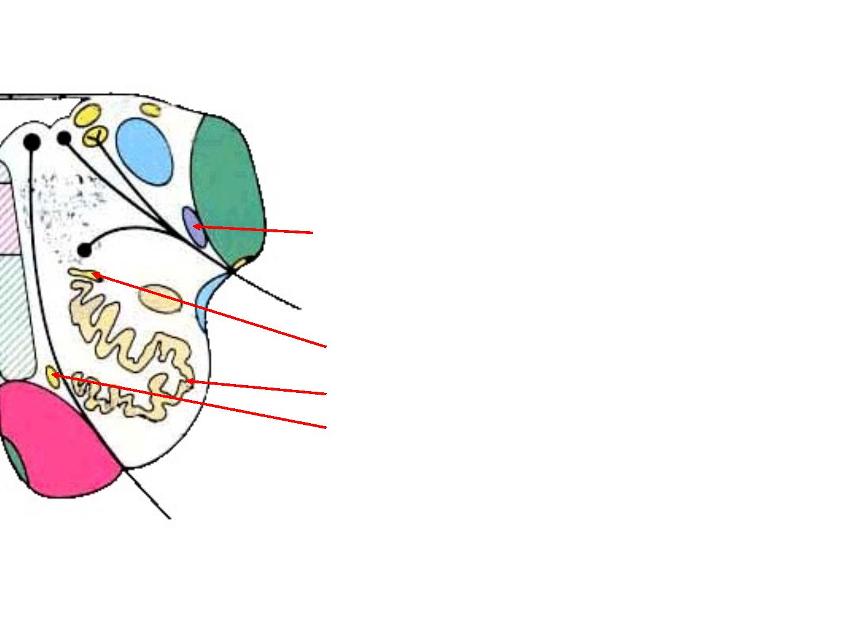
Nucl ei :
Spi nal nucl eus of crani al nerve V,
D or sal accessor y ol i vary nucl eus
I nferi or ol i vary nucl eus,
M edi al accessor y ol i vary nucl eus

Slide 26
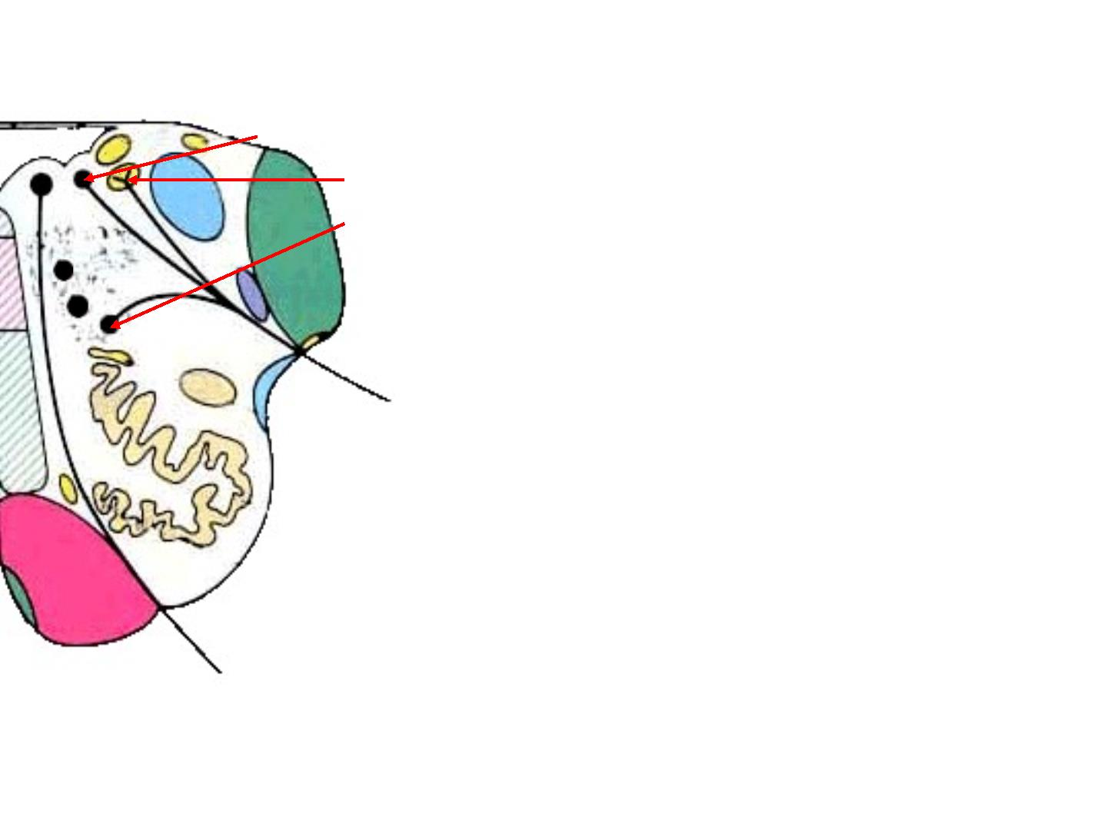
Nucl ei :
V agal nucl ei :
1. dor sal nucl eus
2. nucl eus of tractus sol i tari us
3. nucl eus ambi gi ous

Slide 27
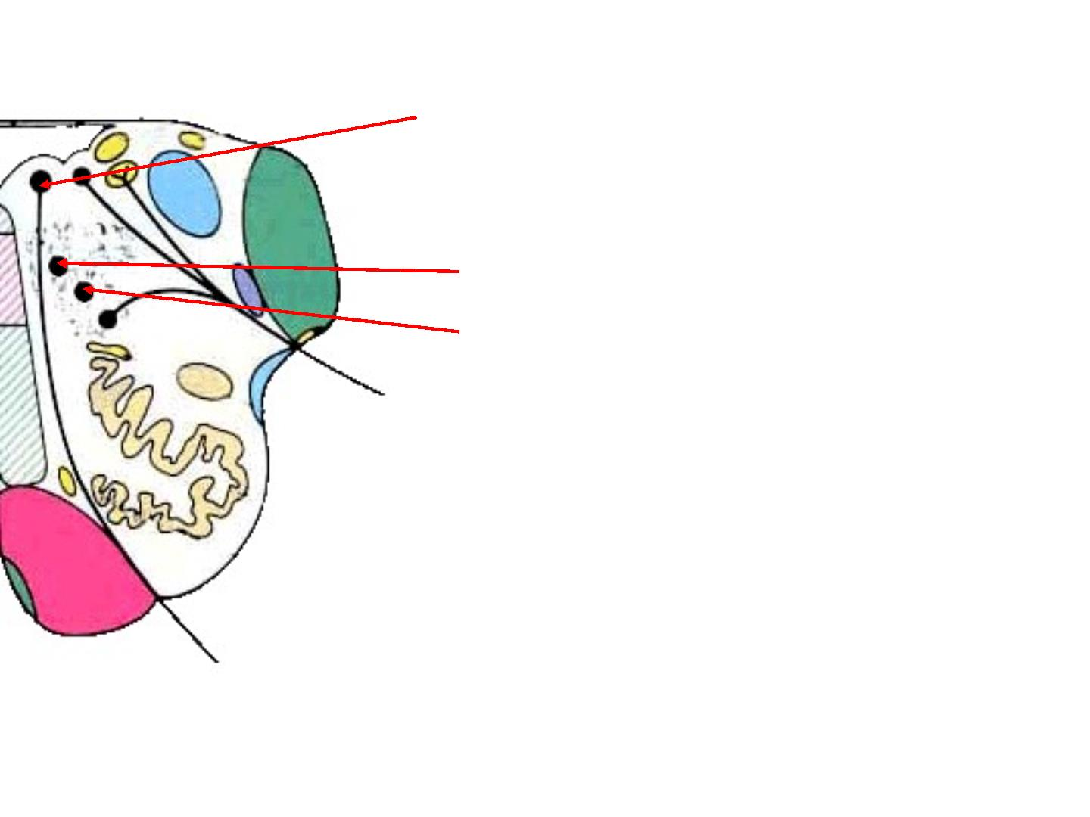
Nucl ei :
Hy pogl ossal nucl eus,
Gl ossophar y ngeal nucl ei :
1. i nferi or sal i vatory n.
2. mai n mot or n.

Slide 28
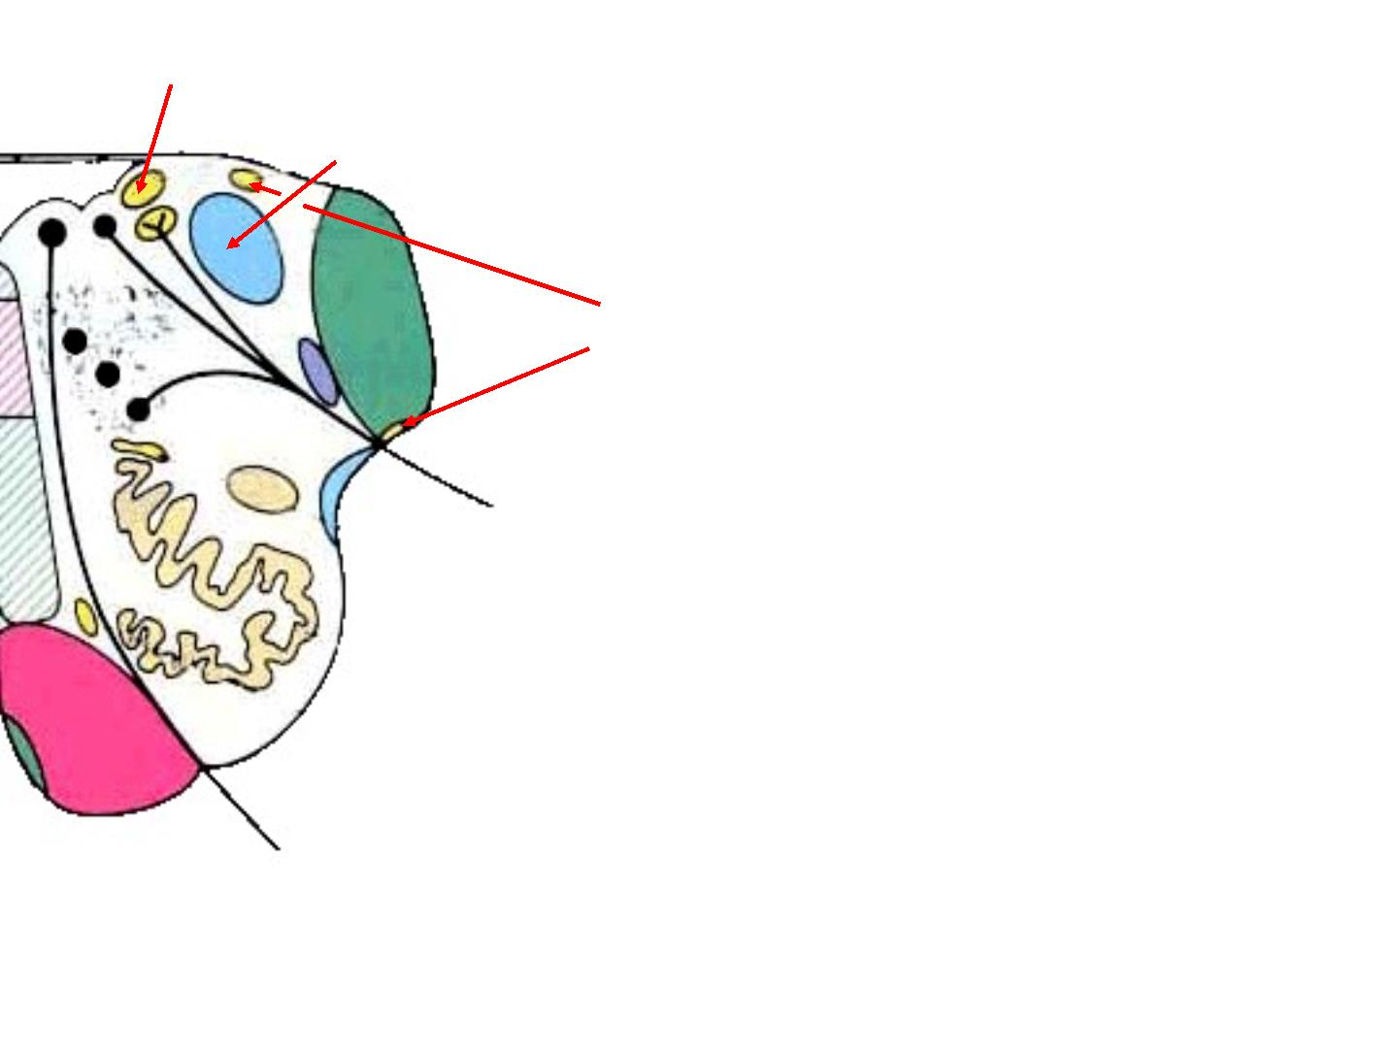
V esti bul ar nucl ei :
1. medi al n.
2. i nferior n.
Cochear nucl ei :
1. posteri or n
2. anteri or n.

Slide 29
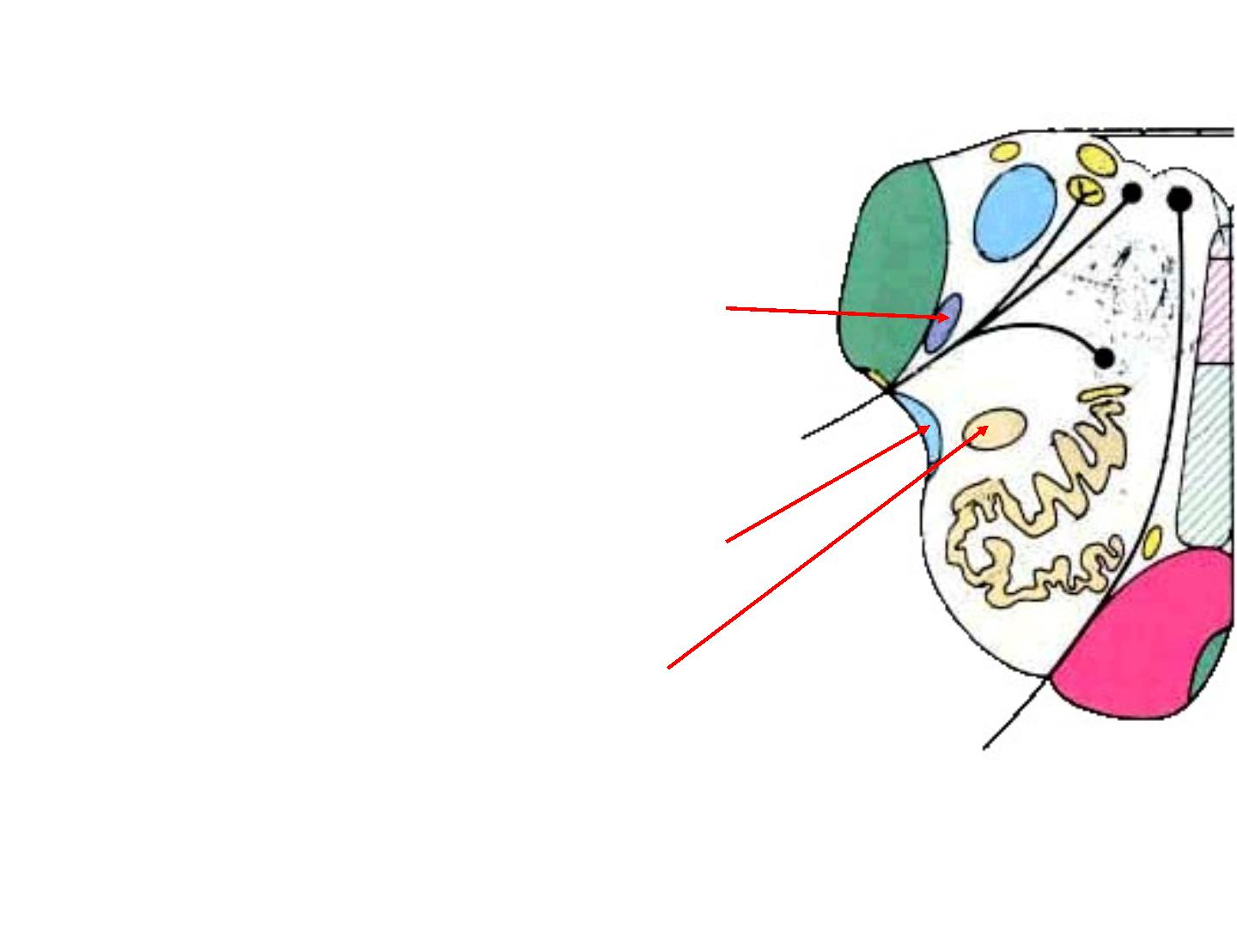
Tracts :
1. Spi nal tract of crani al nerve V,
2. A nteri or spi nocerebel l ar tract
3. L ateral spi nothal ami c tract,

Slide 30
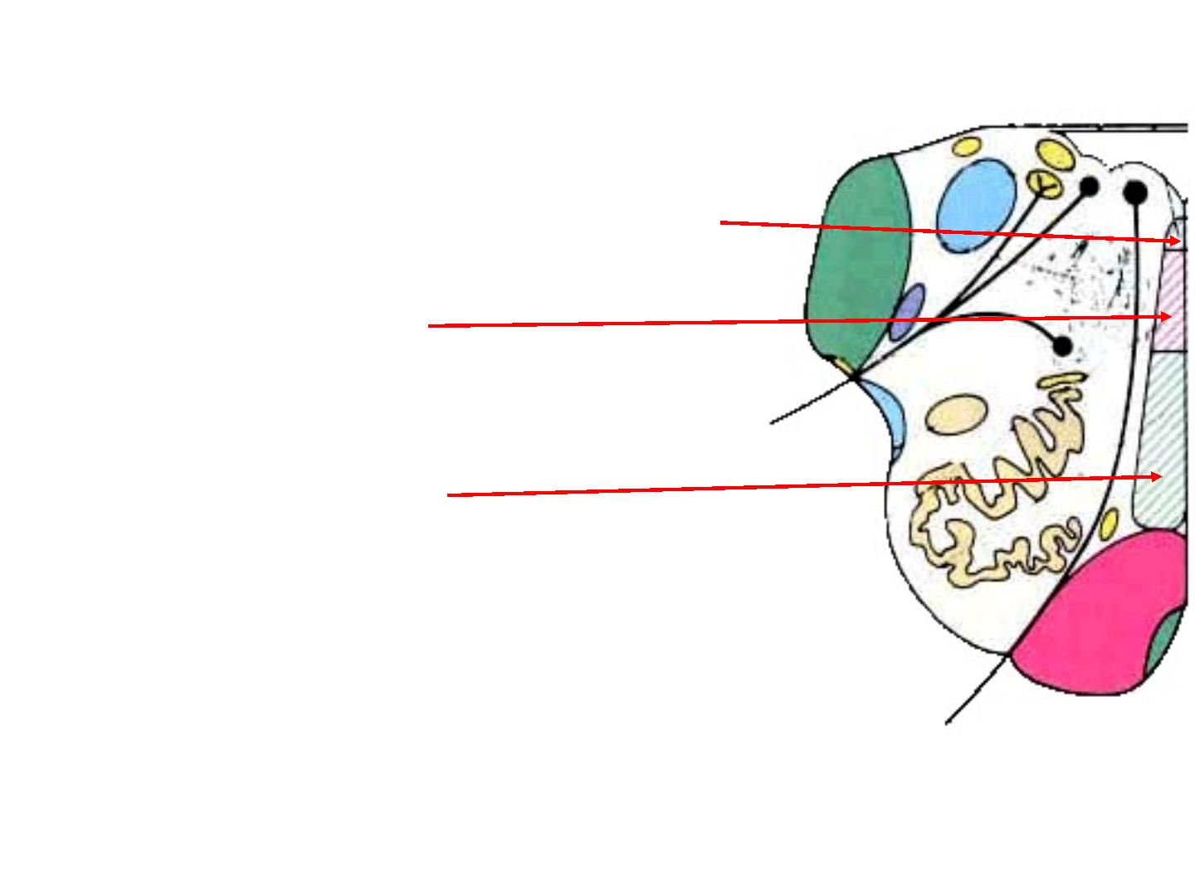
M edi al l ongi tudi nal f asci cul us,
Tectospi nal tract,
M edi al l emni scus,

Slide 31
Pons

Slide 32
Ante rior surface :
•
•
•
The pons is anterior to the
cerebel l um
connects the medul l a
obl ongata to the mi dbrai n.
PONS
The anteri or surface is
conv ex f rom side to si de

Slide 33
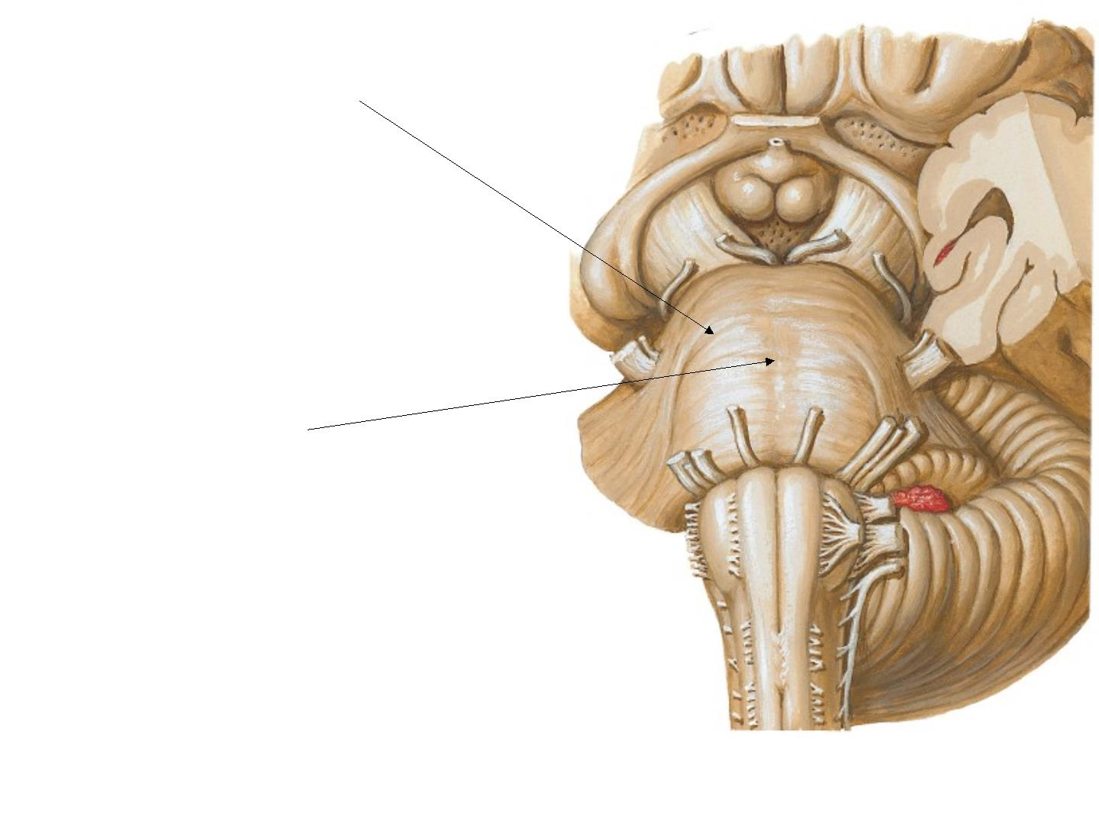
•
•
Transverse f i bers
t hat converge on
side to f orm the mi ddl e
cerebel l ar peduncl e.
eac h
Basi l ar gr oov e
a shallow groove in the
mi dl i ne, lodges the basilar
artery.

Slide 34
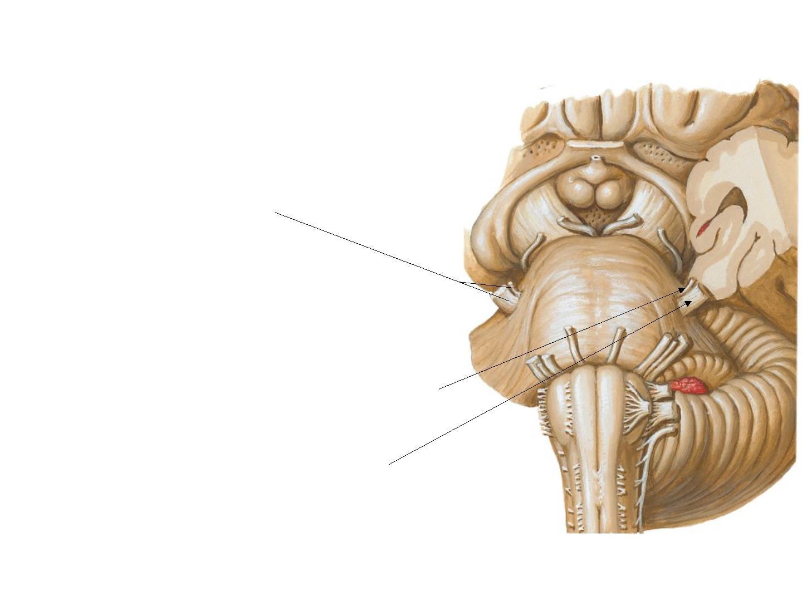
• Tri gemi nal nerve
emerges on eac h
side from the anterol ateral
surface of the pons. Each nerve
consi sts of a smaller, medi al
part, k nown as themot or root,
and a larger, l ateral part,
k nown as thesensor y root.

Slide 35

• In the groove
bet w een the pons
and the medulla,
emer ge, f rom
medi al to l ateral :
1. A bducent ner v e,
2. Faci al ner v e,
3. V esti bul ocochl ear
ner v es.

Slide 36
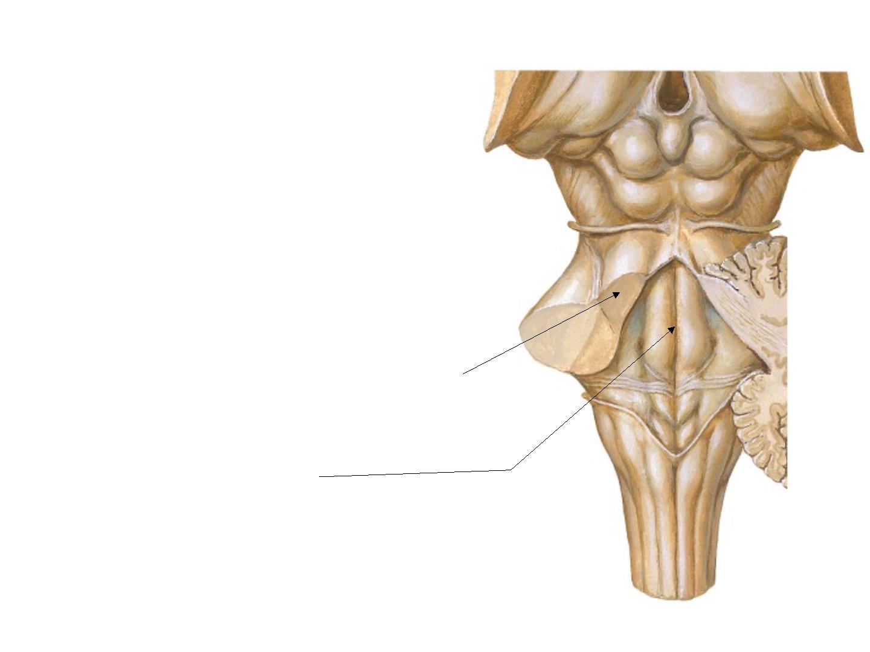
Posteri or surf ace
• Its triangular is hidden by
cerebel l um
• It forms floor of upper 1/ 2 of 4th
ventri cl e
• The posteri or surface is limited
l ateral l y by the
superi or cerebel l ar peduncl es
• di vi ded i nto symmetri cal hal ves
by amedi an sul cus.

Slide 37
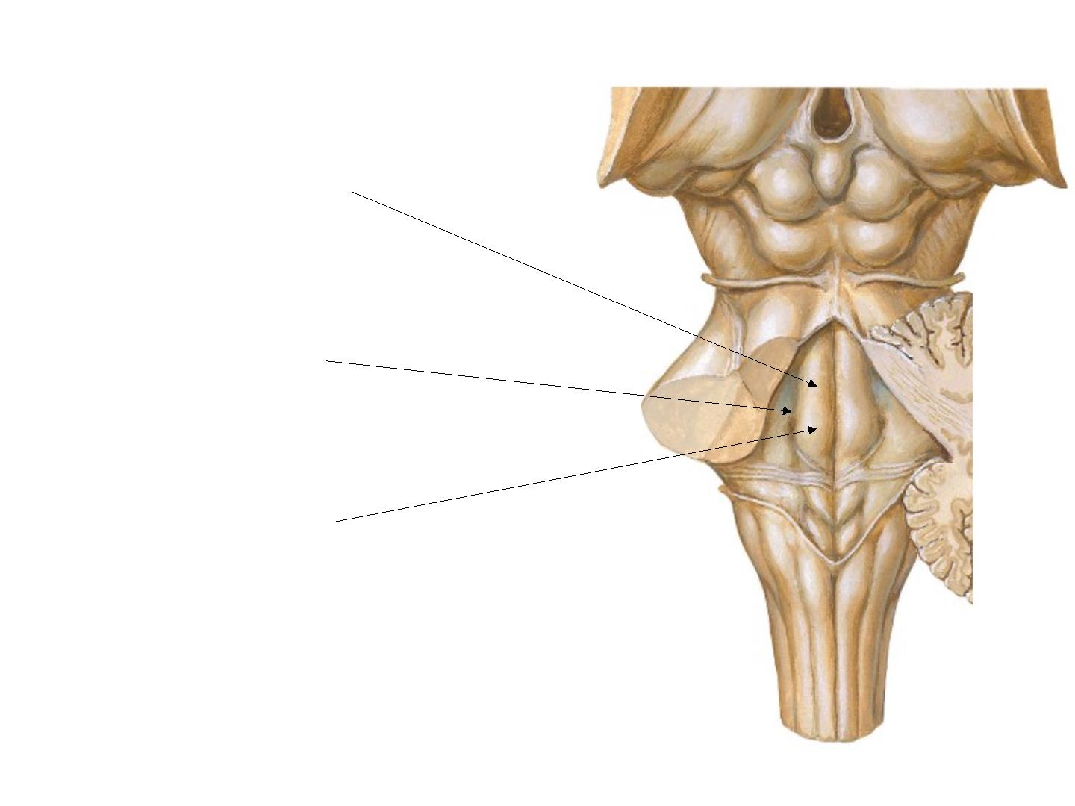
• L ateral to medi an sul cus
is an el ongated el evati on :
M edi al emi nence,
• M edi al eminence is
bounded l ateral ly by :
Sulcus limitans.
• I nferi or end of the medi al
emi nence i s expanded as:
Faci al col l i cul us,
(whi ch i s produced by the root
of the facial nerve winding
ar ound the
abducent nucl eus)

Slide 38

• L ateral to the sulcus
limitans is the :
Area vestibuli
( pr oduced by
the underl ying
vesti bul ar nucl ei ).

Slide 39
Bl ood Suppl y of Pons :
By the
1. basi l ar artery
2. A nteri or cerebel l ar
3. I nf eri or cerebel l ar,
4. superi or cerebel l ar
arteri es.

Slide 40
I nternal f eatures of Pons

Slide 41

A
Level
Faci al col l i cul us
Four t h ventri cl e
Cav ity
Nucle i
Spi nal nucl eus of crani al nerve V,
A bducent nucl eus, Faci al nucl eus,
M edi al vesti bul ar nucl eus,
Ponti ne nucl ei , Trapezoi d nucl ei
Corti cospi nal and Corti conucl ear
Motor Tracts tracts, Transverse ponti ne f i bers,
M edi al l ongi tudi nal f asci cul us
Spi nal tract of crani al nerve V;
Se nsory Tra cts
M edi al l emni sci

Slide 42
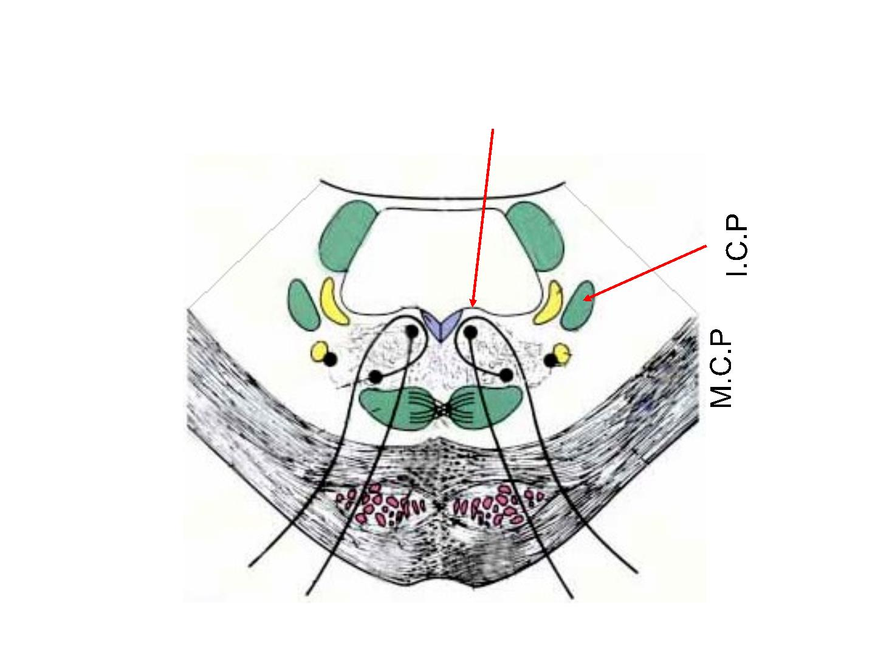
Transverse secti on t hr ough the pons :
at the level of the facial col l i cul us.
4th ventricle
MCP & ICP : Middle & Inferior cerebllar peduncles respectively

Slide 43
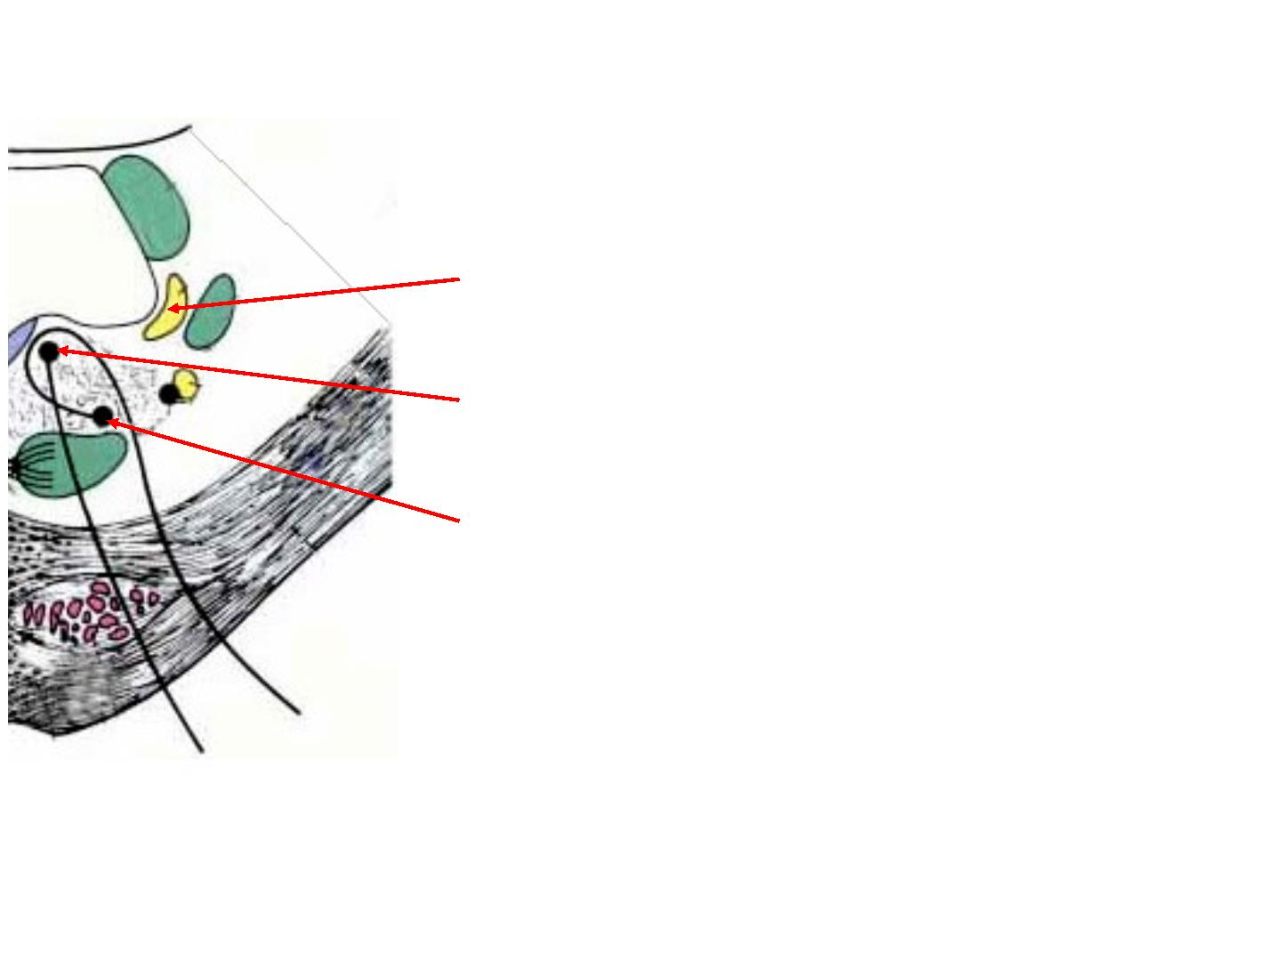
M edi al vesti bul ar nucl eus,
A bducent nucl eus,
Faci al nucl eus

Slide 44
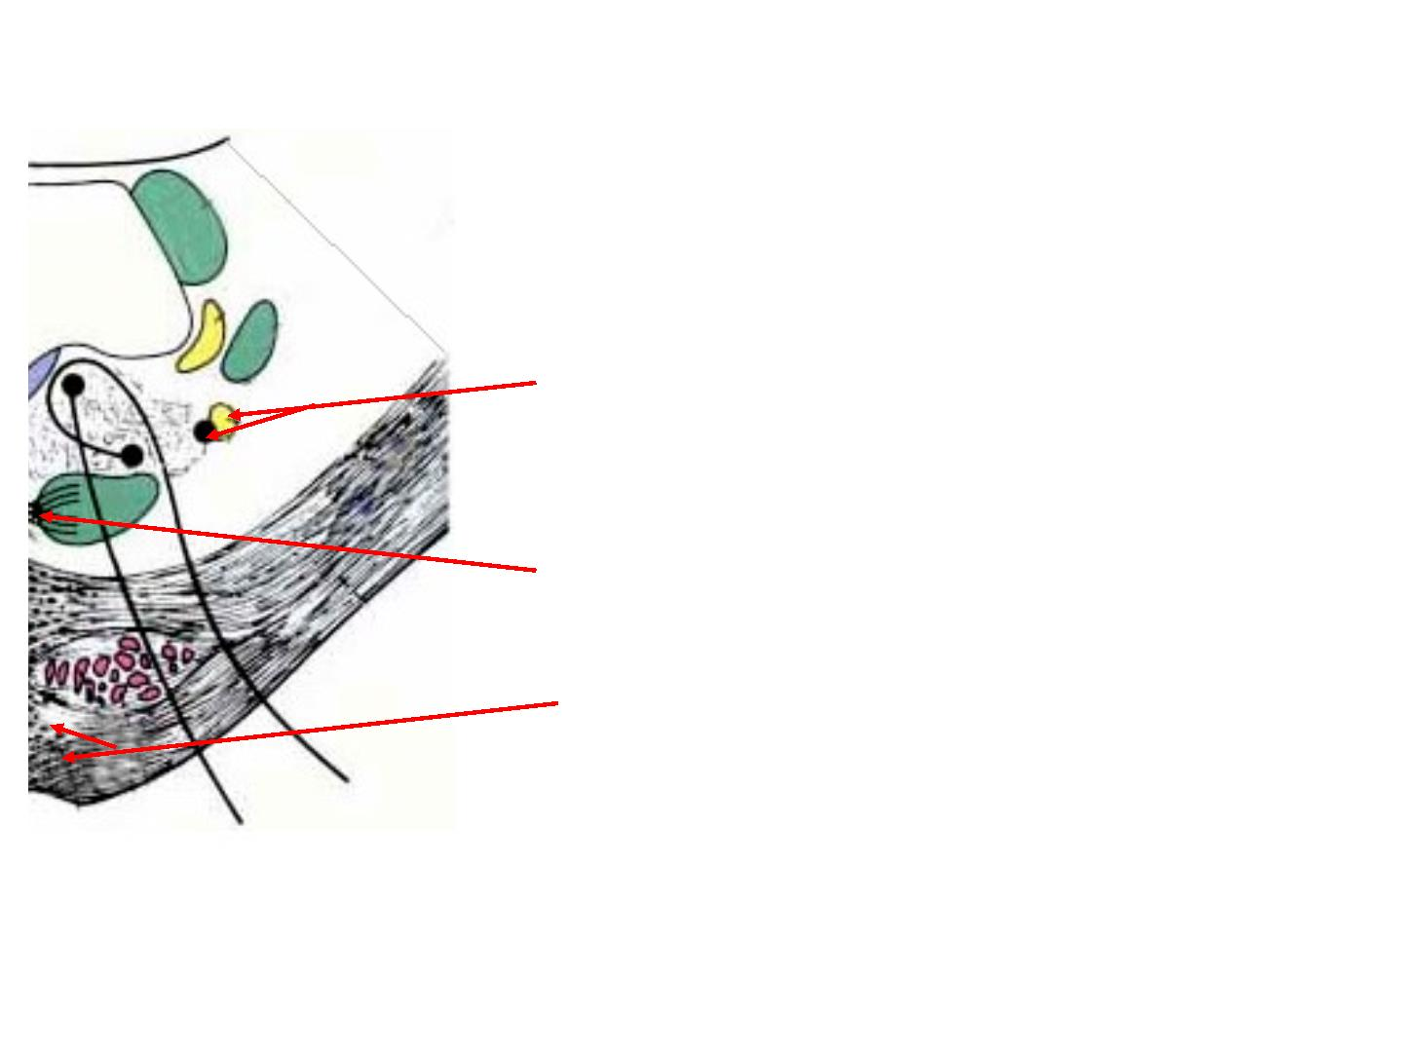
Spi nal tract & nucl eus of crani al
nerve V,
Trapezoi d nucl eus
Ponti ne nucl ei ,

Slide 45

M edi al l ongi tudi nal f asci cul us
M edi al l emni scus
Transverse ponti ne fi bers
Corti cospi nal and Corti conucl ear tracts,
,

Slide 46

B
Level
Tri gemi nal nucl ei
Four t h ventri cl e
Cav ity
Nucle i
Main sensor y and mot or nucl eus of
crani al nerve V,
Ponti ne nucl ei , Trapezoi d nucl ei
Corti cospi nal and corti conucl ear tracts,
Transverse ponti ne f i bers,
Motor Tracts
M edi al l ongi tudi nal f asci cul us
Se nsory Tra cts
M edi al l emni sci

Slide 47
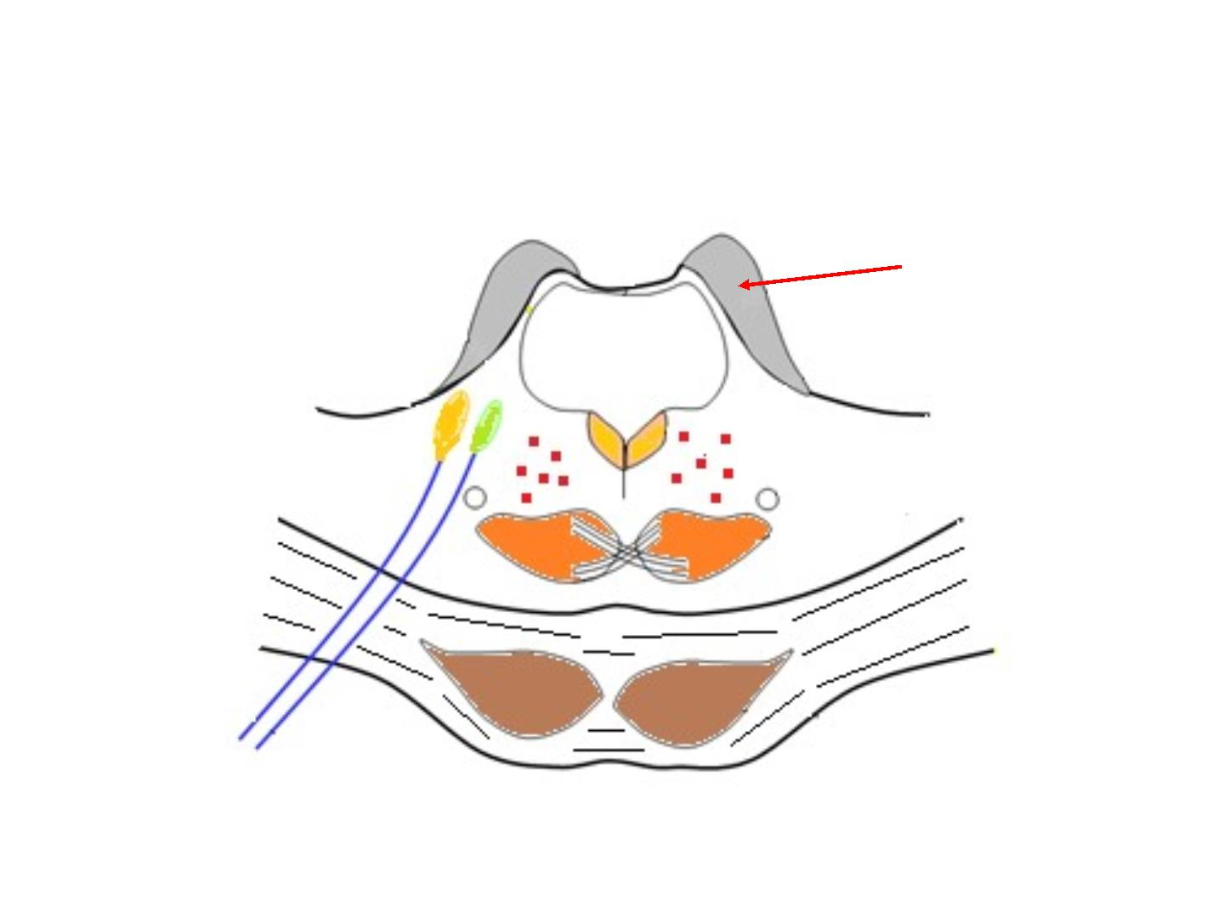
Transverse secti on t hr ough the pons :
at the at the level of the tri gemi nal nucl ei ..
S.C.P
4th ventricle
SCP : Superi or cerebel l ar peduncl e

Slide 48
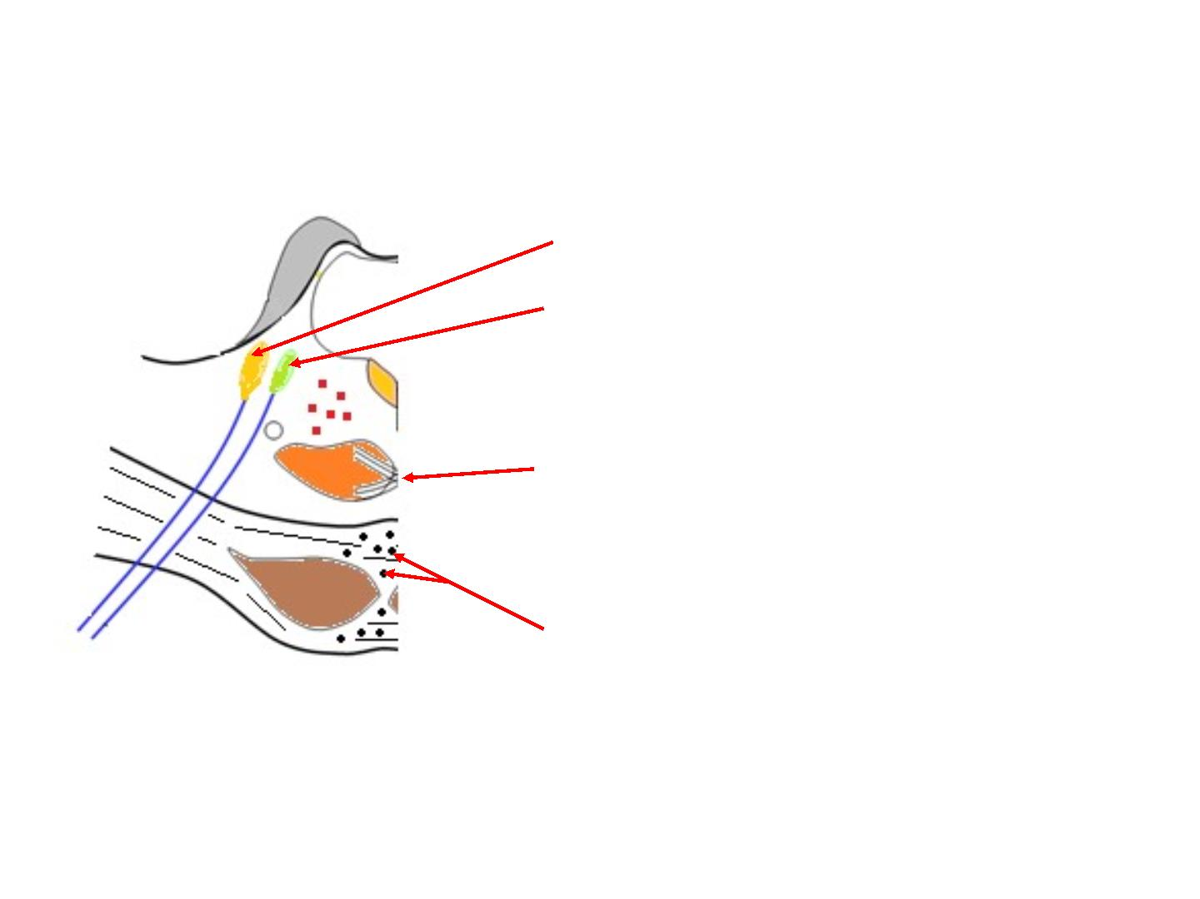
Nucl ei of crani al nerve V:
1. Main sensor y n.
2. M otor n.
Trapezoi d nucl ei
Ponti ne nucl ei ,

Slide 49
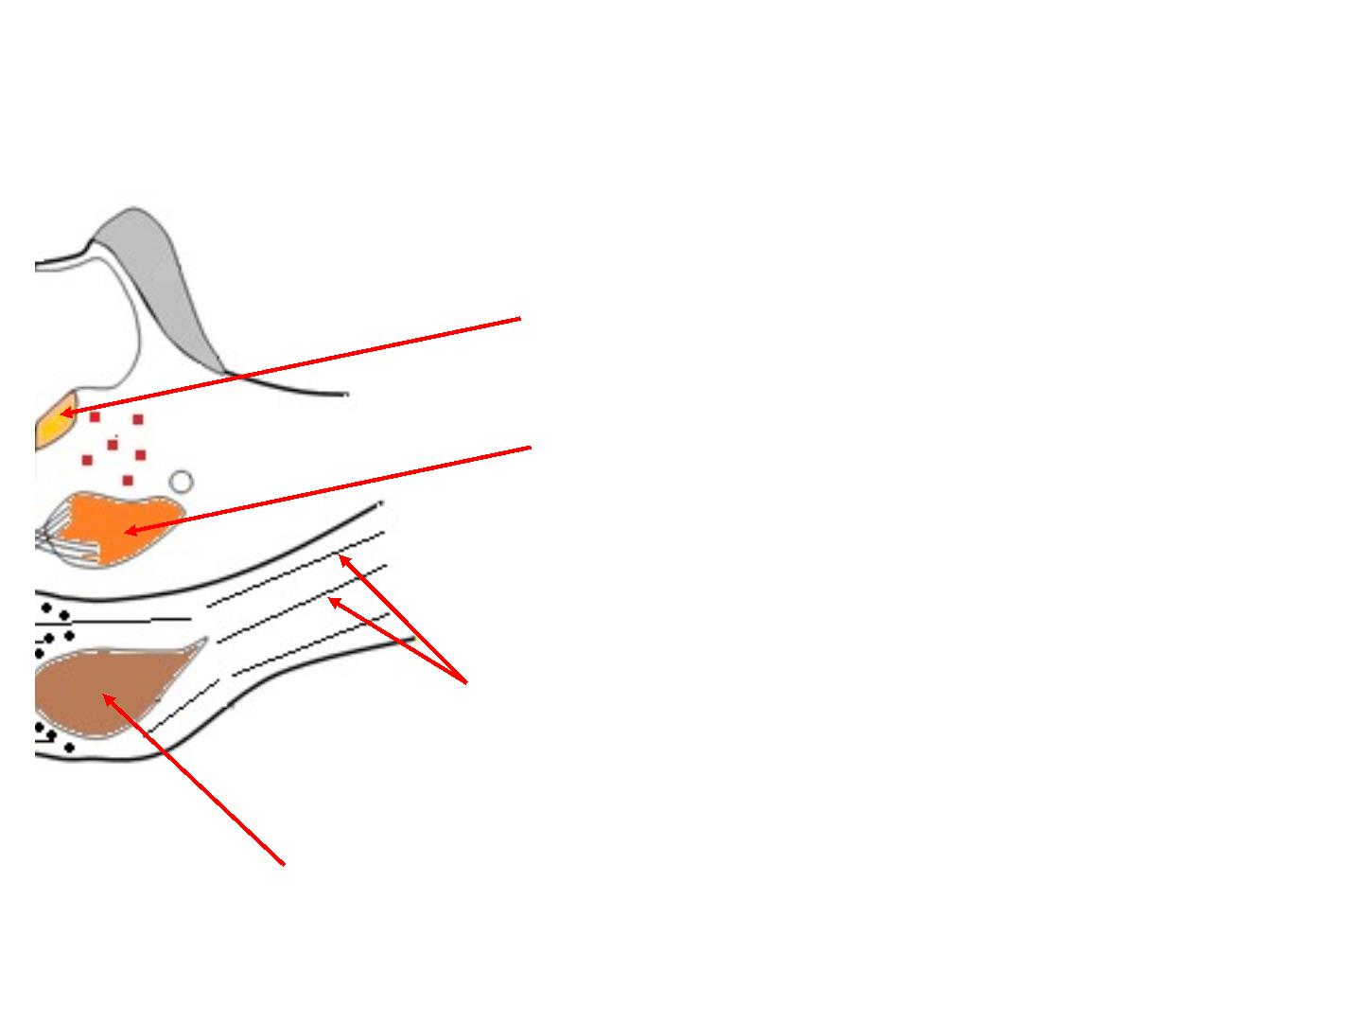
M edi al l ongi tudi nal f asci cul us
M edi al l emni sci
Transverse ponti ne fi bers
Corti cospi nal and Corti conucl ear tracts,

Slide 50
Thanks

