Slide 1
The scalp
It’s the soft tissue covering the valt of the skull

Slide 2
Extends ;
ant. To the supra orbital line
Each side to the sup. Temporal line
Post; external occipital protuberance & highest nuchal line

Slide 3
Layers of the scalp
1- (S)-skin; rich in hair follicles and sebaceous gland
The commonest site of forming sebaceous cyst
2- ( C)connective tissues it contain the nerve and vessels of the scalp
3- (A)aponeurosis of occipito frontalis m; its called epicranial aponeurosis
4-(L) loose areolar connective tissue
5- (P)periosteium ( peri craneium)(its loosely attach to the bone but firmly attach to the suture line)

Slide 4
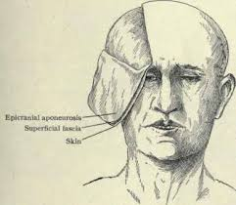

Slide 5
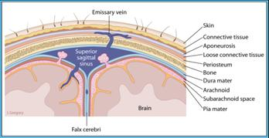

Slide 6
Fissure or fracture produce localized haematoma >why?
Occipitofrontalis muscle;
It’s a muscle of the scalp formed of;
A- 2 frontal bellies anteriorly
B- 2 occipital belies posteriorly
C- aponeurosis called epicranial aponeurosis

Slide 7
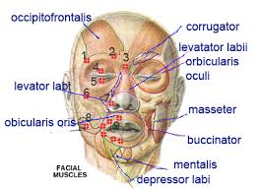

Slide 8
Arterial supply of the scalp
The scalp has very rich blood supply it have 10 arteries , 5 on each side 3 arteries infront of auricle and 2 behind the auricle.
A- arteries in front of auricle;
1- supratrocheolar art---ophtha .art
2- supra orbital art.---ophth.art
3- superfacial temporal art. As a terminal br. Of ext carotid art. Inside the parotid gland

Slide 9
Arteries behind the auricle
Post. Auricular art. Br. Ext. carotid art
Occipital art. From ext. crotid art.
Veins of the scalp;
5 veins drain the scalp on each side corresponding the name of art.
1- supra tocheolar } both unites at the medial side of eye to form ant facial vein
2- supra orbital vein }

Slide 10
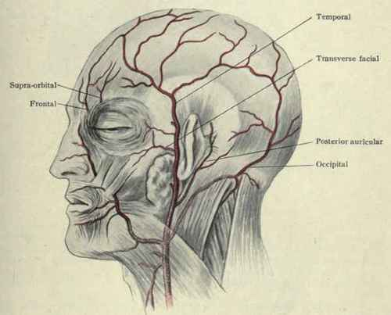

Slide 11
3- superfacial temporal vein enter the parotid gland and unite the maxillary vein to form retromandibular vein
4-post. Auricular vein unite with post division of retromandibular vein to form ext. jugular vein
5- occipital vein drain in to the internal jugular vein

Slide 12
Nerve supply of the scalp
20 nerve supply the scalp ;
10 on each side.
5 nerves inter the scalp infront the auricle and 5 from behind
4 of these 5 nerve are sensory and one motor

Slide 13
The face
Skin; elastic , very vascular , rich in sebaceous gland and sweat glands.
Superfacial facia contain numerous of muscles vessels ,nerves& fat.
Deep fascia is absent except in parotid gland and buccinators muscle.

Slide 14
Muscles of the face
Characterized by
* they presents in superfacial facia
* they have bony origin
*they are inserted to the skin without tendon
* they arrange them self around the opening of the face in 2 group a- dilated group b- sphincter group.
* they are supply by facial nerve

Slide 15
Muscles divided to 2 groups
Large muscles 3 which are;
1-buccinotor m
2- orbicularis oris m
3- orbicularis occuli m

Slide 16
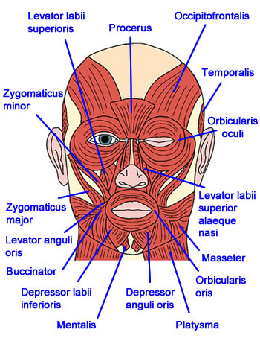

Slide 17
Nerve supply of the face
A- motor to the facial muscle by branches of facial nerve
B- sensory to the skin by trigeminal nerve supply most of the skin and greater auricular nerve supply over the angle of the mandible

Slide 18
Facial nerve
It’s the 7th cranial nerve and give 7 branches;
Course through extra cranial part ;
Leave the skull through stylomastoid foramina
Then it pierces the post medial part of parotid gland, it end in the gland by dividing into 5 terminal branches

Slide 19
Branches of facial nerves
2 branches before entering the parotid gland and 5 br. In side the gland
1- post. Auricular br. 2- br. To post belly of diagasrtic ( those 2 br. Out side the gland)
5 terminal br are;
1-temporal branch
2-zygomatic br.
3-buccal branch
4-marginal mandibular branch
5-cervical branch

Slide 20
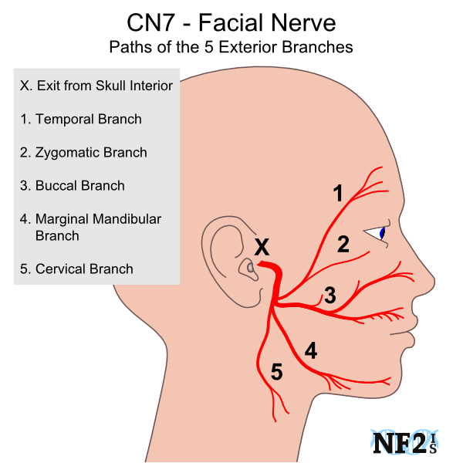

Slide 21
Sensory supply of the face
The skin of face supply by 3 division of trigeminal nerve(ophth, maxillay & mandibular N) except small area over the angle of mandible and over the parotid gland supply by greater auricular nerve which is br. From cervical plexus.
Ophthalmic nerve ; supply area forehead , upper eyelid, and infront of the nose including the tip

Slide 22
Maxilary nerveSupply the skin over the maxilla including inner nose, lower eyelid and upper lip
Manidibular nerve supply the skin over the mandible

Slide 23
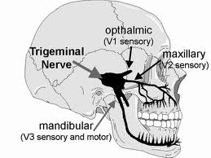

Slide 24
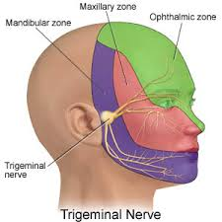

Slide 25
Arterial supply of the face
The face is supply by 2 sets of arteries ant & post.
Anterior set of arteries;
1- facial artery; it’s the principle artery of the face its originate from ext. carotid art.
It end at the medial angle of the eye by becoming the angular artery.
Branches in the face;
Inf & sup.labial art and nasal art.

Slide 26
2- supratrochealar art;
3- supra orbital art
4-infraorbital art( it’s a continuation of maxillary art)
5- mental art it’s a branch of inf alveolar art.

Slide 27
Posterior set
1- transverse facial artery
2- zygomatico orbital art.
Both from superfacial temporal artery

Slide 28
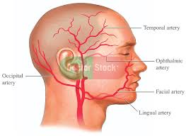

Slide 29
Venous drainge of the face
Face drain by
1- anterior facial vein
2-retromandibular vein

Slide 30
Parotid glands
Size is the largest salivary gland , mainly serous secretion
Site and extension;
It locate below the auricle it occupy the space between the ramous of mandible and stern mastoid muscle. It extend ;
Up word ; to the root of zygomatic arch
Down word to the angle of mandible
Anterioly; to cover part of master m.

Slide 31
Post; to overlap the sternomastoid m
Medialy to the pharyngeal wall
It consist of 2 part
Superfacial part which is the main part and large part.
Deep part small part
Parotid duct;( stenens duct) 5 cm long arise from ant. Part.

Slide 32
3- post glenoid part lie in contact with ext. audatory meatus behind the temporo -mandibular joint
4- accessory part small part lie between parotid duct and zygomatic arch.
Parotid duct;( stenens duct) 5 cm long arise from ant. Part.

Slide 33
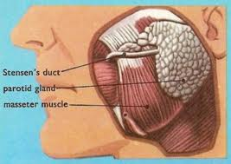

Slide 34
Stracture inside of parotid gland
1- facial nerve the most superfacial structure and it divided to 5 terminal br.
2-retromandibular nerve; it forms inside the gland by union of ?
3-external carotid artery the deepest structure
4-Auroculotemporal nerve; impeded in the upper part of the gland
5-deep parotid l.n

Slide 35
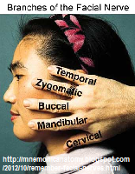

Slide 36
The parotid duct
5 cm long it begin at ant. Border of the gland \it end by open in vestibule of the mouth at opposed to upper 2nd mollar tooth. It has as oblique course in side the buccinator m.
Providing a valvulur mechanism
Blood supply; small br. From ext. carotid art
Venous drainage in to retrombandibular vein
L.n to deep and superfacial parotid l.n
Nerve supply; sensory –greterauricular nerve-- capsule and C.T
auricular temporal nerve supply the parenchyma
Sympathetic– from sympathetic plexus around E.C.A. and middle meningel art.

Slide 37
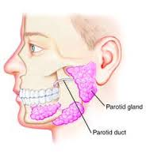

Slide 38
Capsule of parotid gland
The gland has no true fibrous capsule .
The gland acquire facial capsule from investing deep fascia of the neck which split to 2 layer at the lower border of the gland
1- superfacial layer which enclose the superfacial part and the masster m. and its attach above to the zygomatic arch.
2- deep layer which cover the inner surface of the gland , it produce the stylomandibular ligament which separate the lower border of gland from the submandibular salivary gland.

Slide 39
Cranial cavity
Inside the cranial cavity the brain which envelope by meanings ( dura matter, arichenoid matter, and pai matter) from out side to inside
Dura matter; its formed of strong white fibrous tissue, its consist of 2 layers, outer and inner layer. the outer layer separate from inner layer to form the dural venous sinus

Slide 40
Dural folds
They are membrane fold inside the cranial cavity produced by in word reduplication of inner layer of dural matter between the different parts of the brain
Functions;
1-they partially subdivided the cranial cavity into compartments so this decrease the effects of shocks on the brain
2- they support the upper part of the brain thus protecting its lower part from being pressed on

Slide 41
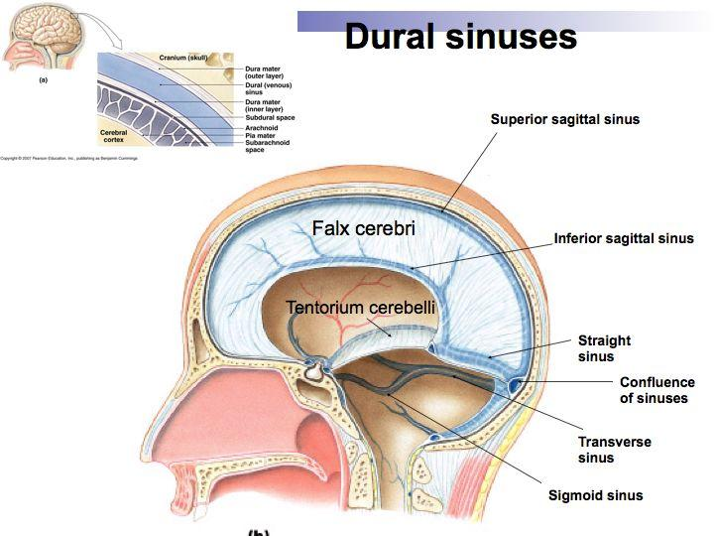

Slide 42
Types of dural folds
1- vertical folds which include;
A- falx cerebri
B- falx cereballi
2- horesental folds; which include
A- tentorium cerebelli
B-diaphragma sellae
C-cavum trigiminale

Slide 43
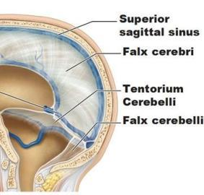

Slide 44
Falx cerebri
Its sickle shaped fold of dura.
Site; it descend from the dura of the vault of skull to occupy the median longitudinal fissure between the 2 cerebral hemispheres and above the corpous collosm.
Parts and attachments;
Apex; its tapering its ant end, its attached to the crista galli and frontal crest.

Slide 45
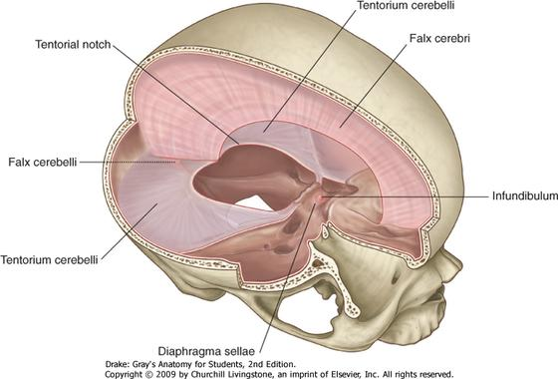

Slide 47
Base. The post broad end its continuous with the upper border of tentorium cereballi.
Upper convex; ( attach border) attach to the lip of sup. Sagittal sulcus.
Lower concave; (free border) lie above the corpous collosum in the bottom of median longitudinal fissure of the brain.
Venous sinuses related to the falx cerebri;
1- sup.sagittal sinus 2-inf. Sagittal sinus 3- straight sinus

Slide 48
Falx cereballi
It’s a dural folds lying between rt and lf cereballar hemispheres.
Its triangular in shape.
Parts and attachments;
Base; above and its continuous with lower layer of tentorium cereballi.
Apex . Below and reach to the post. Border of foramen magnum.
Ant. Border project upward between the 2 cereballar hemispheres.
Post border attach to the internal occipital crest.

Slide 49
Tentorium cereballi
Site; it’s a dural fold which roof the post cranial fossa separating the cerebrum above from cerebellum below.
Shape ; tent shape having a peak above.
Surface;
Upper surface ; give attachment to the falx cerebri.
Lower surface give attachment to the base of falx cereballi.

Slide 50
Dural venous sinus related to the tentorium.
1- the rt and lf sup. Petrossal sinuses
2-rt and lf transverse sinuses.
3- the straeight sinus.
Cavum trigiminale.
It’s a sacculated fold of the inner layer of the dura mater in the middle cranial fossa near to the apex of the petrous temporal bone , its cover the trigiminal ganglion.

Slide 51
Diaphragma selle
It’s a circular fold in the inner layer of dura mater that roof the sella turcica above the pitutary gland.it has a central hole of the infindibulium.

Slide 52
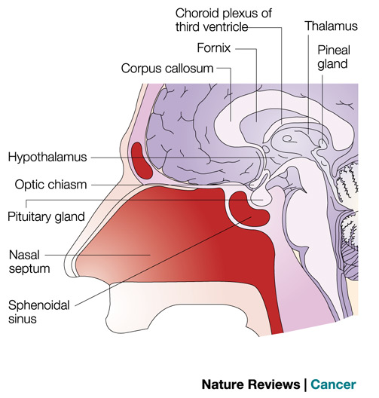

Slide 53
Dural venous sinuses
They are venous channel inside the cranial cavity between inner and outer layer of dural matter.
Character; 1- they are may single ,pair or multiple
2- they are devoid of valve
3- they are lined by endothelium
4-many of them groove the bone on which they lie.

Slide 54
Tributaries; there tributaries mostly com from brain ,menenges,orbit, internal ear, they also drain C.S.F. they may be communicate with extra cranial vein through emissary vein.
Drainage all sinus drain into internal jugular vein

Slide 55
Classification
Single sinuses; sup. Sagital sinus , inf. Sagital sinus, strait sinus , occipital sinus basilar sinus
Pair sinuses; sphenopariatal sinus, cavernous sinus, sup. Petrosal sinus, inf.petrosal sinus, transverse sinus , sigmoid sinus, inter cavernous sinuses

Slide 56
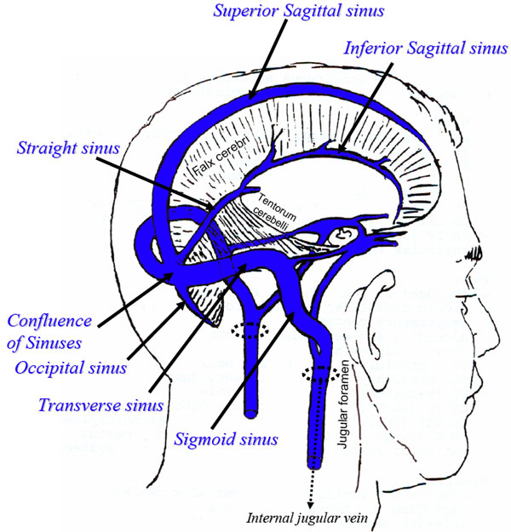

Slide 57
Sup. Sagittal sinus
It begin at the apex of falx cerebri above the crista galli and terminate by becoming rt transverse sinuse
It’s a largest venous sinus its size increase as it pass back word.
Course ; its pass backward at the upper convex border of falx cerebri, grooving the inner aspect of skull cap, forming the sup. Sagittal sulcus.

Slide 58
Inf. Sagittal sinus
It lie in the inf. Border of post. 2/3 of falx cerebri.
It end by free margin of tentorium by uniting with grear cerebral vein to form the straight sinus.

Slide 59
Straight sinus
Its formed by union of great cerebral vein with inf, sagittal sinus.
It terminate at the int. occipital protuberance it usually tent to the lf forming lf transverse sinus.
An apithelio ?sinosidal body; lying on the anterior part of the sinus controls the flow of venous flow from the great cerebral vein thus regulate the formation of C.S.F.

Slide 60
Cavernous sinus
Its one of the most important dural sinus.
Its name come from that its cavity contains network of interlacing trabiculi ( cavernous) giving it spongy appearance.
Its lie on the side of the body of sphenoid in middle cranial fossa.
It extend from sup. Orbital fissure anteriorly to the apex of petrous temporal bone posterior.
It about 2 cm long and 1 cm width.

Slide 61
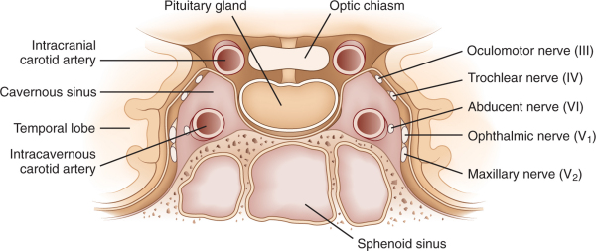

Slide 62
Relation
Anterior; ?
Posterior; ?
Medialy ; pitutirray gland , body of sphenoid& sphenoidal air sinus
Lat. Uncus of temporal bone of the brain
Sup. I.C.A
INF. Body of sphenoid and sphenoidal air sinus.

Slide 63
Structure inside the sinus
1- I.C.A. its pulsation help the drainge of sinus.
2- Abduscent nerve
3- Ophthalmic n
4- Maxillary n.

Slide 64
Structure imbedded in the lat. Wall of the sinus
3rd cranial n
4th cranial n.
Ophthalmic and maxillary nerve ( 5th )

Slide 65
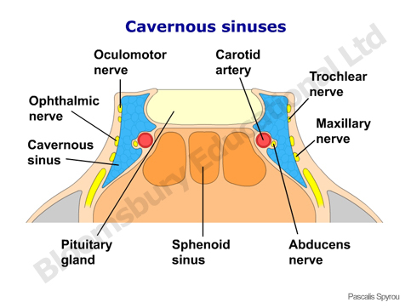

Slide 66
Tribuataries and commincation of the sinus
Ophthalmic v, sphenopariatal sinus,cetral vein of retina
Meddle cerebral v. , inf. Cerebral v
Emissary v. from pterigoid plexus
Intercavernous sinuses and veins from pituitary gland.
It drain to sup and inf . Petrossal sinus by 2 veins.

Slide 67
Clinical importance of sinus is any infection of danger area ( ?) cause thremposis of the sinus.which its very danger condition

Slide 68
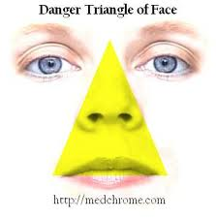

Slide 69
Sup. Petrosal sinus
Its begin from post end of cavernous sinus.
It end by joining the lateral end of transverse sinus
Inf. Petrosal sinus;
It begin from post .end of cavernous sinus
It end by opening into sup. Bulb of I.J.V

Slide 70
Transverse sinus
Its begin at the int. occipital protuberance as a follow;
The rt sinus is usually continuation of sup. Sagittal sinus.
The lf sinus usually continuation of straight sinus.
It end opposet the mastoid temporal bone by becoming segmoid sinus.

Slide 71
Sigmoid sinus
It begin as continuation of transverse sinus
Run in the sigmoid sulcus
End by passing through post compartment of jugular f. to become the IJV

Slide 72
Pituitary gland
It lie in hypophyseal fossa below the diaphragma sella.
Shape ; an ovoid body transverse diameter is 12 mm and ant.post. Diameter is 8 mm.
Relations;
Above; diaphragma sella which separate the gland from optic chiasma
Below ; body of sphenoid and sphenoidal air sinus saparatnig the gland from nasopharanx.

Slide 73
Ant. Trapiculium selle and sphenoidal air sinus
Post. Dorsum selle seperating the gland from
pons and basilar artery.
On each side ; cavernous sinuse and its contents
Blood supply ; inf & sup hypophyseal arteries branches from I.C.A
VENOUS DRAINGE; to the surounding dural sinuses ,cavernous and intercavernous .

Slide 74
Orbital cavity
Bony orbit; its pyromidal shaped spces in the norma frontalis having base apex and 4 wall.
Base; in the orbital opening
Apex lie in obtic canal
Walls ; medial ,lateral roof and floor.

Slide 75
Foramina and fissures in the orbit
Structres passing through it | Foramen
Optic nerve surounding by its meningese Ophthalmic art. | Optic foramen
3rd, 4th, 6th, cran. N and opthalmic nerve and vein | Sup. Orbital fissur
Infraorbital n. infraorbital a.zygomatic n , Emissary vein between inf. Orbital vein and pterigoid plexuses | Inf. Orbital fissure
Ant. Ethemoidal n & vessels | Ant. Ethemoidal fi
Post . Ethemoidal n & vessels | Post , ethemoidal fi
Infra orbital n and vessels | Infra orbital groove or canal

Slide 76
Contents of the orbit
1- the eyeball
2-7 extraocular m.
3- nerves of the orbits motor (3rd, 4th, 6th cr. N) and sensory neves.
4-vessels ( ophthalmic art. & sup and inf ophalmic vein)
5- orbital ligaments fascia and nerves

Slide 77
Lacrimal apparatus
Consist of lacrimal gland and its duct
Congectival sac
Lacrimal sac and nasolacrimal duct.
Lacrimal gland; consist of 2 parts
Main part; lis on lacrimal fossa in the roof of orbit .
palbepral part; imbedded in the lateral part of the upper eye lid .

Slide 78
The lacrimal glands give about 12 ducts open in to sup. Fornex of conjectiva.
Blood supply; lacrimal br. Of ophtha. Artery
Nerve supply ; lacrimal bra. Of ophthalmic nerve.

Slide 79
Extra occular muscles
Levetor palpebrae superioris; origin from post part of roof of the orbit just infront of optic f.
Insertion; it divide to 3 slips inserted to ;
1- the skin of the upper eyelid
2-the tarsus of the upper eyelid
3- the upper fornix of conjectiva.
N. suuply ; the sup. Division of 3rd cr. N.
Sympathetic fiber supply the deep part of the m.which is involuntary m.called mullers m.
Actions; elevate upper eyelid and upper fornix of conjunctiva

Slide 80
The 4 recti muscles ; sup. ,inf, medial and lateral; nerve supply by 3rd cr. N execpt so4
Functions; lat recus abduct the eye
Med. Rectus adducts the eye
Sup rectus ; elevate and adduct the eye
Inf. Rectus ; depress and adduct the eye

Slide 81
The oblique muscles
Sup oblique; function deppress and abduct and rotate the eye laterlly.(lock to your shoulder)
Nerve supply SO4
Inf. Oblique ;
N supply by inf. Devesion of occulomotor nerve
Action; elevate , abducts and rotate the eye lateraly.

Slide 82
Optic nerve
Its sensory nerve carrying visual impulses
Its fiber are the axons of the ganglion cells of the retina
Its end in the cranial cavity by joining the optic chiasma.
The optic nerve considered as a tract of the brain because;
1-it has no neurilemmal sheath so its fiber of in cabaple to regenerate
2- its suround by meningese
Optic nerve is pierce by central artery of retina ( br. Of ophthal art.)

Slide 83
Thank you

Slide 85
The skull
is the Skeleton of the head . It forms from
22 bones
one movable bone ;the mandible which artictilates at synovial joint •
21 immovable bones articalatirg together by fibrous joints,
The 21 immovable bones include

Slide 86
paired bones
8 paired bone rt to lf
Pariatal
Temporal
zygomatic
Iacrimal
maxillary
nasal
Palatine
Inf.concha

Slide 87
Unpaired bones
Frontal
Ethemoidal
Sphenoid
Occipital
vomer

Slide 88
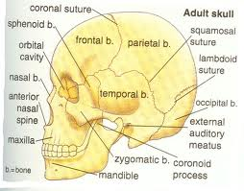

Slide 89
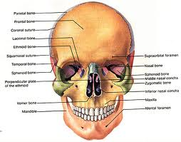

Slide 90
*Parts or the Skull
(1)Cranium: the upper and post, part which
encloses the brain
(2)Faciai Skeleton: is the ant. part of the skull
which includes
an upper Fixed part----
lower movable part. (the mandible)
,*-Different aspects of the Skull
(1) anterior aspect or Norma Frontal':.
(2)superior aspect or Norma Verticcilis,
(3)laterai aspect or Norma Lateral is
(4) posterior aspect or Norma Occipitalii,
(5)inFerior aspect or norma basalis
(6) the interior of the skull or Cranial cavity.
It study by removal of the skull cap

Slide 91
Cranial cavity
(A) INNER SURFACE OF SKULL CAP
Bones;
Frontal bone anteriorly
parietal bones on the sides
Occipital bone: posterior
* suture line;
Coronal , Sagittal, lambdoid

Slide 92
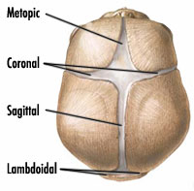

Slide 93
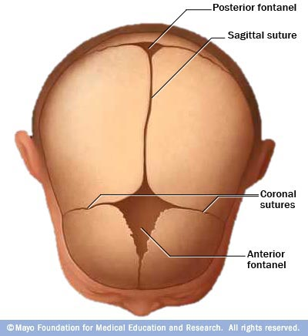

Slide 94
NORMA BASAL'S INTERN
- The narma basalis interna divided to 3 cranial fossa anterior Cranial fossa : is the highest ,Smallest ,lowest Middle Cranial; its lie behind and lower the ant.cranial
fossa & has a butler-fly shape,.
It has a small median part
(lodges the pituitary gland)
And 2 large lateral part lodges the temporal lobe of the brain
Post cranial fossa is the widest ,deepest lodes the hind brain

Slide 95
Anterior cranial fossa
Boundaries ;
anterior and lateral by frontal bone .
Post; by post margin of lesser wing of sphenoid bone.

Slide 96
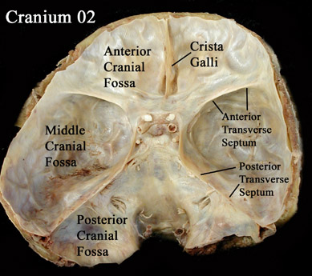

Slide 97
Foramen of ant cranial fossa
Foramen caecum; transmit emissary vein ( connect sup. Sagital sinus with nasal veins).
Foramen of cripriform palate of ethemoidal bone; transmit olfactory nerve.
Anterior ethemoidal foramena; transmit anterior ethemoidal nerve and vessels
Post. Ethemoidal foramina ----post. Ethemoidal nerve and vesels.

Slide 98
Middle cranial fossa
Boundaries
ant. ;
Post border of lesser wings of sphenoid bone and ant. Clinoid process
post.
Sup. Border of petrous, temporal bones and dorsum sellae

Slide 99
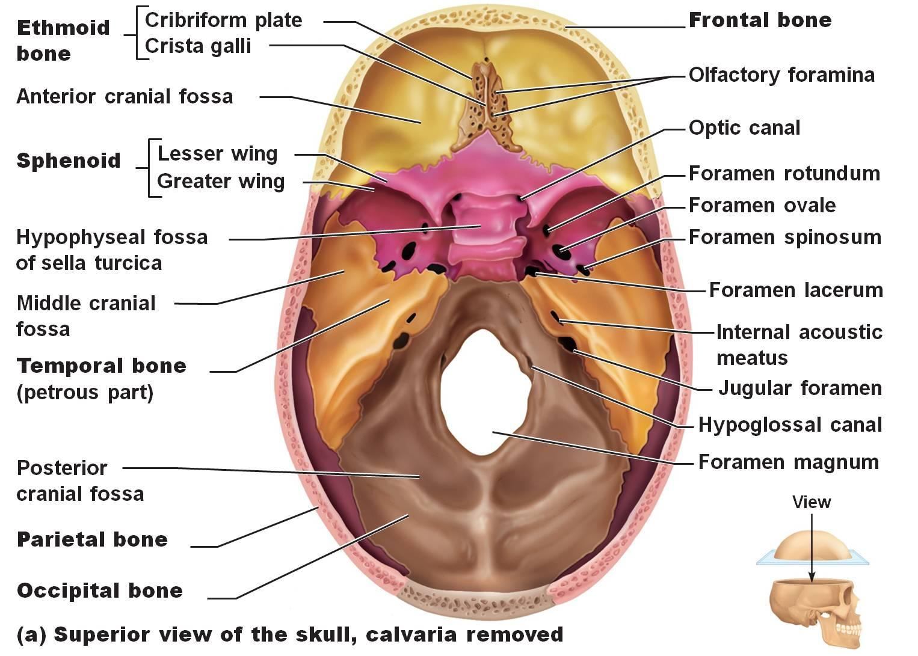

Slide 100
Foramen in middle cranial fossa
Optic foramina----optic N. and ophthalmic art.
F. lacerium---int. carotid art. + sympathetic plexus around the int. carotid artery
Meningeal br. Of ascending pharangeal art.
Emissary veinfrom cavernous sinus to the pterigoid plexus of ein
Supra orbital fissure;-----location between lesser and greater wing of sphenoid ----transmit---

Slide 101
Occulomotor N
Trochealear N
Ophthalmic N
Abduscent N
Ophthalmic vein

Slide 102
Foramin retundum;----- maxillary nerve
F. ovale------
F. spinosum---

Slide 103
Post. Cranial fossa
Bones forming the fossa ; ant. To the foramin magnum----
body of sphenoid uniting with basilar part of the occipit.
On either side of f. magnum; post surface of petrous temporal& mastoid temporal
Post, to f, magnum; squamous part of occipital bone

Slide 104
Foramina of post cr. fossa
Jugular foramine----
Ant. Hondylar foramina (hypoglossal canal)—
Post. Chondylar f.----
F. magnum-----
Mastoid emissary f.----

Slide 105
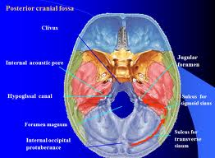

Slide 106
mandible
Is the bone of lower jaw .its the only movable bone of the skull.
Its fomes from body and 2 rami
Body of the mandible;
Its horse-shoe shaped have 2 border and 2 surfaces;( outer and inner)
upper border carry the Sackets of 16 teeth.
Lower border it’s the base of mandible
Show the digestive fossa on either side of middle line anteriorly.

Slide 107
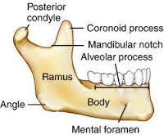

Slide 108
Outer surface
Show the falowing feature;
1- symphasis menti;
2- mental protuberance
3-mental foramin.
4- oblique line
Inner surface; show;
1-Sup & inf genial tubercles
2-mylohoid line
3-Sublinguial fossa
4-submandibular fossa

Slide 109
Ramus of mandible
It project up word it has 4 borders 2 surfaces and 2 processes;
Upper border forms the mandibular notch
Lower border; continuous with lower border of the body it forms the angle of mandible
Post. Border & ant border;
Outer surface continue with outer surface of the body
Inner surface ( medial) show the fallowing;

Slide 110
1- mandibular foramine.
2-Lingula; a smale tongue like process overhanging the manidibular f. anterioly.
3-mylohyoid grove its lodges the mylohyoid N&vessels
4- coronoid process
5-condylar process its contain the head & neck of mandible.

Slide 111
Muscles attach to the mandible
A- the ramus; receive the insertion of 4 muscles of mastication;
Master ,temporalia , lat and medial pterygoid
B-Body receive ;1 insertion and 6 origin;
Insertion platsma M
Origin ; buccinator.
anterior belly of diagastric m
Genioglossus
Genio-hyoid
Mylohyoid
Sup. Constricor m. of the pharynx

Slide 112
Nerves related to the mandible
A- 2 nerves related to the foramina;
1- inf. Alveolar n. inter the mandibular f. pass through mand. Canal and then divided incisive nerve and mental nerve
2- mental nerve ; emerge from the mental foramin.
B- 2 nerves related to the grooves;
1- nerve to the mylohyoid
2- lingual nerve; runs forwords along the groove on the medial aspect of last molar tooth socket.

Slide 113
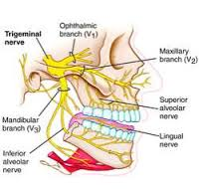

Slide 114
C- 2 nerves related to the neck of mandible;
1- auroculotemporal nerve;
2- marginal mandibilar branch of facial nerve
D- 2 other nerve related to the mandible;
1-buccal branch of mandibilar nerve.
2-

Slide 115
Arteries related to the mandible
1- external carotid artery divided in the neck of mandible to 2 terminal bra.maxillary and superfacial temporal art.
2-inf. Alveolar art. Enter in to the mandiblar f.
3-mental art. Emerge from mandiblar f.
4-facial artery

Slide 116
Glands related to the mandible
Sublinguial salivary gland
Sub mandibular salivary gland
Parotid gland

Slide 117
Thank you

