Slide 1
stomach
Assist. Prof
Dr alaa jamel
Cabs, mrcsi.mbchb
stomach

Slide 2
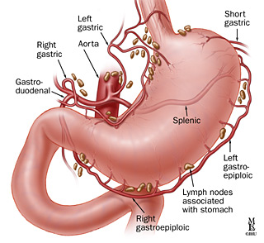
Stomach ch. Site,shape, size,ext.feature,orfice,

Slide 3
It’s the widest &most distensible part of the git.
Site its lie obliquely in the lf hypochondrium ,epigastric and umbilical regions
Shape; j shape but its shape depend on
1- the degree of its destension
2- the body built short and obese more horizontal

Slide 4
3- the phase of respiration ; more vertical with inspiration
4- position of the body ; vertical on standing
Size ;it mean capacity 2 liters in adult
External feature ; it has 2 orfices cardiac and pyloric
2 borders lesser and greter curviture

Slide 5
stomach

Slide 6
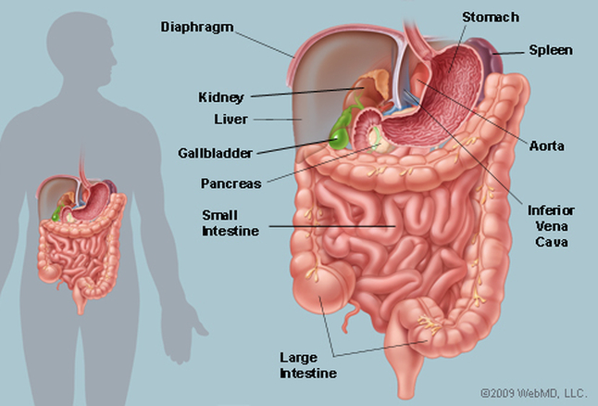

Slide 7
2 surfaces ant.superior and post.inferior
3 parts fundus ,body and pyloric parts
orfices of the stomach;
Cardiac orfice;
its more fixed part, position, it lie behind 7th costal cartilage ,1 inch from median plain
Relations ant .lf lobe of liver
Post. diaphragm

Slide 8
Sphincter
;
G.e junction has no anatomical sphincter
Its closed by physiological sphincter which depend on
A-acute angle between stomach and esophagus
B- sphincter action of fiber of RT crus of diaphragm which encircle the lower end of esophagus.

Slide 9
C- the thick mucosal fold of the lower end of esoph.
D- contraction of circular muscle fiber in the lower end of oesoph.
So why occur of gastro esophageal reflex diseases?

Slide 10
Pyloric orfice
;
less fixed end
Site trans pyloric plane L1
Its connect with duodenum
Pyloric orifice indicated by
A-pyloric constriction( circular groove)
B- prepyloric vein of mayo
This vein important it connect rt gastric vein with rt g.epiploic vein
C- felling of thickness of pyloric sphincter

Slide 11
Relations;
Anterior quadrate lobe of liver
Posterior neck of pancreas
pyloric region has a true anatomical sphincter

Slide 12
Borders of stomach
Lesser curvature; angular notch in its lower part.
It give attachment to the lesser omentum
Its related to the lf and rt gastric vessels and gastric l.n which runs on lesser omentum.

Slide 13
Greater curviture
Cardiac notch at gej
Relation;
It give attachment to 3 ligaments from above down word;
1- gastrophrenic ligament from fundus
2-gastrosplenic ligament from uper part of greater curvature to the spleen.

Slide 14
3-Greater omentum ;
From lower part of greater curvature
Its related to the rt and lf gastro .epiploic vessels and l.n

Slide 15
Parts of the stomach
Fudus;
Body;
Pyloric region which consist of
*pyloric antrum
* pyloric canal
* sphincter.

Slide 16
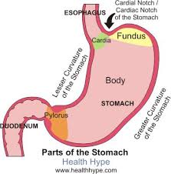

Slide 17
Suface of stomach
;
Ant.sup. Completely cover by peritoneum
Post.inf covered by peritoneum of lesser sac except small area closed to the cardiac orifice (bare area of stomach)

Slide 18
Relation of stomach
;
1-Fundus; diaphragm which separate from the pericardium and heart
2-Ant. Sup. surface ; related to diaphragm ,lf costal margin , lf lobe of liver ,ant. abdominal wall
3-post.inf.surface; related to the stomach bed

Slide 19
Lf side stractuers ;
Spleen, lf crus of diaphragm, lf suprarenal gland, lf kidney, .
Transverse stracture;
Splenic artery, body of pancreas , transverse mesocolon, transverse colon

Slide 20
Pyloric end related anterior to the quadrate lobe of liver
Posteriorly related to neck of pancreas and lesser sac
Post. Relation of stomach bar area related to the lf crus of diaphragm.

Slide 21
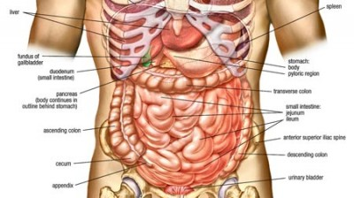

Slide 22
Ligaments of stomach
1- lesser omentum;
2- greater omentum
3- gastrosplenic ligament(ferom upper 1/3 of greater curvature
4- gastrophenic ligament;(from fundus to the diaphragm)

Slide 23
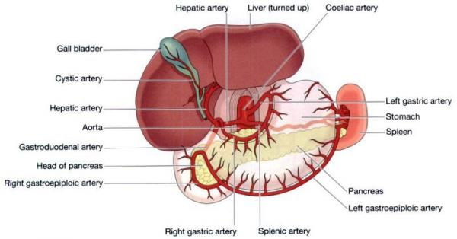
Blood supply

Slide 24
Blood supply of stomach;
1- lf gastric art.largest art. Of stomach
2-rt gastric art.branch from hepatic art.lower lesser curvature
3-lf gastro epiploic art. Along greater curv.(splenic)
4- rt gastro epiplo.art –gastrodud.art---hepatic art.

Slide 25
5- short gastric arts.– splenic art.to the fundus through gastrosplenic art.
Venous drainage;
To the portal vein
Lf &rt gastric vein to the portal vein
Lf gastro epiplo. and short gastric vein to splenic vein
Rt gastro epiplo.to the sup mesenteric vein

Slide 26
Lymphatic drainage;
All lymph daring to the coeliac l,n through
Supragastric l.n,infragastic l,n and pancreaticosplenic l.n

Slide 27
Nerve supply
;
Sympathatic fibers;arise from spinal cord segments from T6 to T10
Runs along or via gastric & gastroepiploic arteries
Function;1- motor to pyloric sphincter but inhibitory to the rest of stomach musculature
2- chief pathway for pain sensation from stomach

Slide 28
Parasympathatic fiber
From vagus
Ant. gastric nerve continuation of lf vagus supply ant. surface of stomach down to the pylorus
Post. gastric nerve continuation of RT vagus
Supply post surface of stomach except the pylorus .it give branch to cealiac plexus
Function; motor to the gastric wall &secretory to gastric juice

Slide 29
Small intestine
Position: in the infra colic compartment of the greater sac occupying the central & lower parts of the abdomen.
Relations: it is surrounded by the curve of the large intestine & covered anteriorly by the greater omentum & the ant. abdominal wall.
Beginning: at the pyloroduodenal junction. Termination: at the ileocaecal junction where it joints the caecum.
Length & Parts: it is 6 meters (20feet) long & is formed by 3 parts.

Slide 30
1. Duodenum: the first 10 inches & fixed to the
post. Abdominal wall.
2. Jejunum: follows the duodenum. It is 8 feet long and forms the proximal 2/5 of the small intestine.
3. Ileum: next to the jejunum. It is 12 feet long and forms the distal 3/5 of the small intestine. It ends by joining the caecum at the ileocaecal
valve.
N.B. both jejunum & ileum have a mesentery attaching them to the post. Abd. Wall.

Slide 31
Duodenum
It is the shortest, widest & the most fixed part of the small intestine.
Site: in the epigastric & umbilical regions, above the level of the umbilicus. It is applied to the post. abd.wall against the upper 3 lumbar vertebrae.
Shape: C-shaped loop surrounding the head of pancreas.
Begins: at the pyloric end of the stomach ½ inch to the right of the median plane.
Ends: at the duodenojejunal flexure 1 inch to the left of the median plane.

Slide 32
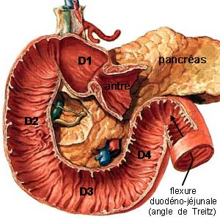

Slide 33
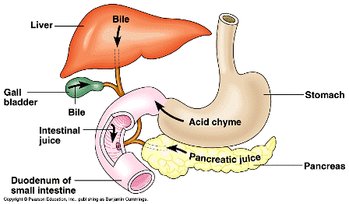

Slide 34
Length & Parts of duod.:
Length & Parts: it is 10 inches long & is divided into 4 parts:
1st Part (superior) 2 inches long & lies opposite the 1st L. vertebra.
2nd part (descending) 3 inches long & extends from L1 to L3 vertebra.
3rd Part (horizontal) 4 inches & lies at the level of L3 vertebra.
4th Part (ascending) 1 inch & ascends from the level of L3 to L2.

Slide 35
Peritoneal relations:
The duodenum is mostly retroperitoneal and fixed to the post.abd.wall except the following 2 mobile parts:
1. The proximal 1 inch which is suspended by : a. lesser omentum: above b. greater omentum: below
2. The distal end which is attached to the right crus of the diaphragm by a fibro muscular band called the suspensory muscle of duodenum.

Slide 36
First Part of Duodenum
- Begins: as a continuation of the pylorus, ½ inch to the Rt. Of the median plane at the level of L1 (transpyloric plane).
- Course: it passes upwards, backwards & to the Rt. undercover of the quadrate lope of the liver.
- Ends: close to the neck of the gall bladder by curving downwards to become the 2nd part.

Slide 37
* Peritoneal connection:
- Its 1st inch is completely covered by peritoneum & and gives attachment to the lesser omentum above & greater omentum below.
- Its 2nd inch is covered by peritoneum only infront & above.

Slide 38
Relations of the 1st part
I. Anteriorly
1. Quadrate lope of liver
2. Neck of gall bladder
II. Superiorly
1. Epiploic foramen
2. Lesser omentum containing portal v., hepatic a. & C. bile duct.
III. Inferiorly
1. Head of pencreas
2. Greater omentum
IV. Posteriorly 1.Neck of pencreas
2. C.B. duct, gastroduodenal a. & portal v.

Slide 39
2nd Part of Duodenum
Begins: at the level of L1 as a continuation of the 1st part.
Course: it descends vertically downwards infront of the hilum of the Rt. Kidney.
Ends: at the level of L3 by curving to the left to become the 3rd part.
Peritoneum: it is covered by peritoneum only anteriorly except its middle part which is devoid of peritoneum & is directly related to transverse colon.

Slide 40
Relation of 2nd part of duodenum:
(A) Anteriorly
1. Rt. Lobe of liver 2. Transverse Colon 3. Coils of jejunum (B) Posteriorly
1. The hilum of Rt. Kidney & adjoining part of ant. Surface. 2. Rt. Renal vessels 3. Rt. Psoas major muscle
(C) Laterally
1. Fat infront of the right kidney
2. Rt. Colic flexure 3. ascending colon

Slide 41
(D) Medially:
1. Head of pencreas
2. Ampulla of vater (hepato-pancreatic ampulla) opens in the posteromedial aspect of 2nd part of duodenum just below its middle.
3. Sup. & Inf. Pancreatico-duodenal vessels in the groove between head of pancreas & 2nd part of duodenum

Slide 42
3rd Part of Duodenum
Length: it is the longest part (4 inches long).
Course: it passes horizontally form Rt. To Lt. at the level of L3 vertebra.
Peritoneum: it is covered by peritoneum anteriorly and inferiorly.

Slide 43
Relations:
A. Superiorly: head of pancreas B. Inferiorly: Coils of jejunum C. Anteriorly:1. Coils of jejunum 2. Root of mesentery 3. Sup. Mesenteric vessels
D. Posteriorly (from right to left):
1. Rt. Psoas major m. (separated from duodenum by the Rt. Ureter).
2. Inferior vena cava (separated from duodenum by the Rt. Gonadal vessels)
3. Abdominal aorta (separated from duodenum by the inf. Mesenteric artery).

Slide 44
4th part of Duodenum
Length: it is the shortest part (one inch long)
Course: it ascends along the Lt. side of the vertebral column (from L3 to L2).
Peritoneum: it is covered by peritoneum anteriorly & to the left.

Slide 45
Relations of the 4th part ..
(a) Anterolaterally: Coils of Jejunum.
(b) Medially (to the Rt.): 1. uncinate process of pancreas
2. abdominal aorta
3. vertebral column
(c) Posteriorly:
1. med. Border of lt. psoas major M.
2. Lt. renal vessels
3. Lt. sympathetic chain
4. Lt Gonadal vessels

Slide 46
Termination of 4th part ..
It ends by curving forwards to form the duodeno-jejunal flexure on the Lt. side of L2.
Suspensory muscle of duodenum
(Lig. Of Treitz)
- It is a fibromuscular band which suspends the duodenojejunal flexure.
- It arises from the Rt. Crus of diaphragm close to the esophagus.
- It descends behind the pancreas to be attached to post aspect of the duodenojejunal flexure & the 3rd & the 4th parts of duodenum.
- It contains striated & smooth muscle fibers & also elastic fibers.

Slide 47
Arterial supply of duodenum :
1. sup. pancreatico duodenal a. (branch of gastroduodenal a.)
2. inf. pancreatico duodenal a. (branch of sup. Mesenteric a.)
3. Branches from hepatic, Rt. Gastric, Rt. Gastroepiploic & supraduodenal arteries.
Venous drainage : into splenic, sup. Mesenteric & portal veins.
Lymphatic drainage : into pyloric, sup. Mesenteric & hepatic lymph nodes.
Nerve supply : sympathetic nerves from T9 & T10 and parasymp. Nerves from vagi pass through the coeliac plexus & accompany the arteries to duodenum

Slide 48
Differences between Jejnum & Ileum
1. Length juj 2/5 8 feet
2. Site umblical region
3. Lumen wider
4. Wall thicker , thick mucosa and muscle
5. Circular folds of mucosa are numorous

Slide 49
The juj.arteries anastemosis together forming 2 arcades (simple art.arcades) while ilium forming 3,4 or even 5 arcades.
Peyres patches (aggregation of lymphoid follicles in sub mucosa)abscent in juj.
At operation juj wall felt as douple layer.

Slide 50
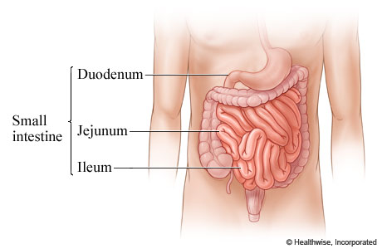

Slide 51
Mesentery of Small Intestine
Definition: it is a peritoneal fold enclosing the free part of the small (jejunum & ileum) & connecting it to the post. Abdominal wall.
Shape: fan-shaped fold having broad free border & narrow attached border:
(a) Free border: is 6 meters (20feets) long & encloses the jejunum & ileum.
(b) Attached border: (Root of mesentery): 6 inches long & 6 inches away from the free border (depth).

Slide 52
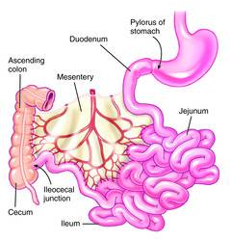

Slide 53
Mesentery of Small Intestine ..
- It is attached to the post. Abdominal wall extending from the duodenojejunal flexure (on the left side of L2) to ileocecal junction (above the Rt. Sacroiliac joint).
- Its attachment follow a curved course with its concavity directed to the Rt. Side.
- The root crosses 6 structures on the post. Abd. wall. (2 parts of duodenum, 2 large vessels & 2 muscles) :
1. The 3rd part of duod. 2. the 4th part of duod.
3. Abdominal aorta 4. Inferior vena cava
5. Rt. Psoas major m. 6. Rt. Iliacus m.

Slide 54
Contents of the mesentery:
1. Coils of jejunum & ileum in the free margin of the mesentery.
2. Superior mesenteric artery & its branches:
- It runs downwards & to the Rt. In the root of mesentery.
- It gives 12-16 jejunal & ileal branches which run between the 2 layers of the mesentery to reach the coils of small intestine in the free border.
- Its branches anastomose together forming arterial arches.

Slide 55
- Contents of the mesentery ..
3. Sup. Mesenteric V. & its tributaries:
- Runs in the root of mesentery on the Rt. Side of the sup. Mesenteric artery.
- Receives tributaries corresponding to the branches of the sup. Mesenteric a.
- It ends by joining Splenic vein to form portal vein.
4. Lymphatics & 3 raws of mesenteric L.Ns.
(a) Small lymph nodes near the intestine in the free border.
(b) Medium-sized L.Ns in the middle of the mesentery
(c) Large L.Ns: lie along the sup. Mesenteric vessels,

Slide 56
- Contents of Mesentery ..
5. Dense plexuses of autonomic nerve fibers around the arteries.
6. Extraperitoneal fatty tissue

Slide 57
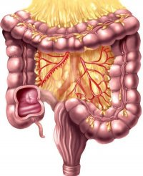

Slide 58
Ileocaecal valve
It is the valve which guards the opening of the ileum into the caecum
Site & surface anatomy: it lies in Rt. Iliac fossa at the point of junction between Rt. Lat. Vertical plane & the intertubercular plane.
Structure: it has 2 lips (upper&lower) & 2 frenula (Rt&Lt)
Function: it regulates the passage of ileal contents into the cecum & prevents reflux from cecum to ileum.
Mechanism: it closes actively by symp. Stimulation & passively by distention of cecum.

Slide 59
Large intestin
Begning ; from iliocecal valve in the rt iliac fossa and end at anal orfice .
About 5 feet (1.5) meters in length
Parts ; caecum and appendix---ascending colon –rt(colic hepatic flexure –transverse colon –lt colic(splenic) flexure—descending colon – pelvic colon (sigmoid)--- rectum and anal canal.

Slide 60
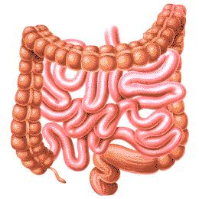

Slide 61
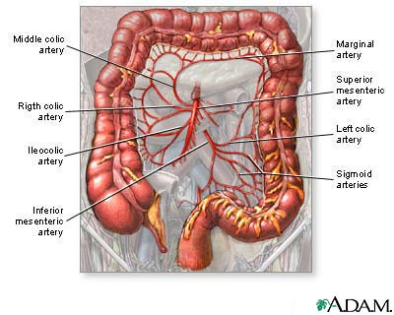

Slide 62
Differences between large and small intestine
Large intestine ch. By
1- appendices epiploicae small peritoneal sac filled with fat scattered over the surface of large bowel except caecum ,appendix and rectum
2- taenia coli longitudinal muscle fiber absent in appendix and rectum
3- saculation ( hustration),it occur because length of tania coli is shorter than the true length of large intestin.
4-diameter.
5- site

Slide 63
caecum
Site in rt iliac fossa above the lateral half of inguainal ligament.
Surface anatomy atriangular area in rt iliac fossa bounded by
Above- intertubercular plain
below -Lateral ½ of inguinal ligament
Medialy – rt lateral vertical plan
Shape blind pouch 3 inch in length

Slide 64
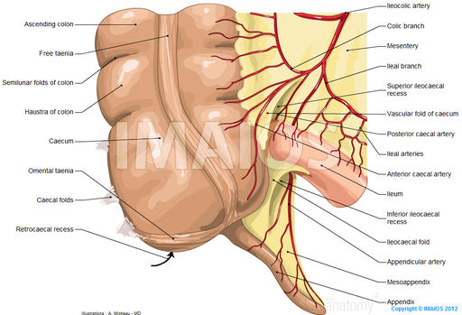

Slide 65
Comminication
Above – medially –ilium
Posteriomedial– appendix
Peritoneal covering completely cover
Relation
Anterior– ant .abd,wall, lower part of greater omentum..coil of small intestin
Posterior-- 2 muscles rt psoas major,,rt iliacus
2 nerve rt cut, n, of thigh,rt femoral n
2 vessels rt ext.iliac vessels& rt gonadal (test or ovarian)

Slide 66
appendix
Site –rt iliac fossa, attach to post. medial aspect of caecum 1 inch below iliocaecal valve
Size ½ -9 inch average 4 inch it’s the narrowest part of GIT
Shape worm like tube
appendixPertonial covering completely cover
Mesoappendix ;
Its peritoneal fold which suspends the appendix

Slide 67
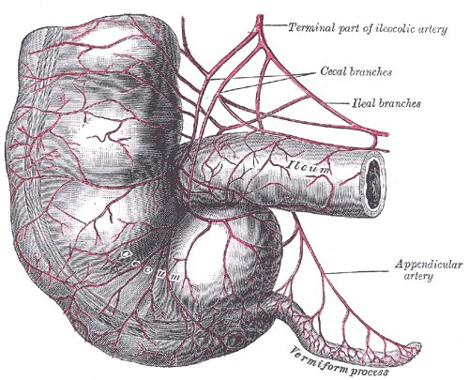

Slide 68
Contains of mesoappendix
1- app,vessels 2-lymphatic and l.n 3- autonomic nerve fiber 4- extrapertoneal fatty tissue.
Position of appendix;
Retrocaecal 65%
Pelvic 31%
Preilial 1.5%
Post ilial 0.5%
Subcaecal 2%

Slide 69
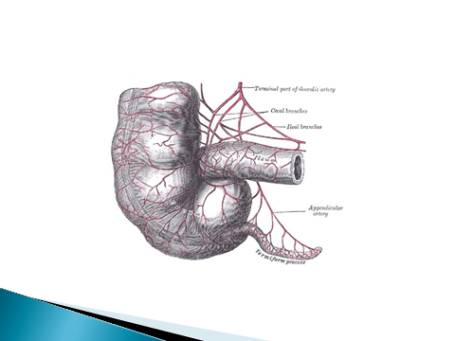

Slide 70
Surface anatomy;
Mc Burney’s point; what?
Arterial supply; appendicular artery branch from iliocolic artery. run through free border of mesoappendix till reach the tip of appendix (it end artery).
It accompanied with app. vein which drain to the sup. mesent,vein.
Lymphatic drainage; 1-to the append. ln
2-To the l.n along iliocolic art.
3-L.n along sup.mesentric artery

Slide 71
Nerve supply ;sympathetic from T10 segment via sup mesenteric plexus
Parasympathetic via vagus nerve
Applied anatomy
Acute appendicitis common --why? 1- narrow lumen 2- rich in lymphoid tissue
Necrosis and rapture because of end artery
Pain start around umbilicus because T10
how reach to the base of appendix?

Slide 72
Ascending colon ;
site RT lumber region
Begning ;from caecum to the RTcolic flexure.
Taenia coli ; 1ant&2 post..
Pertonium ant.and sides only
Relation;
Anteriorly and laterally;
Ant. Abd. wall, rt border of greater omentum,, coil of ilium
Medially coils of ilium

Slide 73
Posteriorly; from above down word
Lower part of rt kidney
Origin of transverses abdomens
Quadrates lumborus muscle
Iliohypogastric and ilio inguinal nerve
Iliac crest and ilio lumber ligament
Iliacus muscle
Lateral cutnous nerve of the thigh
Blood supply rt colic and ascending branch of iliocolic artery

Slide 74
Transverse colon
Site
Begning –rt hypochondirum
End lf hypochond.
Size 18-20 inches
Taenia coli –2 ant .&1 post.
Pertonium; it completely covered with peritoneum except the rt 2 inch wher it adherent to the 2nd part of dued. and head of pancreas
It has transverse mesocolon

Slide 75
Relation of transverse colon
Anterior sup. from rt to lf
Rt lobe of liver..gall bladder..great curvature of stomach…greater omentum.
Posterior from rt to lf
2nd part of dued…head of pancreas
Dj flexure &coil of jej.
Inferiorly…coil of small intestine
Blood supply; middle colic and ascending branches of upper lf colic art.

Slide 76
Colic flexures
Rt and lf colic flexures
Position rt L2 ,,LF L1
Shape rt a blunt forming right angle lf sharp forming acute angle
Attachment to the diaphragm rt no lf yes through phrencocolic ligament.
Relation rt ant sup..rt lobe of liver,, post.inf.. Rt kidney medially 2nd part of duodenum
Lf ant.sup spleen and tail of pancreas
Post inf lf kid. and diaphragm
Medialy lf kidney
Blood supply; rt rt colic art.lf lf colic art.

Slide 77
Descending colon
Site; in the lf lumber and lf iliac region ,start from lf colic flexure to the lf border of pelvic brim where it become pelvic colon(sigmoid)
Size 10-12 inch double length of ascending colon but narrow lumen.
Taenia coli; one ant .and 2 post, same ascending.
Peritonium cover in front and sides same ascending.

Slide 78
Relation; anterior and laterally ;
Ant. Abdominal wall
Lf border of greater omentium
Coil of small intestine
Medial relation;
coil of small intestine
Posterior relation;
It descend on the fallowing strictures;
Diaphragm
Lower lat part of the lf kidney

Slide 79
Origin of lf trans. abdominus m.
Lf quadretous lumborous m. and structures infront of it .a-subcostal n &vessels
B-iliohypogastric n.
C- ilioinguinal n.
Lf iliacus muscle & stracture related to it
A- lat. cutanous n . Of thigh B-femoral n.
Lf psoase major m & structure related to it
A-lf gonodal v.
B- lf genetofemoral n.
C- lf external iliac artery

Slide 80
`
Relation same ascending colon
Pelvic (sigmoid )colon
Site ;in lf iliac fossa ,in pelvic cavity
Shape; s shape
Size ; 16 inches
Begins; infront of ext.iliac artery at the lf border of pelvic prim ,2 inch above the inguinal ligament.as a continuation of descending colon.
End ;opposite the 3rd sacral piece by becoming rectum.

Slide 81
relations
Sup.and to the rt;
Coil of ilium
Inferior;
According to the sex
In female uterus
In male urinary bladder in both male and female
Posreiorly;
Sacrum and structure infront of it;(piriformis and sacral plexus)
Lf ureter
Lf internal iliac vessels

Slide 82
Blood supply; lower lf iliac (sigmoid arteries)
Pertonial covering; completely covering
Has mesentry cold pelvic mesocolon connecting it to the post.abdominal wall.
Pelvic mesocolon
Its peritoneal fold attaching the pelvic colon to the upper part of the post. wall of pelvis.
Shape; inverted v shape having 2 limb
Lat. limb ascending
Med. limb descending.

Slide 83
Attachment;
A- lat. Limb attach to the med. side of lf ext. iliac
B- medial limb attach to the front of sacrum till the 3rd sacral piece
C-The apex ; attach infront of the lf ureter.
Content of pelvic mesocolon;
1- segmoid colon in free margin
2- sigmoid artery;(lower lf colic)
3-sup.rectal v.
4- sympathetic fibers
5- extraperitonial fatty tissue

Slide 84
Blood supply of the colon
Caecum , ascending colon and rt 2/3 of transvese colon supply by sup.mesentric artery through iliocolic,rt colic.middle colic art.
Venous draing corrsponding
Lf 1/3 of trans.colon descending colon sigmoid supply by inf, mesentric art through upper and lower lf colic art.
Venous drainge corresponding

Slide 85
Marginal artery ;its an arterial arcade lying along the concavity of colon . Its formed by anastemosis of iliocolic, middle colic, upper and lower lf colic a.
Lymphatic drainge of colon
Pass through 4 groups of l.n
1- epicolic l.n on wall of colon
2- paracolic along inf. Border
3- intermediate l.n along the colic arteries
4- terminal l.n along the trunk of sup & inf mesenteric a. which continuous with para oartic l.n

Slide 86
quaz
70 years old with atrail fibrillation complaining from acute abdomen due to small bowel gangrene .from anatomical point of view why gangrenous bowel occur mostly
in small bowel not large bowel?
What is the location of Mc Burney’s point;

Slide 87
Thank you

