Slide 1
The Meninges
د. امجد

Slide 2
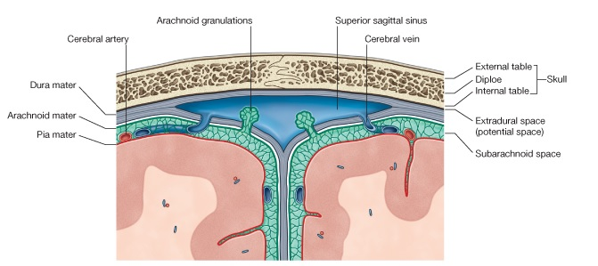
The Meninges
Three protective membranes that surround the brain, cerebellum and the spinal cord.
The Dura mater (tough)
The Arachnoid mater (delicate)
The Pia mater (thin but firmly attached)

Slide 3
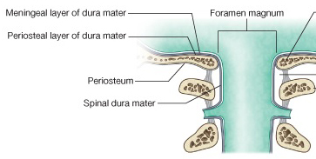
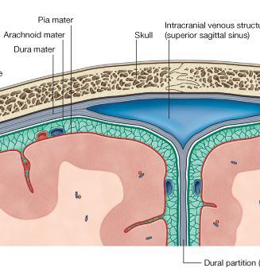
Dura Mater
The Dura Mater:
fibrous layer that is divided into two layers (except@ venous sinuses).
Endosteal layer: (periosteum)
  Do not extend beyond the skull.
  Fuse with periosteum of the skull outside.
  Fuse with sutural ligaments.
Meningeal layer: (dura mater proper)
Extend beyond the skull @ foramen magnum.
Fuse with epineurium of cranial nerves.
Sends inward septa to form cranial partitions.

Slide 4
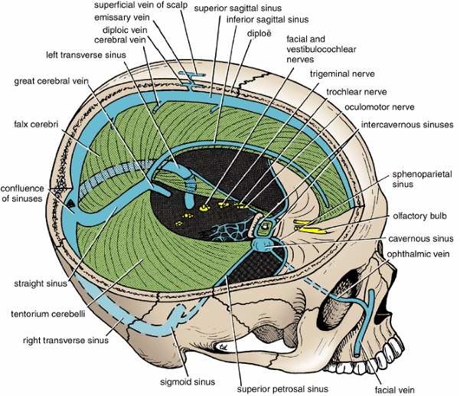
Dura Partitions
Falx Cerebri
Tentorium Cerebelli
Falx Cerebelli
The diaphragma sellae

Slide 5
Dura Partitions – Falx Cerebri
Falx Cerebri:
Sickle-shaped fold of dura mater.
Its ant end is attached to the internal frontal crest and the crista galli. Its posterior end blends with the upper surface of the tentorium cerebelli.
The superior sagittal sinus runs in its upper fixed margin
The inferior sagittal sinus in its lower free margin
The straight sinus runs along its attachment to the tentorium cerebelli.

Slide 6
Dura Partitions – Tentorium Cerebelli
Tentorium Cerebelli
crescent-shaped fold of dura mater.
anteriorly, the tentorial notch for the midbrain.
its outer border is attached to the posterior clinoid processes, the superior borders of the petrous bones, and the margins of the grooves for the transverse sinuses on the occipital bone.
It inner free border crosses the attached border, and is attached to the anterior clinoid process.

Slide 7
Dura Partitions – Falx Cerebelli
Falx Cerebelli:
is a small, sickle-shaped fold of dura mater.
Its fixed posterior margin is attached to the internal occipital crest and contain the occipital sinus.
Its free border anteriorly separate the two cerebellar hemispheres.

Slide 8
Dura Partitions - The diaphragma sellae
The diaphragma sellae
is a small circular fold of dura mater
it forms the roof for the sella turcica.
It has a small opening in its center for stalk of the pituitary gland.

Slide 9
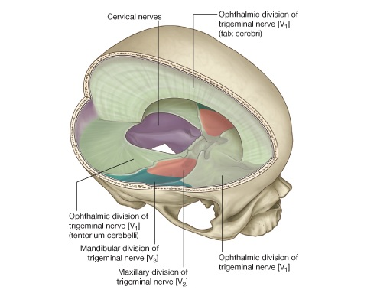
Innervation of the Dura
Dura is sensitive to ?? --► headache
Dura of Posterior cranial fossa by branches from cervical spinal nerves (C1, C2 & C3)
Dura of ACF, MCF, Falx cerebri & Tentorium Cerebelli by Trigeminal nerve:
1- Anterior meningeal nerves
2- Tentorial nerve
3- Meningeal branches of maxillary and Mandibular divisions of Trigeminal nerve

Slide 10
Dura Nerve Supply
Trigeminal Nerve
Ethmoidal Nerves
Maxillary
V2
Mandibular
V3
Ophthalmic
V1
Anterior Meningeal nerves
(Tentorial Nerves) Meningeal branches
Meningeal branches
Meningeal branches
Anterior cranial fossa & Falx cerebri
Anterior & Middle cranial fossa
Post Falx cerebri & Tentorium cerebri
Anterior & Middle cranial fossa
Cervical Nerves
C1,C2,C3
Meningeal branches
Posterior cranial Fossa

Slide 11
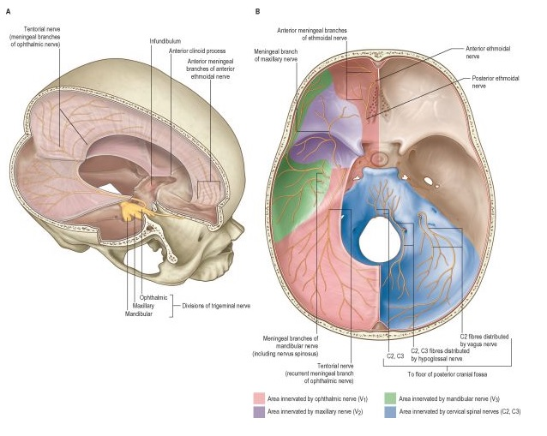

Slide 12
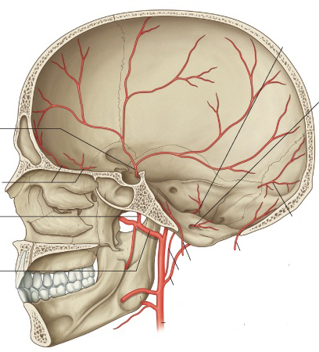
Arterial Supply of Dura
Anterior meningeal artery (branches of ethmoidal arteries which are branches of maxillary artery (ECA).
Middle meningeal artery and accessary meningeal artery: branches of Maxillary artery (ECA)
Posterior meningeal artery (terminal branch of ascending pharyngeal artery (ECA) & other meningeal branches from:
1- Ascending pharyngeal artery
2- Occipital artery
3- Vertebral artery

Slide 13
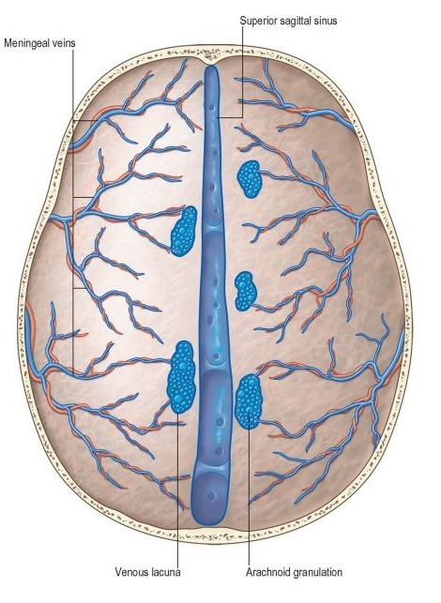
Venous Drainage
Venous drainage of dura usually follow the arterial arrangement of meningeal arteries:
1- anterior Meningeal veins
2- middle Meningeal veins
3- Posterior Meningeal veins

Slide 14
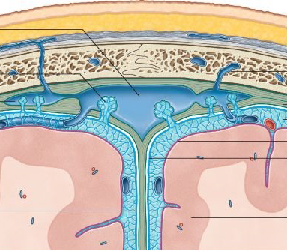
Arachnoid mater
Delicate avascular layer (lies against but not firmly attached to dura mater). It sends numerous trabeculae toward the pia mater.
Subarachnoid space?? CSF?
Arachnoid cisternae.
All cerebral arteries and veins lie in subarachnoid space.
Arachnoid villi: numerous projections to the venous sinus.
Arachnoid granulations: aggregations of these villi at which CSF diffuses to venous sinuses.
Arachnoid mater fuses with epineurium of nerves at the exit foramina except for optic nerve.

Slide 15
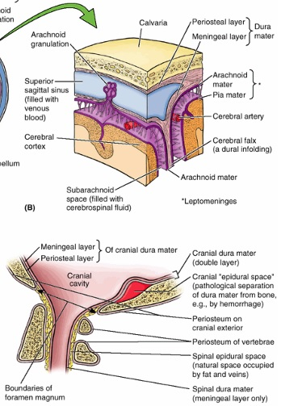
Pia mater
thin vascular layer that is adherent to the brain surface.
It extends with cerebral sulci and cover gyri and fuses with epineurium of cranial nerves at their exit foramina.

Slide 16
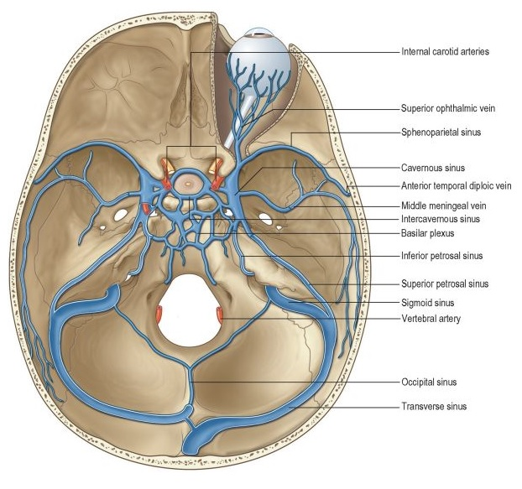
Venous Sinuses
Blood-filled spaces situated between the layers of the dura mater.
The sinuses have no valves.
They receive tributaries from the brain, the diplo of the skull, the orbit, and the internal ear.
The superior sagittal sinus - receives the superior cerebral veins.
The inferior sagittal sinus - joins the great cerebral vein to form the straight sinus. It receives cerebral veins from the medial surface of the cerebral hemisphere.
The straight sinus - it drains into the left transverse sinus.
The left transverse sinus is a continuation of the straight sinus & end on each side by becoming the sigmoid sinus.
The right transverse sinus is as a continuation of the superior sagittal sinus.
The sigmoid sinuses - leave through jugular foramen --►internal jugular vein.
The occipital sinus - communicates with the vertebral veins through the foramen.
The cavernous sinus Anteriorly, the sinus receives the inferior ophthalmic vein and the central vein of the retina & drains posteriorly into the transverse sinus through the superior petrosal sinus.
Intercavernous sinuses connect the two cavernous sinuses through the sella turcica.

Slide 17
Good Luck

