Slide 1
Maternal & Child health services
MCH services-L3
Dr. Muslim N. Saeed
Family & Community Medicine Dept.
March 11th ,2019

Slide 2
Periodic visits (subsequent visits):
-At each visit the following procedures & examination should be performed :
✓ History:
- Record new complaints
- Ask about alarming signs & rate of fetal growth
✓ Examination:
- General: (Weight, Blood pressure, Edema of lower limbs.)
- Abdominal: (FL (fundal level), Fetal lie (longitudinal, transverse, oblique), Fetal
presentation (cephalic, breech), FH (fetal heart).
✓ Laboratory investigation:
- screening for diabetes at 28 week of pregnancy .
- Urine examination for protein , glucose & ketones
- Hb% & PCV

Slide 3
Health education:
- Assessment of fetal wellbeing in low – risk pregnancy:
-Fetal size assessment FL (Fundal level) or the symphyseal – fundal height.
-Fetal kick count ( fetal movement ) at least 10 movements per 12 hours(a change in the kick count is more important than the absolute number).
-Fetal movement absence precedes intrauterine fetal death by 48 hours
-Fetal heart sounds ( bradycardia & or tachycardia indicate possible fetal problem.

Slide 4
Assessment of fetal wellbeing in low risk pregnancy at 37 weeks:
* Assessment of fetal size , lie , and presentation
* Assessment of pelvic capacity if there is suspicion of pelvic inadequacy (stature < 145 cm , pelvic fractures , or previous C\S for cephalo-pelvic disproportion CPD)
* The degree of engagement of the presenting part

Slide 5
Alarming Symptoms & Signs:
-Pregnant women should be advised to seek immediate medical care if they experience any of the following symptoms or signs :
▪ Vaginal bleeding, Sever edema, Passage of fluid from the vagina .
▪ Abnormal gain or loss of weight, Decrease or cessation of fetal movement .
▪ Sever, persistent or recurrent headache, Visual disturbance (blurred vision)
▪ Epigastric pain, Fever, Lower AP, Respiratory discomfort or dyspnea & Convulsion

Slide 6
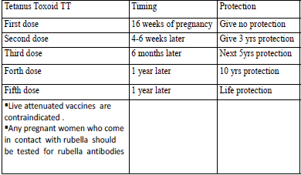
- Immunization:
Only tetanus toxoid (TT ) is needed to prevent tetanus neonatorum.
The following Schedule is used in Iraq:

Slide 7
• Nutrition of pregnant women:
-The developing fetus is influenced mostly by diet between 17 & 56 days after conception,
therefore diet should be optimal before pregnancy.
➢ Ideal nutritional regimen for the pregnant women is by:
A. Increasing the caloric requirement by 200 kcal / day.
B. Increasing protein intake by 20% , calcium by 50%
C. Doubling her folic & iron intake.

Slide 8
➢ Supplementation for pregnant women :
1) Iron (30mg of ferrous iron / day)
-drugs used are either : ferrous gluconat, ferrous fumarate, or ferrous sulfate
-A dose of 30 mg elemental iron /day should be enough for most women.
-women pregnant with twins , those who book for antenatal care late in pregnancy , or taken iron irregularly can take ( 60 – 100 mg/ day ) .
-Anaemic women should take 200 mg / day .
-Iron requirements are increased only in the latter half of pregnancy .

Slide 9
2) Folic acid supplementation (400 μg/ day):
-Megaloblastic anemia from deficiency of folic acid may occur during pregnancy.
To prevent megaloblastic anemia , it is recommended that women take 0.4 mg folic acid/day throughout pregnancy.
-It is recommended that women at high risk for neural tube defects ( who had offspring with neural tube defects , who has neural tube defects herself , or a strong
family history of the disorder ) take a supplement of 4 to 5 mg of folic acid / day at least two months prior to conception and for the first 12 weeks.
-Women on antiepileptic drugs, e.g. carbamazepine and especially valproate , may need higher doses of folic acid to combat folate deficiency .

Slide 10
Common problems associated with pregnancy affecting diet & nutrition of pregnant women:
1) Heartburn
-Eat earlier in the evening and avoid late night meals
-Eat small, low –fat meals & snacks, fruits, and eat slowly.
-Drink fluids mainly between meals.
-Decrease or avoid spices , greasy and fried foods .
-Avoid tobacco, caffeine, and carbonated beverages .
-Avoid lying down for 1 -2 hours after eating or drinking .
-Avoid bending after eating

Slide 11
2) Constipation ;
-Drink plenty of fluids preferably water.
-Eat high – fiber cereals &other grains , fruits , and vegetables.
-Engage in physical activity such as walking .
3) pica : is the practice of eating non food substances, such as clay , freezer scrapings and dirt : could be prevented by
-Going for a walk or reading a book when the urge hits .
-Chewing sugarless gum .
-Eating sour pickles .
-Chewing on frozen fruit juice cubes instead of ice .

Slide 12
➢ Weight gain:
-Weight gained in pregnancy is a combination of maternal and fetal tissues and fluid as well as fat stores
-Rate of weight gain is usually not constant, around 2 kg are gained in the first trimester , and the reminder throughout second and third trimester at a rate of around 0.4 kg / per week
-Weight gain during pregnancy has to be estimated according to the pre- pregnancy weight of the mother:

Slide 13
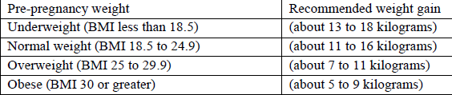

Slide 14
Health education for pregnant women
-Pregnant women should be informed about the following:
1) Adequate nutrition :
-The daily requirement of macronutrient , micronutrient and caloric need
2) Exercise & work:
-Exercise should be mild , preferably walking
-Housework, if not over-tiring, is allowed.
-The following working situations have been associated with adverse pregnancy outcomes:
o Working more than 10 hours /day.
o Standing more than 6 hours/ shift.
o Lifting heavy items.
o Exposure to excessive noise.

Slide 15
3) Travel
-Travel is allowed when comfortable .
-Car safety belts have to be adjusted to be comfortable for the women
-Those traveling more than three hours ( either by car or airplane ) must take a break every two hours and walk for about five minutes to decrease the risk of deep vein thrombosis
4) Dental care
-Have teeth examined twice during pregnancy .
-Brush teeth after meals .
-Tooth extraction is allowed [even for pregnant women with rheumatic heart disease if prophylactic antibiotic are given .

Slide 16
5) Breast care
-Offer the following advice to pregnant women:
*Wash breast daily to reduce cracking.
*Massage breast to:
@Express breast secretions.
@Open lacteal ducts and sinuses
-Nipples
**If there is dry secretion treat with a mixture of glycerin & alcohol
**If retracted, treat by pulling out gently & regularly .

Slide 17
6) Smoking:
-Smoking has potential adverse effect on the current pregnancy:
*1-Fetal anoxia .
*2- Low birth weight neonates (LBW) .
*3- Prematurity .
*4- Pre- labor rupture of the membranes .
*5- Abruptio placenta.
7) Clothing:
@Clothing should be loose ,light and hanging from shoulders .
@Avoid high heels , shoes , with thin soles , belts , or corsets.

Slide 18
8) Sexual activity
ž Sexual activity is allowed in moderate..
ž It is to be avoided in pregnant women with threatened abortion, preterm labor, or
antepartum heamorrhage
9) Drugs
➢ Avoid all unnecessary drugs during pregnancy
➢ Taking drugs that are not known to affect the fetus does not guarantee safety of the fetus.
10) Timing of the subsequent visit (the next visit):
ž Supply the female with a card with full information to maternity hospital at the last visit

Slide 19
Child Health Care
❖ Introduction:
• Child health includes physical, mental and social wellbeing too.
• Each year more than 10 million children under the age of 5 die.
• At least 6.6 million child deaths can be prevented; each year if affordable health interventions are made available to the mothers and children who needs them.
• Many diseases and disorders of childhood, adolescence, and adulthood can be prevented or lessened in severity if detected early.

Slide 20
❖ Preventive services are needed for children for many reasons:
• Children represent high percentage of population (40% -45%).
• Many causes of mortality & morbidity are avoidable: RTA. Poisoning, burns, falls &
drowning.
• Vulnerability (liability) of children & their parents.

Slide 21
❖ Routine periodic examination for children:
(At birth) linked with immunization schedule.
Every 2 months in the first year.
Every 3 months during the 2- 3 year.
Every 6 months during 4-5 years.

Slide 22
❖ Child health care services:
Effective preventive care includes providing many kinds of screening, counseling & immunization services:
• These Services includes:
Complete Physical examination (newborn care, follow up care).
Growth monitoring (weight, height / length).
Developmental assessment.
Immunization (0, 2, 4, 6, 9, 15, 18 months, 4 years).
Conducting vision screening regularly.
Vitamin A supplement.
Feeding instructions (breast feeding & complementary feedings).
Health education (Counselling children and their parents about which foods to eat and which to avoid).
Detection of special cases (birth defects, genetic diseases, disabilities,
allergies…etc.)

Slide 23
• These services can be summarized as:
Growth monitoring.
ORS , ARI and control of diarrhea disease(CDD) ,
Breast feeding.
Immunization against communicable diseases and curative care.
Female health education, Next visit and follow up, using child’s card.
Food supplementation.
Counseling including Family planning.

Slide 24
❖ Newborn Care:
We have two medical examinations to be done for every new baby:
1) Immediate newborn care:
It’s the responsibility of the birth attendant (doctor or midwife):
• To detect abnormalities which need immediate treatment
• Measure birth weight.
• Estimation of Apgar score at the 1st and the 5th minute of life after birth.

Slide 25
• Apgar score: we have 5 signs, each is given a score of 0, 1or 2 :
• Heart rate, Respiratory rate, Muscle tone, Response to catheter in nostril, Color of skin.
• If the score is less than or equal to 3 at 5 minutes this means that the infant is at a
higher risk of neonatal death, or to have respiratory & cerebral complications during
the neonatal period ( neonate intensive care unit).

Slide 26
2) Late newborn care:
This should be done within the 1st 48 hours after birth by a pediatrician, this includes:
examination of all systems with much more details than the immediate, all of the
finding should be recorded. screening for certain diseases.

Slide 27
❖ Child’s development:
There are various definitions of periods in a child's development, since each period is a range of individual differences regarding start and ending. Some age-related development periods and examples of defined intervals are:
newborn (ages 0–1 month); infant (ages 1 month – 1 year); toddler (ages 1–3 years); preschooler (ages 4-6years); school-aged child (ages 6-13 years); adolescent (ages 13-20).

Slide 28
Aspects of child development
Physical growth.
Motor development. 3)
Cognitive/ Intellectual development.
Social-emotional development .
Language.

Slide 29
Primitive reflexes:
Are reflex actions originating in the central nervous system that are exhibited by normal infants but not neurologically intact adults, in response to particular stimuli.
These primitive reflexes are also called infantile (infant or newborn) reflexes.
These reflexes disappear as a child moves through normal child development.
Tonic- neck reflex?, palmer reflex? , sucking reflex? , Moro reflex? , rooting reflex?

Slide 30
Older children and adults with a neurological problems , may retain these reflexes and primitive reflexes may re-appear in adults because of certain neurological conditions including, but not limited to, dementia, traumatic lesions, and strokes.

Slide 31
• Motor Development:
➢ Motor development is recorded in the health card in one simplified chart linked with the vaccination schedule.
➢ The (nurse) tick the mark ✓ opposite the motor development if done by the child at the appropriate time.
➢ If there is a motor developmental delay the child is referred to the family doctor for further assessment

Slide 32
• Growth Monitoring:
➢ Growth monitoring is an important technique for identifying individuals, groups or communities whose growth is not keeping up with the expected pattern (Introduced in early seventies).
➢ Poor growth as a result of infection, malnutrition or other cause needs to be detected in order that corrective action may be taken.
➢ It’s a process of sequential measurements of the weight of Under 5 year’s children, in order to be able to detect signs of malnutrition (e.g. growth failure) as early as possible & to correct this position.

Slide 33
➢ This process should start soon after birth with the measurement of birth weight & the recording of the Wt. on the growth chart. (Wt. for age).
➢ Growth monitoring is done for all children of both sexes less than 5 years through the primary health care (Family medicine) centers.
➢ It is done for the healthy child as a part of the Child care services (follow up visits).
➢ Nurses are directed to do growth monitoring every time the child comes to the unit for any reason.

Slide 34
Growth Chart
• A growth chart is used by pediatricians , family physicians and other health care providers to follow a child's growth over time.
• The height, weight, and head circumference of a child can be compared to the expected parameters of children of the same age and sex to determine whether the child is growing
• Growth charts are different for boys and girls, due in part to pubertal differences and disparity (inequality) in final adult height.

Slide 35
• Growth charts have been constructed by observing the growth of large numbers of normal children over time. Growth charts can also be gathered from a portion of the population considered to have been raised in more or less ideal environments, such as nutrition that conforms to pediatric guidelines, and no maternal smoking. Charts from these sources end up with slightly taller but thinner averages.

Slide 36
• Growth charts can also be used to predict the expected adult height and weight of a child because, in general, children maintain a fairly constant growth curve.
• When a child deviates from his or her previously established growth curve, investigation into the cause is generally necessary. E.g indicate the onset of a chronic illness such as inflammatory bowel disease.
• Children with diseases such as Down syndrome follow distinct growth curves. Due to differences in normal growth rates between breastfed and formula fed babies, there are currently separate charts for breastfed babies which are based on normal growth
patterns of exclusively breastfed babies.

Slide 37
• we use the growth chart for every individual child, where wt. is the best indicator, as it is affected with anything that affect nutrition, appetite, income, psychological, infection.
• The birth weight is used as the 1st reading and wt is measured monthly and plotted on the chart joined by curve (growth curve) , The upper and lower lines on the chart correspond approximately "average" weight of healthy children (WHO "reference“ weights). The space between two lines has been called the {Road to Heath}, In : normal child ---------Up going curve.
No wt. gain --------- Flat curve.
Wt. loss ------------- Down going.

Slide 38
• Record any immunization received in the appropriate space. When potting the child's weight it is important to plot the weight above correct month of the chart.
• Lack of attention to the rising problem of obesity & concentrating mainly on under nutrition.
• What Factors Affect a Child's Growth?
Genetics, gender, nutrition, physical activity, health problems, environment, and hormones all influence a child's height and weight.

Slide 39
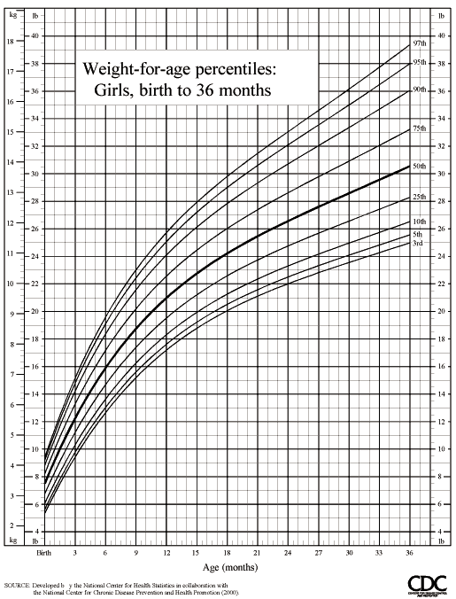

Slide 40
• Children at Risk
Certain risk factors have an influence on child's nutritional state; those children need more care and more frequent follow up visits. These risk factors are related to medical, social, economic and educational conditions and may include:
LBW
Twins or multiple births
Many children in a family, brothers or sisters undernourished
Short spacing {short intervals between births}
Poor growth in early life
Early stopping of breast feeding {i.e. before 6 mothers}
Introduction of complementary food either too early or too late
Many episodes of infection
Poverty- 3 or more children in family died
Children with only one parent
Illiterate mother.

Slide 41
End

