Slide 1
Infections Acquired through the Respiratory Tract
Measles
Dept. of Family & Community medicine
Dr. Muslim N. Saeed
November 13th , 2018

Slide 2
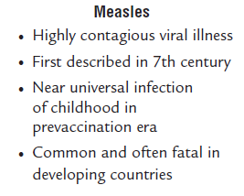

Slide 3
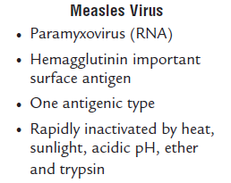

Slide 4
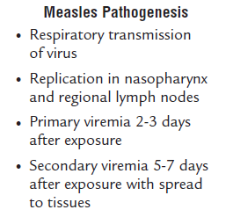

Slide 5
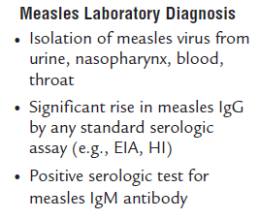

Slide 6
Measles Clinical Features
Incubation period 10-12 days
●●Prodrome 2-4 days stepwise increase in fever to 39.5°C–40.5°C
cough, coryza, conjunctivitis, Koplik spots (rash on mucous membranes)
●●Rash 2-4 days after prodrome, 14 days after exposure
persists 5-6 days
begins on face and upper neck maculopapular, becomes confluent ,fades in order of appearance

Slide 7
Risk factors for severe measles
Malnutrition
Underlying immunodeficiency
Pregnancy
Vitamin A deficiency.
Infants and adults

Slide 8
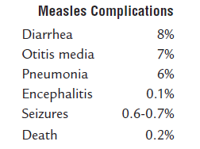

Slide 9
Adults at Increased Risk of Measles
-College students
-Persons working in medical facilities
-International travelers

Slide 10
Epidemiology
Occurrence
Measles occurs throughout the world. However, interruption of indigenous transmission of measles has been achieved in the United States and other parts of the Western Hemisphere.
Reservoir
Measles is a human disease. There is no known animal reservoir, and an asymptomatic carrier state has not been documented.
Transmission
Measles transmission is primarily person to person via large respiratory droplets. Airborne transmission via aerosolized droplet nuclei has been documented in closed areas (e.g., office examination room) for up to 2 hours after a person with measles occupied the area.

Slide 11
Temporal Pattern
In temperate areas, measles disease occurs primarily in late winter and spring.
Communicability
Measles is highly communicable, with greater than 90% secondary attack rates among susceptible persons. Measles may be transmitted from 4 days before to 4 days after rash onset. Maximum communicability occurs from onset of prodrome through the first 3–4 days of rash.

Slide 12
Prevention
1-Public education
2-Immunization
-Live attenuated vaccine indicated to all persons not immune to measles ,unless otherwise contra-indicated.
-Single injection of measles vaccine (MMR) which can be administrated & induces active immunity in 94-98% of susceptible (life long)
2nd dose increases the immunity level to as high as 99%.

Slide 13
Prevention
*Vaccination schedule of measles in Iraq
-Monovalent measles vaccine ⇒ 9 months.
-MMR 1st dose ⇒ 15 months.
-MMR 2nd dose ⇒ 4-6 years.

Slide 14
Side effects
5-15 % fever ,malaise within 5-12 days after immunization, lasts 1-2 days.
Occasionally rash, coryza, Koplik spots.
Infrequently febrile seizures .
1:10 ⁶ dose Encephalitis & encephalopathy

Slide 15
Optimal age of vaccination
WHO recommend immunization at 9 months of age
Immunization before the age of 9 months run the risk the vaccine being rendered ineffective by natural antibodies through mother.
Age of vaccination can be lowered to 6 months if there is measles outbreak.
For infants immunized between 6-9 months, second dose should be given as soon as possible after the child reach age of 9 months.

Slide 16
Contraindication of vaccination
-Immune deficiency.
-Sever illness with or without fever, Delay the dose until recovery (minor illnesses such as diarrhea , upper respiratory infections are not a contra-indication).
-Anaphylactic hypersensitivity to previous measles vaccine, gelatin or neomycin and egg hypersensitivity
Pregnancy

Slide 17
Measles Mumps Rubella (MMR) Vaccine Failure
-Measles, mumps, or rubella disease (or lack of immunity) in a previously vaccinated person
-2%-5% of recipients do not respond to the first dose
-Caused by antibody, damaged vaccine, incorrect records
-Most persons with vaccine failure will respond to second dose

Slide 18
Measles (MMR) Vaccine Indications
-All children 12 months of age and older
-Susceptible adolescents and adults without documented evidence of immunity

Slide 19
MMR Vaccine and Autism
To date there is no convincing evidence that any vaccine causes autism or autism spectrum disorder

Slide 20
MMR and Febrile Seizure
Among children 12-23 months of age one additional febrile seizure occurred 5-12 days after vaccination per 2,300–2,600 children compared to children who received the first dose of MMR and varicella vaccine separately
Data do not suggest that children 4-6 years of age who received the second dose had an increased risk

Slide 21
Control
Reporting is obligatory: early reporting means better control of the outbreak.
Isolation
At community level is impractical .
Children should be kept out of school for 4 days after appearance of rash.
Respiratory isolation for hospital cases.
Contacts
Live attenuated vaccine is effective if it given within 72 hrs of exposure.
IG should be used within 6 days of exposure for susceptible contacts or other contacts with high risk of complications.

Slide 22
Control
The risk of complication is high in
<1 year of age
Pregnant women
Immunocompromised
If measles vaccine is contra indicated
4. Specific treatment (essential steps)
Relieve common symptoms
Provide nutritional support
Promote breast feeding
Giving vit A

Slide 23
Control
Giving vitamine A
It is the recommended for children with measles in the following situations :
Areas where measles CFR>1%.
Areas of known vit A deficiency.
In all cases of sever complicated measles.

Slide 24
Vitamin A
1st dose immediately on the Dx
2nd dose in the next day
If the child has any eye signs indicating vitamin A deficiency, then a third dose must be given 2-4 weeks later
Doses
Infant<6 months 50.000 IU
Infant 6-11 months 100.000 IU
Infant 12 months 200.000 IU

Slide 25
Epidemic measures
-Rapid (within 24 h) reporting of suspected cases.
-Comprehensive immunization program.
-In institutional outbreaks new admission should receive Ig.
-In many developing countries rapid immunization campaign is essential. If the vaccine supply is limited priority should be given to young children for whom the risk is greater.

Slide 26
End

