Slide 1
Screening II
Dept. of Family & Community medicine
Dr. Muslim N. Saeed
November 19th , 2018

Slide 2
Accuracy of Screening Tests
Tests are valued because they discriminate one group of patients from another.
We start by identifying a "gold standard", usually a well-defined pathologic or clinical finding that defines a disease, a condition, or a syndrome
Then we assess conditional probabilities, namely, the frequency with which various clinical findings and test results occur in these defined entities, (eg, the probability of post-operative bleeding in patients with prolonged partial thromboplastin times).

Slide 3
Although some tests can have several results and can be applied to patients who might
belong to one of several different groups, it is often useful to consider a simplified
situation in which the test is either positive or negative and in which a patient either has
one particular disease or does not.
In such simple cases, we use 2x 2 table to simplify calculations terms:

Slide 4
Results of screening test
 | Gold standard Test
Total | Disease free | Disease
Total Test positive (a+b) | (b) False Positive | (a) True Positive | Positive | Screening test
Total Test Negative (c+d) | (d) True Negative | (c) False Negative | Negative
Grand Total (a+b+c+d) | Total Disease Negative (b+d) | Total Disease positive (a+c) | Total

Slide 5
1) Validity
➢ Sensitivity is the likelihood of a positive result in patients known to have the disease (TP+\dis)X 100)= (a\a+c) X 100
➢ Specificity is the likelihood of a negative result in patients known to be free of the disease (TN-|no dis) X 100) = (d\b+d) X 100
2) Predictive values
➢ Positive Predictive Value (PV+): Is the probability that person actually has the disease giving that he or she tests positive.
PV+ = (a / a+b) X 100%, is also called "Yield" of the test
➢ Negative Predictive Value (PV-): Is the probability that person actually has the disease giving that he or she tests negative
PV- = (d / c+d) X 100%

Slide 6
3) Also we have:
➢ The false-positive rate is the likelihood of a positive result in patients known to be free of the disease (FP+|no dis) X 100, and equals (1-specificity);
➢ The false-negative rate is the likelihood of a negative result in patients known to have the disease (FN-|dis) X 100 , and equals (1-sensitivity).
➢ Accuracy of test. (TP+TN) / Total
Thus, sensitivity and the false-negative rate describe how the test performs in patients with disease, whereas specificity and the false positive rate describe how the test performs in patients without disease. “The use of screening tests with poor sensitivity or poor specificity may result in potentially serious consequences due to false negative or false positive results. These in turn may lead to a false sense of security and inappropriate delay in treatment, or the patient’s unnecessary exposure to the risks of treatment.

Slide 7
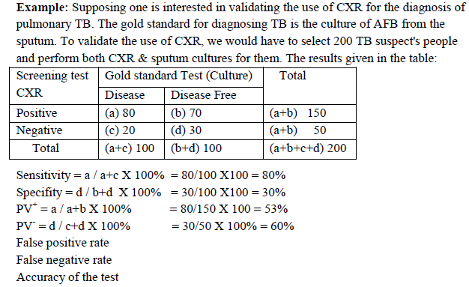

Slide 8
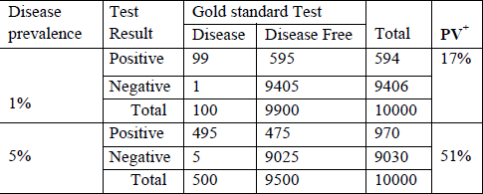
Relation of PV+ to disease prevalence The PV+ of the screening test (yield of the test) is increased as the prevalence of the disease is increased as shown in the below table:
Prevalence affects predictive value (the chance of having the disease in the presence of a positive test), The more prevalent a condition, the fewer false positive test there will be,The less prevalent a condition, the fewer false negative test there will be
EX: High Risk Population: Prevalence=40% PPV=0.985 NPV=0.993
Low Risk Population: Prevalence=0.01% PPV=0.0098 NPV=0.999
It is recommended to screen high risk population

Slide 9
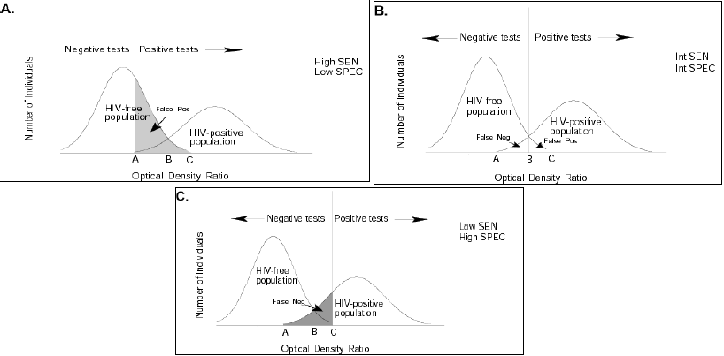
Selection cutoff point: A. Low Cutoff Point B. In-Between Cutoff C. High Cutoff Point

Slide 10
Considerations in selection of cut-point
➢ Implications of false positive results: burden on follow-up services& labeling effect
➢ Implications of false negative results: Failure to intervene

Slide 11
Which is Preferred: High Sensitivity or High Specificity?
-If you have a fatal disease with no treatment (such as for
early cases of AIDS), optimize specificity.
If you are screening to prevent transmission of a
preventable disease (such as screening for HIV in blood
donors), optimize sensitivity.
➢ Remember….
Sensitivity & specificity are functions of the screening
test
If you use a given screening test on a low prevalence
population, you will have a low positive predictive
value and potentially many false positives

Slide 12
Reliability
➢ It is the ability of a test to give consistent results when performed more than once on the same individual under the same conditions.
➢ Variation in the method due to variability of test chemicals or fluctuation in the item measured (e.g., diurnal variation in body temperature or in relation to meals)
-Standardize fluctuating variables
-Use standards in laboratory tests, run multiple samples whenever possible
➢ Observer variation
-Train observers
-Use more than one observer & have them check each other
-Yield:
➢ It is the amount of previously unrecognized disease that is diagnosed and brought to treatment as a result of the screening program.

Slide 13
Biases in Screening
1- Referral Bias (volunteer bias)
2- Length Bias: Screening selectively identifies those with a long preclinical and clinical phase (i.e., those who would have a better prognosis regardless of the screening program).
3- Lead Time Bias: The apparently better survival that is observed for those screened is not because these patients are actually living longer, but instead because diagnosis is being made at an earlier point in the natural history of the disease.
4- Overdiagnosis Bias (a misclassification bias)
Enthusiasm for a new screening program may result in a higher rate of false positives and give false impression of increased rates of diagnosis and detection.

Slide 14
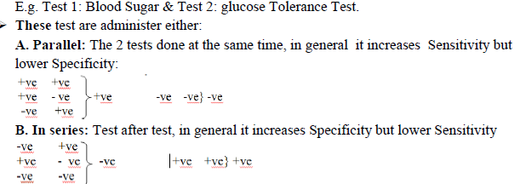
Two Stage Screening ➢ Efficient technique to address the problem of cutoff point. ➢ By using the results of several screening tests together (usually two). ➢ A less expensive test is carried out first and those who screen positive are recalled for further testing with a more expensive or invasive test.

Slide 15
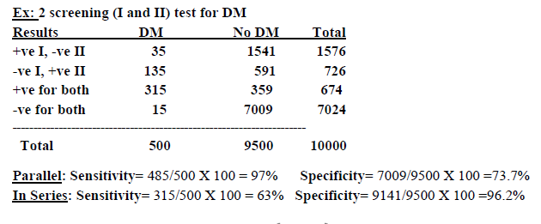

Slide 16
Examples of Preventive Health Care Screening:
➢ Cervical Cancer
Screening for Cervical Cancer--meets all screening test criteria. the disease is prevalent, serious, pre-clinical detectable period, treatable, early treatment is better than late.
➢ Papanicolaou Testing
o PAP testing is not sensitive but quite specific.
o Estimates are that screening in women ages 20-64 reduces the cumulative
incidence of cervical cancer by 91% and yields 96 cases for every 100,000 cases—pretty good for a screening test.
o Recommendations
✓ Routine PAP smears for all women who have ever been sexually active and who have a cervix
✓ Frequency—at least every three years, but most ob/gyn recommend annual testing discontinue PAP smear at age 65 if patient has had regular normal PAPs in the past
✓ HPV infection screening—persistent HPV infection tested along with PAP smear

Slide 17
End

