Slide 1
Spinal cord disorder
Introduction
Spinal cord is continuation of CNS contained within the bony spinal canal, from the foramen magnum at base of skull caudally to conus medullaris at level of L1 .
The three meningeal layers that surround the spinal cord continues below level of Ll as a fibrous tissue (filum teminale) that terminate at the coccyx.
The spinal cord is 45 cm length ,while the vertebral column length is about 70 cm this is discrepancy is clinically important
WM located peripherally, while nerve cell cluster in an inner region shaped like a four-leaf clover surround the central canal

Slide 2
Neuroanatomy of the spinal cord

Slide 3
Distribution of fibers within the spinal cord
Both spinothalamic tract and corticospinal tract are arranged in a certain pattern which is laminated and looks like the layers of the onion and as follows:
C=cervical (the innermost)
T=thoracic
L=lumber
S=sacral(outermost)
This is important in localization of the lesion,for example, if the pathology is an extrinsic it will affect the sacral fibers first , and if the pathology is intrinsic it will firstly affect the cervical fibers.

Slide 4
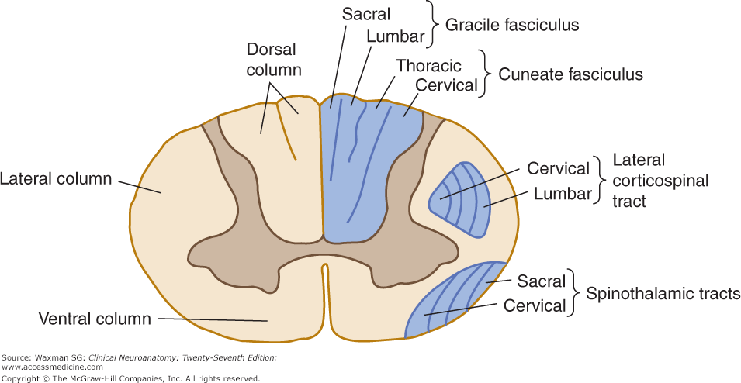

Slide 5
Spinal cord level relative to the vertebral bodies
This is clinically important as when we find certain abnormality or suspect a lesion in certain level, we should remember that discrepancy exits .
Site of suspected lesion The requested level of imaging
Upper cervical same as cord level
Lower cervical 1 levels higher
Upper thoracic 2 levels higher
Lower thoracic 2-3 levels higher
Lumber T10 _T12
Sacral T12_L1
Coccygeal Ll

Slide 6
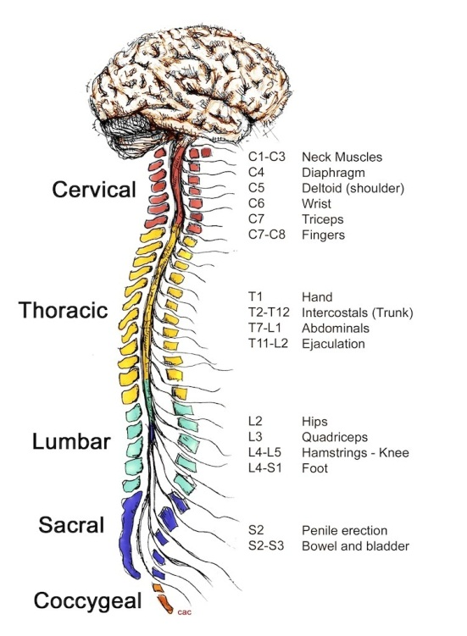

Slide 7
Injuries to spinal cord cervical cord
Junction of cervico-medullary usually fatal
C4-5= quadriplegia with diaphragm paralysis.
C5-6=loss of power and reflex in Biceps
C7=weakness in wrist ,finger extension &triceps
C8=finger &- wrist flexion
Horner syndrome may accompany a cervical cord lesion at any level .

Slide 8
Thoracic & lumber cord
Lesion localized by sensory level
T4=nipples, TlO=umbilicus
Leg weakness and disturbance of bladder and bowel.
L2-4=paralysis of flexion and adduction of the thigh, weakness of leg extension, diminished patellar reflex
L5-S I =paralysis of foot and ankle flexion and abolish ankle jerk(S 1) .

Slide 9
Basic Features of Spinal Cord disease
UMN findings below the lesion
Hyperreflexia and Babinski's
Sensory and motor involvement that localizes to a spinal cord level
Bowel and Bladder dysfunction common

Slide 10
Conus Medullaris Vs. Cauda Equina Lesion
Finding Conus CE
Motor Symmetric Asymmetric
Sensory loss Saddle Saddle
Pain Uncommon Common
Reflexes Increased Decreased
Bowel/bladder Common Uncommon

Slide 11
Investigation of Spinal Cord Disease
Radiographic exam
Plain films
Myelography
CT scan with Myelography
MRI
Spinal tap
If you suspect: inflammation, MS, rupture of a vascular malformation

Slide 12
Metabolic disease of the spinal cord
Subacute combined degeneration of the cord (SACD)
SACD, caused by vitamin B12 deficiency presents as a
myelopathy with prominent dorsal column features.
Those typical are distal paraesthesiae and gait unsteadiness, mild upper motor neuron lower limb weakness, depressed knee and ankle jerks, with extensor plantars – and importantly, impaired joint position sense.
optic atrophy may develop with the macrocytic anaemia

Slide 13
The typical picture of SACD leads many experienced physicians to give therapy immediately, even before serum levels are known.
Treatment is with hydroxocobalamin, a minimum of
1000 μg weekly by injection for the first 3 weeks followed by1000 μg monthly injections for 6 months, and thereafter 1000 μg every 3 months, for life.

Slide 14
Spinal tuberculosis
TB typically first affects the intervertebral discs.
infection typically presents with local pain, fever, night sweats and general ill health including weight loss.
If the disease spreads from the disc into the vertebral body osteomyelitis will occur with epidural abscess formation and/or vertebral body collapse.
Pathological fractures will cause pain, deformity (kyphosis) and in some cases spinal cord compression.

Slide 15
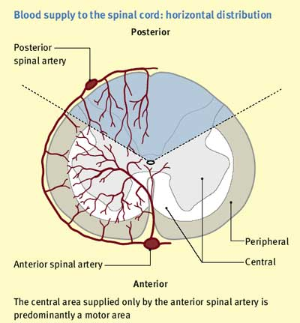

Slide 16
Spinal cord infarction
anterior spinal artery occlusion
Spinal cord infarction usually presents acutely, often with pain followed by paralysis and sensory loss.
In anterior spinal artery occlusion the anterior two-thirds of the spinal cord is affected.
The spinal level is determined by where in
its course the supply from the anterior spinal artery is interrupted.

Slide 17
Clinical feature
The patient presents with an acute flaccid paraparesis with loss of sphincter control and anaesthesia to temperature and pain but classically with preservation of posterior column functions of joint position and vibration sense. The most typical level is the upper thoracic cord.

Slide 18
Diagnosis of spinal vascular disease
MRI is the primary diagnostic investigation.
MRI will detect over 90% of acute spinal cord ischaemic lesions.
MRI usually excludes compressive lesions
evidence of demyelination especially if cranial MRI is also performed (MS) lesion.

Slide 19
Management of spinalcord infarction
There is no curative treatment for acute spinal cord infarction.
The prognosis for functional recovery in established spinal infarction is poor.

