Slide 1
Delirium
acute confusional state
acute brain failure
encephalopathy
global cognitive impairment
Hippocrates “phrenitis”
Notes:
introduce myself
work on 5MB, differentiate delirium from other form of disorganization

Slide 2
Cognition is derived from Latin and means knowledge by experiencing and perceiving. Cognitive functions include:
orientation, thinking, perception, language, reasoning, and remembering and intellect,
Intellect means the ability to understand and comprehend.

Slide 3
Delirium is an acute reversible disturbance of cognition associated with disturbance in the level of consciousness
It can occur at any age, but it occurs more commonly in patients who are elderly and have a previously compromised mental status

Slide 4
Levels of consciousness
Agitated (out of control)
Hyperalert (vigilant)
Alert (normal)
Drowsy (lethargic)
Obtunded (difficult to wake)
Stuporous (v. difficult to wake)
Comatose (unable to wake)

Slide 5
Epidemiology and diagnosis of delirium

Slide 6
DELIRIUM (Acute confusional state)
Delirium affects 11-16% of medical and surgical patients with
Children and elderly are more frequently affected
Highest incidence in ICU

Slide 7
Epidemiology of delirium:
It’s common!
Common in the general population
0.4% of all people
1.0% in individuals over 55 (over 10% in those > 85)
60% of nursing home residents
Common in the medical setting
10-30% of elderly in the ER
20% of all medical admissions
4-53% among hip fracture patients
4-28% of elective surgery patients
13-72% of cardiac surgery patients

Slide 8
causes
drug intoxication, withdrawal from alcohol (delirium tremens),barbiturates and sedative-hypnotic following prolonged usage, metabolic disturbances, CNS infections,CNS pathology,hypoxia,endocrinopathies,HT,shock,toxins or drug,heavy metals(lead,mercury) head injury, and nutritional and vitamin deficiency and following generalised seizures, petit mal status, and partial complex seizures

Slide 9
Clinical features
the symptoms are usually fluctuating with worsening at night.
1-disturbance of consciousness(inattention and distractibility).Assessed by asking the patient to name the days of the week in reverse order
2-memory impairment:assessed by asking the patient to recall 3 words.
3-impaired orientation;disorientation to time,place but rarely to person.

Slide 10
Clinical features
overctivity, irritability, and sensitivity to noise, fear, suspiciousness. Visual hallucinations (frightening scenes) and misinterpretation of shapes, patterns, and colours (illusions) are common. Auditory (threatening voices) and tactile hallucinations (crawling insects) may occur. Delusions are often persecutory. Restless patients resent interference and may become aggressive. Some patients are retarded rather than overactive. Patient’s mood is labile with a mixer of fear, anxiety, agitation, irritability, and depression

Slide 12
The diagnosis depends on impairment of consciousness, disorientation, and fluctuation of the clinical picture.
Clock-drawing test provide a rapid screen for the presence and degree of delirium.
Minimental state examination is used as screening and diagnostic tool

Slide 13
Clinical case:
44 y/o non-compliant patient
A 44 y/o male is sustained multiple injures after being hit by a car. Three days after surgical admission psychiatry is consulted secondary to his variable refusal of care and an attempted elopement. He is described as intermittently yelling, throwing food, and RISing. He is homeless, has known mental illness and a history of alcoholism. The surgical team is asking if he has capacity to refuse care. When you meet with him he is disoriented to time and circumstance and is often incomprehensible because of mumbling and tangentiality.

Slide 14
investigation
complete blood count, plasma electrolytes and urea, serum glucose, liver function tests, and other appropriate tests dictated by the suspected diagnosis

Slide 15
Using the MMSE in delirium
Scores < 24 have been suggested to be a threshold
4 key questions of the MMSE
Year
Date
Backward spelling (“DLROW”)
Figure copying
Fayes et al. J Pain Symptom Manage 30: 41 (2005)

Slide 16
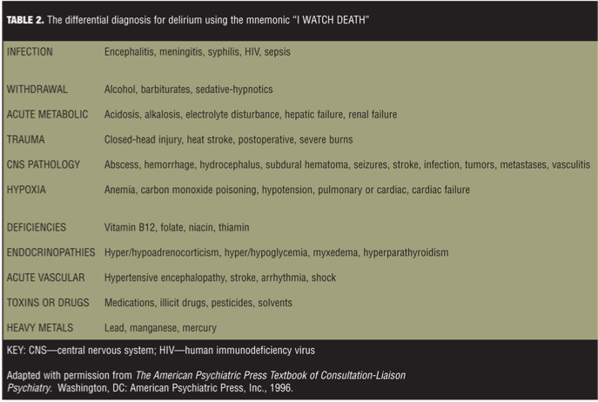
“I watch death”
Notes:
Nearly any medical illness

Slide 17
Pathophysiology of delirium:
Several hypotheses
Neurotransmitter hypothesis
hypocholinergic state
supported by deliriogenic effects of anticholinergic medications and dementia
dopamine (and norepinephrine) excess
supported by intoxicating effects of numerous dopaminergic agonists and the beneficial effects of antipsychotics
Neuroinflammatory hypothesis
elevated cortisol, elevated CRP, elevated procalcitonin
alteration of the BBB and microglia activation disrupts brain function
Hypoxia hypothesis
disrupted oxygen supply or neurovascular coupling causing neuronal dysfunction
Notes:
procalcitonin (marker of systemic infection)
like muscle the brain regulates flow, complicated process (neurotransmitter, glial cells)

Slide 18
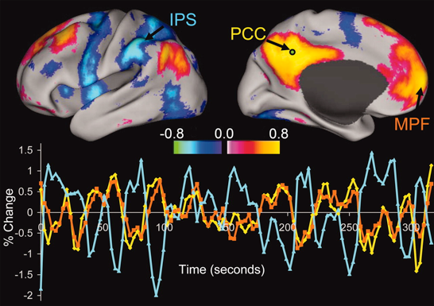
Functional MRI:
Defining large networks potentially disrupted in delirium
Fox et al. PNAS 2005

Slide 19
management
There are four main aspects to managing delirium:
x Identifying and treating the underlying causes
x Providing environmental and supportive measures
x Prescribing drugs aimed at managing symptoms
x Regular clinical review and follow up.
Good management of delirium goes beyond mere control of the most florid and obvious symptoms

Slide 20
Management
Management of delirium is a medical emergency and includes treatment of the cause and ABC, observation in quiet surrounding, supportive and reassuring attitude, and presence of a person familiar to the patient (relative, fried).
The room should be comfortably lit, colours are plain, and the furniture is simple.
Frequent reorientation to time and place

Slide 21
Environmental and supportive measures in delirium
x Education of all who interact with patient (doctors, nurses, ancillary staff, friends, family)
x Reality orientation techniques
Firm clear communication—preferably by same member of staff
Use of clocks and calendars
x Creating an environment that optimises stimulation (adequate
lighting, reducing unnecessary noise, mobilising patient whenever
possible)

Slide 22
Environmental and supportive measures in delirium
x Correcting sensory impairments (providing hearing aids, glasses, etc)
x Ensuring adequate warmth and nutrition
x Making environment safe (removing objects with which patient could harm self or others.

Slide 23
Pharmacotherapy
Haloperidol (serenace IV,IM,oral) is the best 0.5-5 mg as a starting dose and can be increase till the patient is calm ,less in patient with dementia and strock.
2-Benzodiazepines:Diazepam,lorazepam or clonazepam
3-Intubation,sedation and paralysis using metocurine when other measures fail to control sever agitation .
4-Mechanical restrains when all measures fail and the patient still perform dangerous maneuvers

Slide 24
prognosis
Prognosis: most patients recover(usually suddenly) without observable sequelae.
The mortality rate is 20%

Slide 25
Consequences of delirium
Increased length of stay
Increased mortality and morbidity
Perhaps between 25-75%, as high as MI and sepsis
Prolonged cognitive difficulties
Institutionalization

