Slide 1
Amino Acid ,peptides and proteins

Slide 2
Amino acids: Carboxylic acids with an α–amino group
Peptides: consists of few linked amino acids
Proteins: composed of α–amino acids
The amino acids obtain from protein hydrolysis are: α -amino acids
Optically active (except glycine)
Have the L- configuration relative to glyceraldehyde
Amino acid

Slide 3
20 amino acids are commonly found in proteins
12 can be synthesized in the body
8 (essential amino acids ) can not be synthesized in the body, and must be obtain from the diet in the form of proteins
A three letter abbreviation is used when writing the formulas of peptides
A one letter abbreviation is used to describe the amino acid sequence in a protein

Slide 4
Name | Three-letter abbreviation (isoelectric point) one-letter abbreviation | formula | R
A. One amino group and one carboxyl group
Glycine | Gly (6.0) G |  | R is hydrogen
2.alanine | Ala(6.0) A |  | R is alkyl group
3.Valine | Val(6.0) V |  | R is alkyl group
4. leucine | leu(6.0) L |  | R is alkyl group

Slide 5
5.Isoleucine | Ile(6.0) I |  | R an alkyl group
6.Serine | Ser(5.7) S |  | R Contains an alcohol function
7.theronine | Thr (5.6) T |  | R Contains an alcohol function
8.Cysteine | Cys (5.0) C |  | R contains sulfur
9.methionine | Met(5.7) M |  | R contains sulfur

Slide 6
10.Proline | Pro (6.3) P |  | The amino group is part of a ring
11.phenylalanine | Phe (5.5) F |  | R of aromatic ring.
12.tyrosine | Tyr(5.7) Y |  | R of aromatic ring.
13.trptophan | Trp (5.9) w |  | heteroaromatic (indole) ring.

Slide 7
One amino group and two carboxyl groups, and One carboxyl group and two amino groups
14.Aspartic acid | Asp(3.0) D |  | One amino group and two carboxyl groups
15.Glutamic acid | Glu(3.2) E |  | One amino group and two carboxyl groups
16.asparagine | Asn(5.4) N |  | One carboxyl group and two amino groups
17.Glutamine | Gln(5.7) Q |  | One carboxyl group and two amino groups

Slide 8
One carboxyl group and two basic groups
18.lysine | Lys(9.7) k
19.arginine | Arg(10.8) R
20.histidine | His(7.6) H

Slide 9
Removal of a water molecule formation of the peptide

Slide 10
This general formation of peptides or proteins

Slide 11
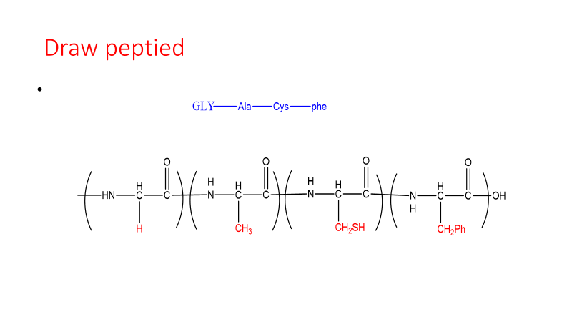
Draw peptide

Slide 12
The acid base properties of amino acids
COOH (acidic group) NH2(basic group)
Amino acids are better represented by a dipolar ion structure (Zwitterions)

Slide 13
Amino acids in electric fields
Isoelectric point: is the pH at which the amino acid will be dipolar and have a net charge equal to zero. It will not move toward either electrode

Slide 14
Electrophoresis
Electrophoresis: is a method for separating amino acids and proteins based on their charge differences
Example
pI for aspartic acid 3.0 pI for alanine 6.0
At pH 5
Aspartic acid is negative alanine is positive
So they can be separated
Problem
Glycine and lysine at pH 7
Phenylalanine, leucine and proline at pH 6

Slide 15
Separation of proteins
Separation aspartic acid and alanine acid at PH 5

Slide 16
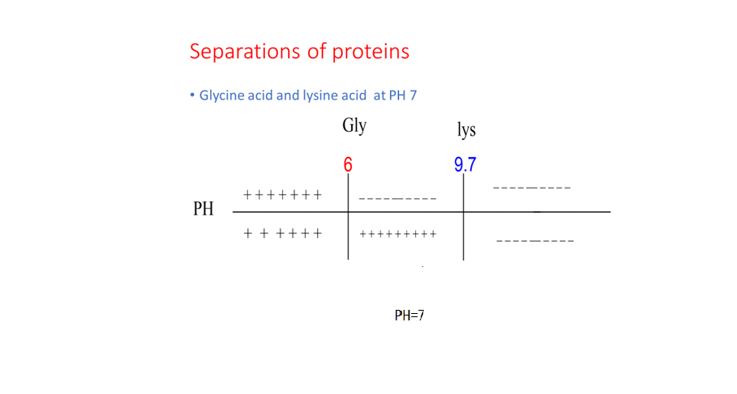
Separation of proteins

Slide 17
Reaction of amino acid

Slide 18
Mechanism

Slide 20
Reaction of amino acid
Glycine and Alanine

Slide 21
Rection of Glycine and Alanine
Gly-Ala

Slide 22
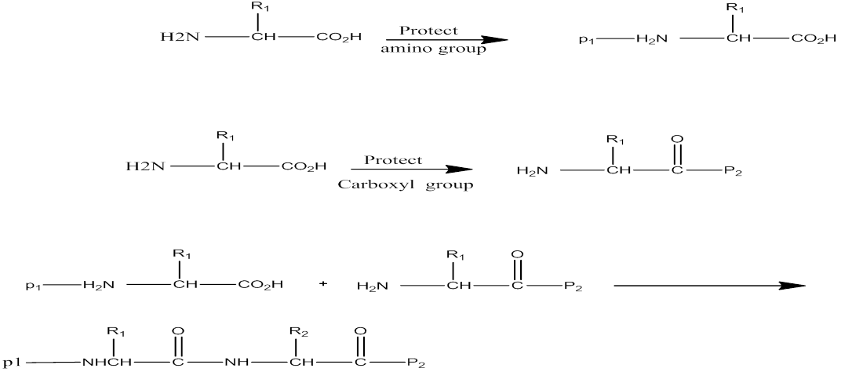
Peptide synthesis linking amino acids in a controlled manner

Slide 23
Oxidation and reduction

Slide 24
Proteins
Proteins are major components of:
Structural tissues (muscle, skin, nails, hair)
Transport molecules (Hemoglobin)
Enzymes (biological catalysts)
Structure of Peptides and Proteins:
Primary structure: Amino acids and sequence
Secondary, tertiary and quaternary structures:

Slide 25
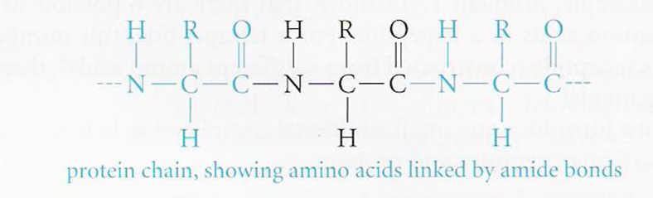
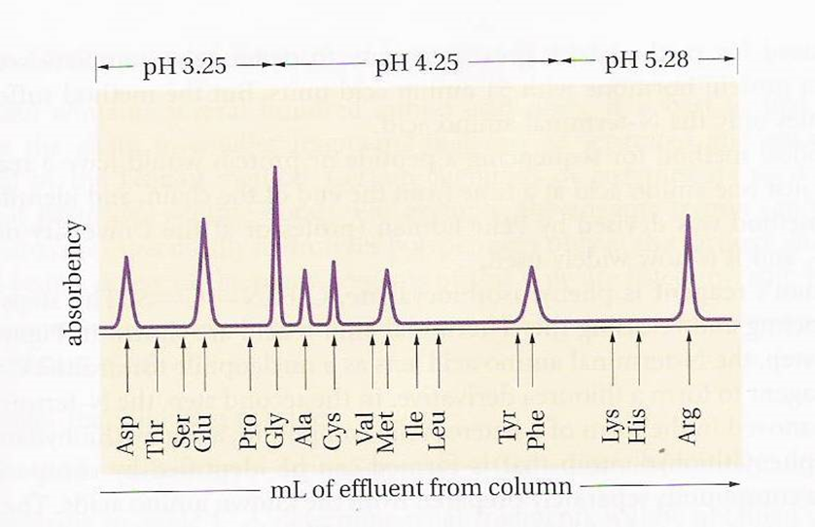
The primary structure
The backbone of proteins is a repeating sequence of one nitrogen and two carbon atoms
Hydrolysis of proteins and peptides (6 M HCl at 110 oC for 24 hours)
Amino acid analyzer

Slide 26
Sequence Determination
Sanger’s reagent is 2,4 dinitrofluorobenzene which reacts with the NH2 group of amino acids and peptides to give yellow 2,4-dinitrophenyl (DNP) derivatives.

Slide 27
EDMAN’S REAGENT
A reagent that clips off lust one amino acid at a time the end of the chain

Slide 28
Mechanism
A reagent that clips off lust one amino acid at a time the end of the chain
The next amino acid to be removed when the two-step sequence is repeated

Slide 29
Cleavage of selected peptide bonds
Proteins containing several hundred amino acid units are better cleaved at particular peptide bonds using certain chemicals or enzymes, then they are sequenced by Edman met
This table :Reagents for specific cleavage of polypeptides
Reagent Cleavage site
_________ _____________
Trypsin carboxyl side of lys,Arg
Chymotrypsin carboxyl side of phe,Ty ,Trp
Cyanogen bromide (CNBr) carboxyl side of Met
Carboxypeptidase the C-terminal amino acid

Slide 30
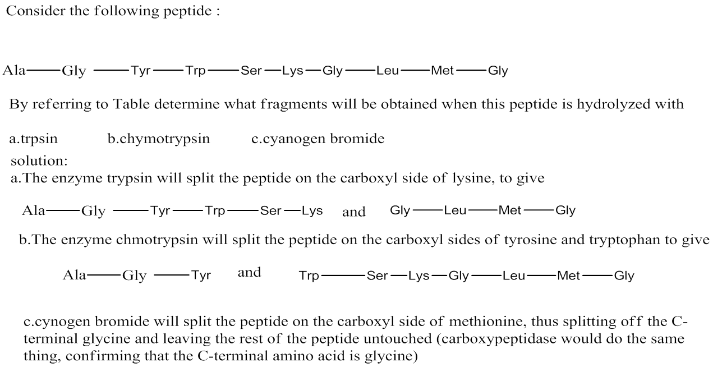
EXAMPLE:

Slide 31
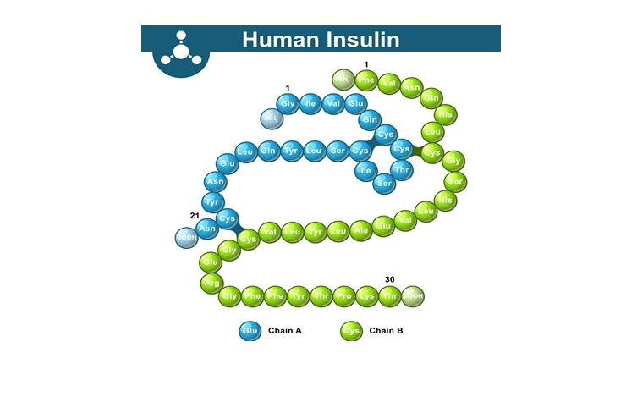
Insulin
Insulin (from Latin insula, island) is a peptide hormone produced by beta cells of the pancreatic islets; it is considered to be the main anabolic hormone of the body. It regulates the metabolism of carbohydrates, fats and protein by promoting the absorption of carbohydrates, especially glucose from the blood into liver, fat and skeletal muscle cells. In these tissues the absorbed glucose is converted into either glycogen via glycogenesis or fats (triglycerides) via lipogenesis, or, in the case of the liver, into both.^{[6]} Glucose production and secretion by the liver is strongly inhibited by high concentrations of insulin in the blood.^{[7]} Circulating insulin also affects the synthesis of proteins in a wide variety of tissues. It is therefore an anabolic hormone, promoting the conversion of small molecules in the blood into large molecules inside the cells. Low insulin levels in the blood have the opposite effect by promoting widespread catabolism, especially of reserve body fat

Slide 32
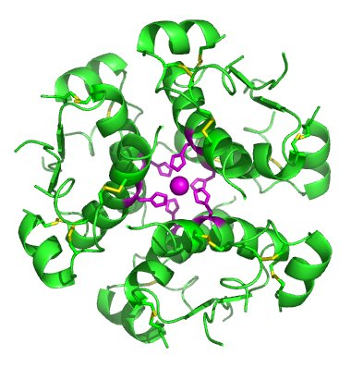
Structure 3D for the Insulin

Slide 33
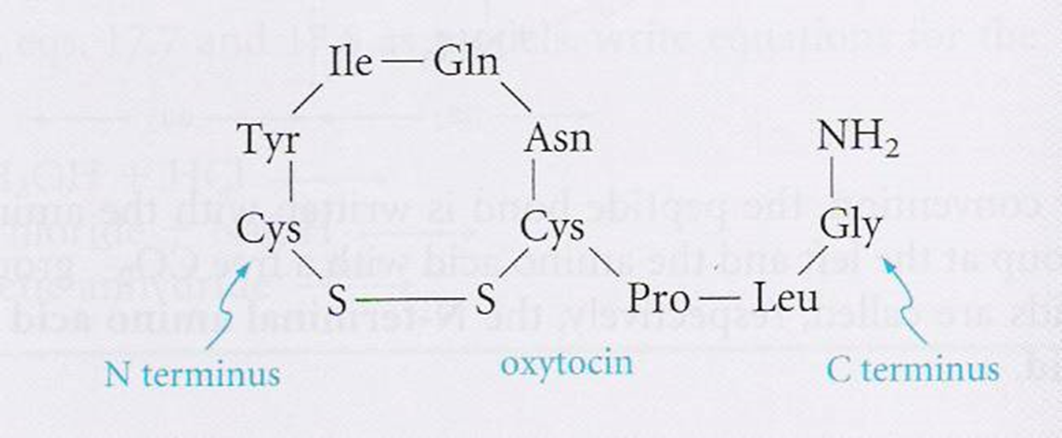
Oxytocin
To add more amino acids, we must selectively remove one of the protecting groups and join the next amino acid
Oxytocin (prepared by Vincent du Vigneaud – Nobel 1955)
Oxytocin produced by posterior pituitary gland. It regulates uterine contraction and lactation and may be administered when it is necessary to induce labor at childbirth

Slide 34
Vasopressin (Antidiuretic Hormone, ADH)
Vasopressin, also called antidiuretic hormone (ADH), arginine vasopressin (AVP) or aggression is a hormone synthesized as a peptide prohormone in neurons in the hypothalamus, and is converted to AVP. It then travels down the axon of that cell, which terminates in the posterior pituitary, and is released from vesicles into the circulation in response to extracellular fluid hypertonicity (hyperosmolality). AVP has two primary functions. First, it increases the amount of solute-free water reabsorbed back into the circulation from the filtrate in the kidney tubules of the nephrons. Second, AVP constricts arterioles, which increases peripheral vascular resistance and raises arterial blood pressure.

Slide 35
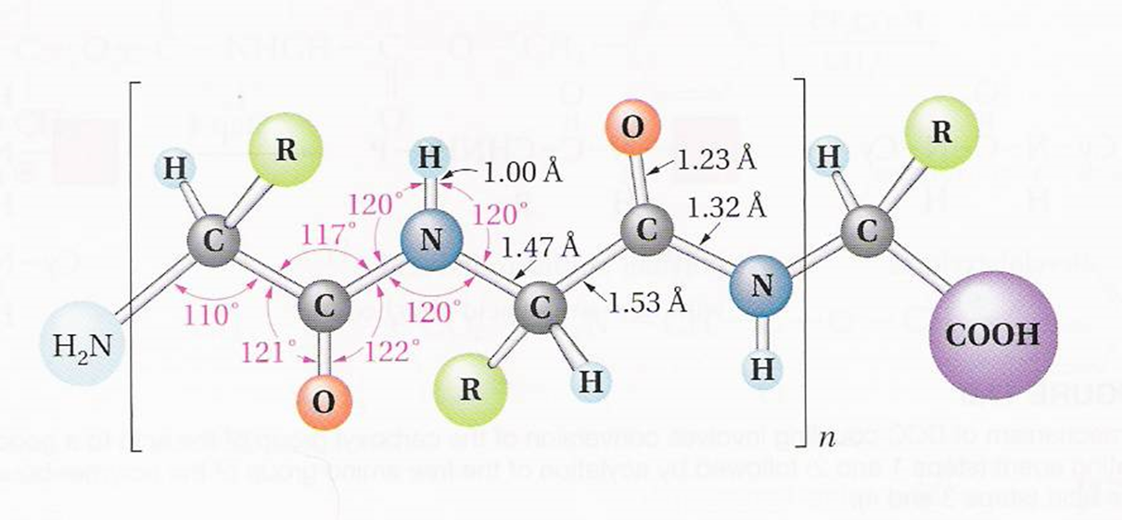
Secondary Structure of Proteins
Many polymers have been isolated in pure crystalline form and are polymers with very well defined shapes.
Geometry of the peptide bond
Planar geometry
Amide C-N bond (1.32 A) is shorter than normal C-N bond (1.47 A)
Rotation around the amide bond is restricted (double bond character)

Slide 36
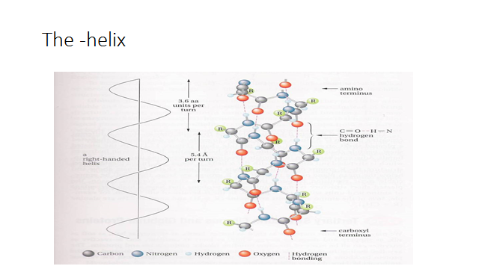
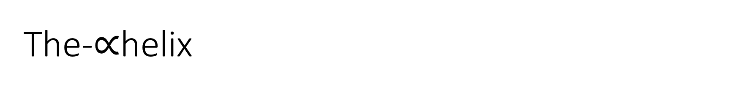

The-$∝$helix

Slide 37
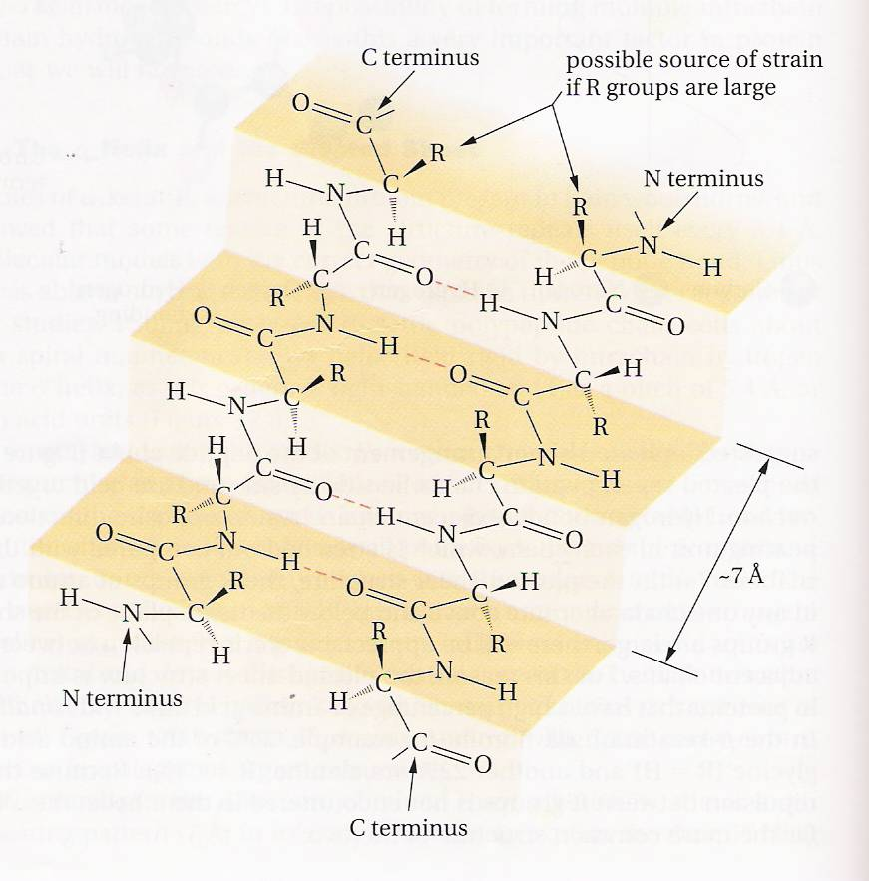
The pleated sheet

Slide 38
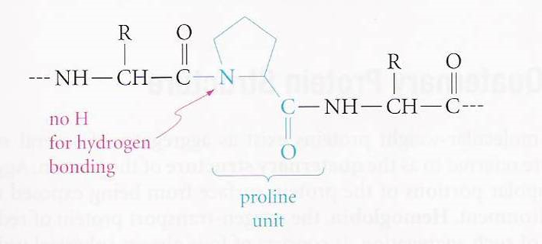
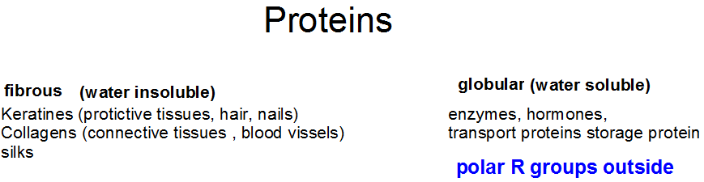
Tertiary structure: Fibrous and globular proteins
Three dimensional structure of the protein which results from the:
R groups b) the disulfide bonds
For example turns are found at or near proline (No H bonding)

Slide 39
Quaternary Protein structure

